Slide 1
Threads

Slide 2
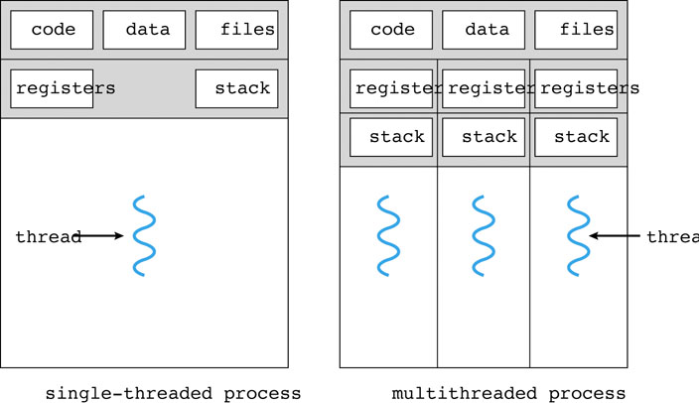
Processes Deconstructed
Process Parts
Resources
Execution
Parallel Processing
Multiple Processes
Creation
Maintenance
“Heavy Weight”
Notes:
Exercise: Compare Process with Thread creation and maintenance

Slide 3
Threads Deconstructed
Separate
Resources
Shared
Owned by process
Execution
Execution state replicated
Within contest of process
Communication with shared resources

Slide 4
Sharing is the Key
Compared to processes, threads…
Take less time/space to create
Provide faster communication through shared memory instead of IPC

Slide 5
POSIX Threads
thread.c – Give 1 or more “greeting” strings on command-line
gcc thread.c -std=c99 -lpthread -D_GNU_SOURCE
thread2.c – thread.c is broken
Notes:
gcc -std=c99 -lpthread thread.c

Slide 6
Java Threads
ThreadEx.java - Give 1 or more “greeting” strings on command-line

Slide 7
Thread Implementations
User threads
User process performs thread scheduling, context switching, etc. (virtualized processor)
Single process in user space
Kernel doesn’t know; just schedules process
User thread surrenders “processor” if
Dependency on another thread (keep processor)
Blocking I/O call (surrender processor)
Time slice expiration (surrender processor)

Slide 8
Thread Implementations
User threads problems
Blocking I/O causes entire process to surrender processor
Cannot take advantage of multiple processors
Process with 1 thread gets same time slice as process with 100 threads (kernel unaware)
Kernel threads
Scheduled like process
Work of thread management done by kernel
Address user thread problems above
Implementations: PThreads, Win32, (and Java)

Slide 9
Thread Implementations
User thread advantages (vs. kernel)
Context switch doesn’t require mode switch (user to kernel and back again)
Application customized scheduling
Operates over any OS

Slide 10
Thread Thrashing
Kernel thread context switch still expensive
More threads implies more of the processor’s time spent context switching
Thrashing = CPU mostly context switching
Solutions:
Control number of created threads (extra work)
Map many user threads (U) to the same kernel thread (K): K << U (K may be constant)

Slide 11
Playing with fire (fork/exec)
Threads are contained in a process so…
fork() – Copy all threads in process or just calling thread?
OS dependent
fork() variants
exec() – Replace entire process (including threads) with new process?
Typically “yes”

Slide 12
Thread Cancellation
Want to terminate a target thread
Cancellation Operation
Asynchronous – Target dies immediately
Deferred – Flag is set that target may periodically check to find out if termination is requested
Asynchronous doesn’t provide opportunity to deallocate resources
Java deprecated asynchronous cancellation

Slide 13

Thread Cancellation
Want to terminate a target thread
Cancellation Operation
Asynchronous – Target dies immediately
Deferred – Flag is set that target may periodically check to find out if termination is requested
Asynchronous doesn’t provide opportunity to deallocate resources
Java deprecated asynchronous cancellation

Slide 14
Threads and Signals
Event notification for processes
Synchronous (SIGSEGV) or Asynchronous (SIGINT)
Handling Options
Ignored
Terminate process
Handling routine called
Blocked (masked)
Default behavior
SIGINT = Termination
SIGCHLD = Ignore

Slide 15
Threads and Signals
Change handling by setting handler
SIG_IGN = Ignore
SIG_DFL = Default
Custom handler function
Signal masking (blocking signals)

Slide 16
Thread Pools
Thread creation (cheaper but not free)
Thread count bound (less context switching)
Solution: Thread Pools
Create a fixed-size set of threads at startup
New request gets thread from pool
Thread returned upon request completion
If no threads in the pool, request must wait

Slide 17
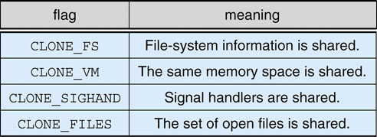
Linux Cloning
What gets copied?
Process – Everything
Thread – Only execute state
What if we wanted to copy the data but not the file descriptor table?
Linux clone()

Slide 18
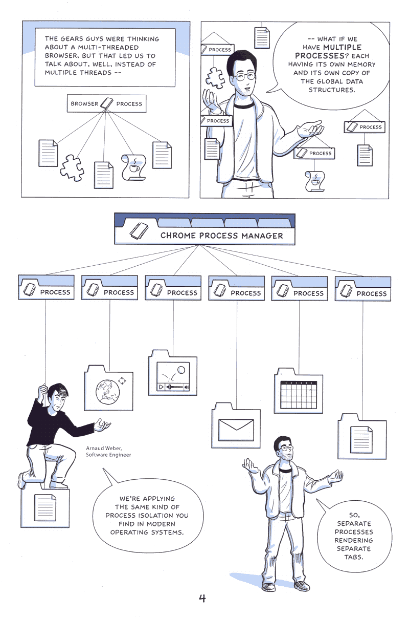
So Threads It Is…
Bad thread?
One bad thread (div-by-0)
Shared resource violation
Processes allow protection
Browsers
Complex renders/plugins
Fault hangs browser
Solution: Process per tab
Chrome
IE8 (not IE7 and before)
Source: Google on Google Chrome - Comic book http://blogoscoped.com/google-chrome
Used under Creative Commons License
Notes:
Div-by-0 kills process if not handled

