Slide 1
CPU Scheduling

Slide 2
Scheduling
Goal of scheduler: Make sure the CPU remains busy
CPU/ short term scheduler: Which process to execute next?

Slide 3
Process Bursts
CPU Bursts
run
Task
Disk I/O
User I/O
wait
x
I/O Bursts
CPU-I/O Burst Cycle

Slide 4
Impact of Scheduling
Process A
Which schedule do you want?
Process B
I/O
CPU
Schedule A
I/O Device
Schedule B
CPU
I/O Device
Time
Schedule another waiting process while current CPU relinquish to CPU due to I/O

Slide 5
Resource Classification
Preemptable Resource
Can forcibly removed (then possibly return) without ill effects
Characteristics
Small state (so it is not too costly to preempt)
Only one resource
Examples
CPU and memory
Non-preemptable Resource
Cannot take away without causing the computation to fail
Characteristics
Complicated state
May need many instances of this resource
Examples
CD recorder - once starting to burn a CD needs to record to completion otherwise the end up with a garbled CD
Blocks on disk

Slide 6
Resource Management Tasks
Allocation
Space Sharing - Which request gets which resource (control access to resource)?
Scheduling
Time Sharing – Which request gets resource and at what time (order and time)?

Slide 7
CPU Workload Model
Workload contains collection of jobs (processes)
Job model
Job alternates between CPU usage and waiting for I/O
CPU-bound job
Spends most of its time computing
Characteristics: Long CPU bursts and infrequent I/O waits
I/O-bound job
Spends most of its time waiting for I/O
Characteristics: Short CPU bursts and frequent I/O waits
Trend: As CPUs get faster, processes tend to get more I/O bound (Why?)

Slide 8
I/O and CPU Bound Processes
Long CPU Burst
Long CPU bursts and infrequent I/O waits
CPU Bound
Short CPU Burst
Waiting for I/O
I/O Bound
Short CPU bursts and frequent I/O waits

Slide 9
Process Scheduling
Observations
If all processes are I/O bound, the ready queue will almost always be empty (little scheduling)
If all processes are CPU bound, the I/O devices are underutilized
Approach (long term scheduler): ‘Admit’ a good mix of CPU bound and I/O bound processes
Do not know type of job before it executes
Do not know duration of CPU or I/O burst
Need job scheduling for each ready job
Schedule each CPU burst

Slide 10
When to Schedule?
Option 1: Non-preemptive (Cooperative) scheduling
Process remains scheduled until voluntarily relinquishes CPU
Scheduler may switch in two cases
When process exits
When process blocks (e.g., on I/O)
Trust process to relinquish CPU through traps
Trap: Event internal to process that gives control to OS
Examples: System call, page fault (access page not in main memory), or error (illegal instruction or divide by zero)
Disadvantages: Processes can misbehave
Interactive applications
By avoiding all traps and performing no I/O, can take over entire machine
Only solution: Reboot!
Not performed in modern operating systems

Slide 11
When to Schedule?
Option 2: Preemptive scheduling
Process may be ‘de-scheduled’ at any time
Additional cases
Process creation (higher priority process enters system)
When an I/O interrupt occurs
When a clock interrupt occurs
Guarantee OS can obtain control periodically
Enter OS by enabling periodic alarm clock
Hardware generates timer interrupt (CPU or separate chip)
Example: Every 10ms
User must not be able to mask timer interrupt
Dispatcher counts interrupts between context switches
Example: Waiting 20 timer ticks gives 200 ms time slice
Common time slices range from 10 ms to 200 ms

Slide 12
Interrupting the Big Guy
Interrupting during kernel operation
May leave inconsistent state
Solution: Disallow kernel preemption
Disable interrupts
Wait for blocking
Problem: Can impact performance

Slide 13
Scheduling
CPU
Approach: Divide up scheduling into task levels
Select process who gets the CPU (from memory)
Admit processes into memory
Short-term scheduler (CPU scheduler)
Selects which process should be executed next and allocates CPU
Invoked frequently (ms) ⇒ (must be fast)
Long-term scheduler
Selects which processes should be brought into the memory (and into the ready state)
Invoked infrequently (seconds, minutes)
Controls the degree of multiprogramming
Short term
scheduler
Main Memory
Long term
scheduler
Arriving Job

Slide 14
Dispatch Mechanism
Dispatcher is the module that gives control of the CPU to the process selected by the scheduler
OS runs dispatch loop
while (true) {
run process A for some time slice
stop process A and save its context
load context of another process B
jump to proper location and resume execution
}

Slide 15
Scheduling Performance Metrics
Trade-off between maximizing
System’s point of view
Overall efficiency
User’s point of view
Good service to individual processes

Slide 16
Service Metrics
Utilization – Keep CPU busy
Throughput – Completed processes per unit time
Turnaround time - Time between job arrival and finish
Response time - Time from request to first output
e.g., interactive jobs, virtual reality (VR) games, click on mouse see VR change
Waiting time - Time in ready queue (long = bad)
Better ‘scheduling’ quality metric than turn-around time since scheduler does not have control over blocking time or time a process does actual computing.
Fairness - All jobs get the same amount of CPU over time
Overhead - Reduce number of context switches
Variance – Variability in response time

Slide 17
Service Metrics
Utilization – Keep CPU busy
Throughput – Completed processes per unit time
Turnaround time - Time between job arrival and finish
Response time - Time from request to first output
e.g., interactive jobs, virtual reality (VR) games, click on mouse see VR change
Waiting time - Time in ready queue (long = bad)
Better ‘scheduling’ quality metric than turn-around time since scheduler does not have control over blocking time or time a process does actual computing.
Fairness - All jobs get the same amount of CPU over time
Overhead - Reduce number of context switches
Variance – Variability in response time
User
Scheduler

Slide 18
Overall Efficiency
Throughput
Offered Load
Scheduling Goal: Ensure that throughput increase linearly with load

Slide 19
Performance Criteria Depends on System
All systems
Fairness
Overall system utilization
Policy enforcement (e.g., priorities)
Batch systems
Throughput
Interactive systems
Response time
Real-time systems
Meet deadlines (more later)

Slide 20
CPU Scheduling
How do you schedule processes that need to use the CPU?
CPU
Short term
scheduler
Main Memory

Slide 21
Gantt Chart
A
B
C
D
0
10
14.2
17.3
22
Time
Shows how jobs are scheduled over time on the CPU

Slide 22
First-Come-First-Served (FCFS)
Idea: Maintain FIFO list of jobs as they arrive
Non-preemptive policy
Allocate CPU to job at head of list
Average wait time
(0 +(10-1)+(12-2))/3 = 6.33
Average turnaround time
((10-0)+(12-1)+(16-2))/3 = 11.67
Job | Arrival | CPU burst
A | 0 | 10
B | 1 | 2
C | 2 | 4
A
B
C
0
10
12
16
Time

Slide 23
First-Come-First-Served (FCFS)
Problem: Rearrangement improves metrics
Average wait time
(0+2+6)/3 = 2.67
Average turnaround time
(2+6+16)/3 = 8
Job | Arrival | CPU burst
A | 0 | 10
B | 0 | 2
C | 0 | 4
B
C
A
0
2
6
16
Time

Slide 24
FCFS Problem
Convoy effect - if there is an imbalance between I/O and CPU bound jobs
Example
1 CPU bound job and
3 I/O bound jobs

Slide 25
Convoy Effect
CPU
Empty!
I/O
I/O bound
Empty!
CPU
CPU bound
I/O
CPU bound job(s) gets CPU and holds it
I/O bound job(s) moves onto ready queue and waits
All I/O devices idle even when the system contains lots of I/O jobs
CPU idle even if system contains CPU bound jobs

Slide 26
FCFS Discussion
Advantage
Simple implementation
Fair!?!?
Disadvantages
Waiting time depends on arrival order (see SJF)
Tend to favor long bursts (CPU bound processes)
Want to favor short bursts since they will finish quickly and not crowd the ready list
Convoy effect: Short jobs stuck waiting for long jobs
Hurt waiting time for short jobs
Reduces utilization of I/O devices
Does not work on time-sharing systems

Slide 27
Shortest-Job-First (SJF)
Idea: Minimize average wait time by running shortest CPU-burst next
Non-preemptive policy
Use FCFS if jobs are of same length
Job | Arrival | CPU burst
A | 0 | 10
B | 0 | 2
C | 0 | 4
Average wait time
(6+0+2)/3 = 2.67
Average turnaround time
(16+2+6)/3 = 8
B
C
A
0
2
6
16
Time

Slide 28
SJF Discussion
Advantages
Provably optimal for minimizing average wait time (with no preemption)
Moving shorter job before longer job improves waiting time of short job more than it harms waiting time of long job
Helps keep I/O devices busy
Disadvantages
Problem: Cannot predict future CPU burst time
Approach: Use past behavior to predict future behavior
Exponential Avg: t = α M + (1 – α) t
Starvation: Long jobs may never be scheduled

Slide 29
Shortest-Time-to-Completion-First (STCF/SCTF)
Idea: Add preemption to SJF
Schedule newly ready job if it has shorter than remaining burst for running job
Job | Arrival | CPU burst
A | 0 | 8
B | 1 | 4
C | 2 | 9
D | 3 | 5
A
B
D
C
0
8
12
17
26
A
B
D
A
C
0
1
5
10
17
26

Slide 30
Round-Robin (RR)
Interactivity in time-sharing systems?
Idea: Run each job for a time-slice (e.g., q=1) and then move to back of FIFO queue
Preempt job if still running at end of time-slice
Job | Arrival | CPU burst
A | 0 | 10
B | 1 | 2
C | 1 | 4
Average wait:
A
B
C
A
B
C
A
C
A
C
A
0
1
2

Slide 31
RR Discussion
Advantages
Jobs get fair share of CPU
Shortest jobs finish relatively quickly
Disadvantages
Poor average waiting time with similar job lengths
Example: 10 jobs that each requires 10 time slices
RR: All complete after about 100 time slices
FCFS performs better!
Performance depends on length of time-slice
If time-slice too short, pay overhead of context switch
If time-slice too long, degenerate to FCFS (see next slide)
Overhead of context switching

Slide 32
RR Time-Slice
If time-slice too long, RR degenerates to FCFS
Example
Job A with 1 ms compute and 10ms I/O
Job B always computes
Time-slice is 50 ms
What about a really short time slices?
CPU
A
B
A
B
Disk
A
Idle
A
Idle
Time
Goal: Adjust length of time-slice to match CPU burst

Slide 33
Priority Based
Idea: Each job is assigned a priority
Schedule highest priority ready job
May be preemptive or non-preemptive
Priority may be static or dynamic
Problems
Low priority jobs can starve
Solution: Escalate priority over times
How to choose priority of each job?
Goal: Adjust priority of job to match CPU burst
Approximate SCTF by giving short jobs high priority

Slide 34
Multilevel Queue Scheduling
Classify processes and put them in different scheduling queues
Interactive, batch, etc.
Different scheduling priorities depending on process group priority
Schedule processes with highest priority first, then lower priority processes.
Other possibility: Time slice CPU time between the queues (higher priority queue gets more CPU time).

Slide 35
Real-Time CPU Scheduling
Need priority based preemptive algorithm, why?
Three characteristics of process:
Period p : Need CPU every t time units
Processing time t
Deadline d: Need to be completed by this time
What is their ordering?
Rate: 1/p

Slide 36
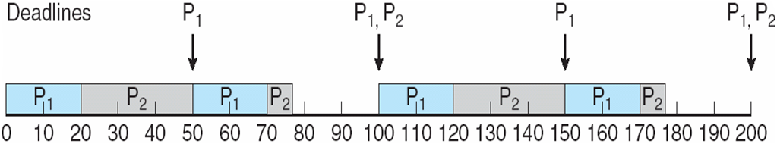
Rate-Monotonic
Shorter periods have higher priority
When higher priority process become available (new period), they interrupt low priority process
Given P1 p = 50, t = 20 P2 p = 100, t = 35

Slide 37
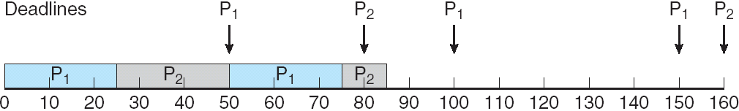
Rate-Monotonic
Given P1 p=50 t =25 P2 p=80 t = 35
P2 misses deadline, why?
Rate = (25/50) + (35/80) = .94
Worst case: N * (2 ^ 1/N -1)
For N = 2, Worst case = .83 < .94

Slide 38
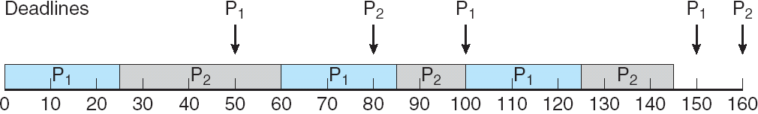
Earliest Deadline First
P1 p=50 t =25 P2 p=80 t = 35
Theoretically optimal but..
Context switching takes time

Slide 39
Proportional Share
I have some many shares
I give them out as processes ask for them.
Each process gets shares/ shares given time
Don’t have the shares you want? Too bad.

