Slide 1
Deadlock
Notes:
We created multiple processes and threads. Great advance. Why?
Think about the resources you need to make a program work (e.g., shared memory)
You may even need multiple resources simultaneously
Some of these resources may only be used by on thread at a time (e.g., printer)
Unfortunately, this creates the need for coordination of threads when using resources
Fine. We invented synchronization primitives to provide exclusive access
Unfortunately, the combination of resource dependency and exclusivity can lead to problems

Slide 2
Deadlock in (In)action
You must have insurance to transfer the title
You must have the title to get insurance
Deadlock – Set of processes where each is waiting for an event that only another process in the set can cause
Causes permanent blocking of multiple processes
Situations
Competing for shared resources
All are waiting for a resource that is held by another waiting entity
Waiting for communication
I’ll go when I hear from you
Focus on resource sharing

Slide 3
Example: Two Threads?
Two threads access two shared variables, A and B
Variable A is protected by lock a
Variable B is protected by lock b
How to add lock and unlock statements?
Thread One
Thread Two
A += 10;
B += 20;
A += B;
A += 30
B += 10;
A += 20;
A += B;
B += 30
lock(a);
lock(b);
unlock(b);
unlock(a);
lock(b)
lock(a);
unlock(a);
unlock(b);
Does this work?
Notes:
If Thread One grabs Lock A and Thread Two grabs Lock B

Slide 4
Resources
Types
Preemptable – Can be taken away
Non-preemptable – Cannot be taken away
Resource use
Request the resource
Use the resource
Release the resource

Slide 5
Resource-Allocation Graph
Vertex
Process
Resource
Edge (Directed)
Request (Process to Resource)
Assignment (Resource to Process)
Multiple instances of resource type
R₁
P₁
P₁
P₂
R₁
R₂
P₁
R₁
P₁
R₁
▪ ▪
R₁

Slide 6
Necessary Conditions for Deadlock
Mutual exclusion – Only one process may use a resource at a time
Hold and wait – A process may hold allocated resources while awaiting assignment of others
No preemption – Previously granted resources may not be taken away
Circular wait – A chain of processes exists, such that each process holds at least one resource needed by the next process in the chain

Slide 7
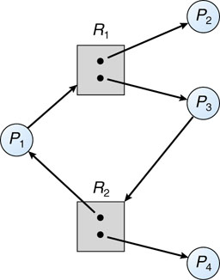
Resource-Allocation Graph
If no cycle, then no deadlock
If cycle, then deadlock may exist
Special case: If cycle and each resource type has only one instance, then deadlock
R₁
P₁
P₂
R₂
Deadlock
No Deadlock

Slide 8
Handling Deadlock
Ignore
Easiest and most common approach
Deadlock prevention
Ensure deadlock does not happen
Avoid at least one of 4 necessary conditions for deadlock
Mutual exclusion, Hold & wait, No preemption, Circular wait
System built so deadlock cannot happen
Deadlock avoidance
Ensure deadlock does not happen
Use information about resource requests to dynamically avoid unsafe situations
Deadlock detection and recovery
Allow deadlocks but detect
When deadlock occurs, recover and continue

Slide 9
Deadlock Prevention
Idea
Ensure 1 of 4 conditions cannot occur
Necessary Conditions
Mutual exclusion
Hold and wait
No preemption
Circular wait

Slide 10
Deadlock Prevention Eliminate Mutual Exclusion
Idea
No resource mutual exclusion
Make resource sharable
Examples
Read-only files
Problem
Some resources are nonsharable (e.g., printer)

Slide 11
Deadlock Prevention Eliminate Hold and Wait
When a process requests a resource, it doesn’t hold any others
Two Approaches
Atomically acquire all resources at once
One lock to rule them all
Problems
Do not know a priori what resources it needs
Holds resources longer (Poor utilization)
Longer wait for all resources (Starvation)
Thread One
Thread Two
lock(AB);
A += 10;
B += 20;
A += 30;
unlock(AB);
lock(AB);
B += 10;
A += 20;
B += 30;
unlock(AB);

Slide 12
Deadlock Prevention Eliminate Hold and Wait
Two Approaches
Only request resources when it does not hold other resources; release resources before requesting new ones
Problem: May release resources you need later
Inefficient
Starvation
Thread One
Thread Two
lock(a);
A += 10;
unlock(a);
lock(b);
B += 20;
unlock(b);
lock(a);
A += 30;
unlock(a);
lock(b)
B += 10;
unlock(b);
lock(a);
A += 20;
unlock(a);
lock(b);
B += 30;
unlock(b);

Slide 13
Deadlock Prevention No Preemption
Two Approaches
Preempt requestor resource
Example: If B is holding some resources and then requests additional resources that are held by other threads, then B releases all its resources
Preempt holder resource
Example: If A requests something held by B (and B is waiting for something else), then take resource away from B and give to A
Not possible if resource cannot be saved and restored
Can’t take away a lock without causing problems
Only works for some resources (e.g., CPU and memory)

Slide 14
Deadlock Prevention Circular Wait
Idea
Eliminate the possibility of a cycle
Options
Only one resource at a time Problem: Very limited
Impose global ordering for acquiring resources
Assign each resource a unique rank
Processes must acquire resource in rank order Ex: printer = 1, disk = 2, tape = 3 Must acquire printer before tape
Problem: Inefficient (e.g., Need to read from tape to disk in order to print but must get printer first even if tape copy is long). No order satisfies everybody

Slide 15
Deadlock Avoidance
Prevention views each process independently, limiting efficiency
Avoidance uses knowledge about future behavior of process group
Ex: Max. number of each resource type
Decision made dynamically based on current and potential maximum allocation
Allows greater concurrency
So let’s see how we can stay out of trouble…

Slide 16
Process-resource Trajectories
Requests Printer
Requests CD-RW
Releases Printer
Releases CD-RW
RP
RC
RLP
RLC
instruction
t₁
t₂
t₃
t₄
Process A

Slide 17
Process-resource Trajectories
instruction
Releases CD-RW
Requests Printer
Releases Printer
RLP
t_{Z}
Process B
t_{Y}
RLC
Request CD-RW
t_{X}
RP
t_{W}
RC

Slide 18
Process-resource Trajectories
instruction
RLP
t_{Z}
Process B
Both processes
hold CD-RW
t_{Y}
RLC
t_{X}
RP
t_{W}
RC
RP
RC
RLP
RLC
instruction
t₁
t₂
t₃
t₄
Process A

Slide 19
Process-resource Trajectories
instruction
Both processes
hold printer
RLP
t_{Z}
Process B
t_{Y}
RLC
t_{X}
RP
t_{W}
RC
RP
RC
RLP
RLC
instruction
t₁
t₂
t₃
t₄
Process A

Slide 20
Process-resource Trajectories
instruction
Forbidden
Zone
RLP
t_{Z}
Process B
t_{Y}
RLC
t_{X}
RP
t_{W}
RC
RP
RC
RLP
RLC
instruction
t₁
t₂
t₃
t₄
Process A

Slide 21
Process-resource Trajectories
instruction
RLP
t_{Z}
Process B
t_{Y}
RLC
t_{X}
RP
t_{W}
RC
RP
RC
RLP
RLC
instruction
t₁
t₂
t₃
t₄
Process A
Trajectory showing
system progress

Slide 22
Process-resource Trajectories
instruction
RLP
B makes progress;
A is not running
t_{Z}
Process B
t_{Y}
RLC
t_{X}
RP
t_{W}
RC
RP
RC
RLP
RLC
instruction
t₁
t₂
t₃
t₄
Process A

Slide 23
Process-resource Trajectories
instruction
RLP
t_{Z}
Process B
t_{Y}
RLC
t_{X}
RP
t_{W}
RC
RP
RC
RLP
RLC
instruction
t₁
t₂
t₃
t₄
Process A
B requests
the CD-RW

Slide 24
Process-resource Trajectories
instruction
RLP
t_{Z}
Process B
t_{Y}
RLC
t_{X}
RP
Request is granted
t_{W}
RC
RP
RC
RLP
RLC
instruction
t₁
t₂
t₃
t₄
Process A

Slide 25
Process-resource Trajectories
instruction
A runs & makes
a request for printer
RLP
t_{Z}
Process B
t_{Y}
RLC
t_{X}
RP
t_{W}
RC
RP
RC
RLP
RLC
instruction
t₁
t₂
t₃
t₄
Process A

Slide 26
Process-resource Trajectories
instruction
RLP
t_{Z}
Process B
t_{Y}
RLC
t_{X}
RP
t_{W}
RC
RP
RC
RLP
RLC
instruction
t₁
t₂
t₃
t₄
Process A
Request is granted;
A proceeds

Slide 27
Process-resource Trajectories
instruction
B runs & requests
the printer...
MUST WAIT!
RLP
t_{Z}
Process B
t_{Y}
RLC
t_{X}
RP
t_{W}
RC
RP
RC
RLP
RLC
instruction
t₁
t₂
t₃
t₄
Process A

Slide 28
Process-resource Trajectories
instruction
A runs & requests
the CD-RW
RLP
t_{Z}
Process B
t_{Y}
RLC
t_{X}
RP
t_{W}
RC
RP
RC
RLP
RLC
instruction
t₁
t₂
t₃
t₄
Process A

Slide 29
Process-resource Trajectories
instruction
A...
holds printer
requests CD-RW
B...
holds CD-RW
requests printer
DEADLOCK!
RLP
t_{Z}
Process B
t_{Y}
RLC
t_{X}
RP
t_{W}
RC
RP
RC
RLP
RLC
instruction
t₁
t₂
t₃
t₄
Process A

Slide 30
Process-resource Trajectories
instruction
Danger
occurred here
Should the OS
give A the printer,
or make it wait???
RLP
t_{Z}
Process B
t_{Y}
RLC
t_{X}
RP
t_{W}
RC
RP
RC
RLP
RLC
instruction
t₁
t₂
t₃
t₄
Process A

Slide 31
Process-resource Trajectories
instruction
RLP
t_{Z}
Process B
t_{Y}
RLC
t_{X}
RP
t_{W}
RC
RP
RC
RLP
RLC
instruction
t₁
t₂
t₃
t₄
Process A
This area is “unsafe”

Slide 32
Process-resource Trajectories
instruction
Within this area,
deadlock is inevitable.
We don’t want to
enter this area.
The OS should make
A wait at this point!
RLP
t_{Z}
Process B
t_{Y}
RLC
t_{X}
RP
t_{W}
RC
RP
RC
RLP
RLC
instruction
t₁
t₂
t₃
t₄
Process A

Slide 33
Process-resource Trajectories
instruction
RLP
t_{Z}
Process B
t_{Y}
RLC
t_{X}
RP
t_{W}
RC
B requests the printer,
B releases CD-RW,
B releases printer,
then A runs to completion!
RP
RC
RLP
RLC
time
t₁
t₂
t₃
t₄
Process A

Slide 34
Safe states
Current state
Which processes hold which resources
Safe state
There is some scheduling order in which every process can run to completion even if all of them request their maximum number of units immediately

Slide 35
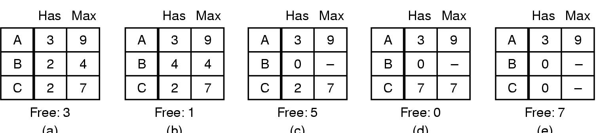
Safe vs. Unsafe States
There is some scheduling order in which every process can run to completion even if all of them request their maximum number of units immediately
Example: One resource type with 10 units
Safe?
B takes max
B finishes
C takes max
C finishes

Slide 36
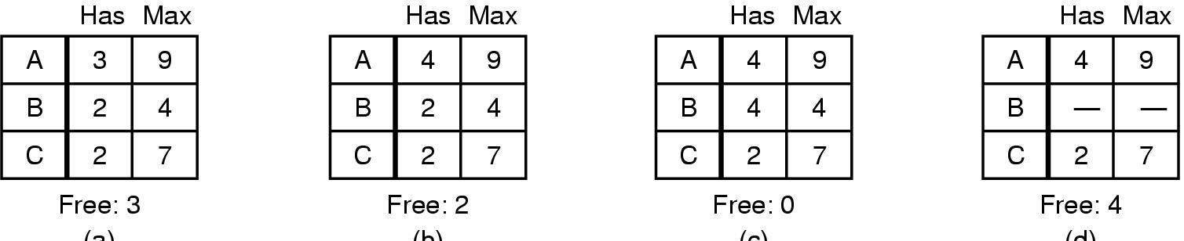
Unsafe/Safe State?
We disallow transition to an unsafe state so we are always safe
Example: One resource type with 10 units
A takes 1
B takes max
Problem!
Unsafe!
Safe

Slide 37
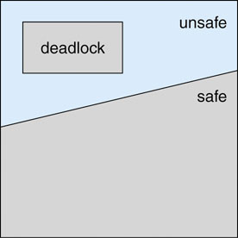
Unsafe State
A safe state avoids deadlock
An unsafe is not necessarily deadlocked but may lead to a deadlocked state
Example: One resource type with 10 units
A takes 1
UNSAFE!!
B takes max
(C cannot)
A or C could release 2+

Slide 38
Deadlock Avoidance
Avoid unsafe states of processes holding resources
Unsafe states might lead to deadlock if processes make certain future requests
When process requests a resource, only allocate if doing so does not create an unsafe state

Slide 39
The Banker’s Algorithm
Assumptions
Only one type of resource with multiple units
Processes declare their maximum potential resource needs ahead of time
Algorithm
The system will only grant a process request if it does not lead to an unsafe state
Has
Max
Has
Max
A | 1 | 6
B | 1 | 5
C | 2 | 4
D | 4 | 7
A | 3 | 9
B | 2 | 4
C | 2 | 7
Free: 2
Free: 2
Safe?
Safe?

Slide 40
Banker’s with Multiple Resource Types
What about handling multiple resource types?
Tape
Printer
Tape
Printer
Tape
Printer
CD
CD
CD
P1
3 | 2 | 2
6 | 1 | 3
3 | 1 | 4
4 | 2 | 2
P1
1 | 0 | 0
6 | 1 | 1
2 | 1 | 1
0 | 0 | 2
0 | 1 | 1
P2
P2
Available (A)
P3
P3
P4
P4
Max (M)
Current (C)

Slide 41

Banker’s with Multiple Resource Types
What about handling multiple resource types?
Tape
Printer
Tape
Printer
Tape
Printer
CD
CD
CD
P1
3 | 2 | 2
6 | 1 | 3
3 | 1 | 4
4 | 2 | 2
P1
1 | 0 | 0
6 | 1 | 1
2 | 1 | 1
0 | 0 | 2
0 | 1 | 1
P2
P2
Available (A)
P3
P3
P4
P4
Max (M)
Current (C)

Slide 42
Banker’s with Multiple Resource Types
Make change request, updating C and A
Look for a row, r, in C whose unmet resource needs are all smaller than or equal to A. If no such row exists, the system may deadlock since no process can run to completion in the worst case
Assume the process of the row chosen requests all the resources that it needs and finishes. Mark that process as terminated and add all its resources to A
Repeat Steps 2 and 3 until either all processes are marked terminated (initial state was safe) or no process is left whose resource needs can be met (initial state was unsafe)
Tape
Printer
Tape
Printer
CD
CD
P1
3 | 2 | 2
6 | 1 | 2
3 | 1 | 4
4 | 2 | 2
P1
1 | 0 | 0
6 | 1 | 1
2 | 1 | 1
0 | 0 | 2
P2
P2
P3
P3
P4
P4
Max (M)
Current (C)
Tape
Printer
CD
0 | 1 | 2
Available (A)

Slide 43
Banker’s with Multiple Resource Types
Make change request, updating C and A
Look for a row, r, in C whose unmet resource needs are all smaller than or equal to A. If no such row exists, the system may deadlock since no process can run to completion in the worst case
Assume the process of the row chosen requests all the resources that it needs and finishes. Mark that process as terminated and add all its resources to A
Repeat Steps 2 and 3 until either all processes are marked terminated (initial state was safe) or no process is left whose resource needs can be met (initial state was unsafe)
Tape
Printer
Tape
Printer
CD
CD
P1
3 | 2 | 2
6 | 1 | 2
3 | 1 | 4
4 | 2 | 2
P1
1 | 0 | 0
6 | 1 | 1
2 | 1 | 1
0 | 0 | 2
P2
P2
P3
P3
2
P4
P4
Max (M)
Current (C)
Tape
Printer
CD
0 | 1 | 2
1
Available (A)
P3 requests 1 new printer
Safe?

Slide 44
Banker’s with Multiple Resource Types
Make change request, updating C and A
Look for a row, r, in C whose unmet resource needs are all smaller than or equal to A. If no such row exists, the system may deadlock since no process can run to completion in the worst case
Assume the process of the row chosen requests all the resources that it needs and finishes. Mark that process as terminated and add all its resources to A
Repeat Steps 2 and 3 until either all processes are marked terminated (initial state was safe) or no process is left whose resource needs can be met (initial state was unsafe)
Tape
Printer
Tape
Printer
CD
CD
P1
3 | 2 | 2
6 | 1 | 2
3 | 1 | 4
4 | 2 | 2
P1
1 | 0 | 0
6 | 1 | 1
2 | 1 | 2
0 | 0 | 2
P2
P2
P3
P3
P4
P4
Max (M)
Current (C)
Tape
Printer
CD
0 | 1 | 1
Available (A)
P2 runs to completion

Slide 45
Banker’s with Multiple Resource Types
Make change request, updating C and A
Look for a row, r, in C whose unmet resource needs are all smaller than or equal to A. If no such row exists, the system may deadlock since no process can run to completion in the worst case
Assume the process of the row chosen requests all the resources that it needs and finishes. Mark that process as terminated and add all its resources to A
Repeat Steps 2 and 3 until either all processes are marked terminated (initial state was safe) or no process is left whose resource needs can be met (initial state was unsafe)
Tape
Printer
Tape
Printer
CD
CD
P1
3 | 2 | 2
0 | 0 | 0
3 | 1 | 4
4 | 2 | 2
P1
1 | 0 | 0
0 | 0 | 0
2 | 1 | 2
0 | 0 | 2
P2
P2
P3
P3
P4
P4
Max (M)
Current (C)
Tape
Printer
CD
6 | 2 | 2
Available (A)
P1 runs to completion

Slide 46
Banker’s with Multiple Resource Types
Make change request, updating C and A
Look for a row, r, in C whose unmet resource needs are all smaller than or equal to A. If no such row exists, the system may deadlock since no process can run to completion in the worst case
Assume the process of the row chosen requests all the resources that it needs and finishes. Mark that process as terminated and add all its resources to A
Repeat Steps 2 and 3 until either all processes are marked terminated (initial state was safe) or no process is left whose resource needs can be met (initial state was unsafe)
Tape
Printer
Tape
Printer
CD
CD
P1
0 | 0 | 0
0 | 0 | 0
3 | 1 | 4
4 | 2 | 2
P1
0 | 0 | 0
0 | 0 | 0
2 | 1 | 2
0 | 0 | 2
P2
P2
P3
P3
P4
P4
Max (M)
Current (C)
Tape
Printer
CD
7 | 2 | 2
Available (A)
P3 runs to completion

Slide 47
Banker’s with Multiple Resource Types
Make change request, updating C and A
Look for a row, r, in C whose unmet resource needs are all smaller than or equal to A. If no such row exists, the system may deadlock since no process can run to completion in the worst case
Assume the process of the row chosen requests all the resources that it needs and finishes. Mark that process as terminated and add all its resources to A
Repeat Steps 2 and 3 until either all processes are marked terminated (initial state was safe) or no process is left whose resource needs can be met (initial state was unsafe)
Tape
Printer
Tape
Printer
CD
CD
P1
0 | 0 | 0
0 | 0 | 0
0 | 0 | 0
4 | 2 | 2
P1
0 | 0 | 0
0 | 0 | 0
0 | 0 | 0
0 | 0 | 2
P2
P2
P3
P3
P4
P4
Max (M)
Current (C)
Tape
Printer
CD
9 | 3 | 4
Available (A)
P4 runs to completion

Slide 48
Banker’s with Multiple Resource Types
Make change request, updating C and A
Look for a row, r, in C whose unmet resource needs are all smaller than or equal to A. If no such row exists, the system may deadlock since no process can run to completion in the worst case
Assume the process of the row chosen requests all the resources that it needs and finishes. Mark that process as terminated and add all its resources to A
Repeat Steps 2 and 3 until either all processes are marked terminated (initial state was safe) or no process is left whose resource needs can be met (initial state was unsafe)
Tape
Printer
Tape
Printer
CD
CD
P1
0 | 0 | 0
0 | 0 | 0
0 | 0 | 0
0 | 0 | 0
P1
0 | 0 | 0
0 | 0 | 0
0 | 0 | 0
0 | 0 | 0
P2
P2
P3
P3
P4
P4
Max (M)
Current (C)
Tape
Printer
CD
9 | 3 | 6
Available (A)
Safe!

Slide 49
Deadlock Avoidance
Deadlock avoidance is often impractical
You don’t know in advance what resources a process will need!

Slide 50
Deadlock Detection & Recovery
Allow system to enter deadlock state
Detection algorithm
Recovery scheme

Slide 51
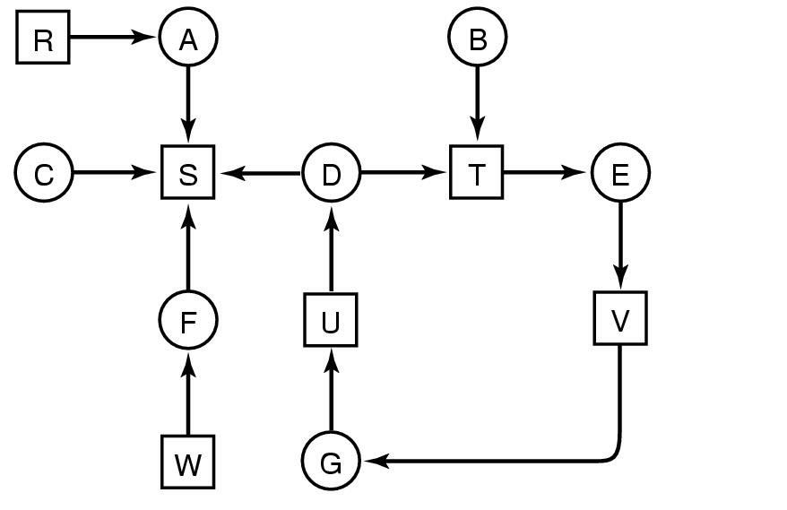
Deadlock Detection Single Instance of Each Resource Type
Periodically invoke an algorithm that searches for a cycle in the graph
An algorithm to detect a cycle in a graph requires O(n²) operations, where n is the number of vertices in the graph
D, E, G?
Deadlocked
A, C, F?
Not deadlocked. Any serial order of A, C, and F works.

Slide 52
Deadlock Detection with Multiple Resource Instances
Theorem: If graph does not contain a cycle then no processes are deadlocked
A cycle is a necessary condition for deadlock
Is it a sufficient condition?
waiting
holding
4
2
holding
waiting
holding
3

Slide 53
Deadlock Detection Multiple Resource Instances
Look for an unmarked process Pi, for which the ith row of R is less than or equal to A
If such a process is found, add the ith row of C to A, mark the process and go back to Step 1
If no such process exists, the algorithm terminates
All unmarked processes are deadlocked
Tape
Printer
Tape
Printer
CD
CD
P1
0 | 0 | 0
2 | 0 | 2
0 | 0 | 0
2 | 0 | 1
P1
0 | 1 | 0
2 | 0 | 0
3 | 0 | 3
2 | 1 | 2
P2
P2
P3
P3
P4
P4
Request (R)
Current (C)
Tape
Printer
CD
0 | 0 | 0
Available (A)

Slide 54
Deadlock Detection Multiple Resource Instances
Look for an unmarked process Pi, for which the ith row of R is less than or equal to A
If such a process is found, add the ith row of C to A, mark the process and go back to Step 1
If no such process exists, the algorithm terminates
All unmarked processes are deadlocked
Tape
Printer
Tape
Printer
CD
CD
P1
0 | 0 | 0
2 | 0 | 2
0 | 0 | 0
2 | 0 | 1
P1
0 | 1 | 0
2 | 0 | 0
3 | 0 | 3
2 | 1 | 2
P2
P2
P3
P3
P4
P4
Request (R)
Current (C)
Tape
Printer
CD
0 | 0 | 0
Available (A)

Slide 55
Deadlock Detection Multiple Resource Instances
Look for an unmarked process Pi, for which the ith row of R is less than or equal to A
If such a process is found, add the ith row of C to A, mark the process and go back to Step 1
If no such process exists, the algorithm terminates
All unmarked processes are deadlocked
Tape
Printer
Tape
Printer
CD
CD
P1
0 | 0 | 0
2 | 0 | 2
0 | 0 | 0
2 | 0 | 1
P1
0 | 1 | 0
2 | 0 | 0
3 | 0 | 3
2 | 1 | 2
P2
P2
P3
P3
P4
P4
Request (R)
Current (C)
Tape
Printer
CD
0 | 1 | 0
Available (A)

Slide 56
Deadlock Detection Multiple Resource Instances
Look for an unmarked process Pi, for which the ith row of R is less than or equal to A
If such a process is found, add the ith row of C to A, mark the process and go back to Step 1
If no such process exists, the algorithm terminates
All unmarked processes are deadlocked
Tape
Printer
Tape
Printer
CD
CD
X
P1
0 | 0 | 0
2 | 0 | 2
0 | 0 | 0
2 | 0 | 1
P1
0 | 1 | 0
2 | 0 | 0
3 | 0 | 3
2 | 1 | 2
P2
P2
P3
P3
P4
P4
Request (R)
Current (C)
Tape
Printer
CD
3 | 1 | 3
Available (A)

Slide 57
Deadlock Detection Multiple Resource Instances
Look for an unmarked process Pi, for which the ith row of R is less than or equal to A
If such a process is found, add the ith row of C to A, mark the process and go back to Step 1
If no such process exists, the algorithm terminates
All unmarked processes are deadlocked
Tape
Printer
Tape
Printer
CD
CD
X
P1
0 | 0 | 0
2 | 0 | 2
0 | 0 | 0
2 | 0 | 1
P1
0 | 1 | 0
2 | 0 | 0
3 | 0 | 3
2 | 1 | 2
P2
P2
X
P3
P3
P4
P4
Request (R)
Current (C)
Tape
Printer
CD
5 | 1 | 3
Available (A)

Slide 58
Deadlock Detection Multiple Resource Instances
Look for an unmarked process Pi, for which the ith row of R is less than or equal to A
If such a process is found, add the ith row of C to A, mark the process and go back to Step 1
If no such process exists, the algorithm terminates
All unmarked processes are deadlocked
Tape
Printer
Tape
Printer
CD
CD
X
P1
0 | 0 | 0
2 | 0 | 2
0 | 0 | 0
2 | 0 | 1
P1
0 | 1 | 0
2 | 0 | 0
3 | 0 | 3
2 | 1 | 2
X
P2
P2
X
P3
P3
P4
P4
Request (R)
Current (C)
Tape
Printer
CD
7 | 2 | 5
Available (A)
No Deadlock

Slide 59
Deadlock Detection Multiple Resource Instances
Look for an unmarked process Pi, for which the ith row of R is less than or equal to A
If such a process is found, add the ith row of C to A, mark the process and go back to Step 1
If no such process exists, the algorithm terminates
All unmarked processes are deadlocked
Tape
Printer
Tape
Printer
CD
CD
P1
0 | 0 | 0
2 | 0 | 1
0 | 0 | 1
2 | 0 | 1
P1
0 | 1 | 0
2 | 0 | 0
3 | 0 | 3
2 | 1 | 2
P2
P2
P3
P3
P4
P4
Request (R)
Current (C)
Tape
Printer
CD
0 | 0 | 0
Available (A)

Slide 60
Deadlock Detection Multiple Resource Instances
Look for an unmarked process Pi, for which the ith row of R is less than or equal to A
If such a process is found, add the ith row of C to A, mark the process and go back to Step 1
If no such process exists, the algorithm terminates
All unmarked processes are deadlocked
Tape
Printer
Tape
Printer
CD
CD
P1
0 | 0 | 0
2 | 0 | 1
0 | 0 | 1
2 | 0 | 1
P1
0 | 1 | 0
2 | 0 | 0
3 | 0 | 3
2 | 1 | 2
P2
P2
P3
P3
P4
P4
Request (R)
Current (C)
Tape
Printer
CD
0 | 1 | 0
Available (A)

Slide 61
Deadlock Detection Multiple Resource Instances
Look for an unmarked process Pi, for which the ith row of R is less than or equal to A
If such a process is found, add the ith row of C to A, mark the process and go back to Step 1
If no such process exists, the algorithm terminates
All unmarked processes are deadlocked
Tape
Printer
Tape
Printer
CD
CD
X
P1
0 | 0 | 0
2 | 0 | 1
0 | 0 | 1
2 | 0 | 1
P1
0 | 1 | 0
2 | 0 | 0
3 | 0 | 3
2 | 1 | 2
P2
P2
P3
P3
P4
P4
Request (R)
Current (C)
Tape
Printer
CD
0 | 1 | 0
Available (A)
Deadlock!!

Slide 62
Recovery from Deadlock
Process Termination
Abort all deadlocked processes and reclaim resources
Abort one process at a time until deadlock cycle is eliminated
Where to start?
Low priority process
How long process has been executing
How many resources a process holds
Batch or interactive
Number of processes that must be terminated

Slide 63
Recovery from Deadlock
Resource Preemption
Take resources away from one process and give to other processes until no deadlock
Issues
Victim selection
Similar to termination
Rollback
Periodically save process state checkpoints to move back to, releasing resources acquired since checkpoint
Starvation
How do we avoid starvation through repeated preemption?

Slide 64
Deadlock Detection Issues
How often should the algorithm run?
After every resource request?
Periodically?
When CPU utilization is low?
When we suspect deadlock because some thread has been asleep for a long period of time?

Slide 65
Deadlock Avoidance
Detection vs. avoidance…
Avoidance – Pessimistic approach
Don’t allocate resource if it may lead to deadlock
If a process requests a resource...
... make it wait until you are sure it’s OK
Detection – Optimistic approach
Allocate resources when requested
Detect presence of deadlock
Kill processes and steal resources to fix it
Which one to use depends upon the application

