Slide 1
Memory Management

Slide 2
Single Process Allocation
2^{n}-1
Physical Memory
OS
0
Stack
User Process
1000
Address Space
Heap
LOAD REGISTER1, 1000
0
Code
Disadvantages:
Process may not need all of the space
Only one process runs at a time (Blocking on I/O?)
Process can destroy OS
We want to share memory

Slide 3
Multiprogramming Goals
Sharing
Several processes coexist in main memory
Cooperating processes can share portions of address space
Transparency
Processes are not aware that memory is shared
Works regardless of number and/or location of processes
Protection
Cannot corrupt OS or other processes
Privacy: Cannot read data of other processes
Efficiency
Do not waste CPU or memory resources
Keep fragmentation low (later)

Slide 4
Static Relocation
Idea: Allow transparent sharing
Each process may be placed anywhere in memory
OS finds free space for new process
Modify addresses statically (similar to linker) when loading process
Advantages
Allows multiple processes to run
Requires no hardware support
System Memory
OS
Process 1
Process 2
Process 3

Slide 5
Static Relocation
System Memory
Disadvantages
No protection
Process can destroy OS or other processes
No privacy
Address space must be allocated contiguously
Allocate space for worst-case stack and heap
Processes may not grow
OS
Process 1
Process 2
Process 3

Slide 6
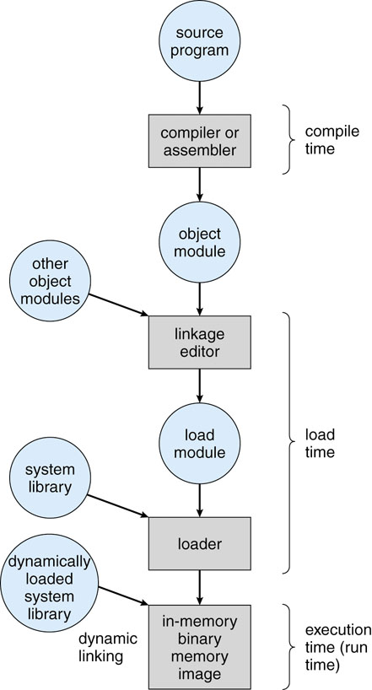
Static Address Binding
When do I bind the physical address?
Compile Time – Set the address when building executable
Load Time – Set the address when loading executable
Execution Time – Set the address at load and then change it if the process moves during execution

Slide 7
Address Spaces
Physical address references are problematic
Bounds violation
Privacy
Address space
Process references logical address space
Logical addresses start at 0
System is responsible for mapping logical to physical addresses

Slide 8
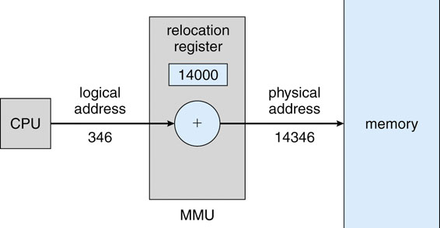
Dynamic Relocation
Goal: Protect processes from one another
Requires hardware support
Memory Management Unit (MMU)
MMU dynamically changes process address at every memory reference
Process generates logical addresses
Memory hardware uses physical (“actual”) addresses
physical address = logical address + base register
Protection is provided by address range testing
logical address < limit register
Base
Limit
Limited to
24000
24000

Slide 9
Example of Dynamic Relocation
What are the physical addresses for the following 16-bit logical addresses?
Process 1: base: 0x4320, limit: 0x2500
0x0000:
0x1110:
0x3000:
Process 2: base: 0x8540, limit: 0xB870
0x0000:
0x1110:
0x3000:
Operating System
0x0000:

Slide 10
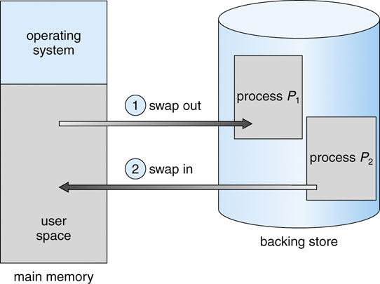
Memory Overload
Many processes loaded; few (one) executing
Most idle (e.g., waiting on iPhone connection)
Not enough memory for all
Solution: Swap idle processes to backing store

Slide 11
Swapping sBits
There can be problems
Swapping is expensive
Two user processes with 100MBs @ 50MBps
8ms disk latency
2008ms in + 2008ms out = 4016ms
Need to swap before given processor
Problem
Process with pending I/O swapped out so…
No memory for I/O completion
Solution: Don’t swap or have OS buffer

Slide 12
Memory Placement
Location, Location, Location
We need to place process memory
New process
Swap in
Contiguous memory allocation
Start (base register)
Finish (base register + limit register)

Slide 13
Fixed-Size Partitions
Divide memory into fixed-size chunks
Limit is the same for all processes
New/Swapped-in process gets a chunk
Problem: Partition size
Too big - Wastes space for smaller processes
Too small - Limits size of process
Internal fragmentation – Unused memory within a partition (Partition minus Needed size)

Slide 14
Variable-Size Partitions
Process requests memory size it needs
Placement depends on availability
Process exit creates holes
Coalescing – Combining adjacent holes
OS must decide where new requests go
B
B
?
C
A
A
Operating
System
Operating
System
Operating
System

Slide 15
Partition Placement Strategy
Keep list of available memory holes
Linked list
Map
Placement
First-fit – First hole in list that is big enough
Best-fit – Smallest hole in list that is big enough
Worst-fit – Largest hole in list

Slide 16
Fragmentation
Loading and reloading creates fragments
Unusably small segments of memory
For first-fit, statistical analysis shows that for N allocated blocks typically N/2 blocks are wasted (50-percent rule)
Compaction – Dynamic relocation of process memory to eliminate fragments
E
D
D
X
E
D
B
B
B
B
Useful?
C
C
C
Operating
System
Operating
System
Operating
System
Operating
System

Slide 17
Comparison of Allocation Strategies
No optimal algorithm
Fragmentation highly dependent on workload
Best-fit
Tends to leave some very large holes and very small holes
Cannot use very small holes easily
First-fit
Tends to leave “average” sized holes
Advantage: Faster than best-fit
Next-fit (starts where it left off) used often in practice
Buddy allocation (Linux)
Minimizes external fragmentation
Disadvantage: Internal fragmentation when request size not a power of 2

Slide 18
Buddy Allocation
Consider
Fixed-size allocation always too large/small (int. frag.)
Variable-size allocation creates odd-sized fragments (ext. frag.)
Compromise: Allocate blocks of 2^{n} bytes
To allocate R bytes
Find the smallest free block, B, that is larger than R
While (R > B/2)
Divide B into two blocks, B1 and B2
B = B1 and B2 (“Buddy” block) remains free
Allocate B (Size of B = 2^{n} such that R < 2^{n} and n is minimized)
Deallocate
Mark block as free
Recursively coalesce block with buddy (if buddy is free)
May coalesce lazily (later, in background) to avoid overhead

Slide 19
Buddy Algorithm
1
2
2
2
3
4
4
5
6
32
32
32
32
32
32
32
32
64
16
16
16
32
8
16
8
8
Initially 64KB of memory
First request is for 5KB
Divide 64 block chunk into half (again and again) until desired block size and return to caller (shaded area)
Second request is for 8KB so return remaining chunk
Third request is for 4KB -- split block again and again and return to caller
8KB is released and returned
5KB is released and coalesced

Slide 20
Continuous Allocation Considered
Advantages
Provides protection (both read and write) across address spaces
Supports dynamic relocation
Simple, inexpensive - Few registers, little logic in MMU
Fast - Add and compare can be done in parallel
Disadvantages
Fixed size – Cannot get the size right
Variable size – Cannot get place right (fragmentation)
No partial sharing - Cannot share limited parts of address space
0
Operating
System
30004
30004
Process
base
42094
12090
Process
limit
Process

Slide 21
Paging
If it doesn’t fit, you mustn’t quit
Observation
Memory allocation need not be continuous
Idea
Divide memory into fixed-sized chunks
Allocate chunks as needed to process
Chunk Size: 2^{n}, Example: 4KB
Physical page: frame
Logical page: page
Problem
Need to map logical address to physical
Logical addresses must be contiguous even if physical addresses are not
Process 1
Physical View (frames)
Process 3
Logical View (pages)

Slide 22
Paging Address Translation
Translate logical address to physical address
High-order bits of address designate page number
Low-order bits of address designate offset within page
20 bits
12 bits
32 bits
page number
page offset
Logical address
page table
frame number
page offset
Physical address

Slide 23
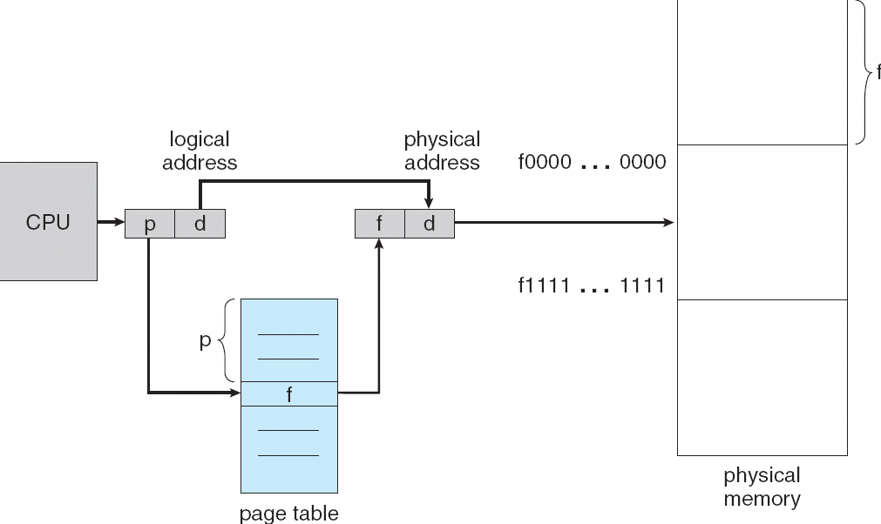
Paging Address Translation
Translate logical address to physical address
High-order bits (p) of address designate page number
Low-order bits (d) of address designate offset within page
Page table per process

Slide 24
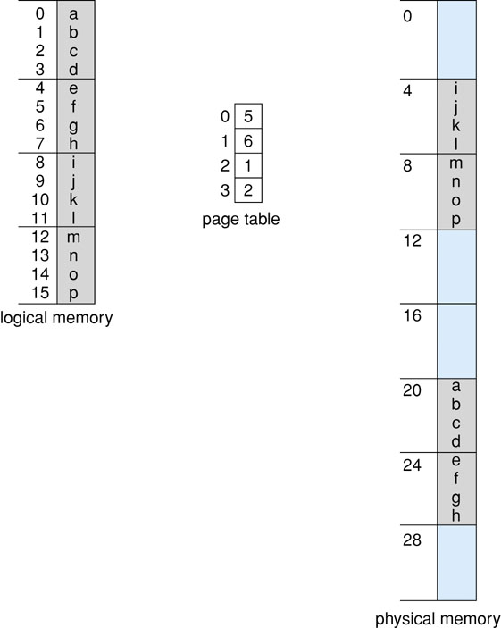
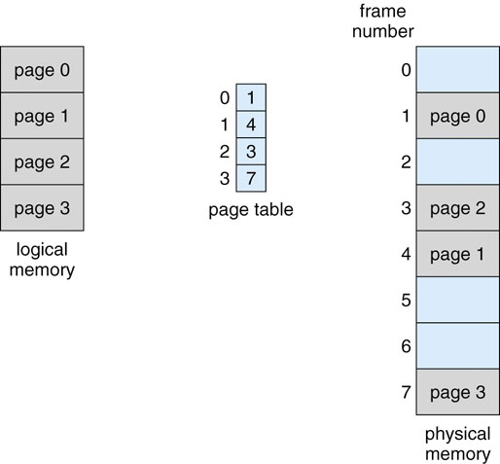
Paging Model
Address spaces
Logical - Contiguous range of addresses
Physical – Frames are placed where available
Logical
Example

Slide 25
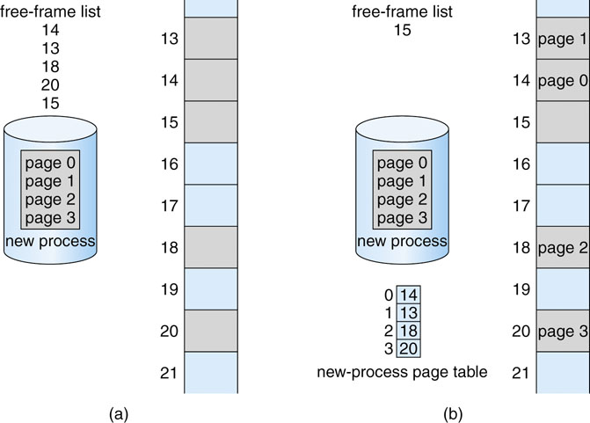
Frame Allocation
Exiting/Swapped out processes release frames
OS maintains list of free frames
Simplified by no physical memory continuity requirement

Slide 26
Cache
Problem
Processor fetches instruction/operands and stores result in memory
Processor vs. memory speed mismatch
Observation: Locality
Solution: Faster memory to temporarily hold recently-accessed data
Divided into fixed-size cache lines
Types
L1 – Always inside CPU
L2 – Slower and may be shared among cores
Cache checked first to determine if information is there
If it is (cache hit), information used directly from the cache (fast)
If not, data copied to cache and used there
Cache smaller than storage being cached
Cache/Block size
Replacement policy
Write policy
Cache coherency (multiple caches)
Processor
Cache
Main Memory
Notes:
Main memory cannot be as faster as registers because of expense

Slide 27
Translation Look-Aside Buffer (TLB)
Problem
Page tables are large and must be stored in main memory
Requires 2 accesses for one byte (page table + frame)
Idea: Hardware cache of recently used page table entries
Associative memory (search all keys at once)
Typical size: 64 to 1024 entries
Does not contain complete page table
TLB Miss
TLB does not have referenced page
Look up in actual page table in main memory
Hit ratio – Percentage of time a page number is found
Why does this work?
Process references only few unique pages in time interval
Spatial, temporal locality
How does page size impact TLB performance?

Slide 28
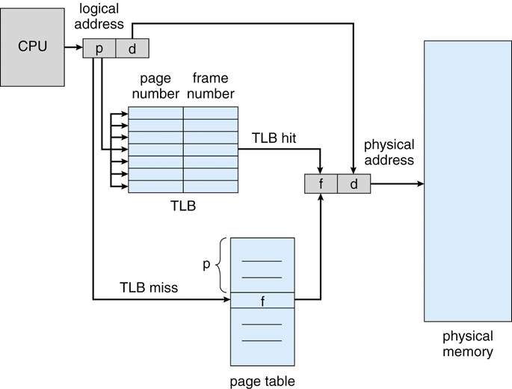
Paging With TLB

Slide 29
Page Size Tradeoffs
Internal fragmentation
Smaller page size decreases internal fragmentation
Number of pages
Smaller page size increases page count, resulting in larger page tables and smaller TLB hit ratio

Slide 30
Advantages of Paging
No external fragmentation
Any page can be placed in any frame in physical memory
Fast to allocate and free
Allocate - No searching for suitable free space
Free – Do not have to coalesce with adjacent free space
Enables sharing of portions of address space
To share a page, have entries from page tables of different processes point to the same frame

Slide 31
Disadvantages of Paging
Internal fragmentation
Page size may not match size needed by process
Wasted memory grows with larger pages
Large vs. small page size
Page table memory reference
Complexity
Less efficient
Page table must be stored in memory

Slide 32
Page Tables Living Large
Large address spaces and/or small frames can create large page tables
Example
32-bit addresses with 4KB pages creates…
Page table of 10⁶ entries so with…
32 bits per entry creates a 4MB page table
Cannot easily allocate such a large page table in contiguous memory
Solutions…

Slide 33
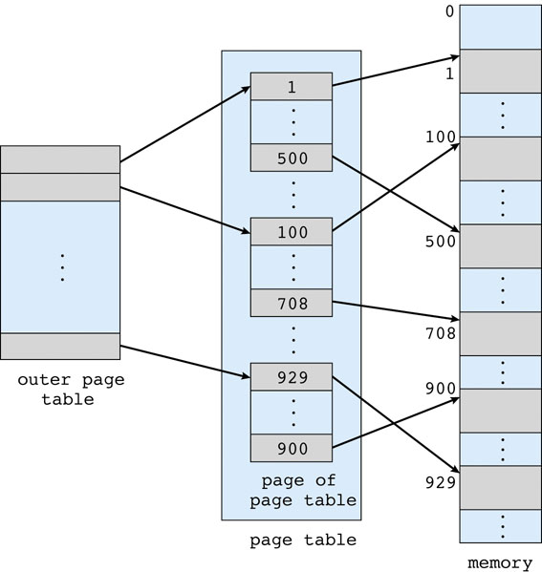
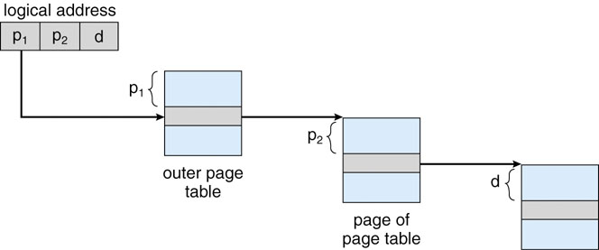
Two-level Page Tables
Page the page table
Use outer page table to find actual page table
Second page table works as before
Address parts
Outer page table offset
Actual page table offset
Frame offset
Individual page tables smaller

Slide 34
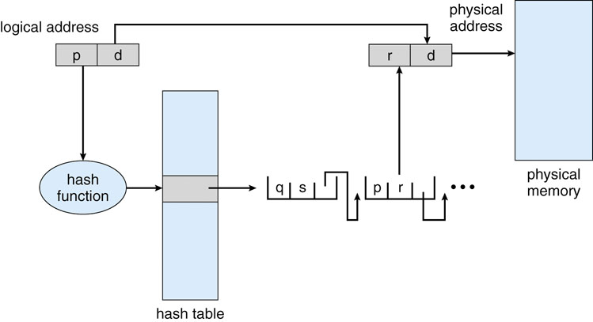
Hashed Page Table
Hash virtual page number (p)
Search linked list of collisions to find frame physical starting address
Use frame offset (d) to get byte
Control size of hash table with hash function

Slide 35
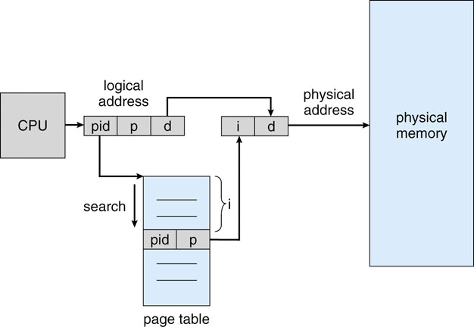
Inverted Page Table
Only one entry per real frame and one page table
Find virtual address in page table and use offset
Adv: Single page table with size O(real frames)
Dis: Must search page table

Slide 36
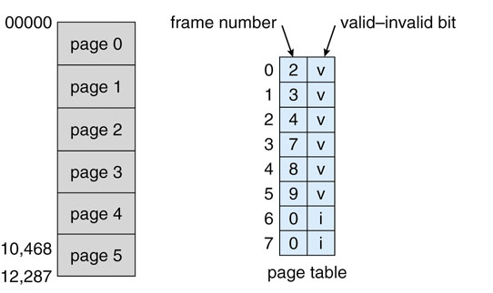
Juiced Page Tables
Most processes do not need all frames
Not all frames need to be in memory (later)
Want to control frame access permission
Example
14-bit address space (0 to 16383) with 2KB page size
Only use 0 to 10468
permission
RW
RW
RW
RW
RW
R

Slide 37
Segmentation
Physical memory need not be contiguous
Not all memory need be logical contiguous
Code, Global variables, Heap, Stack, etc.
Divide logical address space into logical segments
Each segment can independently
be placed separately in physical memory
grow and shrink
be protected (separate read/write/execute protection bits)
subroutine
main
program
symbol
table
table
stack
heap
Logical Address
Space

Slide 38
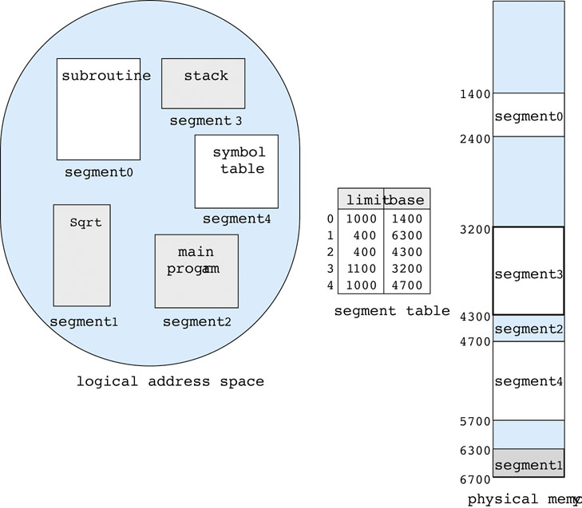
Segment Addressing
Address
Top bits of logical address select segment
Low bits of logical address select offset within segment
Bounds checking
Address
Seg# | Offset

Slide 39
Segmentation Implementation
MMU contains segment table (per process)
Each segment has own base and bounds, protection bits
Example: 14 bit logical address, 4 segments
Segment | Base | Bounds | R W
0 | 0x2000 | 0x06ff | 1 0
1 | 0x0000 | 0x04ff | 1 0
2 | 0x3000 | 0x0fff | 1 1
3 | 0x0000 | 0xffff | 0 0
Translate logical addresses ⇒ physical addresses
0x0240: 0th segment 240 internal address within segment ⇒ what address?
0x1108:
0x265c:
0x3002:

Slide 40
Segmentation Considered
Advantages
Enables sparse allocation of address space
Stack and heap can grow independently
Heap: If no data on free list, dynamic memory allocator requests more from OS (e.g., UNIX: malloc calls sbrk())
Stack: OS recognizes reference outside legal segment, extends stack implicitly
Different protection for different segments
Read-only status for code
Enables sharing of selected segments
Supports dynamic relocation of each segment
Disadvantages
Each segment must be allocated contiguously
May not have sufficient physical memory for large segments

Slide 41
Combine Paging and Segmentation
Goal: More efficient support for sparse address spaces
Idea
Divide address space into segments (code, heap, stack)
Segments can be variable length
Divide each segment into fixed-sized pages
Logical address divided into three portions
Implementation
Each segment has a page table
Each segment track base (physical address) and bounds of page table
seg # (4 bits)
page number (8 bits)
page offset (12 bits)

Slide 42
Paging and Segmentation Example
...
0x01f
0x011
0x003
0x02a
0x013
...
0x00c
0x007
0x004
0x00b
0x006
...
1100
seg | base | bounds | R W
0 | 1400 | 5 | 1 0
1 | 6300 | 400 | 0 0
2 | 4300 | 1100 | 1 1
3 | 1100 | 5 | 1 1
1400

Slide 43
Paging and Segmentation Advantages
Advantages of segments
Supports sparse address spaces
Decreases size of page tables
If segment not used, not need for page table
Advantages of pages
No external fragmentation
Segments can grow without any reshuffling
Can run process when some pages are swapped to disk
Advantages of both
Increases flexibility of sharing
Share either single page or entire segment

Slide 44
Paging and Segmentation Disadvantages
Overhead of accessing memory
Page tables reside in main memory
Overhead reference for every real memory reference
Large page tables
Must allocate page tables contiguously
More problematic with more address bits
Page table size?
Assume 2 bits for segment, 18 bits for page number, 12 bits for offset

