Slide 1
Virtual Memory

Slide 2
Memory Exhausted
We can slice (segment) and dice (page)
All of the process must fit in memory
Limits number or size of processes
Locality - Much of the code/data not needed now
Idea: Store some of the logical address space elsewhere
Programmers can ignore machine-specific physical memory limitations
Larger programs with respect to code/data
More programs in main memory
Less I/O to swap
Less expensive sharing of system libraries

Slide 3
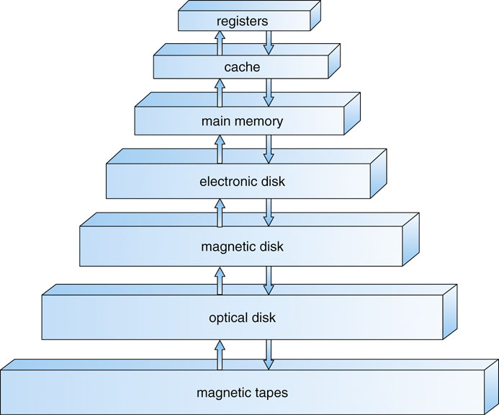
Memory Hierarchy
Ideal speed
Memory = Processor
Reality
Fast memory = $$$
Memory tradeoff
Speed
Cost (and availability)
Each page in virtual address space maps to one of three locations
Physical main memory: Small, fast, expensive
Disk (backing store): Large, slow, cheap
Nothing (error): Free
Faster
Cheaper

Slide 4
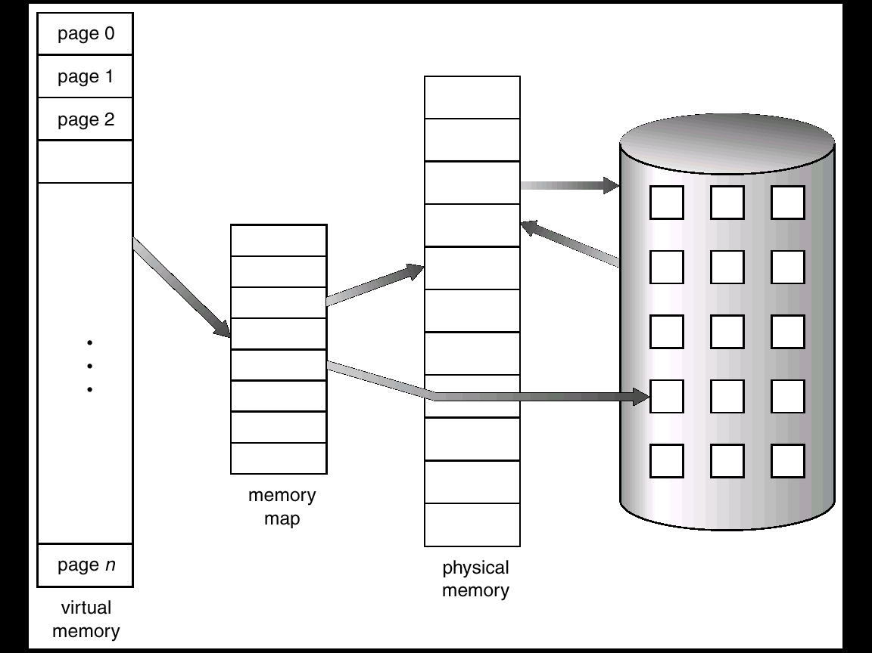
Virtual Memory
OS provides an illusion of more memory than is physically available
Large logical space but really
Small physical memory
Why does this work?
Only part of the program needs to be in memory (at any particular time) for execution
Relies on key properties of user processes (workload) and machine architecture (hardware)

Slide 5
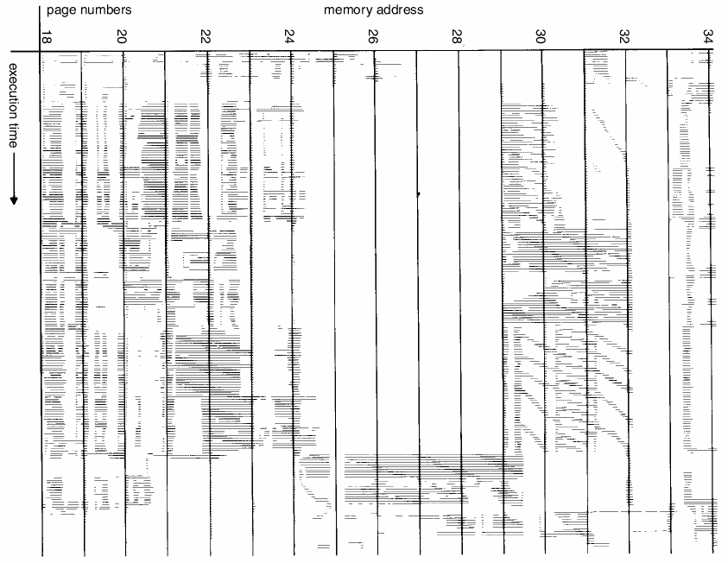
Locality

Slide 6
Observations
Sequential memory accesses of a process are predictable and tend to have locality of reference
Spatial - Reference memory addresses near previously referenced addresses (in memory)
Temporal - Reference memory addresses that have referenced in the past
Processes spend majority of time in small portion of code
Average of 90% of time in 10% of code (e.g., error code seldom executed)
Implications
Process only uses small amount of address space at any moment
Only small amount of address space must be resident in physical memory

Slide 7
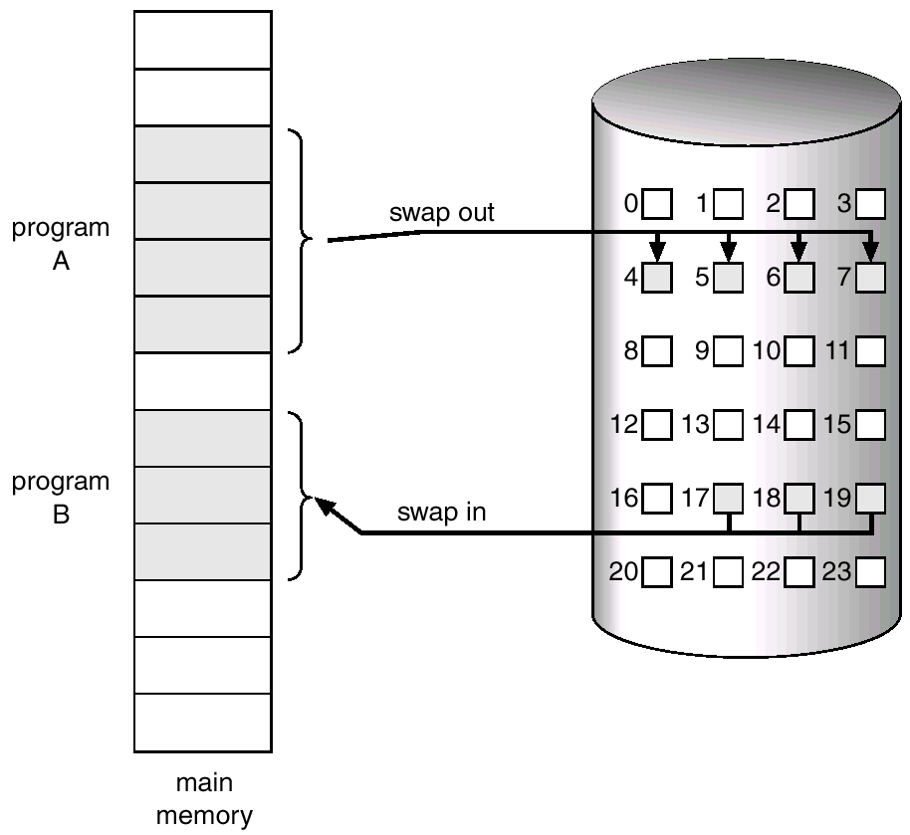
Demand Paging
Bring in pages into memory only when needed
Less memory
Only pages you need
Less I/O
Don’t need to read all pages
Faster response time
Don’t need to swap in entire process
Push unused pages out based on demand

Slide 8
Virtual Memory Intuition
Idea: OS keeps unreferenced pages on disk
Slower, cheaper (bigger) backing store than memory
Process can run even when some pages are not loaded into main memory
OS and hardware cooperate to provide illusion of large process memory
Same behavior as if all of address space in main memory
Hopefully have similar performance
Requirements
OS must have mechanism to identify location of each page in address space in memory or on disk
OS must have policy for determining which pages live in memory and which on disk

Slide 9
Virtual Address Space Mechanisms
Each page in virtual address space maps to one of three locations
Physical main memory: Small, fast, expensive
Disk (backing store): Large, slow, cheap
Nothing (error): Free
Leverage memory hierarchy of machine architecture
Each layer acts as “backing store” for the layer above
Smaller, faster and more expensive
registers
cache
main memory
Bigger, slower and cheaper
disk storage

Slide 10
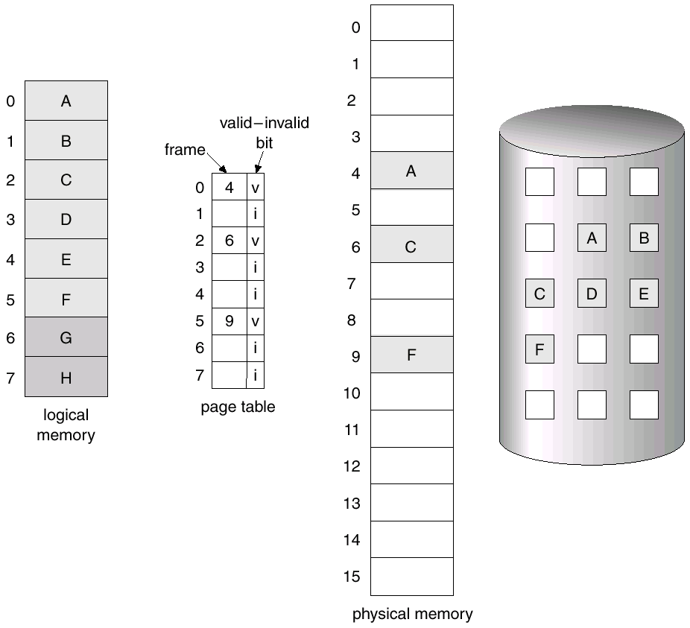
Virtual Address Space Mechanisms
Page table valid bit
Address (page #,page offset)
If valid, then normal paging
If invalid, then page fault
On page fault
Fetch page from disk to frame
Update page table

Slide 11
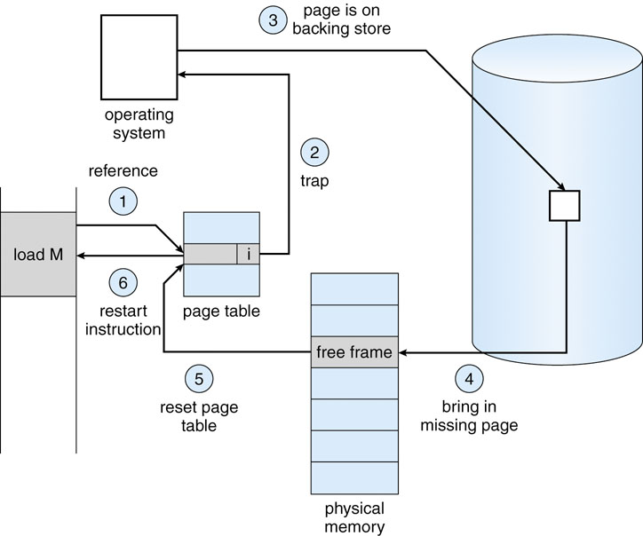
Paging Down to a Fault
swap space

Slide 12
Virtual Memory Policies
We need to decide page faults policies concerning
Page selection
When should a page (or pages) on disk be brought into memory?
Two cases
When process starts, code pages begin on disk
As process runs, code and data pages may be moved to disk
Page replacement
Which resident page (or pages) in memory should be pushed out to disk when physical memory is exhausted?
Goal: Minimize number of page faults
Page faults require milliseconds to handle (Disk I/O)
Plenty of time for OS to make good decision

Slide 13
Page Selection
When should a page be brought from disk into memory?
Request paging: User specifies which pages are needed for process
Problems
Manage memory by hand
Users do not always know future references
Users are not impartial
Demand paging: Load page only when page fault occurs
Intuition: Wait until page must absolutely be in memory
When process starts: No pages are loaded in memory
Advantage: Less work for user
Disadvantage: Pay cost of page fault for every newly accessed page

Slide 14
Page Selection
Prepaging (anticipatory, prefetching): OS loads page into memory before page is referenced
OS predicts future accesses (oracle) and brings pages into memory ahead of time
How?
Works well for some access patterns (e.g., sequential)
Advantage: May avoid page faults
Problems: May force out needed page for no reason
Hints: Combine demand or prepaging with user-supplied hints about page references
User specifies: may need page in future, don’t need this page anymore, or sequential access pattern, ...
Example: madvise() in Unix
Notes:
Is it worth it - pre-paging may cause more overhead than just serving existing overhead… I.e., it may
Not really save page faults

Slide 15
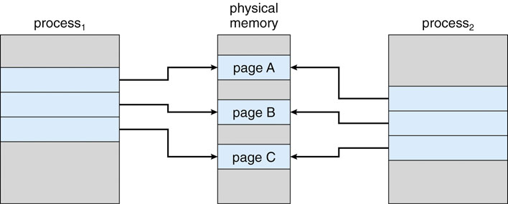
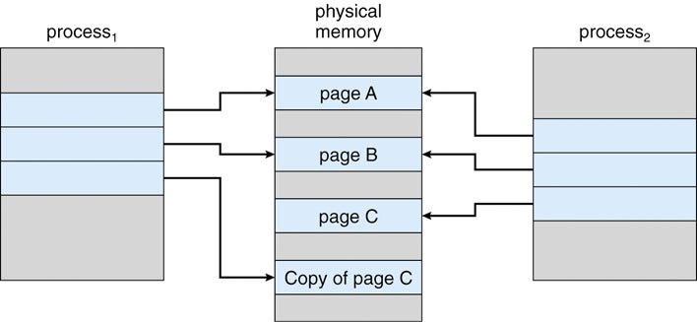
Virtual Memory Optimizations
When I fork() a process, must I copy all of the pages? It’s hard!
Copy-on-Write - On process creation, allow parent and child to share the same page in memory until one modifies the page
Shared pages on fork()
Page C copied on write

Slide 16
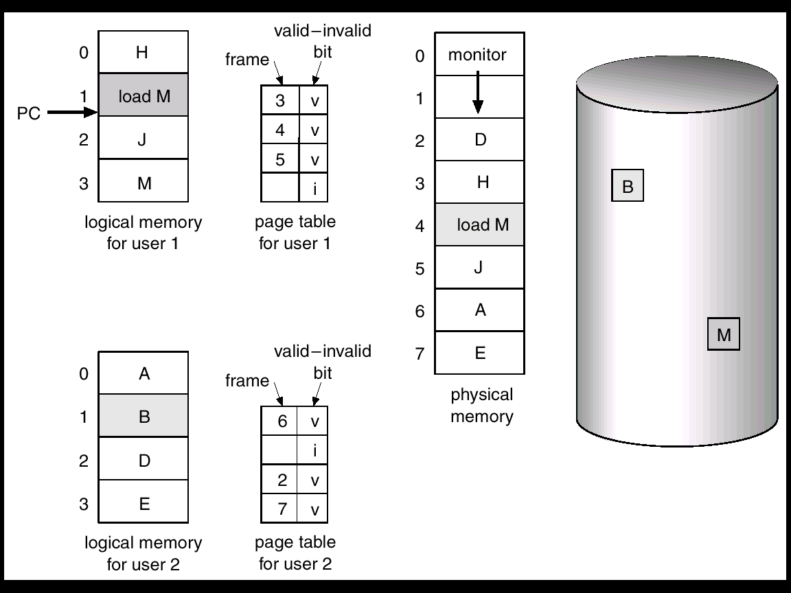
What happens if there is no free frame?
If every process has a large address space, we eventually run out of physical memory
Page replacement
Find some page in memory and swap it out
Same page may be brought into memory several times
We need M for User 1 so swap out B.
Notes:
Freeze frame song?

Slide 17
Page Replacement Algorithm
Identify page to replace (“victim”)
Optimal: Replace page not used for longest time in future
Guaranteed to minimize number of page faults
OS must predict the future
Not practical but good for comparison
Random: Replace random page
Easy to implement
Works okay when memory is not severely over-committed
Write victim page to disk
Not necessary if page hasn’t been altered since last load
Add “dirty bit” to page table entry; set if page has been altered
Write out victim page to disk if modified (dirty bit set)
If victim page is not modified (clean), just discard
Read selected page into recently vacated frame

Slide 18
Page Replacement Algorithm Evaluation
Want lowest page-fault rate
Evaluate algorithm by running it on a particular string of memory references (reference string) and computing the number of page faults on that string
Reference String: Convert address to page
Example: Assume 100 bytes per page and
Consider the address sequence
0100, 0210, 0250, 0300, 0350, 0380, 0400, 0160, 0250, 0505, 0100, 0110, 0230, 0350, 0450, 0450, 0500, 0500
Convert address to a reference string
1, 2, 3, 4, 1, 2, 5, 1, 2, 3, 4, 5
We do not include back-to-back references to the same page because it will not cause a page fault

Slide 19
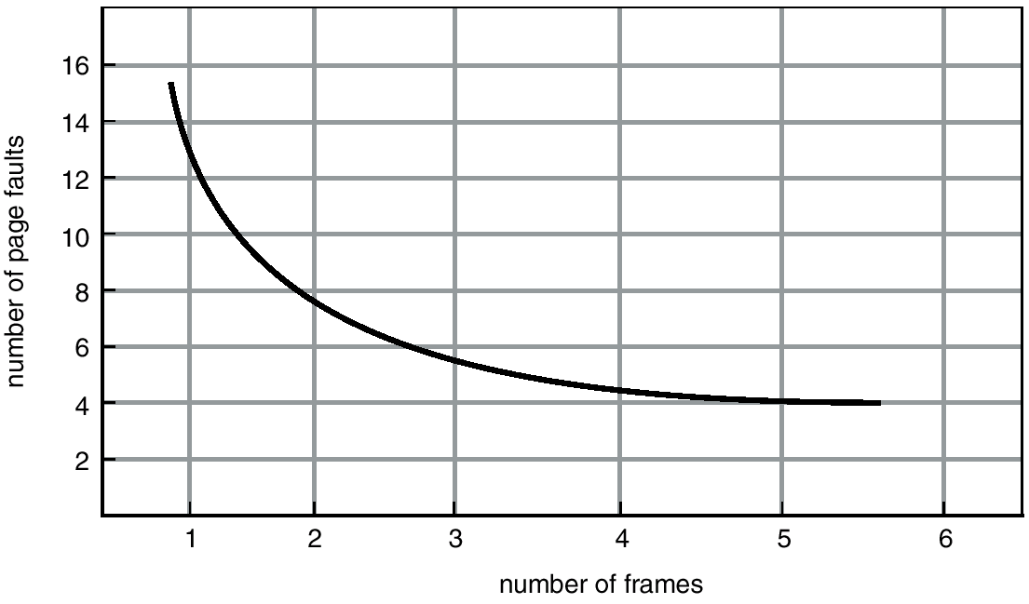
Page Replacement and Total Memory
Does increasing memory impact performance?
Ideally the numbers of page faults should should decrease as number of available frames increases
Example: 1, 2, 3, 4, 1, 2, 5, 1, 2, 3, 4, 5
If 1 page frame: Number of page faults?
12 page faults, one fault for every page (11 faults)
If 12 frames: Number of page faults?
5 page faults

Slide 20
FIFO Page Replacement
First In First Out
Replace page that has been in memory the longest
Intuition: First referenced long time ago; done with it now
Advantages
Fair: All pages receive equal residency
Easy to implement (circular buffer)
Disadvantage
Some pages may always be needed

Slide 21
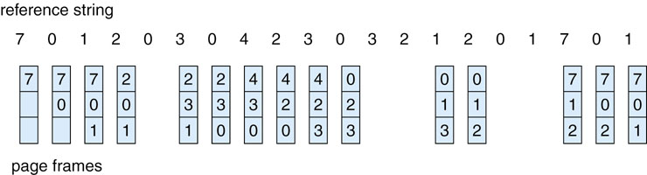
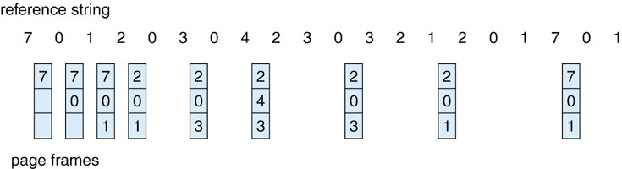
FIFO Page Replacement
Replace page that has been in memory the longest
Optimal page replacement
No Fault
No Fault
No Fault
No Fault
No Fault
No Fault
No Fault
No Fault
No Fault
No Fault
No Fault
No Fault
No Fault
No Fault
No Fault
No Fault

Slide 22
First-In-First-Out (FIFO) Algorithm Add Memory
Reference string: 1, 2, 3, 4, 1, 2, 5, 1, 2, 3, 4, 5
3 frames
1
2
3
9 page faults
4
1
2
5
3
4
4 frames
1
2
3
4
10 page faults
5
1
2
3
4
5
FIFO Replacement – Belady’s Anomaly
More frames create more page faults?!?!?!?

Slide 23
LRU Page Replacement
Least Recently Used
Replace page not used for longest time in past
Intuition: Use past to predict the future
Advantage
With locality, LRU approximates OPT
Disadvantages
Harder to implement, must track which pages have been accessed
Does not handle all workloads well

Slide 24
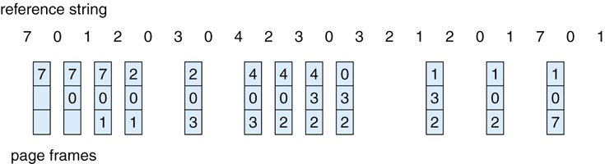
LRU Page Replacement
Replace page not used for longest time in past
No Fault
No Fault
No Fault
No Fault
No Fault
No Fault
No Fault
No Fault

Slide 25
Page Replacement Example
Page reference string: ABCABDADBCB
Three frames of physical memory
OPT
FIFO
LRU
ABC
A | B | C
A | B | C
A | B | C
A | B | D
A | B | D
A | B | D
A | B | D
C | B | D
C | B | D
A | B | C
A | B | C
A | B | C
D | B | C
D | A | C
D | A | C
D | A | B
C | A | B
C | A | B
A | B | C
A | B | C
A | B | C
A | B | D
A | B | D
A | B | D
A | B | D
C | B | D
C | B | D
A
B
D
A
D
B
C
B
Compare number of page faults

Slide 26
Page Replacement Comparison
How does adding more physical memory impact performance?
LRU, OPT: Add more memory, guaranteed to have fewer (or same number of) page faults
FIFO: Add more memory, usually have fewer page faults
Belady’s anomaly: May actually have more page faults!

Slide 27
Implementing LRU
Software Perfect LRU
OS maintains ordered list of physical pages by reference time
When page is referenced: Move page to front of list (top)
When need victim: Pick page at back of list (bottom)
Trade-off: Slow on memory reference, fast on replacement
Hardware Perfect LRU
Associate register with each page
When page is referenced: Store system clock in register
When need victim: Scan through registers to find oldest clock
Trade-off: Fast on memory reference, slow on replacement (especially as size of memory grows)
In practice, do not implement LRU precisely
LRU is an approximation anyway, so approximate more
Goal: Find an old page, but not necessarily the very oldest

Slide 28
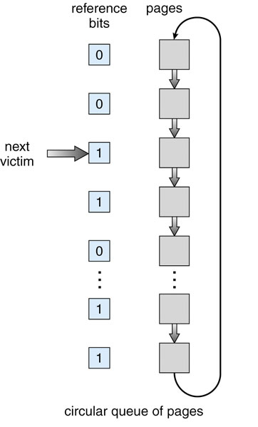
Clock Algorithm
LRU is expensive so we approximate
One approximation is the Clock Algorithm
Setup
Keep reference bit for each page frame initialized to 0
When page is referenced, set reference bit (1)
Organized allocated pages in a circular list
Keep a pointer to next victim frame
Page replacement
Start search at the next victim frame
If reference bit set, clear it and continue
Stop at page with already cleared use bit and replace this page
Also called the Second-Chance Algorithm because a set use bit gives a page a 2nd chance

Slide 29
Problems with LRU-based Replacement
Example: 2, 1, 3, 2, 4, 2, 4, 1, 5, 6, 2, …
Problem
Dislodges warm pages if a long sequence of one time page references occur.
EX: Page 2 may get dislodged by the access pattern …, 4, 1, 5, 6,
LRU does not consider frequency of accesses
Is a page that has been accessed once in the past as likely to be accessed in the future as one that has been accessed N times?
Solution: Track frequency of accesses to page
LFU (Least Frequently Used) replacement
But LFU can never forget pages from the far past…

Slide 30
Combine LRU and LFU
LRU-K: Combines recency and frequency
Idea
Keep time of last K references for each page
Remove page with oldest Kth reference time
If only one page has fewer than K references, remove it
If multiple pages have fewer than K references, use LRU
LRU-1 is the classic LRU
Expensive to implement; LRU-2 used in databases

Slide 31
Allocating Memory Across Processes
Problem
2 processes and 25 free frames
How are the frames divided up?
Three General Approaches
Global Replacement
Per-Process Replacement
Per-User Replacement

Slide 32
Global Replacement
Pages from all processes lumped into single replacement pool
Example: Run clock over all page frames
Each process competes with other processes for frames
Advantages
Flexibility of allocation
Minimize total number of page faults
Disadvantages
One memory-intensive process can hog memory, hurting all processes
Paging behavior of one process depends on the behavior of other processes

Slide 33
Per-process replacement
Per-process free pool of pages
Equal, Fixed Allocation
Fixed number of pages per process or fraction of physical memory
100 frames and 5 processes, give each 20 pages
Proportional Allocation
Proportional to size of address space
Adjust size allocated if a process have higher priority
Page fault in one process only replaces frame of that process
Advantage: Relieves interference from other processes
Disadvantage: Potentially inefficient allocation of resources

Slide 34
Per-User Replacement
Advantages: Users running more processes cannot hog memory
Disadvantage: Inefficient allocation

Slide 35
Over Committing Memory
When does the virtual memory illusion break?
Example
Set of processes frequently referencing 33 important pages
Physical memory can fit 32 pages
What happens? System Repeat Cycle
Reference page not in memory
Replace a page in memory with newly referenced page
Replace another page right away again, since all its pages are in active use…

Slide 36
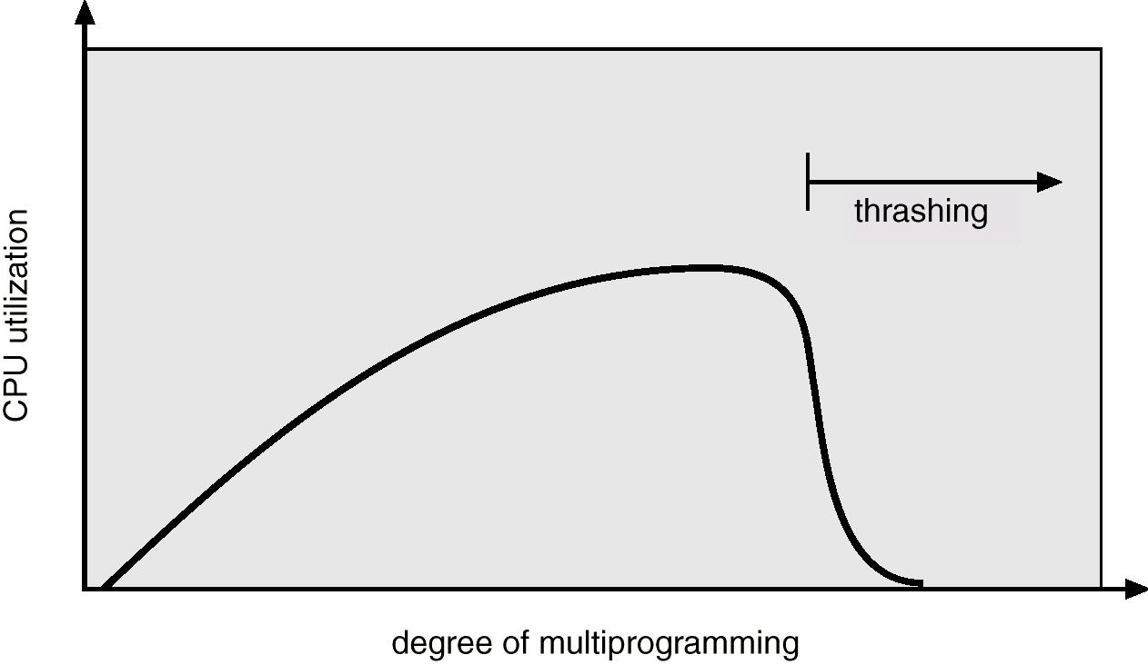
Thrashing
Defn: Process spends more time paging than execution (i.e., system reading and writing pages instead of executing useful instructions)
Average memory access time equals to disk access time
Illusion breaks: Memory appears slow as disk rather than disk appearing fast as memory
Adding more processes makes thrashing worse

Slide 37
The OS Thrasher
If a process does not have “enough” pages, the page-fault rate is very high. This leads to
Low CPU utilization
Operating system thinks that it needs to increase the degree of multiprogramming
Another process added to the system
Why the CPU utilization decreases
Suppose a process need more frames, starts faulting, removing frames from others, in turn making the other processes fault
Processes queue up for the paging device; CPU decreases
OS adds processes that immediately need new frames further taking away pages from running processes

Slide 38

Thrashing: Solutions
Limit thrashing using local replacement frame allocation
Process does not steal frames from other processes, causing them to thrash
Average service time for a page fault will still increase as paging queue lengthens
Admission Control
Determine how much memory each process needs
Long-term scheduling policy
Run only processes whose memory requirement can be satisfied
What if memory requirement of one process is too high?
Observation: A process moves through different ``localities’’ through out is lifetime
Locality - Set of pages that are actively used together
Solution: Allocate enough pages for current locality
How many pages are in the current locality…

Slide 39
Motivation for Solution
Thrashing cannot be fixed with better replacement policies
Page replacement policies do not indicate that a page must be kept in memory
Only show which pages are better than others to replace
Student’s analogy to thrashing: Too many courses
Solution: Drop a course
OS solution: Admission control
Determine how much memory each process needs
Long-term scheduling policy
Run only those processes whose memory requirements can be satisfied
What if memory needs of one process are too large?

Slide 40
Working Set
Informal definition
Collection of pages the process is referencing frequently
Collection of pages that must be resident to avoid thrashing
Formal definition
Assume locality; use recent past to predict future
Pages referenced by process in last T seconds of execution
Working set changes slowly over time
Example
Δ = 8
Time
A A B C B B B C D C D E B B E E D F B F D B B E D B
A B C
B D E F

Slide 41
Balance Set
Motivation: Process should not be scheduled unless working set is resident in main memory
Divide runnable processes into two groups
Active: Working set is loaded
Inactive: Working set is swapped to disk
Balance set: Sum of working sets of all active processes
Interaction with scheduler
If balance set exceeds size of memory, move some process to inactive set
Which process?
If balance set is less than size of memory, move some process to active set
Which process?

Slide 42
Working Set Implementation
Leverage use bits (as in clock algorithm)
OS maintains idle time for each page
Amount of CPU received by process since last access to page
Periodically scan all resident pages of a process
If use bit is set, clear page’s idle time
If use bit is clear, add process CPU time (since last scan) to idle time
If idle time < T, page is in working set

Slide 43
Unresolved Questions
How should value of T be configured?
What if T is too large? Too small?
How should working set be defined when pages are shared?
Put jobs sharing pages in same balance set
What processes should compose balance set?
How much memory needed for a “balanced system”?
Balanced system: Each resource (e.g., CPU, memory, disk) becomes bottleneck at nearly same time
How much memory is needed to keep the CPU busy?
With working set approach, CPU may be idle even with runnable processes

Slide 44
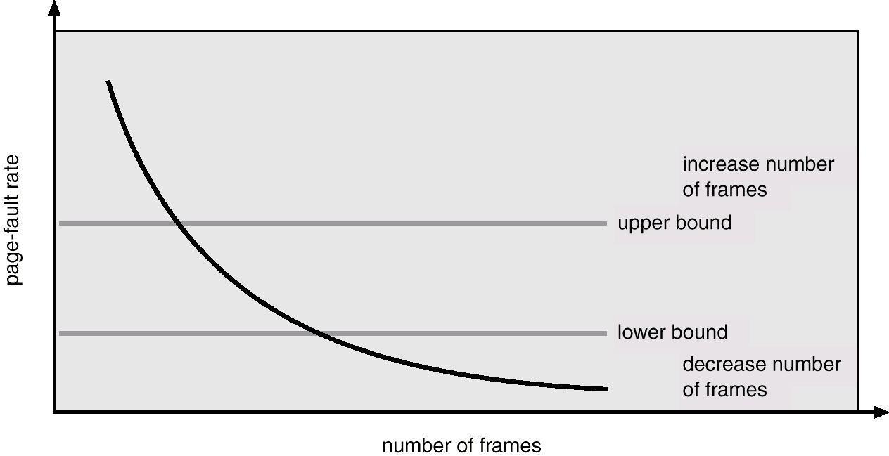
Page-Fault Frequency (PFF) Scheme
Maintaining working set is complex and expensive
Observation: Thrashing has a high page-fault rate
Idea: Control page fault-rate by controlling # frames that are allocated to a process
Too high page fault rate: Process needs more frames
Too low: Process has too many frames
Approach: Establish “acceptable” page-fault rate (upper and lower bound)
If actual rate falls below lower limit, process loses frame.
If actual rate exceeds upper limit, process gains frame.

Slide 45
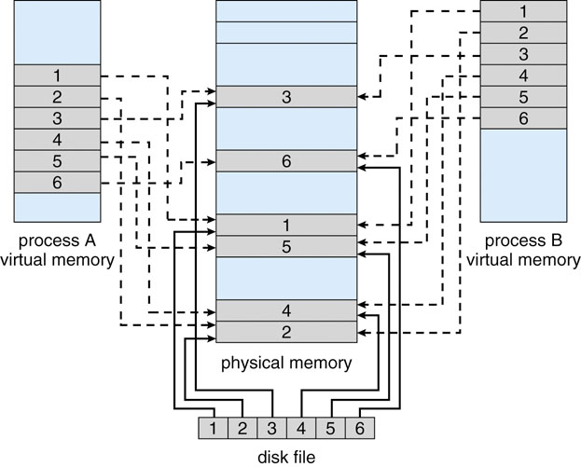
Memory-Mapped Files
If the OS can pretend that file access is just memory access, can we?
No…Just kidding
We can use memory mapping on a file

Slide 46
Memory-Mapped I/O
mmiofill.c – Fills file with person records
filesrch.c – Randomly searches file for records using file seek
mmiosrch.c – Randomly searches using memory-mapped I/O
Compare execution times for file vs/ mmiosrch
Why is one faster? Compare strace

