Slide 1
File System Implementation

Slide 2
File Systems
We know about interfacing with file systems through abstractions like files, directories, and links
How do you implement a file system?

Slide 3
Efficient I/O is Important
Applications have two essential components
Processing
Input/Output (I/O)
I/O performance limits application performance

Slide 4
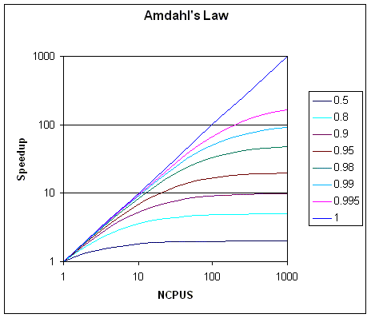
I/O vs. Application Performance
Amdahl’s Law: Continually improving only part of application (e.g., processing) achieves diminishing returns in speedup
Example: infinite speedup and affect only 15% of the overall task roughly: 1/(1-0.15) = 1.18 times faster is max!
f: portion of application that is improved (e.g., processing)
Speedup_{f} - speedup of portion of application
Speedup_{app} = 1/((1-f) + (f/speedup_{f}))
Examples:
f = .15, speedup_{f} = 2, speedup_{app} = 1.08
f = 1/3, speedup_{f} = 2, speedup_{app} = 1.20
f = 1/2, speedup_{f} = 2, speedup_{app} = 1.33
Example: When only 10% of the application is sequential the maximum speedup using infinite number of processors is 10.

Slide 5
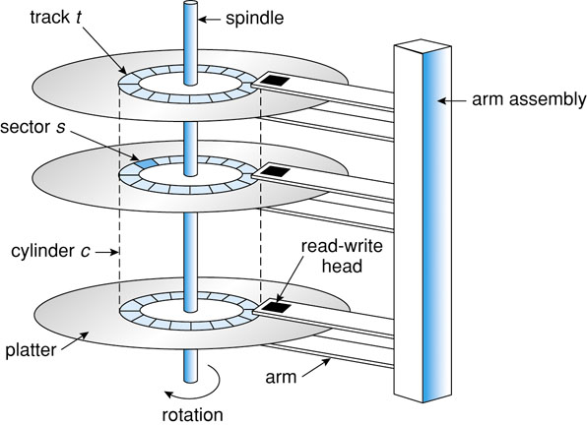
On the Down Low (Level)
Block – Minimum unit to read/write
Block is made up of one or more sectors
Typical size = 512 bytes
Partition – Subdivision of disk

Slide 6
Disk Structure
Partition – Subdivision of disk
Partition Table (PT) – Map of disk partitions
File System - Structure for storing files on storage device (e.g., hard disk)
Volume – Entity containing a file system
May be partition, disk, or multiple disks/partitions
Disk
MBR | PT | Partition 1 | Partition 2

Slide 7
File System
Master Boot Record (MBR) – Executed at boot
Boot Block – First block of partition that MBR executes to boot OS
Volume Block – Information about file system including type, size (in blocks), etc.
Disk
MBR | PT | Partition 1 | Partition 2
Boot Block | Volume Block (Superblock) | Files, Directories, Free Space, etc.

Slide 8
File Allocation
Remainder of partition made up of blocks
Must allocate blocks to file
Which blocks do I assign to a file?

Slide 9
Contiguous Allocation
Allocate each file to contiguous blocks on disk
Meta-data: Starting block and size of file (base & bound)
OS allocates by finding sufficient free space
Must predict future size of file. Should space be reserved?
Examples: IBM OS/360, CDROMS, DVDs
Advantages
Little overhead for meta-data
Excellent performance for sequential accesses
Simple to calculate random addresses
Disadvantages
External fragmentation (Requires periodic compaction)
Internal fragmentation (Must preallocate in anticipation of future size)
May not be able to grow file without moving it
A
A
A
E
E
B
B
B
B
C
C
C
Free E
A
A
A
B
B
B
B
C
C
C

Slide 10
Extent-Based Allocation
Multiple contiguous regions (extents) per file
Meta-data: Small array (2-6) designating each extent
Each entry: Starting block and size
Improves contiguous allocation
File can grow over time (until run out of extents)
Helps with external fragmentation
Advantages
Limited overhead for meta-data
Very good performance for sequential accesses
Simple to calculate random addresses
Disadvantages
External/Internal fragmentation can still be a problem
Not able to grow file when run out of extents
D
A
A
A
D
D
B
B
B
B
C
C
C
B
B

Slide 11
Linked Allocation
Allocate linked-list of fixed-sized blocks
Meta-data: Location of first (fixed-size) block of file
Each block also contains pointer to next block
Advantages
No external fragmentation
Files can be easily grown (no limit)
Disadvantages
Cannot calculate random addresses w/o reading previous blocks
Sequential bandwidth may not be good (contiguous allocation?)
Pointer overhead
Use cluster of blocks for list element
Tradeoff: Increases internal fragmentation but can decrease seek time
Reliability – Damaged pointer
Use doubly linked list
Trade-off: Block size (does not need to equal sector size)
Larger ⇒ ?? , Smaller ⇒ ??
D
D
A
A
A
D
B
B
B
B
C
C
C
B
B
D
B
D

Slide 12
File-Allocation Table (FAT)
Problem: Linked Allocation must read to find next block (slow)
Idea: Keep linked-list information for all files in on-disk FAT table
Meta-data: Location of first block of file
FAT located at beginning of each partition
Indexed by block number
Entry contains block number of next entry
Comparison to Linked Allocation
Advantage: Random access improved because disk head can read location in FAT
Disadvantage: Read from two disk locations for every data read (FAT + actual block)
Optimization: Cache FAT in main memory
Advantage: Greatly improves random accesses
Still very hard to access random file blocks
FAT
Directory Table
0
A | 4
B | 6
… | …
1
2
10
3
11
4
7
5
6
3
7
Physical Block
2
8
9
10
12
11
14
12
-1
13
14
-1
15
File A: Links of Physical Blocks
4
7
2
10
12
File B: Links of Physical Blocks
6
3
11
14

Slide 13
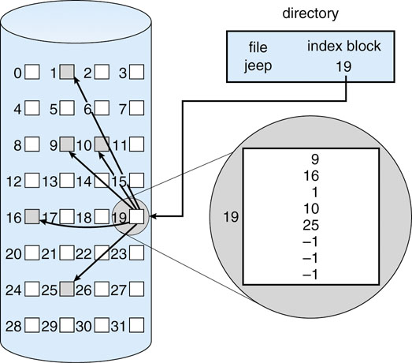
Indexed Allocation
Allocate fixed-sized blocks for each file
Meta-data: Fixed-sized array of block pointers
Allocate space for ptrs at file creation time
Directory Entry: Address of index block
Advantages
No external fragmentation (fixed sized blocks)
Supports random access
Disadvantages
Waste of space (more than linked list)
A one block file needs an ENTIRE additional block for the index
Implementation Issues
How big should an index block be?
Too small: Limits file size
Too big: Wastes pointer space
How do we accommodate very large files?

Slide 14
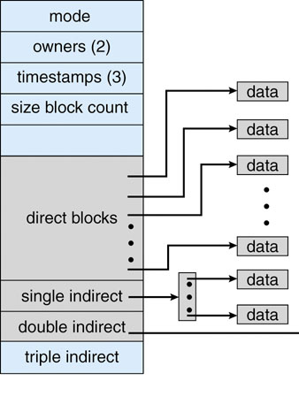
Multi-Level Indexed Files
What if index block is too small?
Linked-list of index blocks
Multilevel index
Index blocks points to set of index blocks
Combined
Mix of pointers to data and index blocks
Tradeoff
Advantage
Can have smaller blocks (reduced internal fragmentation) while still supporting large files
Still fast access for small files
Disadvantage
Need to read indirect blocks of pointers to calculate addresses (extra disk read)
Keep indirect blocks cached in main memory
UNIX inode

Slide 15
Unix i-nodes
If data blocks are 4K …
First 48K reachable from the inode
Next 4MB available from single-indirect
Next 4GB available from double-indirect
Next 4TB available through the triple-indirect block
Any block can be found with at most 3 disk accesses

Slide 16
Directory Implementation
Now we can implement a file but…
Directory – Maps filename to
First block (contiguous and linked-list) or index node
Attributes
So directories are just data, and we already have files that can store data…
Idea: Put directory information in a file

Slide 17
Directory File Format
Map filename to information
Linear List of <name, metadata> pairs
Advantage: Simple with little overhead
Disadvantage: Slow with gaps created in list by deletion
Hash Table mapping name to metadata
Advantage: Faster
Disadvantage: Complex (e.g., collision, table size) and overhead (e.g., chain pointers, empty table space)
Filename length
Fixed: Easy but either too small/big
Variable-Length: Allows long names but complex (e.g., name space (de)allocation)
Notes:
11 (DOS), 14 (UNIX), 255

Slide 18
UNIX Directory Structure
A directory “file” is a sequence of lines; each line holds an i-node number (index-node) and a file name
The data is stored as binary so we cannot simply cat to view it, but some UNIXs allow an “octal dump” (other formats also available) :
895690 | “.”
288767 | “..”
287243 | “csdep.html”
287259 | “baylor.txt”
od -c .
0000000 \0 \r 252 312 \0 \f \0 001 . \0 \0 \0 \0 004 g 377
0000020 \0 \f \0 002 . . \0 \0 \0 004 b 013 \0 024 \0 \n
0000040 c s d e p . h t m l \0 \0 \0 004 b 033
0000060 \0 024 \0 \n b a y l o r . t x t \0 \0

Slide 19
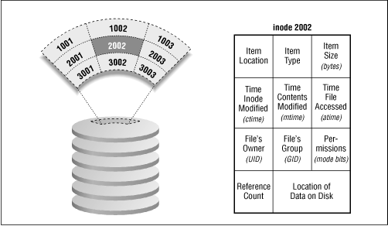
Directory Implementation
Directory system function: Maps string names onto what is needed to locate the data
Where do we store the file attributes?
A simple directory: fixed sized entries attributes stored with the entry
Directory in each entry just refers to an i-node (UNIX implementation)
games | attributes
mail | attributes
news | attributes
work | attributes
attributes
games
mail
news
work
attributes
attributes
attributes

Slide 20
Hard Links
More general than tree structure
Add connections across the tree (no cycles)
Create links from one file (or directory) to another
Hard link: “ln a b” (“a” must exist already)
Idea: Can use name “a” or “b” to get to same file data
Implementation: Multiple directory entries point to same meta-data
link(“csdep.html”, “cpsci.html”);
895690 | “.”
288767 | “..”
287243 | “csdep.html”
287259 | “baylor.txt”
895690 | “.”
288767 | “..”
287243 | “csdep.html”
287259 | “baylor.txt”
287243 | “cpsci.html”

Slide 21
Seeing Hard Links
Compare status information
% ls -l file_a file_b file_c
-rw-r--r-- 2 fendt 36 May 24 10:52 file_a -rw-r--r-- 2 fendt 36 May 24 10:52 file_b -rw-r--r-- 1 fendt 16 May 24 10:55 file_c
File mode, # links, owner’s name, #bytes, date, pathname
Look at i-node number
% ls -i file_a file_b file_c 3534 file_a 3534 file_b 5800 file_c
Directories may appear to have more links
% ls -ld dir
drwxr-xr-x 2 fendt users 68 Apr 7 17:57 dir/
% mkdir dir/hello
% ls -ld dir
drwxr-xr-x 3 fendt users 68 Apr 7 17:58 dir/
This is because subdirectories (e.g., directories inside dir/)have a link back to their parent

Slide 22
Symbolic Links
A hard link is a pointer to a file which must be on the same file system
A symbolic link is an indirect pointer to a file
Stores the pathname of the file that it points to
Symbolic links can link across file systems
Symbolic links are listed differently
% ln -s dir ~/unix/d/Sdir
% ls -lFd dir ~/unix/d/Sdir
lrwxr-xr-x 1 fendt faculty 3 1 Apr 21:51 /home/fendt/unix/d/Sdir@ -> dir
drwxr-xr-x 3 fendt faculty 102 1 Apr 21:39 dir/

Slide 23
Removing a Link
Removing or deleting a link does not necessarily remove the file (why?)
Only when the file and every link is gone will the file be removed

Slide 24
Free-Space Management
Need to reclaim space from deleted files
Keep a free space list of blocks
Free list implementations
Bit Vector
Linked Lists

Slide 25
Bit Vector
Represent the list of free blocks as a bit vector, 1 bit/block
111111111111111001110101011101111...
If bit i = 0 then block i is free, if i = 1 then it is allocated
Disadvantages
The vector can be large, 17.5 million elements for a 9 GB disk with 512B blocks (2.2 MB worth of bits)
Advantages
Simple
Fast (if vector in memory)
Easy to find sets of contiguous blocks

Slide 26
Linked List
Keep linked list of free blocks
Grouping
Store addresses of first n free blocks in first free block
Nth free block contains address of next n free blocks
Counting
Observation: Blocks freed in contiguous chunks
Idea: First block of contiguous chunk contains 1) count of free blocks in chunk and 2) pointer to next free chunk
F
F
F
F
F
F
F
F
F
F
F
F
F(3)
F
F
F(2)
F
F(1)

Slide 27
Defragmentation
File blocks can be allocated anywhere
I/O performance is better when file blocks are contiguous
Over time as files are deleted, free blocks become more distributed across disk with fewer contiguous free block sequences
Defragmentation involves moving data around so file blocks are contiguous
More free space provides faster and better defragmentation
Some files cannot be moved so defragmentation is not perfect
A1 | B2 | C3 | B3 | C4
 | A4 |  |  | A3
 | C5 | B4 | B5 | C6
B1 |  | A2 |  | C2
 | C1
A1 | A2 | A3 | A4 | C4
 | C5 | B4 | B5 | C6
B1 |  |  |  | C2
 | C1 | B2 | C3 | B3

Slide 28
File System Consistency
I’m creating a new file…
Add new file to directory file data
Get 2 blocks from free list (inode and data block)
Add block to inode
Write data to block
System crash before blocks are written?
inode? directory? free list?
Leads to inconsistency in file system
fsck (UNIX) & scandisk (Windows) check consistency
Check
Block Consistency
File Consistency

Slide 29
File System Consistency
Block consistency uses two block tables
File Blocks – # times a block in a file
Read all inodes incrementing block counters
Free Blocks - # times a block in the free list
Read all blocks in free list
Consistent state if block is in exactly one table
File consistency uses one table
Counts number of references to a file
Recursively searches directory
Increments file counter for each inode found
Compares final count to inode count (hard links)
Scenarios: Inode count
High – Last reference delete does not deallocate file (wastes space)
Low – Premature deletion

Slide 30
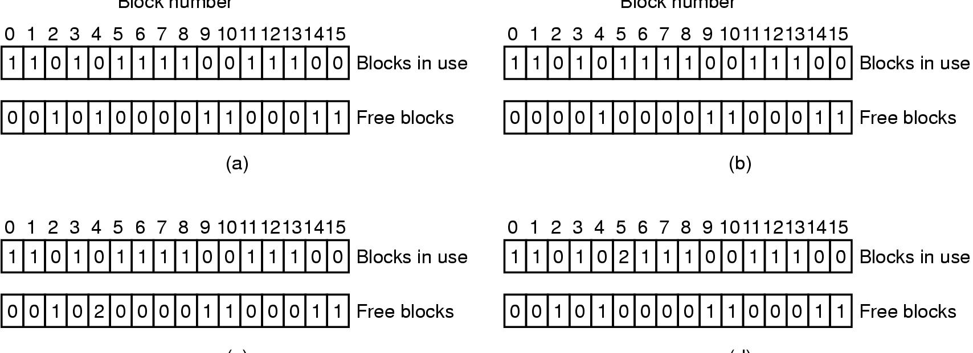
Examples: Inconsistent States
File system states
Consistent
(b) Missing block (2) - No harm; wasted space; add to free list
(c) Duplicate block in free list (4) - Rebuild free list
(d) Duplicate data block (5) - If either files are removed, block will be on free list, leading to situations where block is in both free list and USE list, if both are removed, block in free list twice
ACTION: allocate new block to copy block 5 into it, insert copy in one of the files

Slide 31
Caching
Cache blocks for faster read access
Handling writes with cache?
Synchronous – Writes go all the way to disk
Asynchronous – Update cache; flush later
Asynchronous performs better, but vulnerable to loss if system crashes before flush
Try removing a USB drive prior to flush!
Solution: Critical meta (e.g., inodes) and application (e.g., database) data written synchronously
Read-ahead – Assume block locality so if block K is read then preemptively read block K+1

Slide 32
Journaling File Systems
Consider removing a file
Remove file from directory
Release inode
Release disk blocks
Crash creates inconsistency
Solution
Log actions before you attempt them
Recover system by inspecting logs
Examples include Linux ext3 and Windows NTFS

Slide 33
Backup Questions
Why backup?
What to backup?
OS? CD in drive? Swap space? Special files? Pipes?
Which blocks to backup?
Full – All data (big & time-consuming)
Incremental – Only changed data (fast dump but more complex recovery)
How to backup?
Physical – Block-by-block
Can perfectly restore
Wastes space by dumping free/bad blocks
Logical – Recursively dump files/directories
When to backup a file during backup operation?
On active system, files are constantly changing
Backup may take hours, but I cannot halt operations
Snapshot – Copies critical structures and requires changes to copies of blocks instead of originals

Slide 34
Network File Systems (NFS)
Allow transparent use of remote file system
Mounting - Attaching a remote file system
Mount Point
UNIX mounts into single hierarchy wind% ls /usr/local Acrobat config info jdk1.5.0_05 nagios share Acrobat4 disable j2sdk1.4.0 jdk1.6.0 nusmv spin … wind% df … brick.ecs.baylor.edu:/export/local/x86.linux 50% /usr/local …
Issues
Permissions
Cascading mounts (mount system that mounts....)

