Slide 1


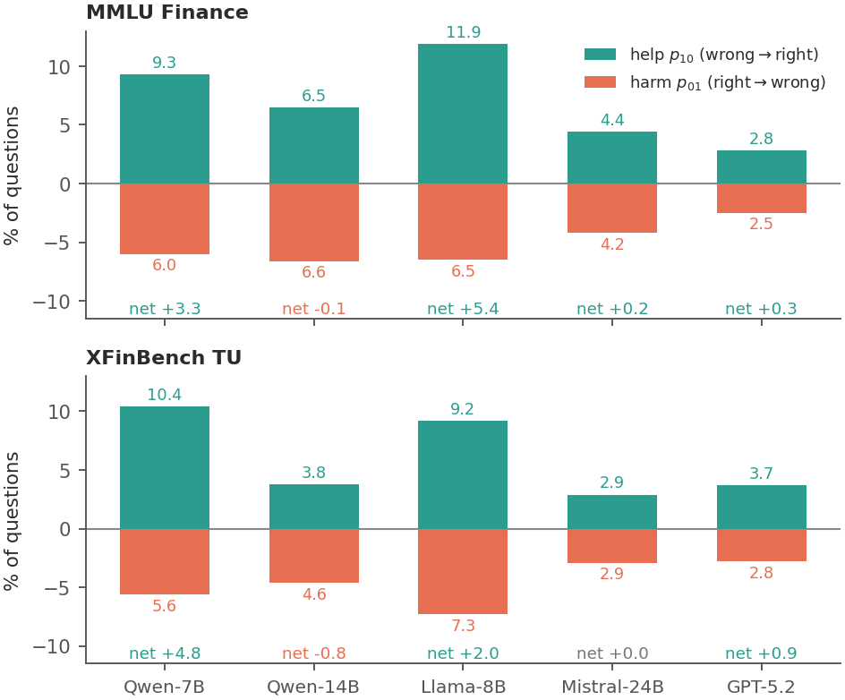
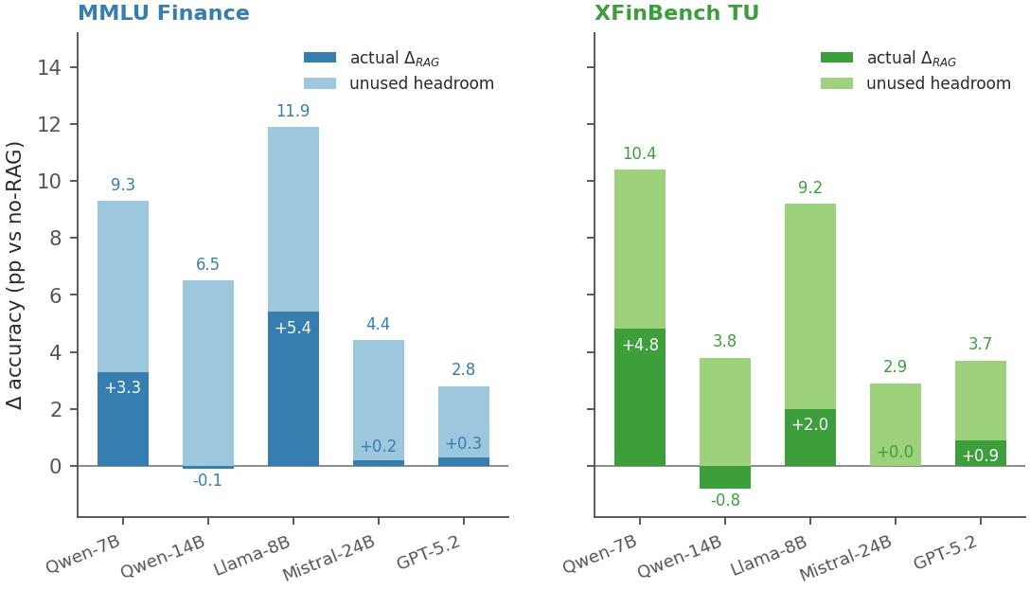
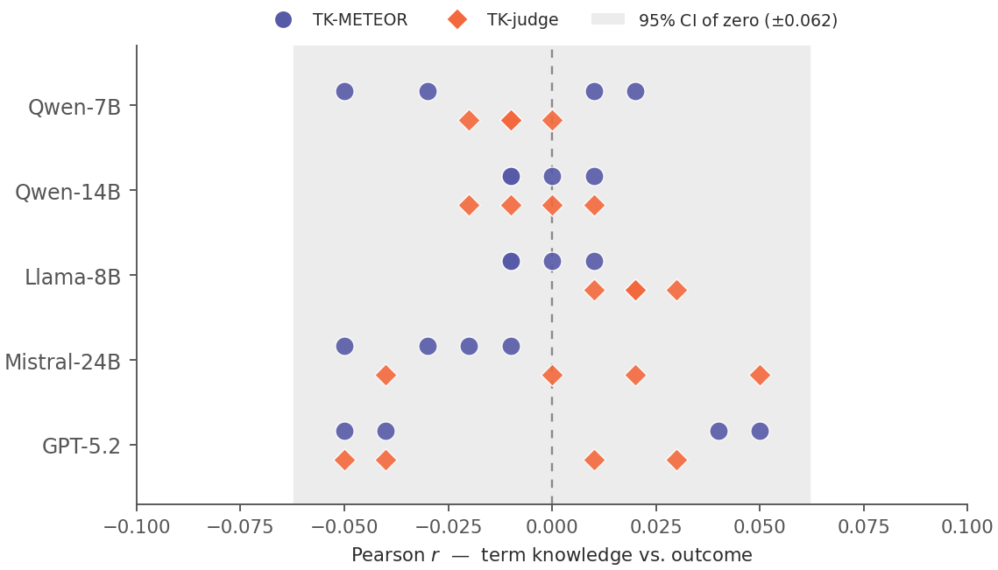
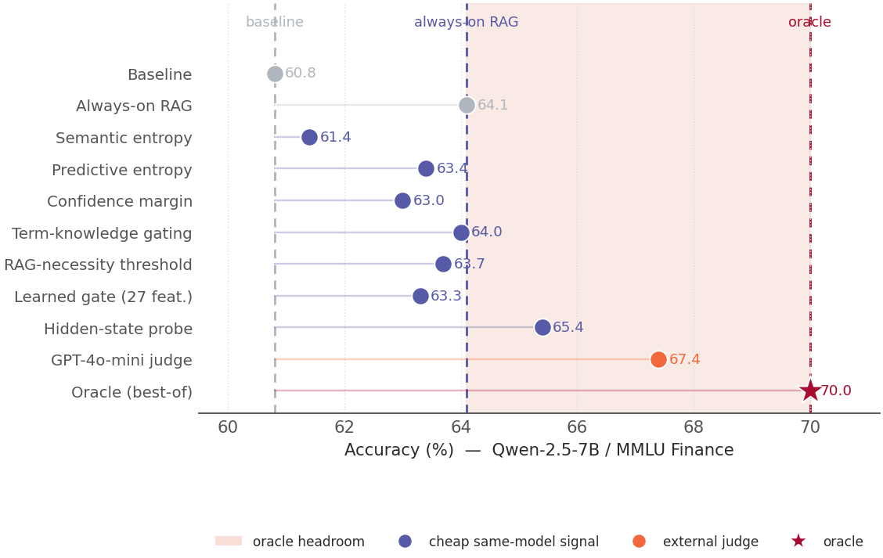
Definition-Only RAG for Financial QA:
Average Gains and a Diagnostic Boundary
Leyi Ouyang, Edison Marrese-Taylor, Yutaka Matsuo
The University of Tokyo
Findings of EMNLP 2026
Introduction
Related work
The failure mode. A model can miss a specialized question for no reason other than not knowing what one term means. Qwen-2.5-7B answers American Depositary Receipt where the answer is Guilder Share. One sentence of Investopedia flips it.
Why a glossary definition. It is the smallest and most auditable payload a retriever can inject, and the only one whose content can be checked term by term.
Definition modeling
probes what a model has internalized about a domain.
  Noraset et al. 2017; Gardner et al. 2022
  Finance: Jhirad et al. 2023. Multilingual: Marrese-Taylor et al. 2025
Scale has not removed it. On MMLU finance subjects a frontier model still misses one question in eight; 7–8B models miss 40–50%.
Two operational levels. One signal, term knowledge: a diagnostic of what a model holds, and the control for a selective retrieval policy.
Selective and adaptive RAG
assumes some observable property of the question or model state carries enough signal to route between retrieve and no-retrieve.
  Lewis et al. 2020; Asai et al. 2024; Jeong et al. 2024
RQ1 Does injecting a retrieved definition improve financial QA on average?
RQ2 Can the model’s own term knowledge say, per question, whether it is needed?
Uncertainty-style routing baselines
Semantic entropy (Farquhar et al. 2024) and option-margin signals.
  Wang et al. 2024: first-token MCQ scoring can disagree with the model’s final text answer.
We test the narrowest version of that assumption in finance, using definition-level term knowledge, the most semantically transparent candidate signal this domain offers.
Method and Data
Diagnostic. The model writes the definition itself. Measures what it already holds, no retrieval.
Retrieval pipeline. A lexical retriever and a dense sentence-encoder each propose candidates from a fixed glossary of 13,609 Investopedia terms, the two ranked lists are fused, a cross-encoder reranks them, and the top-3 snippets are injected above the question stem. Option letters are scored by log-probability at temperature 0, fixed across every experiment.
Resource | Size | Role
Investopedia glossary | 13,609 | index + reference
MMLU Finance | 1,124 q | primary benchmark
XFinBench TU | 1,790 q | replication
Term annotation | 995 q | per-question map
Invented terms | 50 | memorisation control
Interventional. We supply gold definitions through retrieval and measure what changes downstream.
Model panel. Qwen-2.5-7B and 14B, Llama-3.1-8B, Mistral-Small-24B, GPT-5.2: four families from 7B to a frontier closed model, so a capability-dependent effect is separable from a universal one.
Paired evaluation. Every question is answered twice, with the definitions and without, so each lands in one of four states: correct in both, fixed, broken, or wrong in both. Net gain is the fix rate minus the break rate, and an oracle that retrieved only where it helps would collect the fixes without paying the breaks.
Table 1. The glossary, the two benchmarks, and the resources derived from them.
Per-question term annotation. No MMLU–Investopedia mapping existed, so we built one. Two LLM annotators proposed candidates (κ = 0.76); the first author adjudicated all 2,233 pairs by hand, leaving 995 term-bearing questions.
Results
Definition-only retrieval helps on average, and the gain is confined to a mid-capability band on both benchmarks.
The split follows neither size nor family. No stalling model gains even in its own weakest term-knowledge quartile.
The gain is the definition, not leakage. Only 20 of 3,228 injected snippets contain a full answer string, and removing them changes nothing.
Model | Base | +RAG | Δ
MMLU Finance (n = 1,124)
Qwen-2.5-7B | 60.8 | 64.1 | +3.3
Qwen-2.5-14B | 68.2 | 68.1 | −0.1
Llama-3.1-8B | 52.1 | 57.6 | +5.4
Mistral-S-24B | 72.3 | 72.5 | +0.2
GPT-5.2 | 87.8 | 88.1 | +0.3
XFinBench TU (n = 1,790)
Qwen-2.5-7B | 70.5 | 75.3 | +4.8
Qwen-2.5-14B | 77.7 | 76.8 | −0.8
Llama-3.1-8B | 61.5 | 63.5 | +2.0
Mistral-S-24B | 78.9 | 78.9 | ±0.0
GPT-5.2 | 87.6 | 88.5 | +0.9
Condition | Acc. | vs RAG
No RAG (baseline) | 60.8 | −2.9
RAG (as reported) | 63.7 | —
drop answer-matching | 63.7 | ±0.0
mask all term names | 61.9 | −1.8
Invented terms (n = 50, unmemorisable)
GPT-5.2 | 36.0 → | 100.0
Qwen-2.5-7B | 30.0 → | 100.0
Table 3. Controls on the source of the gain.
Table 2. Accuracy with and without definition-only RAG. Coloured Δ: 95% CI excludes zero (paired bootstrap, 2,000 resamples).
Figure 1. Per-model paired-removal decomposition on both benchmarks.
A positive control. On unmemorisable terms the frontier model uses a definition as completely as the mid-capability one, so its flat Δ is not an inability to read one.
Analysis
A net of zero hides two-sided movement. Qwen-2.5-14B sits at Δ ≈ 0 while retrieval still changes 147 of 1,124 answers.
Term knowledge does not predict per question. All 40 cells lie inside |r| < 0.06 (permutation p = 0.91).
No cheap internal signal approaches the oracle.
What the three panels say. Eight signals, each swept in its own favour; only the external judge beats always-on RAG (67.4 vs 64.1, oracle 70.0), and it is itself a second and stronger model. Filtering which definitions to inject fails too. The injected text perturbs the scores assigned to the four options, and whether that helps or hurts depends on question, option set and snippet together.
Figure 2. Actual Δ against the implementable-oracle upper bound.
Figure 3. Per-question correlations as a forest plot.
Figure 4. Routing-signal accuracies against the oracle gap.
References
Thanapon Noraset, Chen Liang, Larry Birnbaum, and Doug Downey. 2017. Definition modeling: learning to define word embeddings in natural language. AAAI.
Akari Asai, Zeqiu Wu, Yizhong Wang, Avirup Sil, and Hannaneh Hajishirzi. 2024. Self-RAG: learning to retrieve, generate, and critique. ICLR.
James Jhirad, Edison Marrese-Taylor, and Yutaka Matsuo. 2023. Evaluating large language models’ understanding of financial terminology. IJCNLP-AACL.
Soyeong Jeong, Jinheon Baek, Sukmin Cho, and Sung Ju Hwang. 2024. Adaptive-RAG: learning to adapt retrieval-augmented large language models. NAACL.
Edison Marrese-Taylor, Erica K. Shimomoto, Alfredo Solano, and Enrique Reid. 2025. Multilingual definition modeling. Findings of ACL.
Sebastian Farquhar, Jannik Kossen, Lorenz Kuhn, and Yarin Gal. 2024. Detecting hallucinations in large language models using semantic entropy. Nature.
Patrick Lewis, Ethan Perez, Aleksandra Piktus, Fabio Petroni, et al.. 2020. Retrieval-augmented generation for knowledge-intensive NLP tasks. NeurIPS.
Xinpeng Wang, Bolei Ma, Chengzhi Hu, Leon Weber-Genzel, et al.. 2024. “My answer is C”: first-token probabilities do not match text answers. Findings of ACL.
Diagnosis and intervention come apart: an aggregate correlation over models licenses neither per-instance use of the same probe nor the routing built on it.
github.com/youngandlei/definition-only-rag

