Slide 1

Definition-Only RAG for Financial Question Answering
Average Gains and a Diagnostic Boundary
Leyi Ouyang, Edison Marrese-Taylor, Yutaka Matsuo
The University of Tokyo
Findings of EMNLP 2026

Slide 2
Introduction
2

Slide 3
Vocabulary Failures in Specialized QA
In a specialized domain a model often misses a question for a reason unrelated to reasoning: it does not know what one term means.
The pattern is general. A misread drug class, two confused legal doctrines and one financial ratio mistaken for another are the same failure.
Finance makes it measurable. On MMLU Finance a frontier model still misses one question in eight; 7–8B models miss 40–50%.
Finance also packages the knowledge: one Investopedia glossary, 13,609 terms, one authoritative definition per entry.
3

Slide 4
Definition Modeling, RAG, and Adaptive Retrieval
Definition modeling: the task of generating a term's definition and scoring it against a reference (Noraset et al., 2017). A definition is short and has an authoritative reference, so knowledge can be checked term by term.
Extended to finance by Jhirad et al. (2023), who report an aggregate correlation: models that define financial terms better also score better on financial benchmarks.
Retrieval-augmented generation supplies the knowledge at answer time instead of asking what the model holds (Lewis et al., 2020).
Adaptive retrieval asks when retrieval should fire, since always retrieving wastes cost and sometimes hurts (Asai et al., 2024; Jeong et al., 2024).
  Candidate signals: question properties, model uncertainty such as semantic entropy (Farquhar et al., 2024), or asking the model directly.
4

Slide 5
Task, Benchmarks, and Metrics
Definition modeling scores a model’s own definition of a term against an authoritative reference, so knowledge can be checked term by term. The same measurement is carried into question answering.
Two measurements, because they disagree. METEOR (Banerjee and Lavie, 2005) combines unigram precision and recall with synonym matching, and is the metric Jhirad et al. (2023) used for the original financial study. An LLM judge scores sense correctness on a 0–3 scale. A definition can overlap lexically yet assign the wrong sense, or paraphrase the right sense in other words, so every per-question result is reported under both.
MMLU Finance is the union of the finance-related MMLU subjects (Hendrycks et al., 2020), 1,124 questions. It ships no knowledge bank of its own, which is what makes it a fair test for an external glossary.
XFinBench (Zhang, Cao and Liao, 2025) benchmarks LLMs on complex financial problem solving across several capability splits. We use its Terminology-Understanding split, 1,790 questions whose primary challenge is matching a question to the meaning of a financial term, and so the split closest to MMLU Finance in capability axis.
It also ships its own knowledge bank: 2,899 terms, each with a single textbook-derived definition, shorter and more formulaic than Investopedia’s. It serves as a second reference corpus and as the alternative index for the knowledge-source ablation.
5

Slide 6
From Model-Level Correlation to Per-Question Routing
Prior work established the correlation across whole models. Selective retrieval needs it to hold across individual questions.
definition quality
(model level)
established
benchmark performance
(model level)
term knowledge
(per question)
assumed, untested
question outcome
(per question)
Testing the lower arrow needs a per-question mapping from questions to their load-bearing terms. No such mapping existed.
6

Slide 7
Contributions
7

Slide 8
Contributions
A structured cross-model gain for definition-only retrieval on financial QA: on two benchmarks the two mid-capability open models gain under a paired bootstrap while the larger and frontier models stay within noise.
A controlled Definition Probe that maps the mechanism's upper bound, in which the retrieved definition determines the answer.
A human-validated per-question term annotation for MMLU Finance (κ = 0.76), the connector that links term-level knowledge to per-question outcomes.
A direct per-question test of the diagnosis-to-intervention claim, with the full routing-signal sweep against an implementable oracle.
8

Slide 9
Proposal
9

Slide 10
Research Questions
One signal, term knowledge, studied at two operational levels on a single fixed glossary.
RQ1 Does injecting a retrieved definition improve financial QA on average?
  The payload is restricted to one glossary definition, the smallest auditable unit a retriever can inject.
RQ2 Can the model's own term knowledge say, per question, whether it is needed?
  This is the selective, retrieve-only-when-needed policy a deployment wants.
10

Slide 11
Approach
11

Slide 12
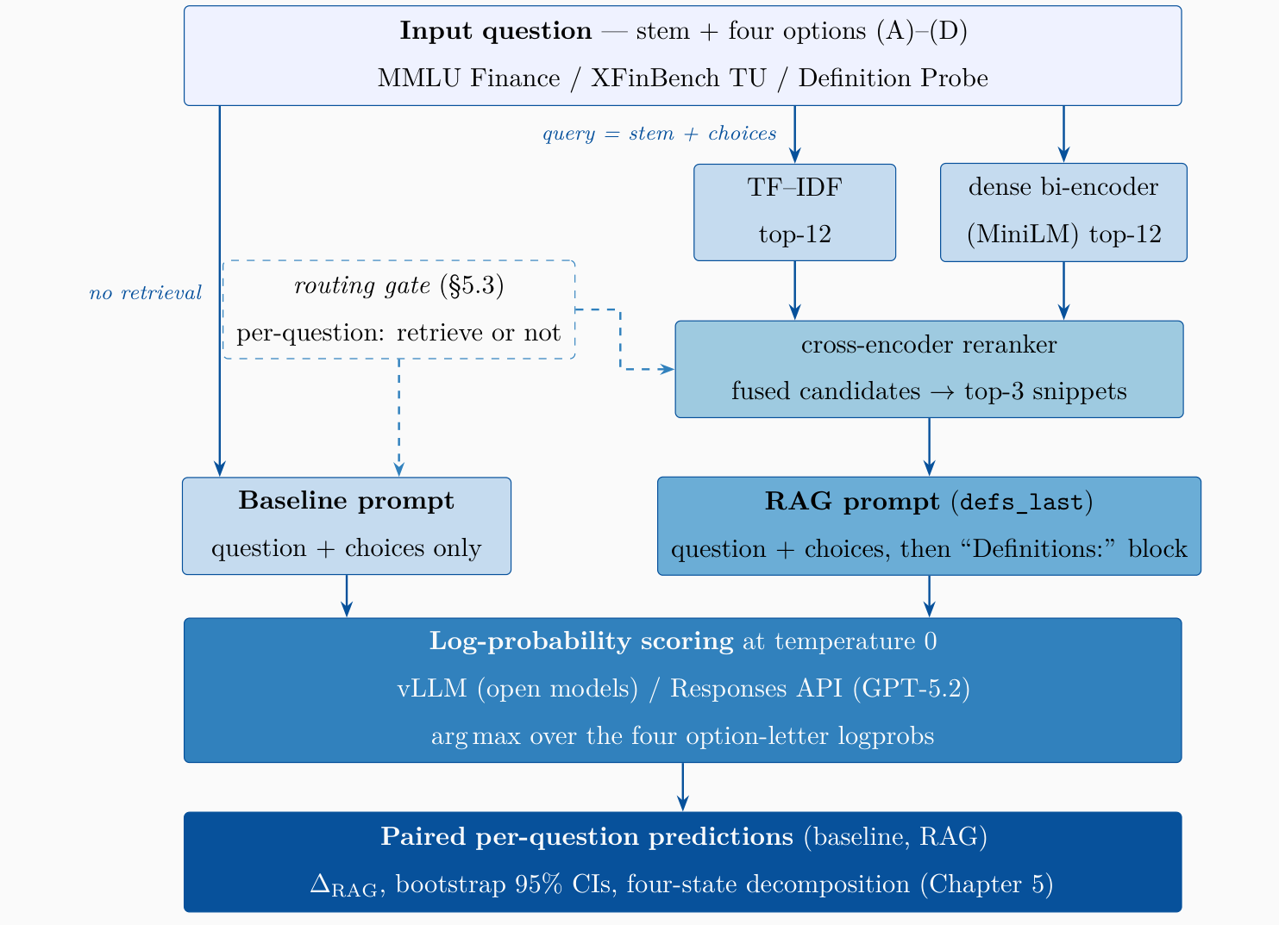
One Question Through the Pipeline
Figure 1. The retrieval and scoring pipeline, fixed across all experiments.
Lexical and dense retrievers each propose 12 candidates, fused by reciprocal rank, reranked by a cross-encoder; the top-3 definitions follow the question.
Option letters are scored by log-probability at temperature 0. The pipeline is fixed across every experiment.
12

Slide 13
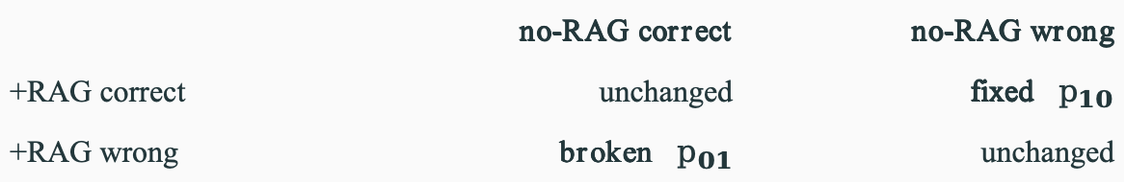
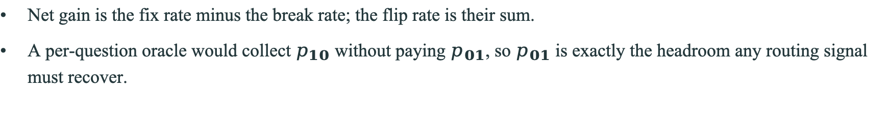
The Paired Evaluation Design
Each question is answered twice, with the definitions and without, and the two outcomes are compared on the same question.
 | no-RAG correct | no-RAG wrong
+RAG correct | unchanged | fixed $p_{10}$
+RAG wrong | broken $p_{01}$ | unchanged
Net gain is the fix rate minus the break rate; the flip rate is their sum.
A per-question oracle would collect $p_{10}$ without paying $p_{01}$, so $p_{01}$ is exactly the headroom any routing signal must recover.
13

Slide 14
Data
14

Slide 15
Glossary and Benchmarks
One glossary serves as both the retrieval index and the reference set for definition modeling.
Resource | Size | Role
Investopedia glossary | 13,609 terms | index + reference
MMLU Finance | 1,124 q | primary benchmark
XFinBench TU | 1,790 q | replication, second group
MMLU Finance ships no knowledge bank of its own, so it is a fair test for an external glossary.
Five instruction-tuned models, 7B to a frontier closed model, four families, so a capability-dependent effect is separable from a universal one.
15

Slide 16
Human Evaluation
Criterion
A (question, term) pair is kept only if
Definitional support
The term’s Investopedia definition directly supports the correct answer.
Necessity
Removing the term would make the answer genuinely ambiguous to a domain-trained reader.
Semantic role
The term contributes to the answer’s semantic construction, not just the question’s surface form.
Table 1. Retention rubric for the per-question term annotation.
The first author (undergraduate training in finance) reviewed all 2,233 (question, term) pairs against the rubric: 84.7% kept, 15.3% removed as misalignments, 20 load-bearing pairs added, leaving 995 term-bearing questions and 129 zero-term controls.
Three audits from outside the protocol: a lab member blind-reviewed 200 pairs (Jaccard 0.74); a blind re-scoring of 200 judge outputs agreed within one point 99.0% of the time (weighted κ = 0.88); an independent economics PhD re-annotated 50 questions from scratch, recovering 4 missed pairs.
The annotation is offline apparatus. It never enters the inference pipeline.
16

Slide 17
Experiments
17

Slide 18
Definition Generation and the 2023 Baseline
Each model writes a free-form definition for every glossary term, scored by surface METEOR and by a 0–3 LLM judge.
Model | Params | METEOR | Δ vs GPT-3.5
Jhirad et al. (2023)
FLAN-UL2 | 20B | 27.71 | −10.79
GPT-3.5-Turbo | 175B | 38.50 | —
This work
Qwen-2.5-7B | 7B | 34.71 | −3.79
GPT-5.2 | — | 27.41 | −11.09
The capability has moved down scale: today's 7B scores above the 20B model of 2023 and within four points of the 175B one.
18

Slide 19
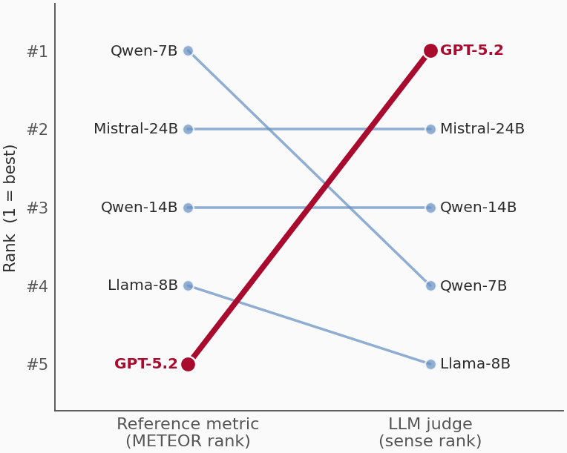
Reference Metrics vs. the LLM Judge
Figure 2. Reference-metric vs judge rankings of definition quality.
GPT-5.2 is last on every reference metric, first under the judge, and strongest downstream. METEOR penalises paraphrastic definitions.
The inversion repeats on a second corpus, so it is a format effect, not a knowledge gap. Both measurements are carried through every later analysis.
19

Slide 20
Results
20

Slide 21
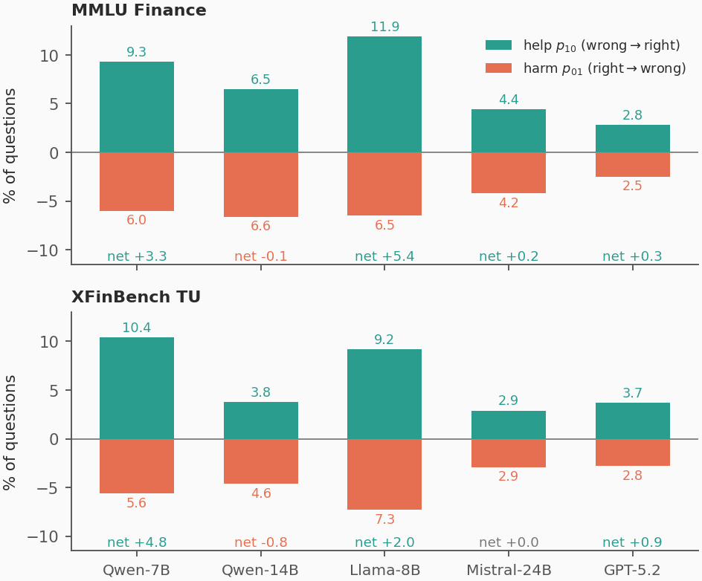
Average Retrieval Gains on the Panel
Model | Base | +RAG | Δ
MMLU Finance (n = 1,124)
Qwen-2.5-7B | 60.8 | 64.1 | +3.3
Qwen-2.5-14B | 68.2 | 68.1 | −0.1
Llama-3.1-8B | 52.1 | 57.6 | +5.4
Mistral-S-24B | 72.3 | 72.5 | +0.2
GPT-5.2 | 87.8 | 88.1 | +0.3
XFinBench TU (n = 1,790)
Qwen-2.5-7B | 70.5 | 75.3 | +4.8
Qwen-2.5-14B | 77.7 | 76.8 | −0.8
Llama-3.1-8B | 61.5 | 63.5 | +2.0
Mistral-S-24B | 78.9 | 78.9 | ±0.0
GPT-5.2 | 87.6 | 88.5 | +0.9
Figure 3. Per-model paired-removal decomposition on both benchmarks.
Replicates on two independently constructed benchmarks.
Follows neither parameter count nor model family: it is a property of the mid-capability band.
Bold Δ: 95% CI excludes zero (paired bootstrap, 2,000 resamples).
21

Slide 22
Controls on the Source of the Gain
A snippet could raise accuracy by carrying the answer string rather than the term’s meaning, and a frontier model could already hold the glossary. We test both.
Only 20 of 3,228 injected snippets contain a full answer option, and re-scoring with those removed leaves accuracy unchanged.
Masking every term name inside its own snippet costs part of the gain but stays above the no-RAG baseline, so the snippet does work the term name alone does not explain.
On 50 invented terms with author-written definitions, both models go from near chance to every item correct, so the frontier model’s flat Δ is not an inability to use a definition.
Condition (Qwen-2.5-7B / MMLU) | Acc. | vs RAG
No RAG (baseline) | 60.8 | −2.9
RAG (as reported) | 63.7 | —
drop answer-matching snippets | 63.7 | ±0.0
mask all term names | 61.9 | −1.8
Invented terms (n = 50, unmemorisable)
GPT-5.2 | 36.0 → | 100.0
Qwen-2.5-7B | 30.0 → | 100.0
22

Slide 23
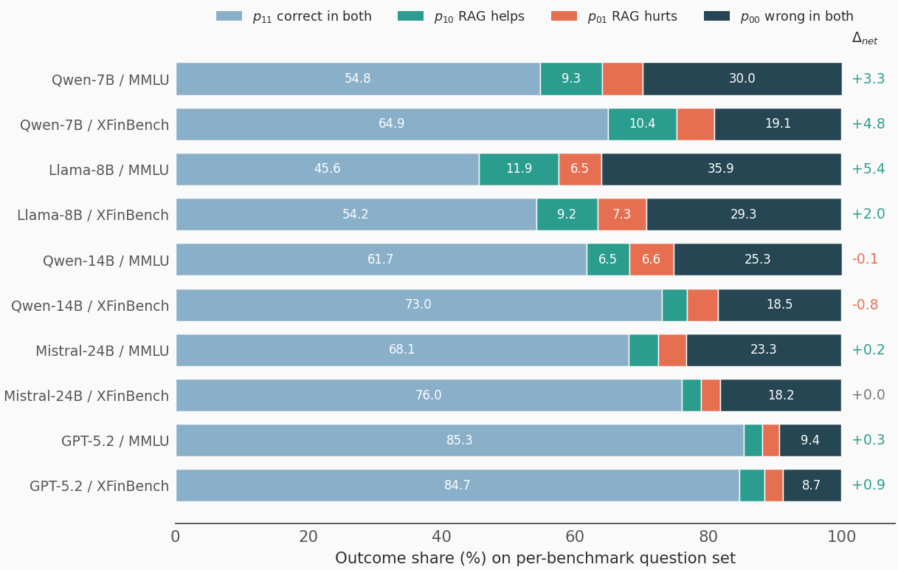
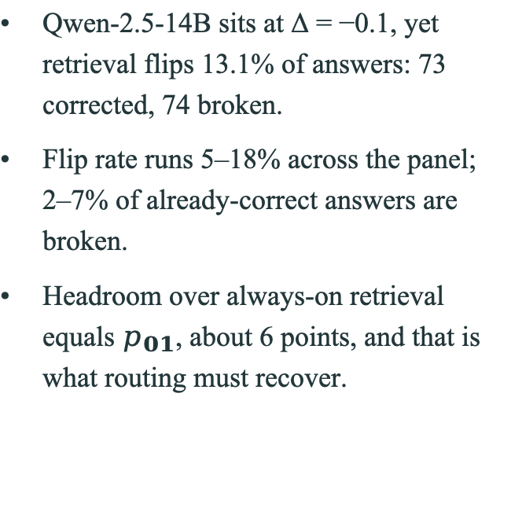
Four-State Decomposition and the Oracle Gap
Qwen-2.5-14B sits at Δ = −0.1, yet retrieval flips 13.1% of answers: 73 corrected, 74 broken.
Flip rate runs 5–18% across the panel; 2–7% of already-correct answers are broken.
Headroom over always-on retrieval equals $p_{01}$, about 6 points, and that is what routing must recover.
Figure 4. Stacked-bar visualisation of the paired RAG-removal decomposition.
23

Slide 24
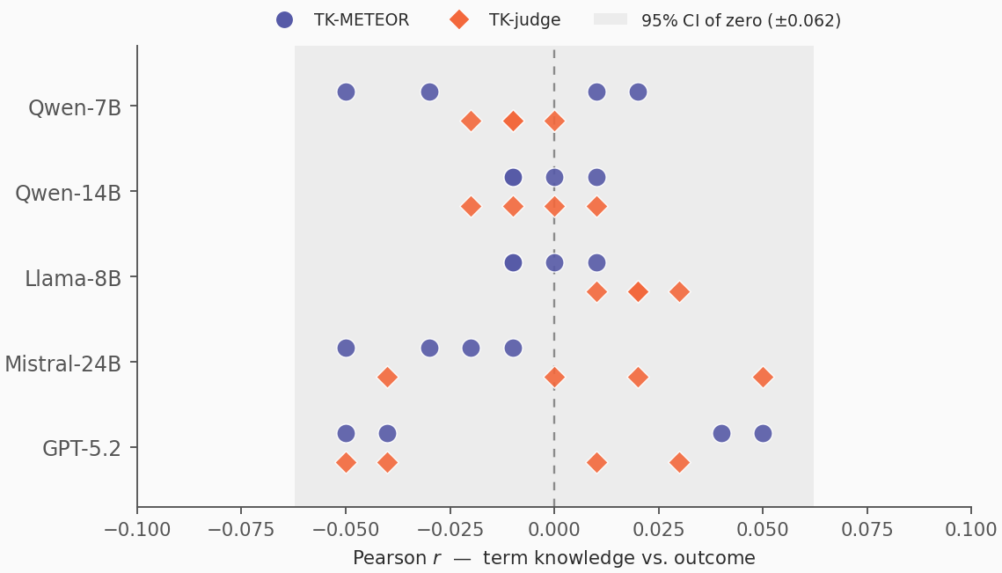
Per-Question Correlation Results
Five models × two measurements × two aggregations × two outcomes = 40 correlations.
All lie within |r| < 0.06, maximum 0.053, accounting for under 1% of outcome variance.
A bounded null, not low power: the Fisher-z zero band is ±0.062 and a permutation test gives p = 0.91.
  Restricting to questions whose term was actually retrieved, or to the both-annotator intersection, changes nothing.
Figure 5. Per-question correlations as a forest plot.
24

Slide 25
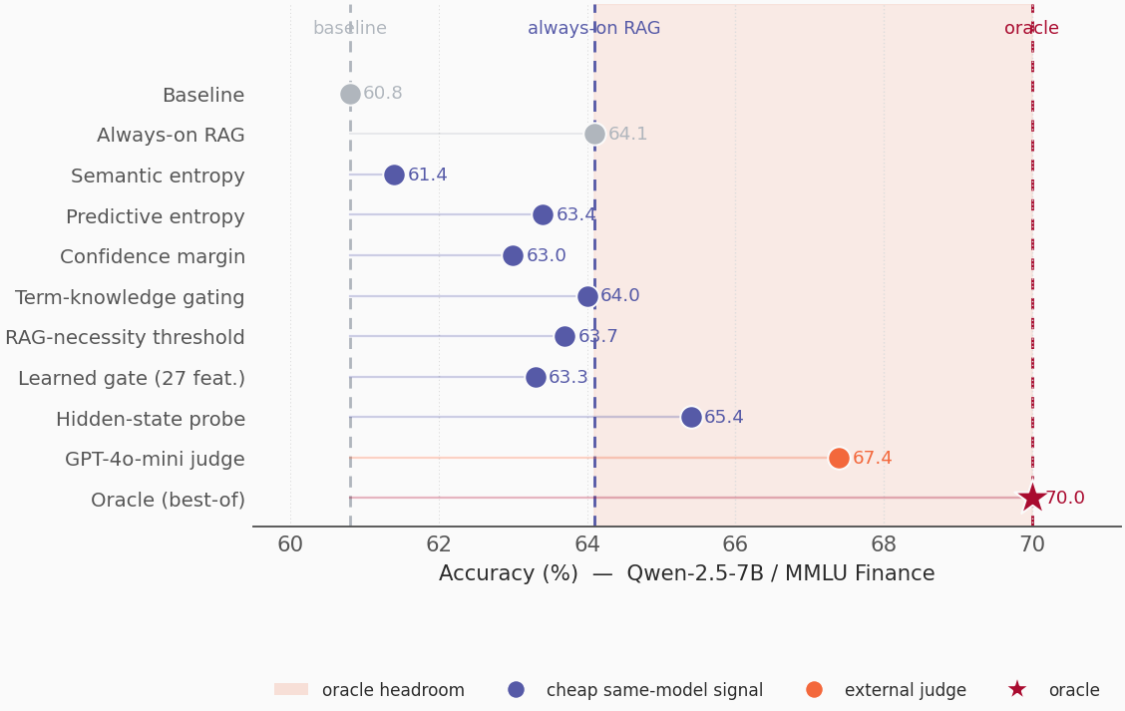
Routing-Signal Comparison
Seven internal signals, each swept in its own favour; none recovers the gap.
The best internal signal adds 1.3 points and needs the post-retrieval state.
Only an external judge exceeds always-on retrieval, and it is itself a second and stronger model.
  Filtering which definitions to inject fails too: −0.8 on MMLU, −2.2 on XFinBench.
Figure 6. Routing-signal accuracies against the oracle gap.
25

Slide 26
Interpreting the Two Results
The simple reading is that the model is missing a fact and we hand it the fact. The observations do not support it.
Retrieval breaks a correct answer on 2–7% of questions; stalling models gain nothing on their own worst-known quartile; filtering known definitions hurts.
What the inserted text changes is the score competition among the four options, and the outcome lives in the joint structure of stem, options and snippet.
  This also explains why the one router that works is the judge that sees that joint input.
An aggregate diagnostic correlation does not license per-instance interventional use of the same signal.
26

Slide 27
Conclusions
At the input level the intervention works. Definition-only retrieval lifts accuracy on the mid-capability band, on two benchmarks, and the controls place the gain in the definition itself rather than in a leaked answer string or in memorisation.
At the routing level the same signal does not, at any scale tested, and not for any of the seven cheap signals across the panel.
Closing the gap needs information beyond the question and its definitions, plausibly the model’s own pretrained ability, where GPT-5.2’s near-saturation suggests the capability already resides.
We release the annotation, the definition probe, the invented terms and the evaluation harness, so this becomes a testbed for whatever routing signal comes next.
github.com/youngandlei/definition-only-rag
27

Slide 28
References i
Akari Asai, Zeqiu Wu, Yizhong Wang, Avirup Sil, and Hannaneh Hajishirzi. 2024. Self-RAG: learning to retrieve, generate, and critique through self-reflection. ICLR.
Satanjeev Banerjee and Alon Lavie. 2005. METEOR: an automatic metric for MT evaluation with improved correlation with human judgments. ACL Workshop on Intrinsic and Extrinsic Evaluation Measures.
Sebastian Farquhar, Jannik Kossen, Lorenz Kuhn, and Yarin Gal. 2024. Detecting hallucinations in large language models using semantic entropy. Nature, 630:625–630.
Noah Gardner, Hafiz Khan, and Chih-Cheng Hung. 2022. Definition modeling: literature review and dataset analysis. Applied Computing and Intelligence, 2(1):83–98.
Dan Hendrycks, Collin Burns, Steven Basart, Andy Zou, Mantas Mazeika, Dawn Song, and Jacob Steinhardt. 2020. Measuring massive multitask language understanding. arXiv:2009.03300.
Soyeong Jeong, Jinheon Baek, Sukmin Cho, Sung Ju Hwang, and Jong C. Park. 2024. Adaptive-RAG: learning to adapt retrieval-augmented large language models through question complexity. NAACL, pages 7036–7050.
James Jhirad, Edison Marrese-Taylor, and Yutaka Matsuo. 2023. Evaluating large language models’ understanding of financial terminology via definition modeling. IJCNLP-AACL Student Research Workshop, pages 93–100.
Patrick Lewis, Ethan Perez, Aleksandara Piktus, Fabio Petroni, Vladimir Karpukhin, Naman Goyal, Heinrich Küttler, Mike Lewis, Wen-tau Yih, Tim Rocktäschel, Sebastian Riedel, and Douwe Kiela. 2020. Retrieval-augmented generation for knowledge-intensive NLP tasks. NeurIPS.
28

Slide 29
References ii
Edison Marrese-Taylor, Erica K. Shimomoto, Alfredo Solano, and Enrique Reid. 2025. Multilingual definition modeling. Findings of ACL 2025.
Meta AI. 2024. The Llama 3 herd of models. Technical report, Meta.
Mistral AI. 2025. Mistral Small 3 (24B Instruct). Model release, mistral.ai.
Rodrigo Nogueira and Kyunghyun Cho. 2019. Passage re-ranking with BERT. arXiv:1901.04085.
Thanapon Noraset, Chen Liang, Larry Birnbaum, and Doug Downey. 2017. Definition modeling: learning to define word embeddings in natural language. AAAI, volume 31.
Qwen Team. 2024. Qwen2.5 technical report. Technical report, Alibaba Cloud.
Nils Reimers and Iryna Gurevych. 2019. Sentence-BERT: sentence embeddings using Siamese BERT-networks. EMNLP-IJCNLP.
Xinpeng Wang, Bolei Ma, Chengzhi Hu, Leon Weber-Genzel, Paul Röttger, Frauke Kreuter, Dirk Hovy, and Barbara Plank. 2024. “My answer is C”: first-token probabilities do not match text answers in instruction-tuned language models. Findings of ACL 2024, pages 7407–7416.
Zhihan Zhang, Yixin Cao, and Lizi Liao. 2025. XFinBench: benchmarking LLMs in complex financial problem solving and reasoning. Findings of ACL 2025.
29

