Slide 1


VIETNAMESE–GERMAN UNIVERSITY
× FRANKFURT UNIVERSITY OF APPLIED SCIENCES
SUPERVISOR
Prof. Dr. Eva Christina Andersson
When AI
Disagrees With You
How university students respond to uncertain AI answers
PRESENTERS
Tran Trong Nhan · 10423160
Nguyen Minh Nhat Huy · 10423045
Dao Hoang Minh Triet · 10423179

Slide 2
TABLE OF CONTENTS · STUDY WORKFLOW
Presentation Outline & Study Pipeline
SECTION 1 · SPEAKER 1 · SLIDES 3–5
SECTION 2 · SPEAKER 2 · SLIDES 6–10
SECTION 3 · SPEAKER 3 · SLIDES 11–16
Motivation, Research Questions & Our Survey
Methodology
Nominal distance, linkage trees & optimal cut selection
Validation and Results
Partition stability, external tests & 6 student archetypes
• Slide 3: Motivation & RQ1–RQ3
• Slide 4: Survey (Q1–Q5, n = 261)
• Slide 5: Marginal Q1–Q5 choices
• Slide 6: Normalized Hamming / Gower metric (nominal space)
• Slides 7–8: Agglomerative trees & 4 linkage criteria
• Slide 9: Dendrogram battle & cophenetic faithfulness (r_coph)
• Slide 10: Choosing K = 6 via silhouette peak & anti-chaining
• Slide 11: Stability check via ARI (ties & 80% subsampling)
• Slides 12–13: Six behavioral archetypes (C1–C6)
• Slides 14–15: External validation on Q6 AI use & S4 year
• Slide 16: Conclusions, limitations & Q&A
STAGE 1 · MOTIVATION & DATA
STAGE 2 · UNSUPERVISED METHODOLOGY
STAGE 3 · VALIDATION & RESULTS
Motivation & RQs (Slide 3)
Uncertain AI · 3 Research Questions
Agglomerative Clustering Pipeline (Bottom-Up)
Preserve unordered choices → compare linkages → pick optimal cut K
E · Check Stability
Shuffle & 80% sample
ARI = 0.50–0.57
Slide 11
Results · K = 6
A · Survey Q1–Q5
B · Distance
C · Build Tree
D · Cut at K = 6
6 Behavioral
Archetypes
(C1–C6 groups)
Slides 12–13, 16
261 VGU students
5 coursework scenarios
Slides 4–5
Pairwise Metric
Hamming / Gower
Slide 6
Average (UPGMA)
r_coph = 0.6221
Slides 7–9
Silhouette Peak
Sil = +0.1952
Slide 10
F · External Checks
Q6 AI use & S4 Year
p = 0.0147 · p = 0.0001
Slides 14–15
Input matrix: 261 × 5 nominal
Unordered A–F · no preset grading
Why UPGMA at K = 6? Breaks Single chains (98%) & resists ties
Zero singletons; largest cluster drops from 88.9% (Complete) to 26.1%

Slide 3
SECTION 1 · MOTIVATION, RQs & SURVEY · SPEAKER 1 (~3.5 MIN)
Motivation & research questions
Motivation: Why Uncertain AI Answers Matter in Higher Education
1. Widespread AI Use
2. Four Failure Traps
3. Unsupervised Goal
4.09 ± 2.13 days/wk
Students use ChatGPT, Gemini & Claude routinely in coursework (n = 261, median = 4.0).
Fluent ≠ Reliable
Wrong facts, fake citations, skipped math steps & answer flips on "Are you sure?".
No Preset Grading
Rather than marking answers right or wrong, let natural reaction groups emerge from Q1–Q5.
Three Core Research Questions (RQ1–RQ3)
RQ1 · Student Habits
RQ2 · Grouping Method
RQ3 · Real-World Check
How do students react when AI seems wrong or unclear?
Does the choice of clustering rule change the results?
Are these groups stable, and linked to AI use & study year?
Tests whether natural first-response strategies emerge across 5 conflict scenarios (Q1–Q5).
Compares Single, Complete & Average (UPGMA) linkage on discrete Normalized Hamming distances.
Checks ARI stability under shuffles & 80% subsampling, plus unseen Q6 usage & S4 year.

Slide 4
SECTION 1 · MOTIVATION, RQs & SURVEY
Survey design: 5 uncertainty scenarios & sample (n = 261)
Survey Architecture: 5 Scenarios (Q1–Q5) & Sample (n = 261)
Q1 (6 opts)
Q2 (6 opts)
Q3 (5 opts)
Q4 (5 opts)
Q5 (6 opts)
AI Disagrees
With Your B
Nominal: A–F
Two AIs
Disagree (B vs D)
Nominal: A–F
Cited Paper
Not on Scholar
Nominal: A–E
Unclear Step
Step 3 → Step 4
Nominal: A–E
AI Flips
'Are you sure?'
Nominal: A–F
Nominal Response Spectrum (What Students Do First)
Opt A
Course Material
Notes / Scholar
Opt B
Self-Solve
Derive / Re-solve
Opt C
Same AI
Probe / Ask DOI
Opt D
Diff AI / Peer
2nd Opinion
Opt E / F
Accept / Reject
No Verification
VGU Sample Profile (n = 261, 0 Missing)
215 unique 5-question profiles / 5,400 possible
Years 1–4: ~24% each · Grad/Master: 4.6%
Major: 52.1% CSE · Top repeat: B-B-A-B-B (n = 8)
Withheld From Clustering (External Validation)
Q6: Weekly AI Usage (0–7 days)
Mean = 4.09 ± 2.13 days/wk · Median = 4.0
S4: Year of Study (1st Yr – Grad, n = 255)

Slide 5
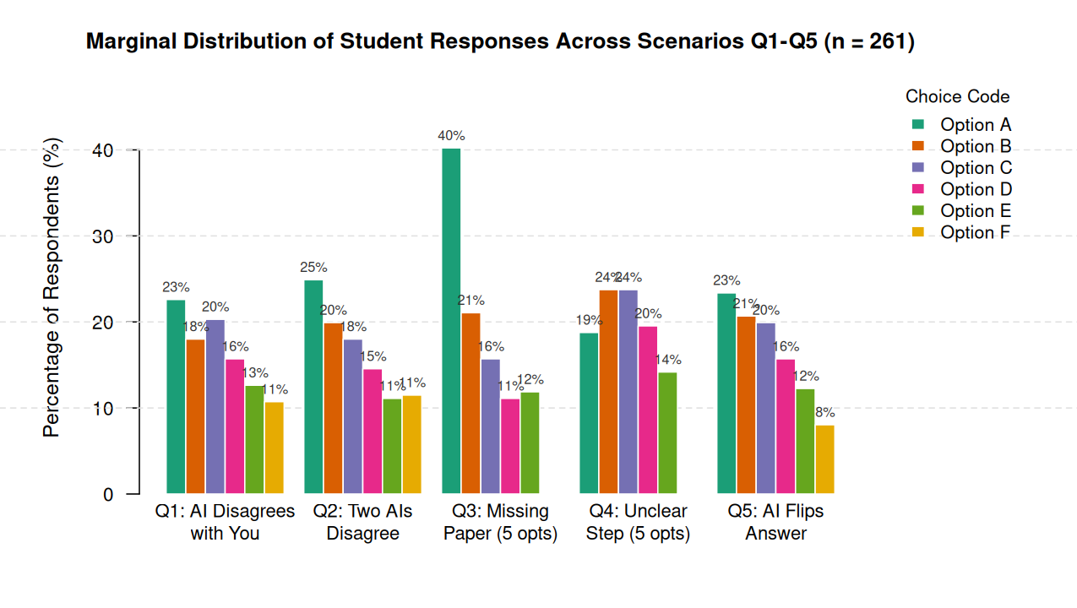
SECTION 1 · MOTIVATION, RQs & SURVEY
First look: student choices across Q1–Q5
Q3 Missing-Paper Spike
40.2% pick Opt A (Search source, n = 105)
Expected Match Rate
Q3 = 25.7% vs. 17.7%–20.7% in Q1/Q2/Q4/Q5
Balanced Mix Elsewhere
Q1, Q2, Q4, Q5 spread 8%–25% across A–F

Slide 6
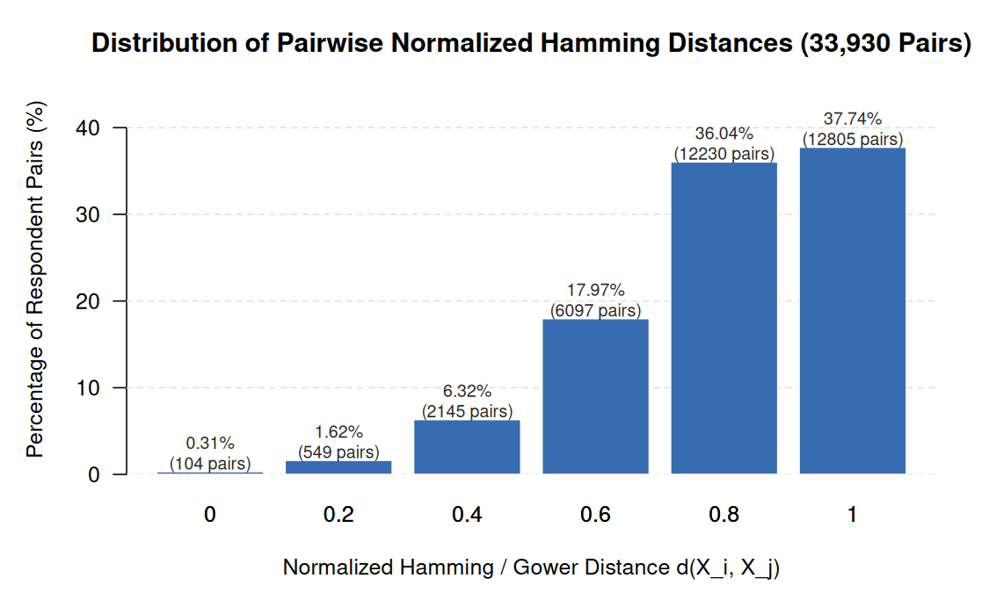
SECTION 2 · METHODOLOGY · SPEAKER 2 (~4.5 MIN)
Nominal metric: Normalized Hamming / Gower distance
d(i, j) = mismatches(Q1..Q5) ÷ 5
0.0 = identical strategy · 1.0 = zero matching options (range 0–1)
Worked Example (Real VGU Student Pair)
Q1
Q2
Q3
Q4
Q5
R018 (C3)
B
B
A
B
B
R008 (C4)
A
D
A
D
F
Mismatch?
1
1
0
1
1
d(R018, R008) = (1 + 1 + 0 + 1 + 1) ÷ 5 = 4/5 = 0.80
33,930 Pairs
Mean d = 0.8021
73.8% pairs differ in ≥ 4 items
Why Nominal Metric?
Unordered A–F labels have
no Euclidean mean (no Ward)

Slide 7
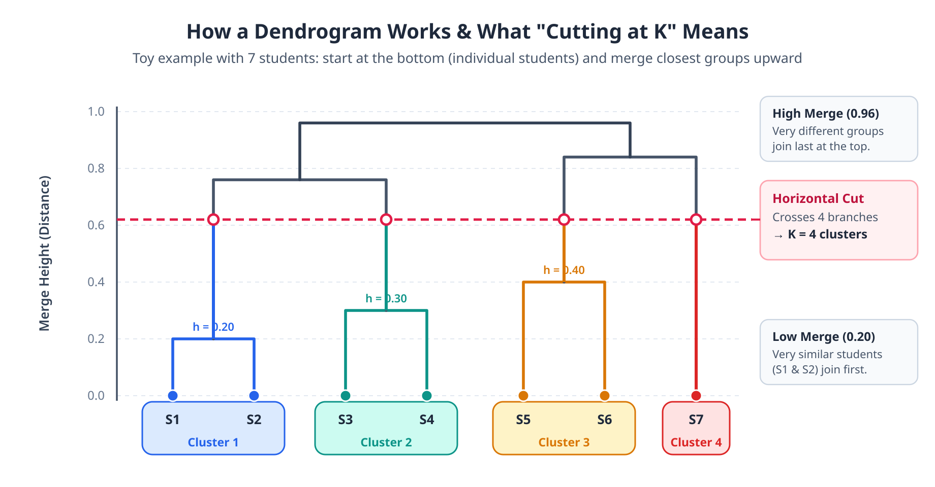
SECTION 2 · METHODOLOGY
How agglomerative trees & cutting work

Slide 8
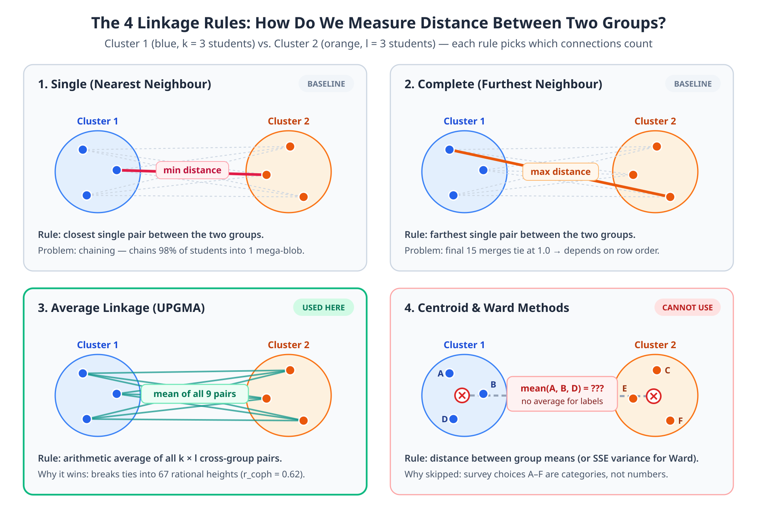
SECTION 2 · METHODOLOGY
Comparing 4 linkage rules on nominal data

Slide 9
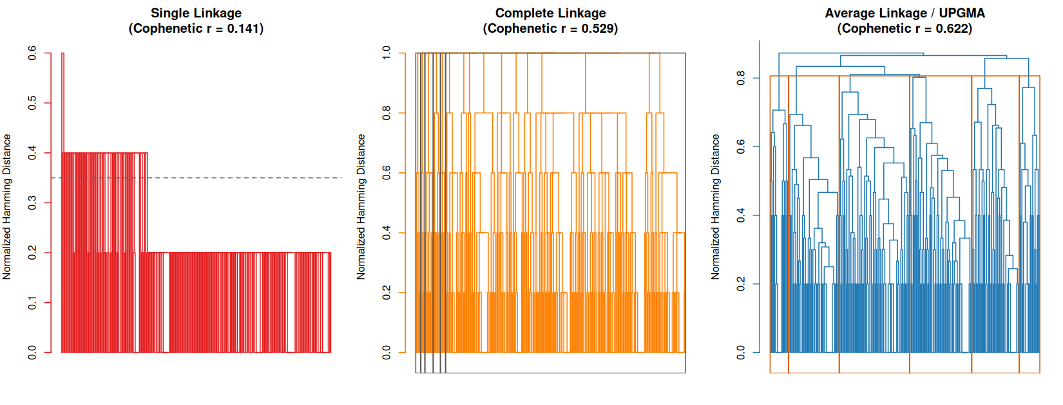
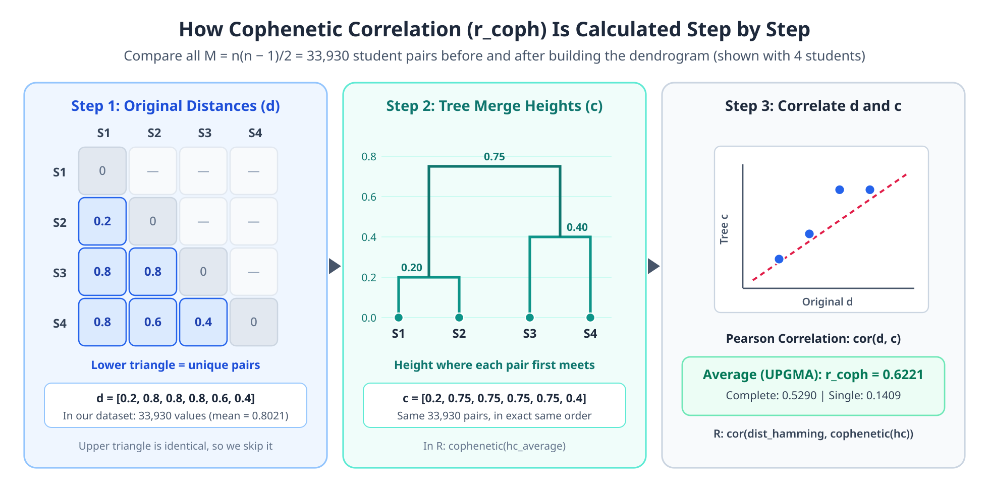
SECTION 2 · METHODOLOGY
Dendrogram battle & cophenetic faithfulness (r_coph)

Slide 10
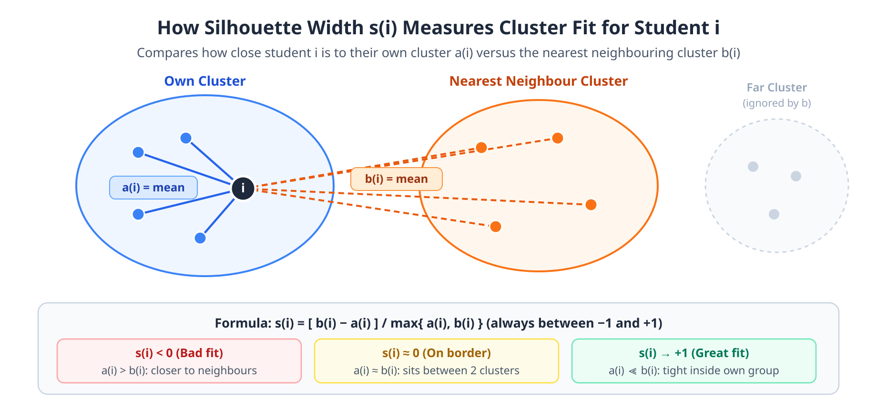
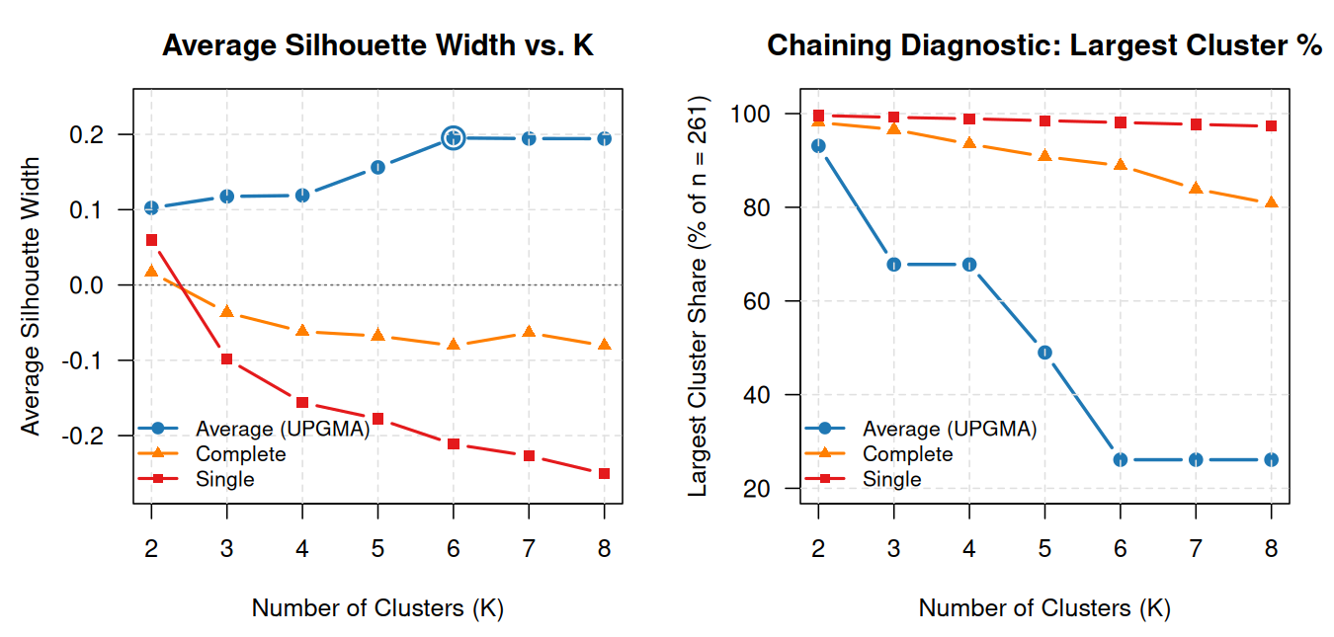
SECTION 2 · METHODOLOGY
Choosing K = 6: silhouette peak & anti-chaining
1. Silhouette Peak at K = 6
+0.1952 peak (only 16.5% < 0)
2. Breaks Dominant Mega-Blob
Max = 26.1% vs. Complete 88.9%
3. Clean Interpretability
Zero singletons; separates C4 & C3

Slide 11
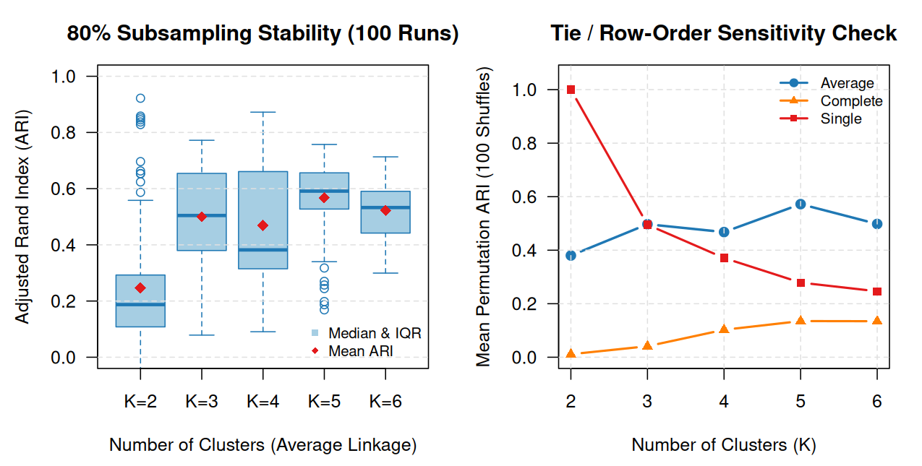
SECTION 3 · VALIDATION & RESULTS · SPEAKER 3 (~5 MIN)
Stability check: ties & 80% subsampling (ARI)
100× 80% Subsampling (n = 209) → Drop-Row Test
Average (K=6): Mean ARI = 0.523 · Median = 0.533
Complete drops to 0.301 · Single’s 0.820 is just 98%-chain stability
100× Row-Order Shuffles → Tie-Breaking Test
Average (K=6): ARI = 0.498 vs. Complete Collapse = 0.135
Discrete distances (0, 0.2..1) cause ties; UPGMA resists row order

Slide 12
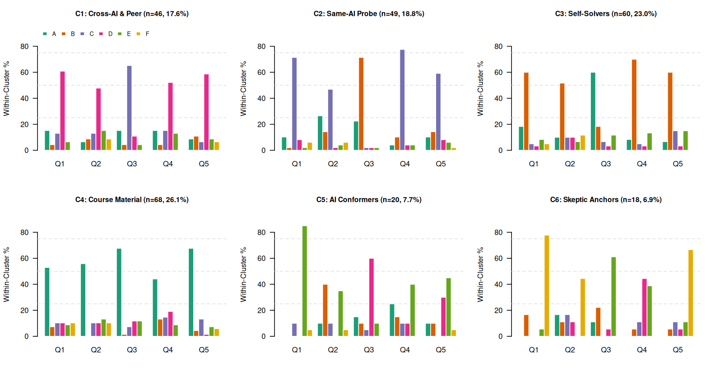
SECTION 3 · VALIDATION & RESULTS
Six behavioral archetypes emerge (K = 6)
K = 5 → 6
K = 5 Super-Cluster
n = 128 (49.0% Active Verifiers)
C4 · Course-Material Verifiers (n = 68 · 26.1%)
Opt A: 44%–68%
C3 · Independent Problem-Solvers (n = 60 · 23.0%)
Opt B: 52%–70%

Slide 13
SECTION 3 · VALIDATION & RESULTS
Behavioral archetype map: 6 student strategies
Six Behavioral Archetypes (UPGMA, K = 6, n = 261)
At K = 5 → 6, the 128-student Self-Verifier super-cluster splits into Course-Material (C4) & Independent Solvers (C3)
C4 · Course-Material Verifiers
n = 68 (26.1%)
C3 · Independent Solvers
n = 60 (23.0%)
Checks lecture notes & Scholar
Q1–Q5 Opt A (44%–68%) · Q6: 4.41 d/wk
Re-solves & derives from scratch
Q1–Q5 Opt B (52%–70%) · Q6: 3.90 d/wk
C2 · Same-AI Conversationalists
n = 49 (18.8%)
C1 · Cross-AI & Peer Triangulators
n = 46 (17.6%)
Probes same AI for DOIs & steps
Q1–Q5 Opt C (47%–78%) · Q6: 4.63 d/wk (Max)
Asks 2nd/3rd AI or classmate
Q1–Q5 Opt D (48%–65%) · Q6: 3.67 d/wk
C5 · Uncritical AI Conformers
n = 20 (7.7%)
C6 · AI-Skeptical Anchors
n = 18 (6.9%)
Accepts AI & drops citations unverified
Q1-E (85%), Q3-D (60%) · Q6: 2.85 d/wk (Min)
Keeps own answer or drops task
Q1-F (78%), Q5-F (67%) · Q6: 4.44 d/wk
■ 49.1% Active Verification (C4 + C3)
■ 36.4% AI / Peer Dialogue (C2 + C1)
■ 14.6% Extreme Poles (C5 + C6)

Slide 14
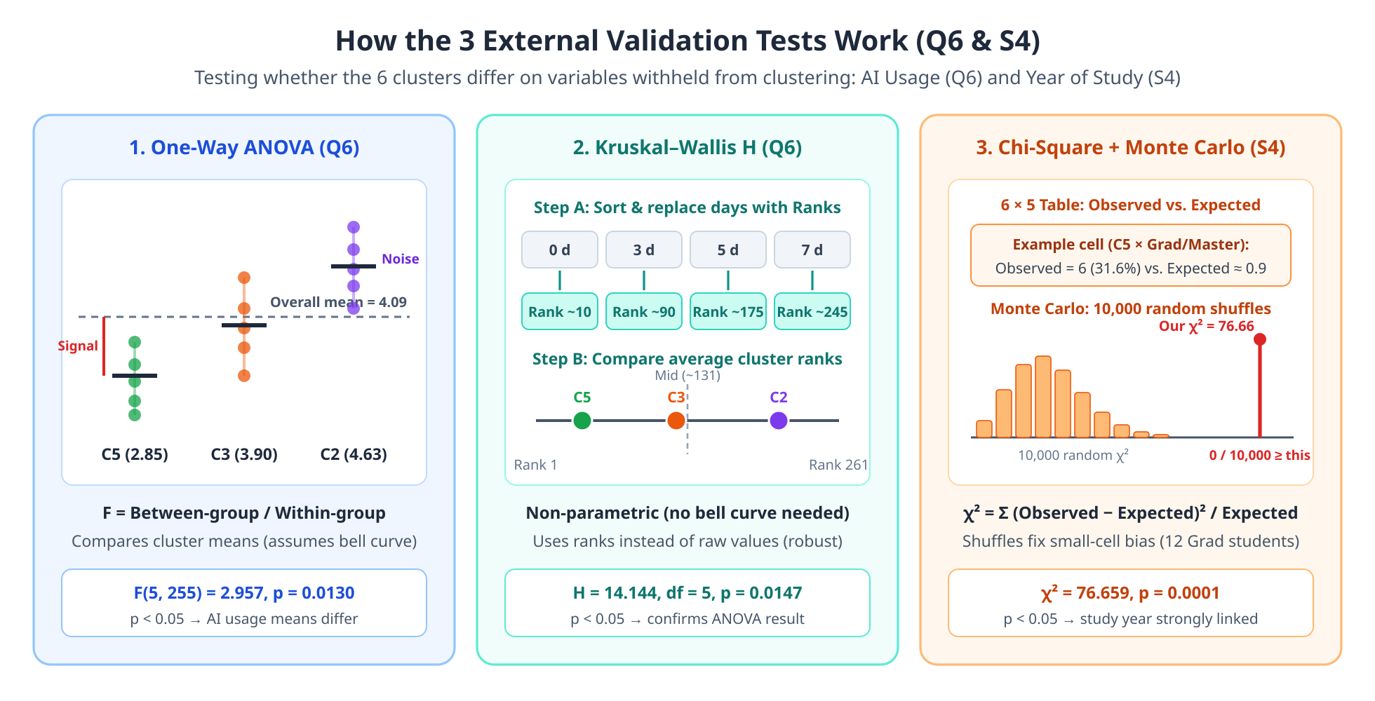
SECTION 3 · VALIDATION & RESULTS
External validation setup: testing Q6 & S4

Slide 15
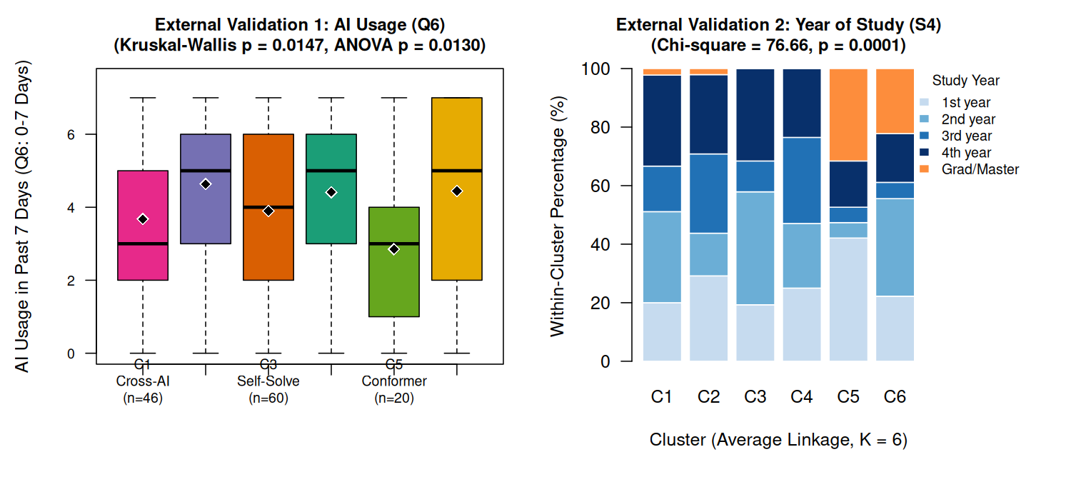
SECTION 3 · VALIDATION & RESULTS
External validation results: AI usage & study year
Q6 · Weekly AI Usage (0–7 Days)
p = 0.0147
Kruskal–Wallis H = 14.14 (ANOVA p = 0.0130)
Highest: C2 Same-AI = 4.63 d/wk
Lowest: C5 Conformers = 2.85 d/wk
S4 · Year of Study (n = 255)
p = 0.0001
χ² = 76.66 · 10,000 Monte Carlo Replicates
10 of 12 Grad/Master sit in C5 (6) & C6 (4)
42.1% of C5 Conformers are 1st-year

Slide 16
SECTION 3 · VALIDATION & RESULTS · FINAL SLIDE
Conclusions, limitations & Q&A
RQ1 · Student Habits
RQ2 · Grouping Method
RQ3 · Real-World Check
6 Distinct Archetypes
UPGMA Wins Clearly
Robust & Meaningful
• 49.1% actively verify
• 36.4% probe AI / peers
• 14.6% uncritical / skeptical
• r_coph = 0.6221 (best)
• 67 heights break ties
• Single chains (98%), Complete ties
• ARI = 0.50–0.57 stable
• Q6 AI use: p = 0.0147
• S4 Study year: p = 0.0001
Methodological Limitations & Future Work
1. Self-reported first intentions (n = 261 at VGU) rather than observed behavior logs or grades
2. Unweighted Hamming treats all option mismatches equally; 5-option Q3/Q4 have higher random match (20.0% vs 16.7%)
Future: Weighted semantic dissimilarities & longitudinal classroom tracking
Questions?

