Slide 1
AgriBot Project Documentation
AI Chatbot & Live Marketplace for Kenyan Agriculture
Team Lead: Samuel Gicharu Members: David Kiptoo

Slide 2
Problem Statement
Misinformation and disinformation around agricultural innovations in Africa have surged, driven by state-sponsored campaigns and unregulated digital media. Farmers lack reliable, real-time guidance on market prices, weather, and best practices—hindering adoption of new technologies and undermining trust.

Slide 3
1. Introduction
AgriBot is a web-based platform designed to empower Kenyan farmers with real-time market intelligence and expert agronomic guidance. It combines two core capabilities:
AI-Driven Chatbot
Begins with a lightweight rule-based engine for rapid, predictable answers to common questions (e.g., “What’s the best time to plant maize?”).
Escalates to Google’s Gemini API for complex, context-rich queries such as pest management or precise fertilizer regimes.
Falls back on a locally hosted, fine-tuned T5 model—trained on thousands of Kenyan agriculture Q&A pairs—for robust offline operation and domain-specific nuances.
Live Marketplace Data
Scrapes and filters up-to-the-minute commodity prices via the KilimoStat API, covering staple and cash crops across all 47 Kenyan counties.
Presents the latest price per market (e.g., Eldoret, Kisumu, Nairobi) in a clean searchable table, enabling farmers to choose where to sell for maximum profit.
Offers both county-wide averages and individual market breakdowns, ensuring transparency and helping smallholders negotiate better deals.
Localized Weather Forecasts
Displays a 14-day weather dashboard: past 7 days for retrospective crop impact analysis, and upcoming 7 days to aid planting, irrigation, and harvesting schedules.
Automatically detects the user’s current location or allows manual county selection.
Forecast includes rainfall, temperature, humidity, and wind data—presented with icons and color-coded alerts for drought, floods, or storms.
Ensures farmers can time their activities accurately, reducing crop losses due to weather unpredictability.

Slide 4
Why It Matters
Bridges the Information Gap: Smallholder farmers can instantly access the same market data and expert advice previously available only through paid consultants or cooperative networks.
Reduces Risk & Waste: By knowing when and where to sell, farmers avoid gluts and price crashes in local markets (e.g “brokers” or mn in the middle in a business).
Scalable, Future-Ready: The hybrid chat architecture can be extended to SMS or USSD for feature-phone users, and the scraping engine can ingest additional data sources (e.g., weather, input costs) down the road.

Slide 5
Proposed Solution
AgriBot is a hybrid AI platform that:
Detects & Counters Mis/Disinformation
Integrates fact-checking tools (Google Fact Check, Meta content moderation, Microsoft Project Origin, Twitter Community Notes).
Applies a “Truth Factor” metric to rate the reliability of any agricultural claim.
Delivers Expert Agronomic Advice
Rule-based engine for quick answers to common queries.
Google Gemini API for complex, context-rich scenarios.
Fine-tuned T5 model trained on thousands of Kenya-specific Q&A pairs.
Provides Live Marketplace Intelligence
KilimoStat API integration to fetch live commodity prices across all 47 counties.
Searchable by commodity and county, with breakdowns per market site.
Shows Localized Weather Data
Past 7-day and next 7-day forecasts for the farmer’s selected location.
Rainfall, temperature, humidity, and wind alerts to guide planting and harvesting.

Slide 6
Technical Architecture
Frontend:
Responsive search UI, carousel, and tables built with HTML/CSS, Chart.js, Leaflet.
USSD/SMS fallback planned for low-connectivity areas.
Backend (Django/Python):
chat_api/: Hybrid chat endpoint.
api_market_prices/: Live price scraper and filter.
api_weather/: Fetches historical & forecast data from OpenWeatherMap.
Machine Learning:
Gemini API for generative answers.
T5 model fine-tuned on local datasets (t5_agri_final).
LLM model

Slide 7
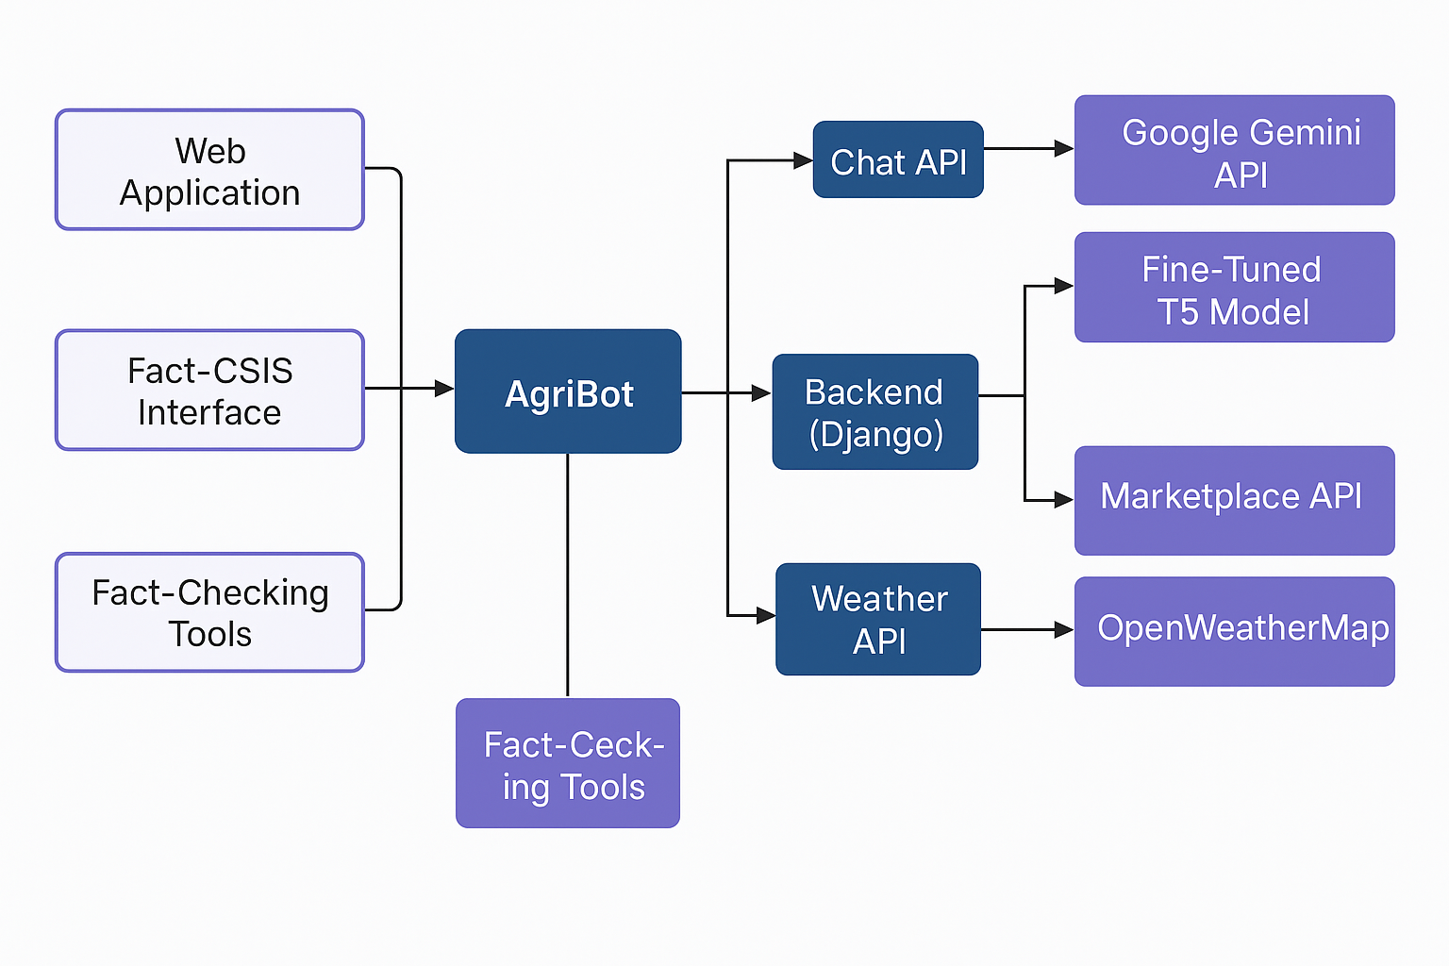

Slide 8
Implementation Steps
Setup & Prerequisites
Clone repo; create and activate Python virtualenv.
Install dependencies (requirements.txt), set GOOGLE_APPLICATION_CREDENTIALS.
Rule-Based Chat
Load regex patterns from data/data.json.
Test basic Q&A flows.
Gemini Integration
Authenticate with service account JSON.
Call Bison-001 model and parse responses.
T5 Fine-Tuning
Clean and tokenize training data (vocab_size=20k).
90/10 train/test split; train with HuggingFace Trainer.
Save model & tokenizer for offline fallback.
Marketplace API
Fetch KilimoStat JSON; filter by commodity & county; dedupe by market/date.
Return latest price entries as JSON.
Weather Module
Use OpenWeatherMap API with geolocation or county lookup.
Store past 7-day and pull 7-day forecast data.
Frontend Integration
Hook up search bar and county dropdown to AJAX calls.
Render tables, carousel, and weather charts.
Testing
Unit tests for view logic (pytest or Django TestCase).
Manual checklist: chatbot fallback, price tables, weather display.

Slide 9
Judging Criteria
Relevance to Misinformation: Does AgriBot directly help detect/counter agri-related mis/disinformation?
AI/ML Usage: Effective integration of Gemini API and T5 model.
Social/Economic Impact: Will farmers’ income or productivity measurably improve? Scalable beyond pilot?
Innovation: Are there novel methods—e.g., “Truth Factor,” SMS fallback, hybrid chat logic?

Slide 10
5. Frontend Implementation
The frontend of AgriBot is designed to be intuitive, responsive, and lightweight, ensuring that small-scale farmers on both smartphones and feature phones can access critical information quickly. We leveraged semantic HTML5, modern CSS (with CSS variables for theming), and vanilla JavaScript for maximum compatibility and performance.

Slide 11
5.1 Search Bar
Purpose: Allows users to enter a commodity name (e.g., “maize”) and select a county or “All Counties” to retrieve live market prices.
Implementation:
An <input> element for commodity text.
A <select> dropdown populated dynamically via Django context with all 47 counties.
A “Search Prices” button that triggers a JavaScript fetch() call to the /api/market_prices/ endpoint.
Input validation prevents empty queries and displays an alert if no commodity is entered.
UX Details:
Flexbox layout for even spacing.
Focus and error states styled with clear border colors for accessibility.
Debounced typing could be added later for autocomplete.

Slide 12
5.2 Subtopic Links
Purpose: Provides quick access to external resources for fact-checking, mapping, news monitoring, and trend analysis.
Implementation:
A flexbox container of <a> tags styled as pills with background colors from our CSS variable palette (secondary and hover-bluish).
Each link opens in a new tab (target="_blank") to avoid losing the app context.
UX Details:
Wrapping enabled for mobile screens.
Hover states darken the background for clear feedback.

Slide 13
5.3 Showcase Carousel
Purpose: Highlights key features (e.g., “AgriBot Smart Chat,” “Fresh Produce Listings”) in an eye-catching, interactive grid.
Implementation:
CSS Grid layout auto-fits cards to screen width, with minmax(280px, 1fr) ensuring no large side margins.
Each card (.carousel-item) contains an <img> and an overlay caption that fades in on hover.
The images are slightly oversized (110% width) and centered via transform: translateX(-5%) to eliminate gaps.
CSS-only hover zoom effect; no JavaScript needed for basic interactivity.
UX Details:
Cards have soft shadows and rounded corners for a modern look.
Responsive breakpoints collapse the grid to two or one column on tablets and phones.

Slide 14
5.4 Data Tables
Purpose: Displays the price results returned from /api/market_prices/ in a clear, tabular format with columns for County, Market, and Price.
Implementation:
JavaScript builds a <table> with <thead> and <tbody> dynamically upon successful fetch.
Table cells are styled with borders and padding for readability.
Header row uses the primary color background with white text for strong contrast.
UX Details:
Horizontal scrolling is enabled on narrow screens to preserve the table layout.
Future enhancements: sorting by price or county, pagination for long lists.

Slide 15
6. Data & API Reference
AgriBot relies on two primary external APIs to power its marketplace and weather features. Below is an overview of each, including endpoint URLs, sample request/response formats, and field definitions.

Slide 16
6.1 KilimoStat Commodity Prices API
KilimoStat Commodity Prices LINK
Returns a JSON array of price records for various commodities across Kenyan markets.
JSON Schema (per record)
Field | Type | Description
Commodity | String | Name of the commodity (e.g., "Maize")
County | String | County name (e.g., "Nairobi")
Market | String | Specific market or town (e.g., "Kibera" or "Eldoret")
Date | String | ISO date of the price (e.g., "2025-05-12")
AveragePrice | Number | Average price in Kenyan Shillings (e.g., 45.0)

Slide 17
Filtering & Usage
You can filter client-side by checking if your commodity substring appears in the Commodity field (case‐insensitive).
Likewise, filtering by county is done by matching against the County field or selecting "all" to include every record.
We then deduplicate by (County, Market) and pick the most recent Date per market.
Data Source
Official KilimoStat portal:

Slide 18
6.2 OpenWeatherMap Forecast & Historical API
Endpoint (Forecast): GET https://api.openweathermap.org/data/2.5/onecall?lat={LAT}&lon={LON}&exclude=minutely,hourly,alerts&units=metric&appid={YOUR_API_KEY}
Returns current weather, 7-day forecast, plus past 7-day historical data if you call the “timemachine” endpoint for each previous day.
Data Source
OpenWeatherMap One Call API docs

Slide 19
Key Fields (per daily block)
Field | Type | Description
dt | Integer | Unix timestamp of the forecast day
temp.day | Number | Daytime temperature in °C
wind_speed | Number | Wind speed in m/s
humidity | Integer | Percentage humidity
pop | Number | Probability of precipitation (0–1)
weather[0].icon | String | Icon code for weather condition

Slide 20
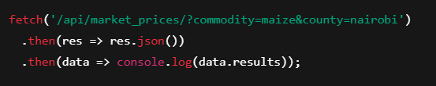
6.3 Usage Examples
Fetching Prices (JavaScript)
Fetching Weather (JavaScript)
fetch(`https://api.openweathermap.org/data/2.5/onecall?lat=${lat}&lon=${lon}&exclude=minutely,hourly,alerts&units=metric&appid=${API_KEY}`)
.then(res => res.json())
.then(data => console.log(data.daily));

Slide 21
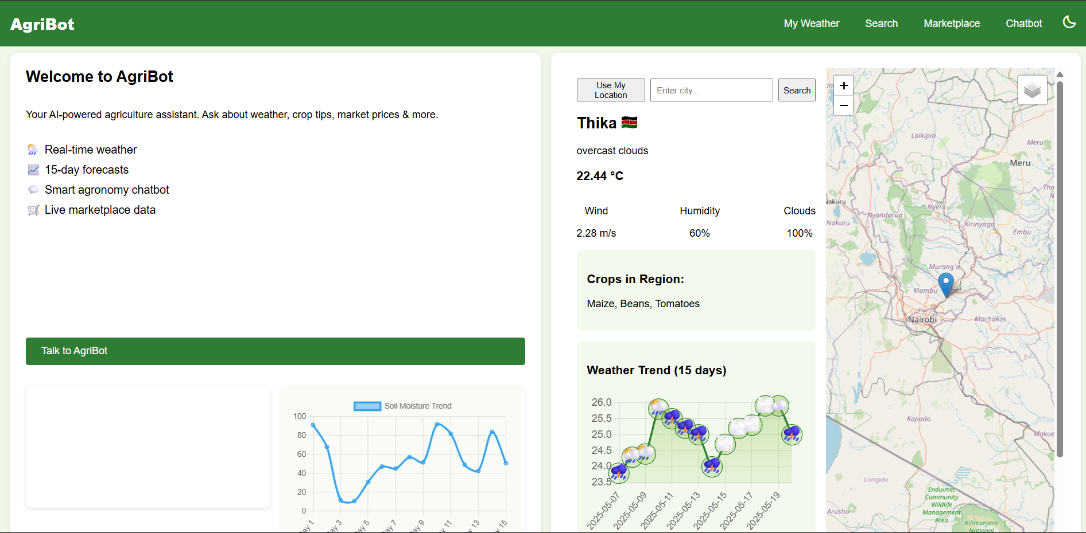
PROJECT OVERVIEW

Slide 22
Backend Implementation
On the backend, we use Django (Python) to orchestrate all core business logic, integrations, and data flows. Below is an outline of our key components and how they interact:
URL Routing & Views
index view renders the main page and injects context variables (counties, carousel_items, modules) to drive the template.
chat_api endpoint (POST /api/chat/) handles incoming user queries:
Attempts a rule-based lookup from data/data.json (fast, no external calls).
Falls back to Google Gemini API for rich, complex queries.
If Gemini fails or is unavailable, uses a fine-tuned T5 model loaded locally.
api_market_prices endpoint (GET /api/market_prices/) fetches live JSON data from KilimoStat, filters by commodity + county, deduplicates to latest per market, and returns a clean JSON array.

Slide 23
External Integrations
KilimoStat API
Uses Python’s requests library with a 10s timeout and error handling.
Filters and sorts in Python, then serializes to JSON.
Google Gemini
Authenticates via service-account JSON (OAuth 2.0).
Posts prompts to the text-bison-001 model and extracts the generated text.
T5 Model
On startup, loads T5ForConditionalGeneration and a pickled Hugging Face tokenizer.
Provides an offline fallback path for conversational queries.

Slide 24
Error Handling & Logging
All external calls (requests.get/post) are wrapped in try/except.
Failures log concise errors to stdout (visible in server logs) and return user-friendly JSON errors to the frontend.
Missing static files (e.g. data.json) are caught at import time to prevent server crashes.
Settings & Configuration
settings.py contains:
GOOGLE_APPLICATION_CREDENTIALS path for Gemini.
Static file locations.
Installed apps and middleware.
Sensitive keys are loaded via environment variables or a .env file (not checked into Git).

Slide 25
Future Backend Enhancements
Add caching (Redis) for repeated commodity-price queries to speed up responses.
Implement user authentication and role-based permissions for personalized dashboards.
Extend the marketplace API to integrate additional data sources (e.g., local cooperative co-op data, weather insurance rates).

Slide 26
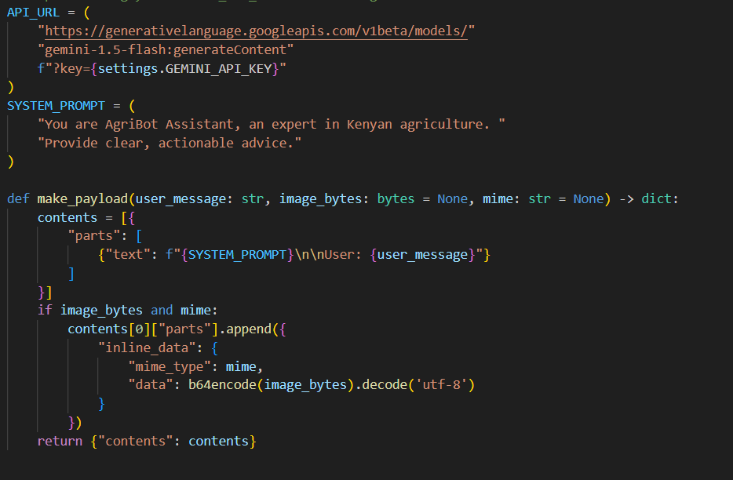
BACKEND CODE

Slide 27
BUDGET
Category | Item | Qty/Duration | Unit Cost (KES) | Subtotal (KES)
Personnel | Full-Stack Developer | 1 × 6 months | 100,000 / month | 600,000
 | ML Engineer (part-time) | 1 × 4 months | 80,000 / month | 320,000
Subtotal Personnel |  |  | 920,000
Cloud & Hosting | Single small VM (app + DB) | 1 × 6 months | 6,000 / month | 36,000
 | Basic CDN (e.g. Cloudflare Pro) | 1 × 6 months | 2,000 / month | 12,000
Subtotal Infra |  |  | 48,000
APIs & Services | Google Gemini API (low usage) | est. usage | 5,000 / month | 30,000
 | OpenWeatherMap OneCall | 1 × 6 months | 1,000 / month | 6,000
 | Domain & SSL | 1 year | 5,000 | 5,000
Subtotal Services |  |  | 41,000
Training Compute | GPU Spot Instances | 100 hours | 400 / hour | 40,000
Miscellaneous | Design assets & incidentals | lump sum | 50,000 | 50,000
Grand Total |  |  | 1,099,000

Slide 28
Key Adjustments:
Combined dev roles into one Full-Stack Developer to handle both backend and frontend.
ML Engineer engaged part-time (4 months) for T5 fine-tuning and integration.
Single VM instead of two; smaller CDN plan.
Reduced API budgets: assume modest usage of Gemini.
Halved GPU-hour requirement for fine-tuning.
This streamlined plan lands at ~1.1 million KES, focusing on core deliverables while minimizing overhead. Let me know if you’d like to adjust any line-item further!

Slide 29
Appendices
Glossary
AgriBot: An AI-powered platform combining a chatbot and live market data to assist Kenyan farmers.
LLM: Large Language Model—advanced AI models trained on vast text corpora (e.g., Google Gemini).
Gemini API: Google’s generative AI service (Text-Bison-001) used to answer complex agronomy queries.
T5 Model: A sequence-to-sequence Transformer model from Hugging Face, fine-tuned on Kenya-specific agricultural Q&A data for offline fallback.
KilimoStat API: An open JSON-based endpoint providing up-to-date commodity prices across Kenya’s counties.
OpenWeatherMap One Call API: Weather data service offering historical and forecast data for specific geolocations.
Truth Factor: A metric or score assessing the accuracy of a given agricultural claim, used to flag potential misinformation.

Slide 30
References & Resources
KilimoStat API Documentation https://statistics.kilimo.go.ke/en/kilimostat-api/download_prices/
Google Gemini API (Text-Bison-001) https://developers.generativelanguage.googleapis.com
Hugging Face Transformers: T5 Model https://huggingface.co/docs/transformers/model_doc/t5
OpenWeatherMap One Call API https://openweathermap.org/api/one-call-api
Mapping a Surge of Disinformation in Africa, Africa Center for Strategic Studies, 2024 (Report on disinformation trends affecting African information systems)
World Economic Forum & Visual Capitalist (Insights on global misinformation monetization and fact-checking tools)

Slide 31
THANK YOU!

