Slide 1

Parity-Stream Separation and SLC/MLC Convertible Programming for Lifespan and Performance Improvement of SSD RAIDs
Yoohyuk Lim, Jaemin Lee, Cassiano Campes, Euiseong Seo
yoohyuk.lim@csl.skku.edu
Sungkyunkwan University
The 9th USENIX Workshop on Hot Topics in Storage and File Systems (HotStorage’17)

Slide 2
Introduction
In data centers or enterprise systems, SSDs are mostly used in a form of RAID for reliability and performance
In RAID-4, 5 and 6, parity bits are used for reliability
Corresponding parity should be updated when data is updated
Access patterns of RAID reduce the lifespan of SSDs
Because of partial stripe write
Flash cells have limited life-cycle of write (program) and erase

Slide 3
Partial Stripe Write Problem
Four SSDs with RAID
Three data blocks and one parity block in one stripe
Parity block in 4th SSD
RAID Controller
Data
Data
Data
Parity

Slide 4
Partial Stripe Write Problem
First write request requires updating the first data block
This induces update of corresponding parity block
WR #1
RAID Controller
WR #1
WR #1
Data
Data
Data
Parity

Slide 5
Partial Stripe Write Problem
Second write request requires updating second data block
The same parity block must be updated again
WR #1,2
RAID Controller
WR #1
WR #2
WR #1,2
Data
Data
Data
Parity

Slide 6
Partial Stripe Write Problem
For every write to this stripe, its parity block should be updated
This amplifies the number of write operations to the parity block
WR #1,2,3
RAID Controller
WR #1
WR #2
WR #3
WR #1,2,3
Data
Data
Data
Parity

Slide 7
Partial-Stripe Write Problem
To quantitatively verify write amplification from partial-stripe write
We carried out FIO microbenchmark and measured number of writes to each disk
Random writes smaller than stripe size
Seven SSDs with RAID-4 (to fix parity disk)
5.3×

Slide 8
Adversary Effect from Mixing Parity and Data
In RAID-5, 6, parity disk is rotated
Parity and data writes tend to interleave
RAID Controller
SSD
Parity #1
Parity #1
Data #3
Data #5
Parity #7
…
Parity #2
Data #3
Parity #7
Data #3
…
Data #4
Valid page copy in garbage collection
Reduce lifespan and latency
Parity #2
Parity #7
Parity #1
Parity #1
Parity #1
Data #2
Data #11
Block #1
Block #2
Block #3

Slide 9
Our Approach to Reduce Parity-Induced Wear
Parity-stream separation
Separate frequently-updating parity pages from data pages
This reduces valid page copy operations during garbage collection
SLC/MLC convertible programming
Various types of NAND flash memory
Single-level Cell(SLC) and Multi-level Cell(MLC), etc
SLC has a longer lifespan than MLC
It is possible to program MLCs as if they are SLCs
Our approach programs parity pages in SLC mode to extend lifespan

Slide 10
Parity-stream separation
Separate flash blocks to parity blocks and data blocks
Reduce copy operations during garbage collection
Parity
Data
Data
Parity
Data
Parity
Parity
Data
Parity
Parity
Data
Parity
Data
Parity
Parity
Parity
Data
Parity
Valid page copy during GC
Parity
Parity
Data
Data
Parity
Data
Block #1
Block #2
Block #3
Just free victim block
Block #1
Block #2
Block #3

Slide 11
Parity-stream separation
Multi-streamed SSDs
Separate writing flash blocks according to stream IDs
Assign stream IDs by life cycles of data
Incorporated in NVMe 1.3 Specifications
Request data :
1
20
100
21
1
22
1
20
1
1
1
1
1
1
20
100
1
20
22
1
1
21
Reduce valid pages to copy
Reduce GC overhead
100
1
1
22
21
20
1
20
Block #1
Block #2
Block #3
Block #1
Block #2
Block #3
Block #4
Without stream
Multi-stream

Slide 12
Parity-stream separation
RAID controller accordingly tags write requests with parity or data stream
SSD separately stores parity from data blocks
Write Operation
RAID-Controller
Parity Stream
Data Stream
SSD
Parity
Data
Parity
Data
Parity
Data
Parity
Data
Parity Flash Blocks
Data Flash Blocks

Slide 13
SLC/MLC Convertible Programming
Separating parity and data blocks is not sufficient
This reduces WAF caused by garbage collection
However, it does not reduce the number of parity write operations itself
Reducing the wear caused by frequent parity writes is important
5.3×

Slide 14
SLC/MLC Convertible Programming
SLC has a longer lifespan than MLC
SLC and MLC typically have the same structure
1
0
11
01
00
10
Vt
Vt
Single-level Cell
Multi-level Cell

Slide 15
SLC/MLC Convertible Programming
SLC has a longer lifespan than MLC
SLC and MLC typically have the same structure
It is possible to change type of flash cells on demand
To shorten write latency, some commercial MLC SSDs use a few of flash blocks as a write buffer simulating SLC
1
0
11
01
00
10
Vt
Vt
Single-level Cell
Multi-level Cell
SLC mode

Slide 16
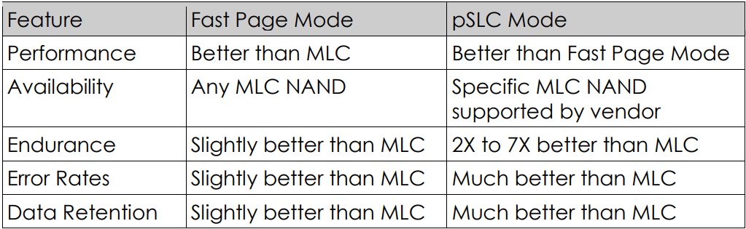
SLC/MLC Convertible Programming
Lifespan of SLC mode extends 7× more than MLC
Because SLC provides a half capacity in comparison to MLC, the endurance gain is 3.5× for the same amount of write operations
“Cactus Technologies, An overview of Pseudo-SLC NAND, White Paper, 2016”

Slide 17
SLC/MLC Convertible Programming
Extend lifespan by allocating parity pages to SLC-mode blocks
SLC blocks for parity block writes
MLC blocks for data block writes
Write Operation
RAID-Controller
Parity Stream
Data Stream
SSD
FTL
MLC
SLC
Parity
MLC
Data
MLC
Data
SLC Allocation
MLC Allocation
Parity
Data
Data
SLC
MLC
Parity Flash Blocks
Free Blocks
Data Flash Blocks

Slide 18
SLC/MLC Convertible Programming
Capacity shrinks when MLC blocks are used in SLC mode
SLC block is half the size of MLC block
Using MLC blocks as SLCs on demand may not guarantee the nameplated capacity
MLC|MLC
MLC|MLC
MLC|MLC
MLC|MLC
Capacity shrinks
SLC
SLC
MLC|MLC
MLC|MLC

Slide 19
SLC/MLC Convertible Programming
Capacity shrinks when MLC blocks are used in SLC mode
SLC block is half the size of MLC block
Using MLC blocks as SLCs on demand may not guarantee the nameplated capacity
Obtain extra blocks from over-provisioned area of SSDs
Usually up to 28% of the nameplate capacity for enterprise SSDs
Over-provisioned area
MLC|MLC
MLC|MLC
MLC|MLC
MLC|MLC
MLC|MLC
MLC|MLC
Keep same capacity
SLC
SLC
MLC|MLC
MLC|MLC
MLC|MLC
MLC|MLC

Slide 20
SLC/MLC Convertible Programming
The number of available SLC blocks is limited according to the over-provisioned area size
After reaching the upper limit, parity blocks will be allocated with MLC blocks
May increase the overhead of garbage collection
Require to dynamically determine the optimal number of SLC blocks
Over-provisioned area
MLC|MLC
MLC|MLC
MLC|MLC
MLC|MLC
MLC|MLC
MLC|MLC
Maximum available SLC blocks
SLC
SLC
SLC
SLC
MLC|MLC
MLC|MLC

Slide 21
Evaluation Environment
FIO
TPC-C
MySQL
YCSB
Cassandra
Input
RAID Controller in Linux
Added tags to identify parity write
I/O with parity info
ftrace
FlashSim SSD simulator
Block Layer
Added multi-stream, SLC/MLC convertible programming
Block level I/O with parity info
Simulation results
Seven SSDs with RAID-5

Slide 22
Parameters for SSD Simulator
Total block number |  | 2048
Over provisioned area |  | 28%
Page size |  | 16KB
No. of pages per block | SLC | 128
 | MLC | 256
Read delay | SLC | 20 us
 | MLC | 35 us
Write delay | SLC | 180 us
 | MLC | 390 us
Block erase latency |  | 4000 us
MLC:SLC write stress |  | 1.5×, 2.5×, 3.5×

Slide 23
Parameters for SSD Simulator
Total block number |  | 2048
Over provisioned area |  | 28%
Page size |  | 16KB
No. of pages per block | SLC | 128
 | MLC | 256
Read delay | SLC | 20 us
 | MLC | 35 us
Write delay | SLC | 180 us
 | MLC | 390 us
Block erase latency |  | 4000 us
MLC:SLC write stress |  | 1.5×, 2.5×, 3.5×

Slide 24
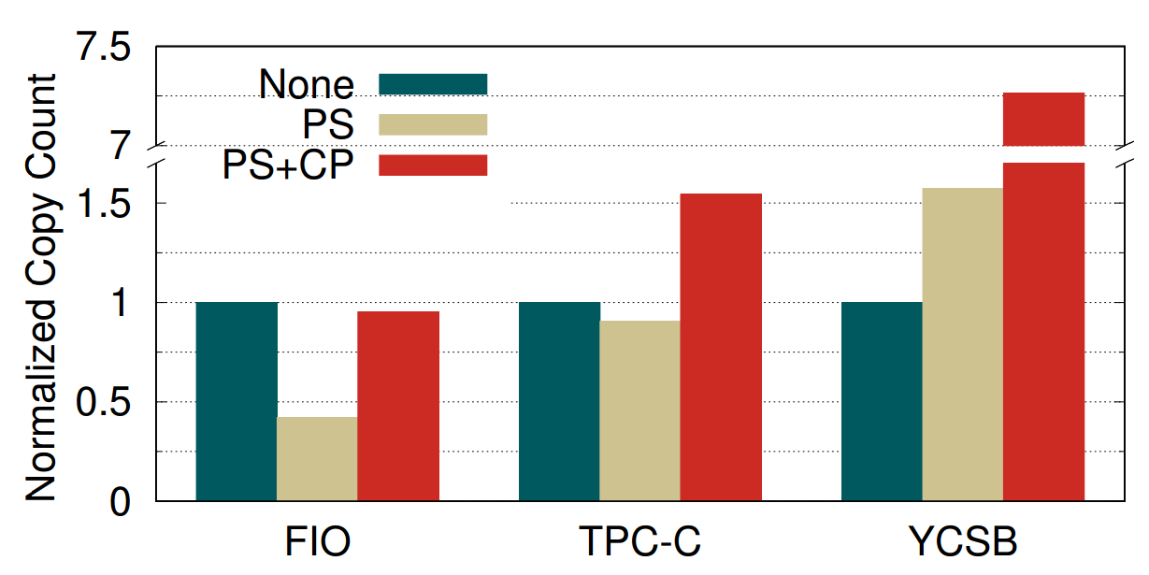
Reduced Page Copy Operations of Garbage Collection
When the number of page copy caused by GC is reduced, the response delays will be reduced as well
58%
PS : Parity-stream
CP : SLC/MLC Convertible Programming

Slide 25
Reduced Page Copy Operations for Garbage Collection
When the number of page copy caused by GC is reduced, the response delays will be reduced as well
Cassandra
Copy-on-write database
Architecture is not appropriate for our scheme
Buffered I/O
Direct I/O
PS : Parity-stream
CP : SLC/MLC Convertible Programming

Slide 26
Write Operation in Cassandra
Write Operation
Memory
Copy on write
Partial stripe writes are very small
Request large size of writes
No TRIM in the simulator
High capacity utilization
▶ Incapacitate parity separation
Memtable
Disk
Commit Log
SSTable
SSTable
Immutable
SSTable
SSTable

Slide 27
Reduced Page Copy Operations for Garbage Collection
Convertible programming shrinks the over-provisioned area
▶Increase Garbage collection overhead
High capacity utilization due to COW and logging
Most of copy operations in SLC mode
Performance decrease
< Copy operation increase
PS : Parity-stream
CP : SLC/MLC Convertible Programming

Slide 28
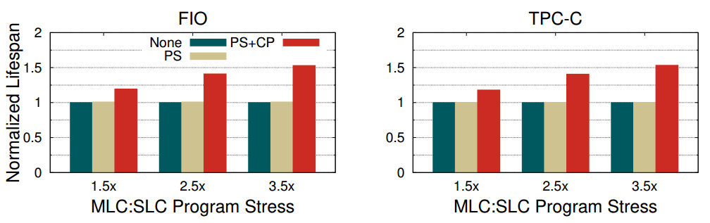
Expected Lifespans under Various MLC:SLC Stress
Counted the number of write operations with write overhead
Assumed that MLC write stress has 1.5× ~ 3.5× of SLC’s
53%
PS : Parity-stream
CP : SLC/MLC Convertible Programming

Slide 29
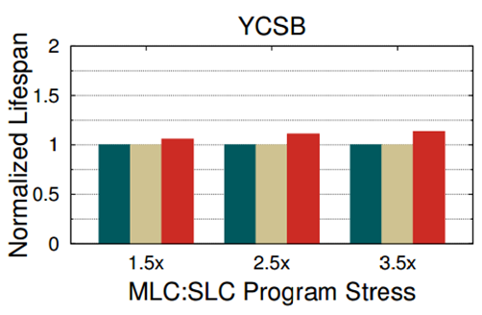
Expected Lifespans under Various MLC:SLC Stress
Counted the number of write operations with write overhead
Assumed that MLC write stress has 1.5× ~ 3.5× of SLC’s
The number of copy during GC was a relatively small portion of the total writes
The increased copy count barely affected lifespan
10%
PS : Parity-stream
CP : SLC/MLC Convertible Programming

Slide 30
Problem of SLC mode
Using SLC mode under condition of high capacity utilization
Shrink the relative size of over-provisioned area
Increase garbage collection overhead

Slide 31
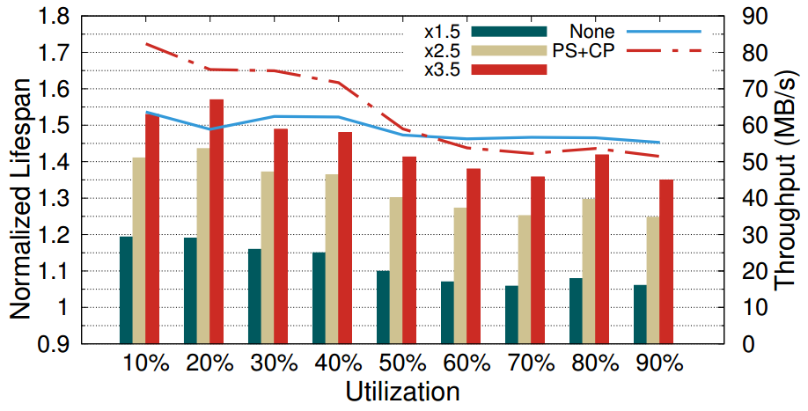
Overhead with Varying Capacity Utilization
Storage capacity is being severely underutilized in most of data centers
No TRIM in the simulator
Our approach will operate under favorable conditions most of the time
PS : Parity-stream
CP : SLC/MLC Convertible Programming
FIO microbenchmark
Lines mean throughput, bars mean normalized lifespan

Slide 32
Overhead with Varying Capacity Utilization
Although diminishment of lifespan improvement occurred,
our approach extends lifespan of SSD in all conditions

Slide 33
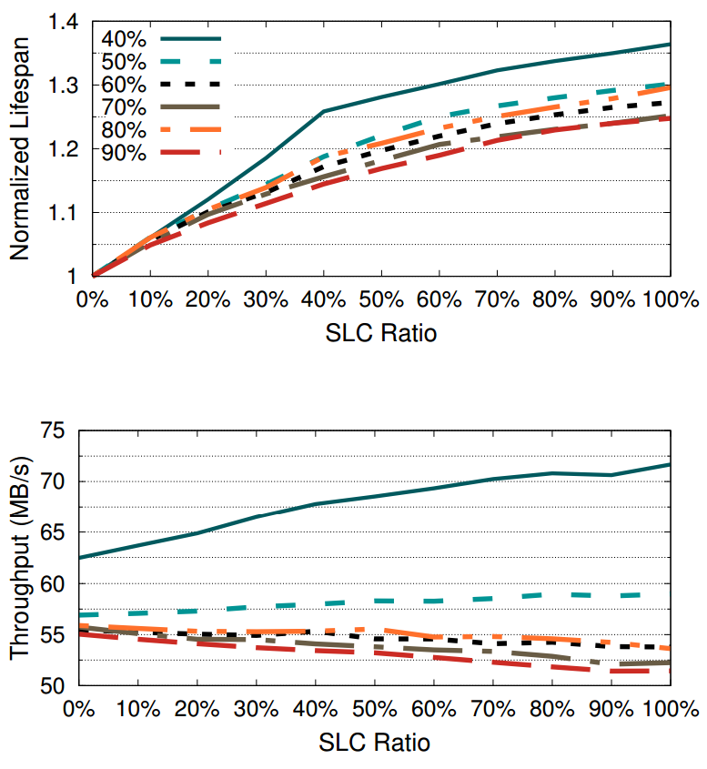
Overhead with Varying SLC Block Ratio
SLC Ratio 0% : Disable SLC mode of MLC blocks
SLC Ratio 100% : Enable all over-provisioned area to keep capacity
PS : Parity-stream
CP : SLC/MLC Convertible Programming
FIO microbenchmark
Each bar means capacity utilization

Slide 34
Conclusion
We identified that partial stripe writes in RAID systems reduce the lifespan
We proposed the parity-stream separation and SLC/MLC convertible programming
Our evaluation showed that not only reduced garbage collection, but also improved lifespan of SSDs
Garbage collection can be further reduced when the parity-stream is split into multiple streams based on the update patterns

Slide 35
Thank you
yoohyuk.lim@csl.skku.edu

