Slide 1

COMP 2501 Project Presentation
Hoe Young 3036385640

Slide 2

Global video game sales trends: Evolution of platforms, regions and categories
What are the trends of popular game platforms and game types.
Are there differences in game genre and platform popularity between different regions?

Slide 3
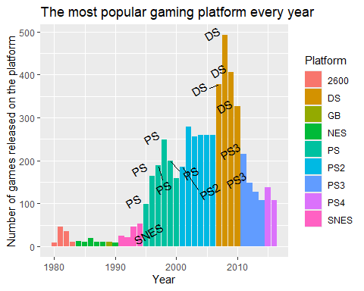
What are the trends of popular game platforms
1995-2000: PS
2000-2005: PS2
2005-2010: DS (Nintendo)
2010-2015: PS3
2015 onwards: PS4
The PS series of gaming platforms dominate the market

Slide 4
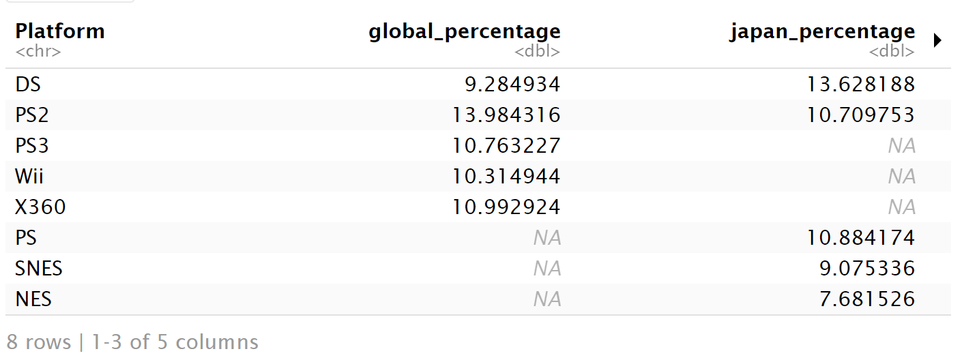
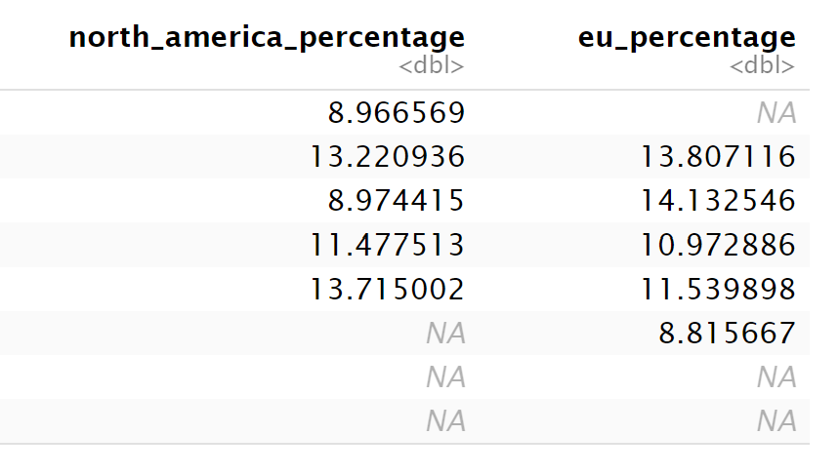
Market share of gaming platform in different regions
DS, PS2 and PS3 have the highest share in Japan, showing Japanese players prefer portable devices and PlayStation series.
Traditional consoles (SNES and NES) only have a high market share in Japan, shows that Japanese players are more nostalgic and stick to traditional gameplay.
Home consoles (Wii, X360) have higher market share in Western world, showing that they tend to play games at home

Slide 5
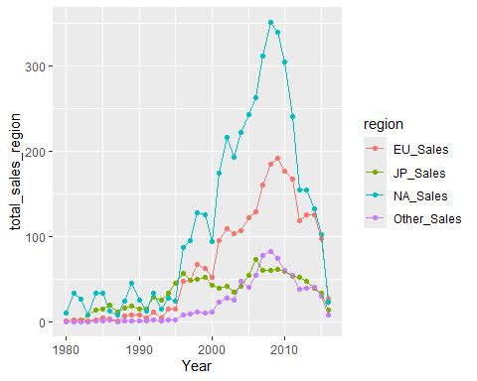
Game market trends by region
North America
European
Game sales
Japan
Other countries

Slide 6
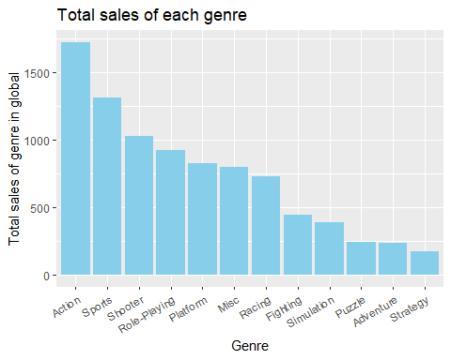


Total sales of each game genre
Action, sports and shooter games share the largest market share.

Slide 7
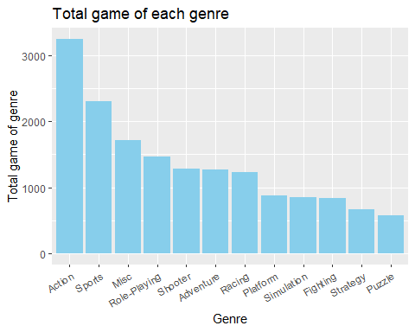


Although adventure have a middle number of game produced, but its sale is one of the lowest.
Although the production volume of shooting games is medium, their sales volume is higher than that of games with the same production volume.

Slide 8
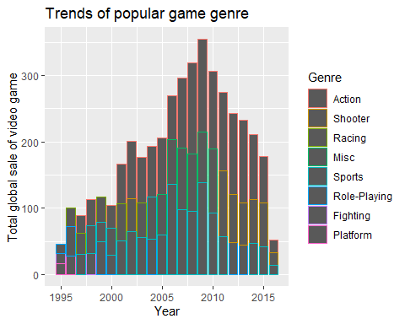
Trends of popular game genre
The action game is an evergreen category
The second popular genre trend:
  2005-2010: Misc
  2010-2015: Shooting

Slide 9
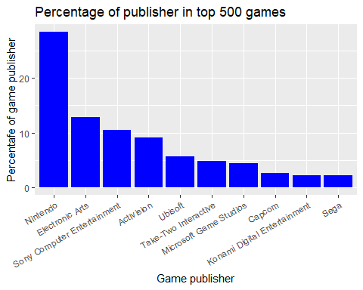
Among the top 500 games, the market share of games released by each publisher
Nintendo and Electronic Arts occupies one third of the total number of games.
Except Ubisoft (France), all companies are coming from Japan and USA, showing that Japan and the United States have a leading advantage in the gaming field

Slide 10

Let’s dive deeper into game sales by publisher in each region

Slide 11
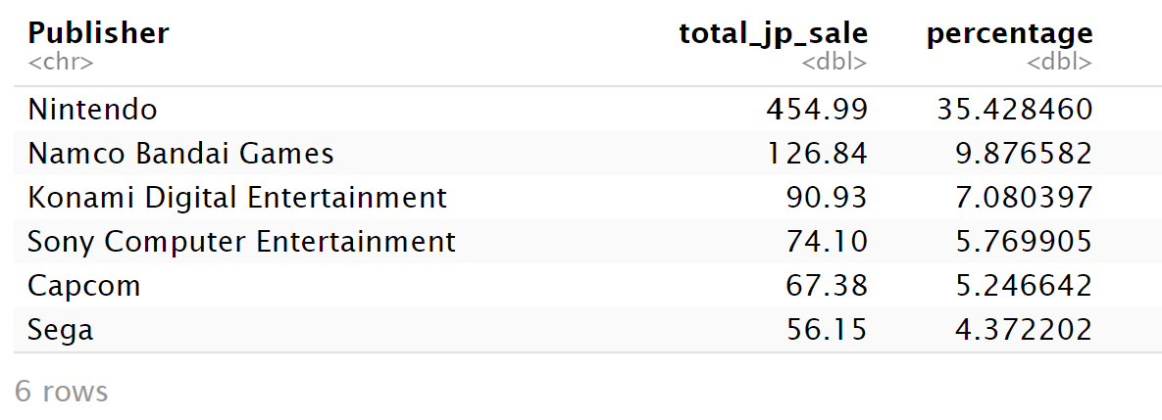
Japan
Games published by local Japanese game publishers are more popular in Japan
Nintendo's market share here is much higher than in other markets, indicating that the company's main focus may be the local market.

Slide 12
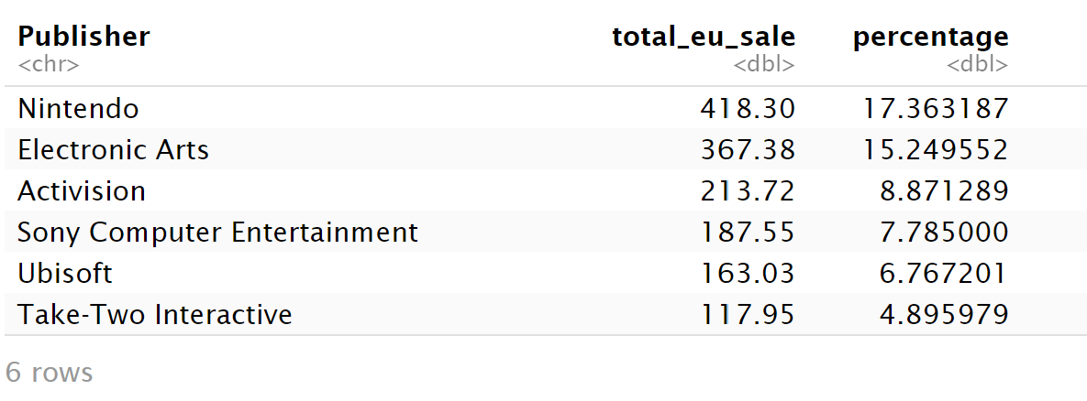
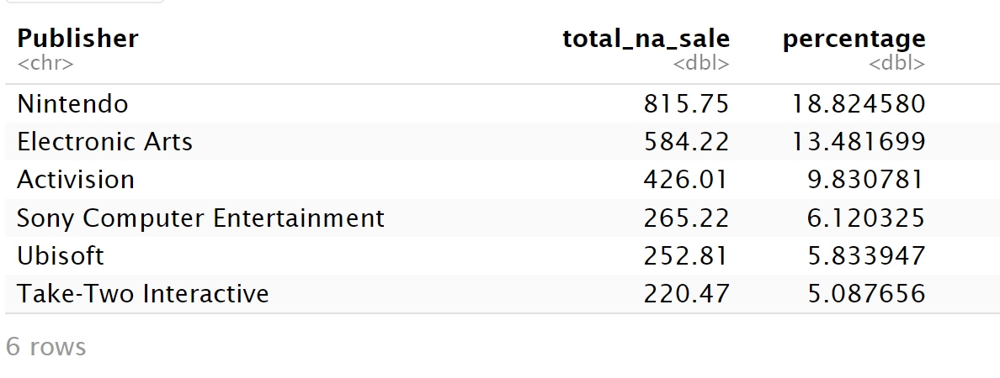
North America and Europe
North America
In the United States and Europe, the market share of game publishers on both sides is highly overlapping.
This may be due to the high cultural similarity, similar values ​​and similar living habits.
Europe

Slide 13
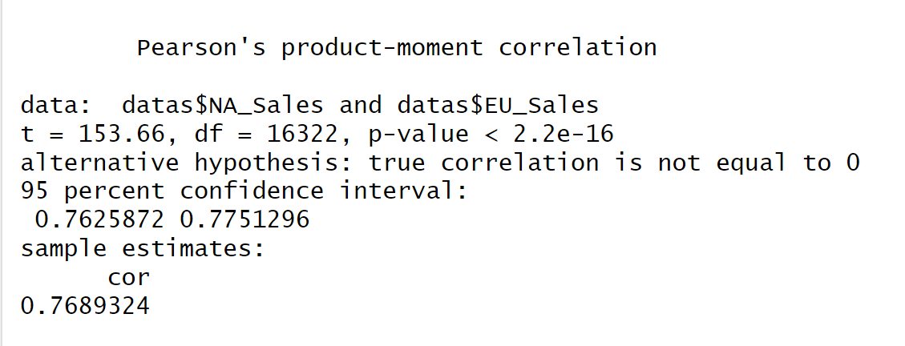
Correlation between game sales of North American and European sales
A high correlation shows between two market
Japan market game sales only shows a correlation of 0.451 between North America market, showing that there is indeed some close connection between Europe and the United States.

Slide 14

Predicting the probability of game success using Bayes' theorem
Assume a success game will have a global sales higher than 1 million
Comparing the success rate of Action (Highest sales) and Strategy (Lowest sales) games
The action genre success rate is 2% without indication other factor and the strategy genre success rate is only 0.6%
The differences of two genre is 2.978 times.

Slide 15
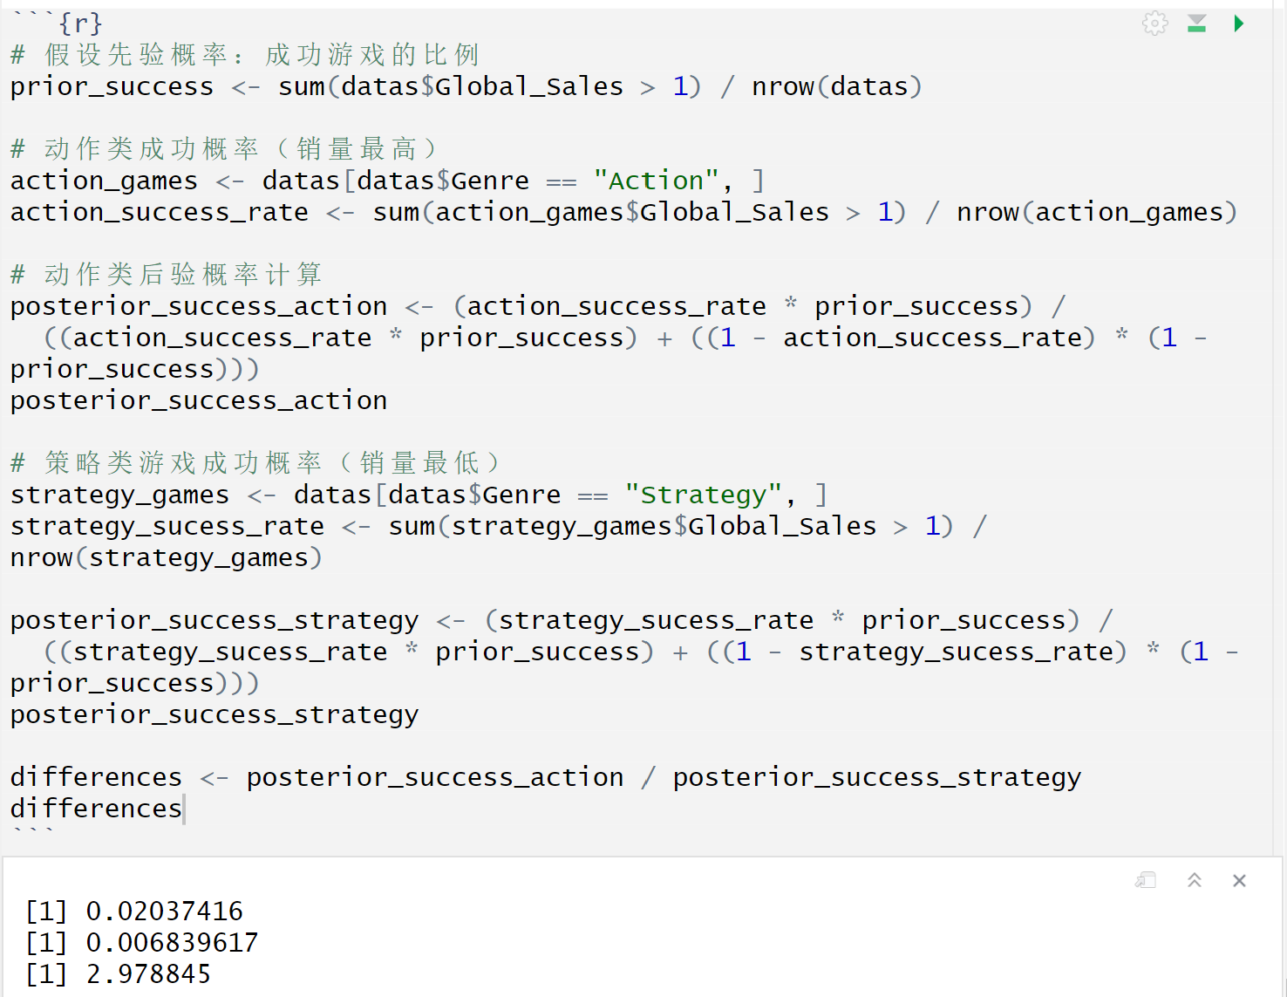
Calculation method

Slide 16
Limitations
Insufficient regional representation
The “Other countries” category is too general and may ignore unique trends in emerging markets (e.g., China, Southeast Asia).
Correlation ≠ Causation
The high correlation between the North American and European markets only indicates association, but cannot prove causation (e.g. cultural similarities, distribution strategies, etc.).
Assumptions and limitations of Bayesian theorem
The calculation of success rate ignore key variables such as marketing investment, IP effect, and platform exclusivity.

Slide 17

Thank you

