Slide 1
RxSwift Basics – Day 2
Younghwan Kim

Slide 2

RxSwift Basics
Day 1 – Observable, Operator (Filter, Transform, Combine)
Day 2 – Subject (flatMap, flatMapFirst, flatMapLatest)
Day 3 – Two VCs communications with Subject, RxCocoa (Button)
Day 4 – Sequential, Merged Observable Calls
Day 5 – RxCocoa, UI Binding (Button, TextField, Label, TableView)

Slide 3
Advanced RxSwift
Day 1 – Protocol-Oriented Programming, Protocol Extension, Associatetype
Day 2 – Network Call, Generic Enum
Day 3 – Binding Track Activity (show / hide ‘Loading’ ), Scan Operator
Day 4 – Adding a Reactive Extension to Custom UI Element,
2 Way Binding, Advanced TableView – RxDataSources
Day 5 – Schedulers (observeOn, subscribeOn),
Unit Test (RxTest, RxBlocking)

Slide 4
Subject
Observable
Observer
PublishSubject, BehaviorSubject, ReplaySubject
PublishRelay, BehaviorRelay (Variable)

Slide 5
Subject
• PublishSubject: Starts empty and only emits new elements to subscribers.
• BehaviorSubject: Starts with an initial value and replays it or the latest element to new subscribers.
• ReplaySubject: Initialized with a buffer size and will maintain a buffer of elements up to that size and replay it to new subscribers.
• Variable: Wraps a BehaviorSubject, preserves its current value as state, and replays only the latest/initial value to new subscribers.

Slide 6
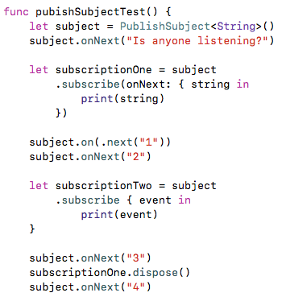
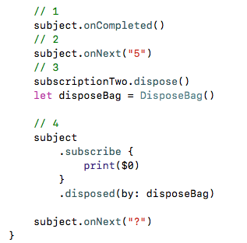
PublishSubject

Slide 7
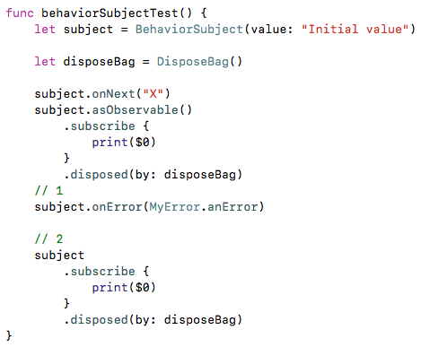
BehaviorSubject

Slide 8
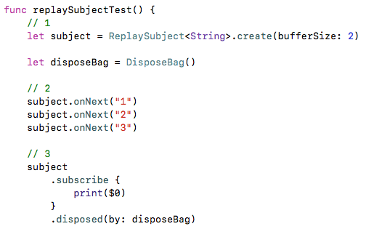
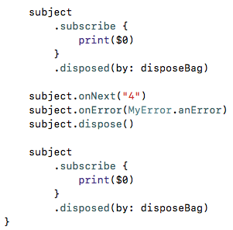
ReplaySubject

Slide 9
Lab - 1
BehaviorSubject, PublishSubject, ReplaySubject

Slide 10
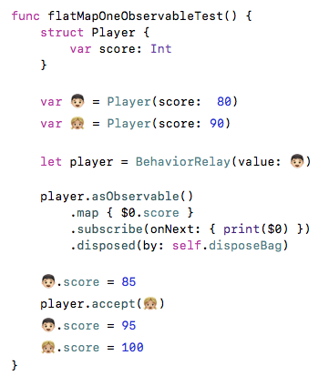
flatMap, flatMapFirst, flatMapLatest - 1

Slide 11
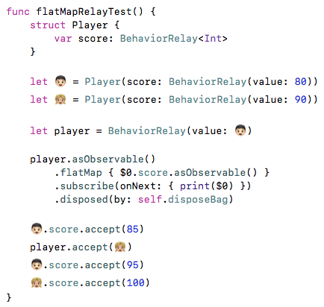
flatMap, flatMapFirst, flatMapLatest - 2

Slide 12
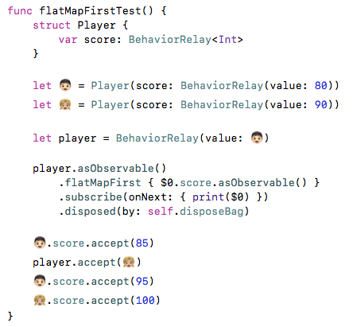
flatMap, flatMapFirst, flatMapLatest - 3

Slide 13
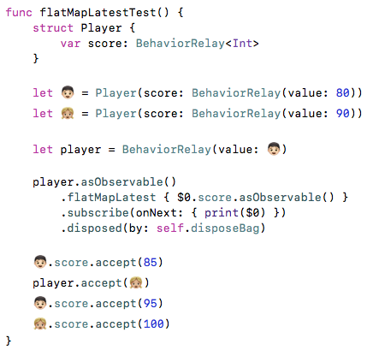
flatMap, flatMapFirst, flatMapLatest - 4

Slide 14
Lab -2
flatMap, flatMapFirst, flatMapLatest

Slide 15
BehaviorRelay
import RxSwift
/// BehaviorRelay is a wrapper for `BehaviorSubject`.
///
/// Unlike `BehaviorSubject` it can't terminate with error or completed.
public final class BehaviorRelay<Element>: ObservableType {
public typealias E = Element
private let _subject: BehaviorSubject<Element>
// Accepts `event` and emits it to subscribers
public func accept(_ event: Element) {
_subject.onNext(event)
}
/// Current value of behavior subject
public var value: Element {
// this try! is ok because subject can't error out or be disposed
return try! _subject.value()
}

Slide 16
BehaviorRelay
/// Initializes variable with initial value.
public init(value: Element) {
_subject = BehaviorSubject(value: value)
}
/// Subscribes observer
public func subscribe<O: ObserverType>(_ observer: O) -> Disposable where O.E == E {
return _subject.subscribe(observer)
}
/// - returns: Canonical interface for push style sequence
public func asObservable() -> Observable<Element> {
return _subject.asObservable()
}
}

