Slide 1
RxSwift Basics – Day 3
Younghwan Kim

Slide 2

RxSwift Basics
Day 1 – Observable, Operator (Filter, Transform, Combine)
Day 2 – Subject (flatMap, flatMapFirst, flatMapLatest)
Day 3 – Two VCs communications with Subject, RxCocoa (Button)
Day 4 – Sequential, Merged Observable Calls
Day 5 – RxCocoa, UI Binding (Button, TextField, Label, TableView)

Slide 3
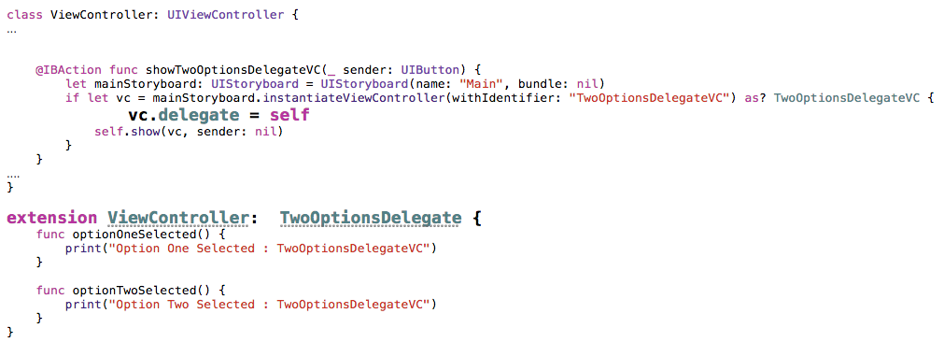
Two VCs : delegate - 1

Slide 4
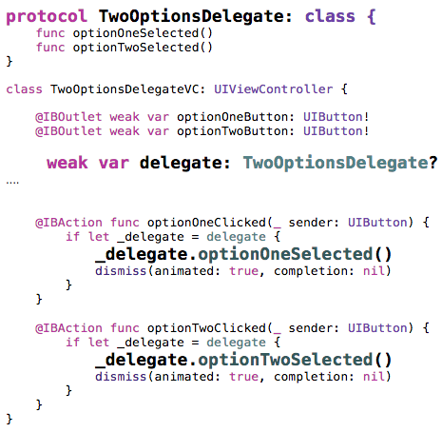
Two VCs : delegate - 2

Slide 5
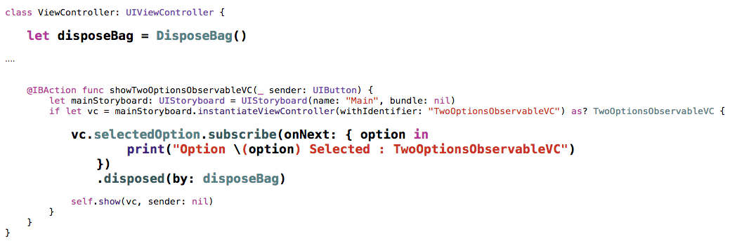
Two VCs : Observable - 1

Slide 6
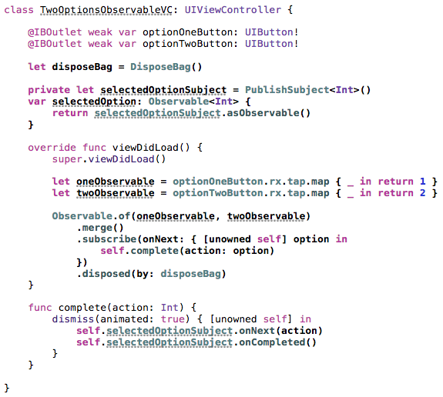
Two VCs : Observable - 2

Slide 7
Lab
Two VCs communications using subject

