Slide 1
RxSwift Basics – Day 4
Younghwan Kim

Slide 2

RxSwift Basics
Day 1 – Observable, Operator (Filter, Transform, Combine)
Day 2 – Subject (flatMap, flatMapFirst, flatMapLatest)
Day 3 – Two VCs communications with Subject, RxCocoa (Button)
Day 4 – Sequential, Merged Observable Calls
Day 5 – RxCocoa, UI Binding (Button, TextField, Label, TableView)

Slide 3
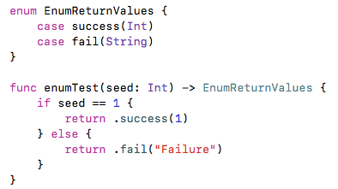
Enum - merge return values

Slide 4
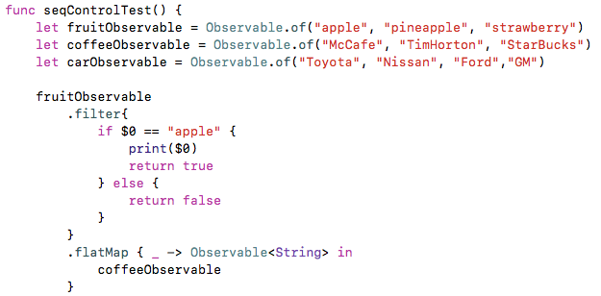
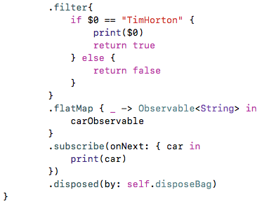
Sequential Call

Slide 5
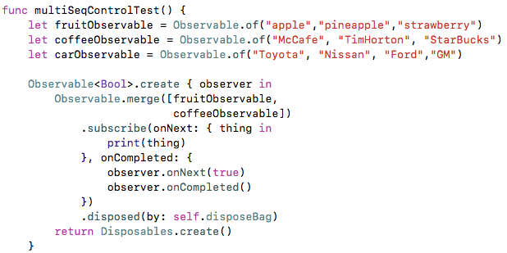
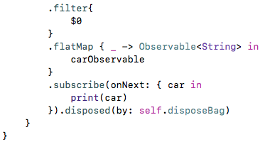
Multi- Sequential Call

Slide 6
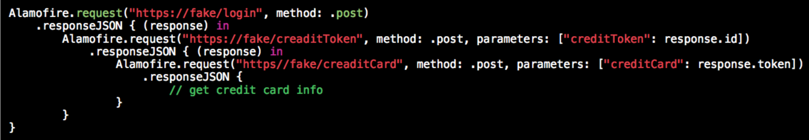
Traditional

Slide 7
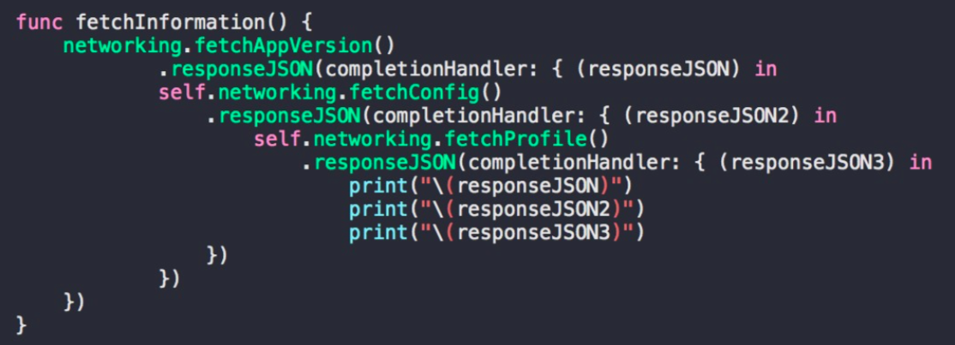
Traditional

Slide 8
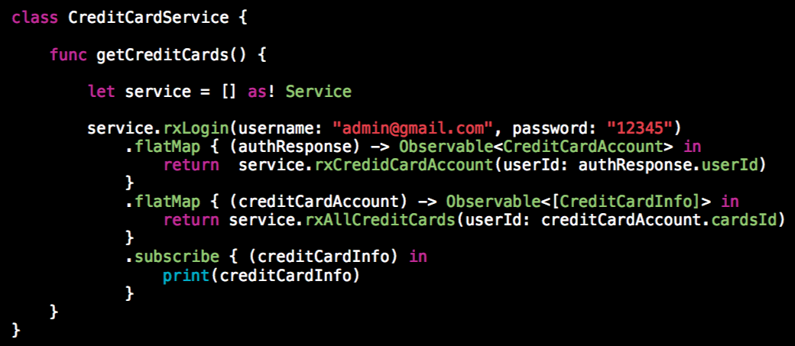
Reactive

Slide 9
Lab
Serial, Multi Calls
Different Type Observable

