Slide 1
RxSwift Basics – Day 5
Younghwan Kim

Slide 2

RxSwift Basics
Day 1 – Observable, Operator (Filter, Transform, Combine)
Day 2 – Subject (flatMap, flatMapFirst, flatMapLatest)
Day 3 – Two VCs communications with Subject, RxCocoa (Button)
Day 4 – Sequential, Merged Observable Calls
Day 5 – RxCocoa, UI Binding (Button, TextField, Label, TableView)

Slide 3
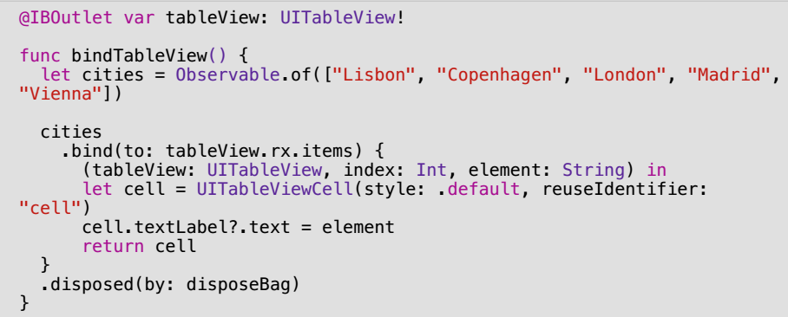
Simple Table View

Slide 4
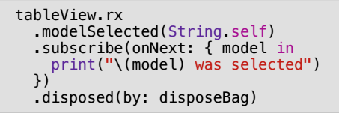
Simple Table View

Slide 5
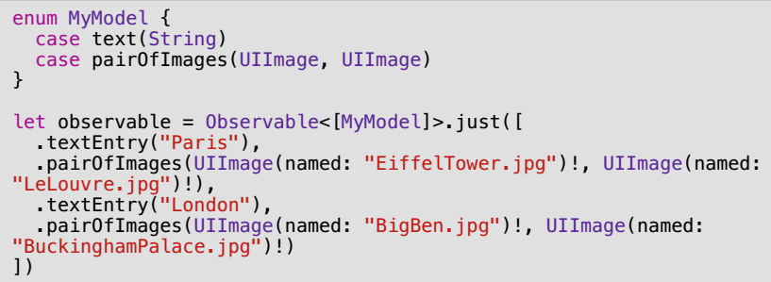
Table View – Multi Cell

Slide 6
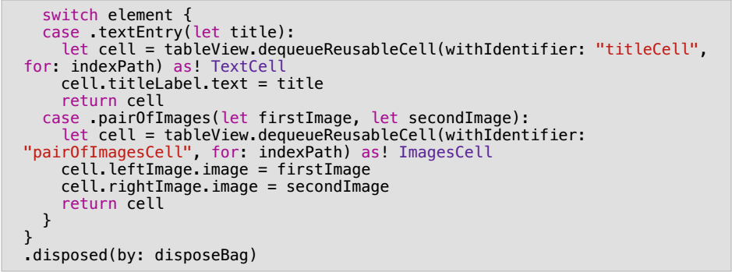
Table View – Multi Cell

Slide 7
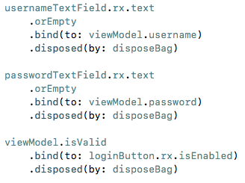
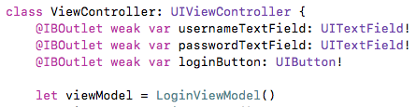
TextField – Binding

Slide 8
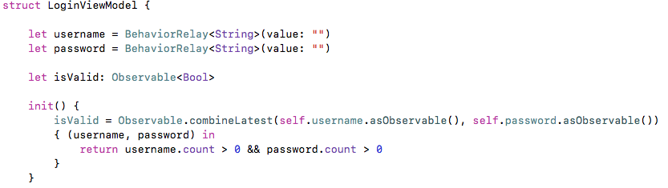
TextField – Binding

Slide 9
Comprehensive Lab
Observable
Create login and get profile observables
Sequential Call – Two Observables
RxCocoa UI Binding – button, textfield, TableView
Subject, Relay

