Slide 1
RxSwift Basics – Day 4
Younghwan Kim

Slide 2

RxSwift Basics
Day 1 – Observable, Operator (Filter, Transform, Combine)
Day 2 – Subject (flatMap, flatMapFirst, flatMapLatest)
Day 3 – Two VCs communications with Subject, RxCocoa (Button)
Day 4 – Sequential, Merged Observable Calls
Day 5 – RxCocoa, UI Binding (Button, TextField, Label, TableView)

Slide 3
Advanced RxSwift
Day 1 – Protocol-Oriented Programming, Protocol Extension, Associatetype
Day 2 – Network Call, Generic Enum
Day 3 – Binding Track Activity (show / hide ‘Loading’ ), Scan Operator
Day 4 – Adding a Reactive Extension to Custom UI Element,
2 Way Binding, Advanced TableView – RxDataSources
Day 5 – Schedulers (observeOn, subscribeOn),
Unit Test (RxTest, RxBlocking)

Slide 4
Operation
let backgroundOperation = Operation()
backgroundOperation.queuePriority = .low
backgroundOperation.qualityOfService = .background
let operationQueue = OperationQueue.main
operationQueue.addOperation(backgroundOperation)
let networkingOperation: Operation = ...
let resizingOperation: Operation = ...
resizingOperation.addDependency(networkingOperation)
let operationQueue = OperationQueue.main
operationQueue.addOperations([networkingOperation, resizingOperation],
waitUntilFinished: false)

Slide 5
Operation
let operation = Operation()
operation.completionBlock = {
print("Completed")
}
OperationQueue.main.addOperation(operation)

Slide 6
DispatchGroup
let dispatchGroup = DispatchGroup()
dispatchGroup.enter()
longRunningFunction { dispatchGroup.leave() }
dispatchGroup.enter()
longRunningFunctionTwo { dispatchGroup.leave() }
//Case 1. Sequential
dispatch_group_wait(dispatchGroup, DISPATCH_TIME_FOREVER)
//Case 2. All Completion
dispatchGroup.notify(queue: .main) {
print("Both functions complete")
}

Slide 7
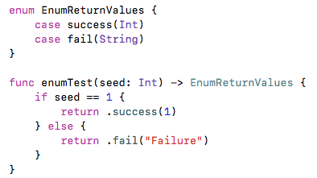
Enum - merge return values

Slide 8
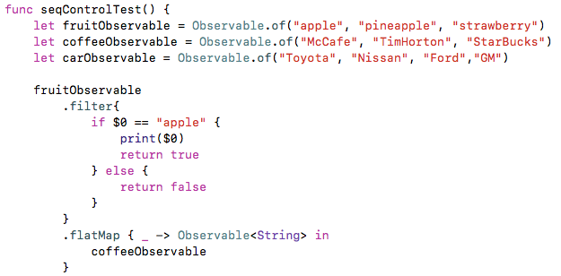
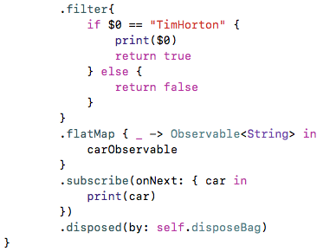
Sequential Call

Slide 9
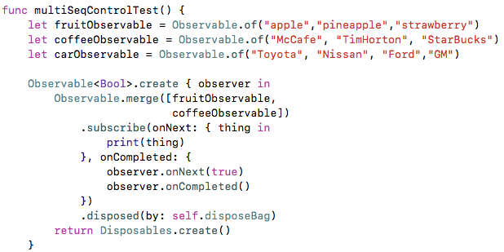
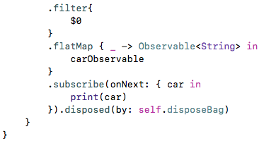
Multi- Sequential Call

Slide 10
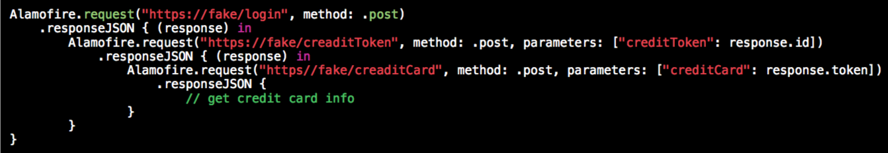
Traditional

Slide 11
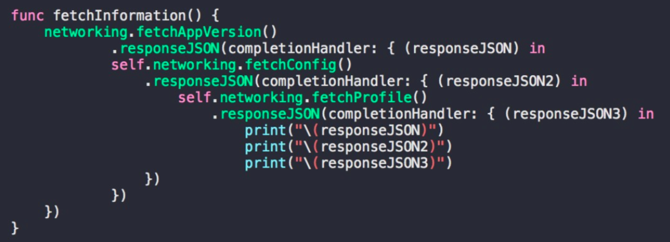
Traditional

Slide 12
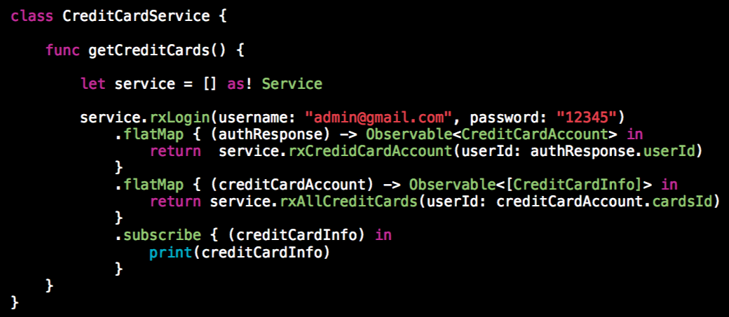
Reactive

Slide 13
Lab
Serial, Multi Calls
Different Type Observable

