Slide 1
Advanced RxSwift – Day 5
Younghwan Kim

Slide 2

RxSwift Basics
Day 1 – Observable, Operator (Filter, Transform, Combine)
Day 2 – Subject (flatMap, flatMapFirst, flatMapLatest)
Day 3 – Two VCs communications with Subject, RxCocoa (Button)
Day 4 – Sequential, Merged Observable Calls
Day 5 – RxCocoa, UI Binding (Button, TextField, Label, TableView)

Slide 3
Advanced RxSwift
Day 1 – Protocol-Oriented Programming, Protocol Extension, Associatetype
Day 2 – Network Call, Generic Enum
Day 3 – Binding Track Activity (show / hide ‘Loading’ ), Scan Operator
Day 4 – Adding a Reactive Extension to Custom UI Element,
2 Way Binding, Advanced TableView – RxDataSources
Day 5 – Schedulers (observeOn, subscribeOn),
Unit Test (RxTest, RxBlocking)

Slide 4
Scheduler – observeOn, subscribeOn
Observable<Int>.create { observer in
print(Thread.isMainThread)
observer.onNext(1)
sleep(1)
observer.onNext(2)
return Disposables.create()
}
.observeOn(MainScheduler.instance)
.subscribeOn(ConcurrentDispatchQueueScheduler(qos: .background))
.subscribe(onNext: { el in
print(Thread.isMainThread)
}).disposed(by: disposeBag)

Slide 5
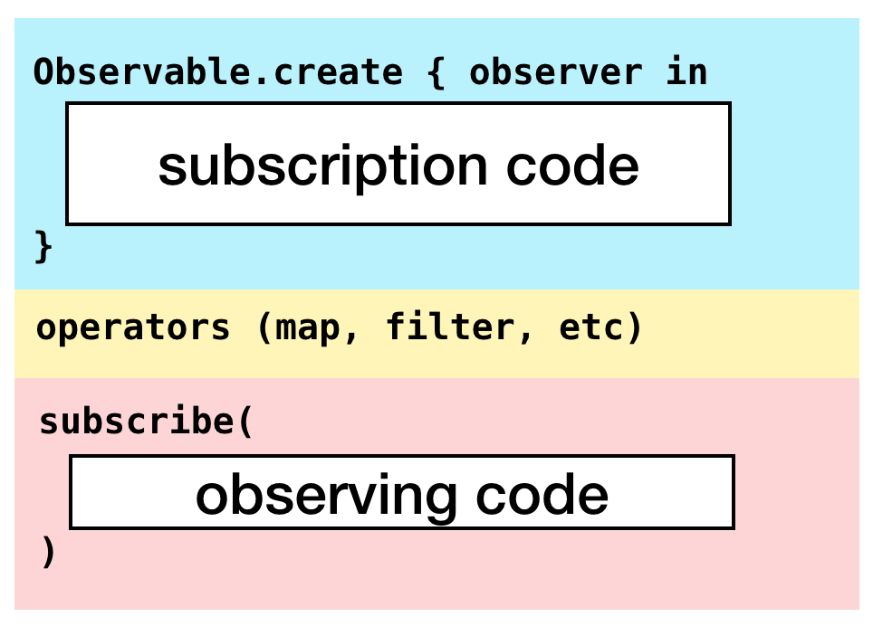
Scheduler – observeOn, subscribeOn

Slide 6
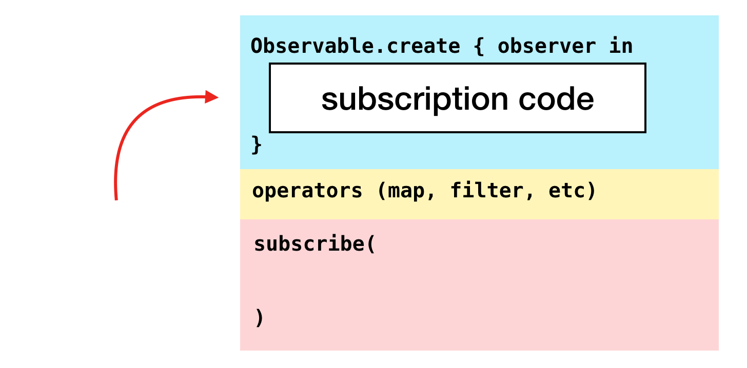
Scheduler – observeOn, subscribeOn

Slide 7
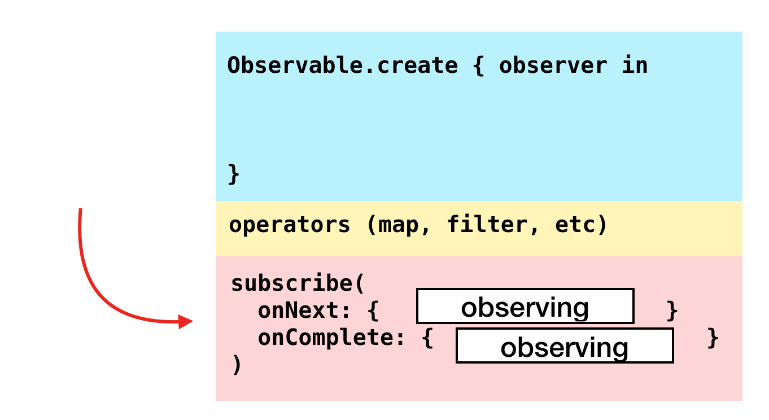
Scheduler – observeOn, subscribeOn

Slide 8
Schedulers
CurrentThreadScheduler (Serial) – schedules on the current thread, this is also the default scheduler.
MainScheduler (Serial) – schedules on the main thread.
SerialDispatchQueueScheduler (Serial) – schedules on a specific queue (dispatch_queue_t).
ConcurrentDispatchQueueScheduler (Concurrent) – schedules on a specific queue (dispatch_queue_t).
OperationQueueScheduler (Concurrent) – schedules on a specific queue (NSOperationQueue).

Slide 9
MainScheduler
Abstracts work that needs to be performed on MainThread. In case schedule
methods are called from the main thread, it will perform the action immediately
without scheduling.This scheduler is usually used to perform UI work.
MainScheduler.instance

Slide 10
CurrentThreadScheduler
Schedules units of work on the current thread.
This is the default scheduler for operators that generate elements.

Slide 11
SerialDispatchQueueScheduler
Abstracts the work that needs to be performed on a specific dispatch_queue_t.
It will make sure that even if a concurrent dispatch queue is passed, it's transformed
into a serial one.Serial schedulers enable certain optimizations for observeOn.
The main scheduler is an instance of SerialDispatchQueueScheduler
SerialDispatchQueueScheduler(qos: .default)

Slide 12
ConcurrentDispatchQueueScheduler
Abstracts the work that needs to be performed on a specific dispatch_queue_t.
You can also pass a serial dispatch queue, it shouldn't cause any problems.
This scheduler is suitable when some work needs to be performed in the background.
ConcurrentDispatchQueueScheduler(qos: .background)
ConcurrentDispatchQueueScheduler(queue: DispatchQueue.global())

Slide 13
OperationQueueScheduler
Abstracts the work that needs to be performed on a specific NSOperationQueue.
This scheduler is suitable for cases when there is some bigger chunk of work that
needs to be performed in the background and you want to fine tune concurrent
processing using maxConcurrentOperationCount.

Slide 14
OperationQueueScheduler
let operationQueue = NSOperationQueue()
operationQueue.maxConcurrentOperationCount = 3
operationQueue.qualityOfService = NSQualityOfService.UserInitiated
let backgroundWorkScheduler
= OperationQueueScheduler(operationQueue: operationQueue)
videoUpload
.observeOn(backgroundWorkScheduler)
.map({ json in
return json["videoUrl"].stringValue
})
.observeOn(MainScheduler.sharedInstance)
.subscribe(onNext: { url
self.urlLabel.text = url
}).disposed(by disposeBag)

Slide 15
TestScheduler
TestScheduler is a special kind of beast. It’s meant only to be used in testing, so try not to use this scheduler in production code.
This special scheduler simplifies operator testing; it’s part of the RxTest library. You will have a look into using this scheduler in the dedicated chapter about testing, but let's have a quick look since you're doing the grand tour of schedulers.

Slide 16
RxTest
TestableObserver<ElementType> - an observer, which records all emitted events so you can inspect them and run your asserts on those events
TestScheduler - a scheduler which let’s you control values and time, and let’s you create testable observers
TestObservable - Observable, where you can pass what events should it send at given schedule
== (lhs: Event<Element>, rhs: Event<Element>) adds Equatable implementation to Rx events so you can easily check recorded events

Slide 17
RxTest
struct CornSorter {
let barnStream: Observable<String>
init(tractorStream: Observable<String>) {
barnStream = tractorStream
.filter { $0 == "🌽" }
}
}

Slide 18
RxTest
func testCornSorter() {
var scheduler: TestScheduler!
let disposeBag = DisposeBag()
scheduler = TestScheduler(initialClock: 0)
let testObserver = scheduler.createObserver(String.self)
// Given
let observableInput = scheduler.createHotObservable([
// 2
Recorded.next(100, "🌽"),
Recorded.next(200, "🐛"),
Recorded.next(300, "🐭"),
Recorded.next(400, "🌽"),
Recorded.next(500, "🐝"),
Recorded.next(600, "🐞")
])
let cornSorter = CornSorter(tractorStream: observableInput.asObservable())

Slide 19
RxTest
// When
cornSorter.barnStream
.subscribe(testObserver)
.disposed(by: disposeBag)
scheduler.start()
// Then
let results = testObserver.events.map {
$0.value.element!
}
_ = XCTAssertEqual(results, ["🌽", "🌽"])
}

Slide 20
RxBlocking
RxBlocking on the other hand is handy in case you need to test some asynchronous functionality where you can’t control the source of asynchronisity. Often times this means you’re stepping up from unit tests to integration test.
What RxBlocking is great to is to allow you to consume an observable sequence in batches or even wait on a single element to be emitted.

Slide 21
RxBlocking
func testElements() {
let items = Observable.of(1, 5, 10, 15, 20)
let elements = try! items.toBlocking().toArray()
XCTAssertEqual([1, 5, 10, 15, 20], elements)
let results = try! items.skip(3).take(2).toBlocking().toArray()
XCTAssertEqual([15, 20], results)
}

Slide 22
RxBlocking
func testCountryInfoFlow() {
let scheduler = ConcurrentDispatchQueueScheduler(qos: .default)
do {
let myArray = try BordersBusinessLogic.shared.countryInfoFlow(code: "FRA")
.subscribeOn(scheduler)
.toBlocking()
.toArray()
if let countryInfo = myArray.first {
switch countryInfo {
case .success(_):
XCTAssert(true)
break
case .failure(_):
XCTAssert(false)
break
}
}
} catch(let e) { XCTAssert(false, e.localizedDescription)
}
}

