Slide 1
Advanced RxSwift – Day 1
Younghwan Kim

Slide 2

RxSwift Basics
Day 1 – Observable, Operator (Filter, Transform, Combine)
Day 2 – Subject (flatMap, flatMapFirst, flatMapLatest)
Day 3 – Two VCs communications with Subject, RxCocoa (Button)
Day 4 – Sequential, Merged Observable Calls
Day 5 – RxCocoa, UI Binding (Button, TextField, Label, TableView)

Slide 3
Advanced RxSwift
Day 1 – Protocol-Oriented Programming, Protocol Extension, Associatetype
Day 2 – Network Call, Generic Enum
Day 3 – Binding Track Activity (show / hide ‘Loading’ ), Scan Operator
Day 4 – Adding a Reactive Extension to Custom UI Element,
2 Way Binding, Advanced TableView – RxDataSources
Day 5 – Schedulers (observeOn, subscribeOn),
Unit Test (RxTest, RxBlocking)

Slide 4
Protocol-Oriented Programming in Swift
WWDC 2015 – Session 408
At the heart of Swift's design are two incredibly powerful ideas: protocol-oriented programming
and first class value semantics. Each of these concepts benefit predictability, performance,
and productivity, but together they can change the way we think about programming.
Find out how you can apply these ideas to improve the code you write.
https://developer.apple.com/videos/play/wwdc2015/408/

Slide 5
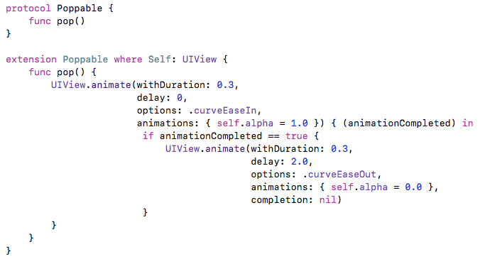
Protocol – Example 1

Slide 6
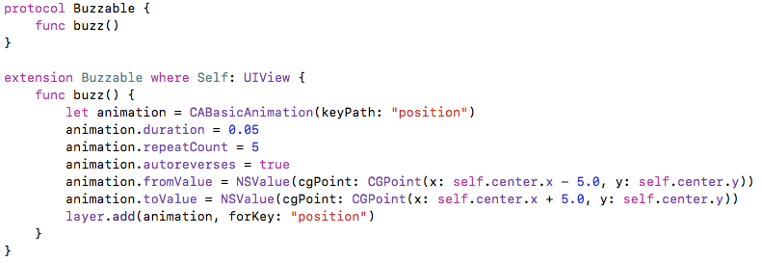
Protocol – Example 2

Slide 7
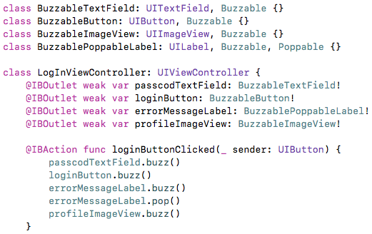
Protocol – Example 3

Slide 8
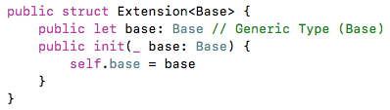
Grouping – Protocol Extension, associatetype

Slide 9

Grouping – Protocol Extension, associatetype

Slide 10
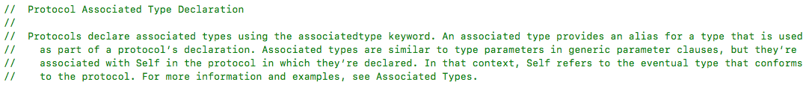
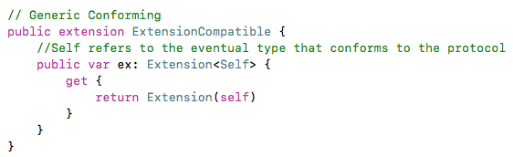
Grouping – Protocol Extension, associatetype

Slide 11
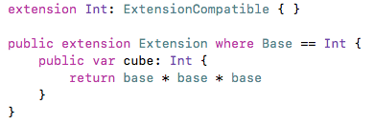
Grouping – Protocol Extension, associatetype

Slide 12
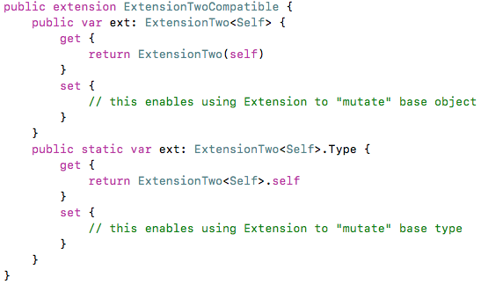
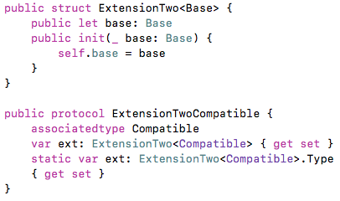
Grouping – Protocol Extension, associatetype

Slide 13
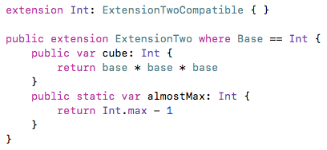

Grouping – Protocol Extension, associatetype

Slide 14
RxSwift – Reactive.swift
https://github.com/ReactiveX/RxSwift/blob/master/RxSwift/Reactive.swift

Slide 15
RxSwift – Reactive.swift
public struct Reactive<Base> {
/// Base object to extend.
public let base: Base
/// Creates extensions with base object.
public init(_ base: Base) {
self.base = base
}
}
/// A type that has reactive extensions.
public protocol ReactiveCompatible {
/// Extended type
associatedtype CompatibleType
/// Reactive extensions.
static var rx: Reactive<CompatibleType>.Type { get set }
/// Reactive extensions.
var rx: Reactive<CompatibleType> { get set }
}

Slide 16
RxSwift – Reactive.swift
extension ReactiveCompatible {
/// Reactive extensions.
public static var rx: Reactive<Self>.Type {
get {
return Reactive<Self>.self
}
set {// this enables using Reactive to "mutate" base type }
}
/// Reactive extensions.
public var rx: Reactive<Self> {
get {
return Reactive(self)
}
set {// this enables using Reactive to "mutate" base object }
}
}
import class Foundation.NSObject
/// Extend NSObject with `rx` proxy.
extension NSObject: ReactiveCompatible { }

