Slide 1
Advanced RxSwift – Day 2
Younghwan Kim

Slide 2

RxSwift Basics
Day 1 – Observable, Operator (Filter, Transform, Combine)
Day 2 – Subject (flatMap, flatMapFirst, flatMapLatest)
Day 3 – Two VCs communications with Subject, RxCocoa (Button)
Day 4 – Sequential, Merged Observable Calls
Day 5 – RxCocoa, UI Binding (Button, TextField, Label, TableView)

Slide 3
Advanced RxSwift
Day 1 – Protocol-Oriented Programming, Protocol Extension, Associatetype
Day 2 – Network Call, Generic Enum
Day 3 – Binding Track Activity (show / hide ‘Loading’ ), Scan Operator
Day 4 – Adding a Reactive Extension to Custom UI Element,
2 Way Binding, Advanced TableView – RxDataSources
Day 5 – Schedulers (observeOn, subscribeOn),
Unit Test (RxTest, RxBlocking)

Slide 4
Integrate with API Call
API Call (create Observable)
Flow Control in API calls ( filter, flatMap operation in Observables)
Create View Model ( BehaviorSubject )
Data Model ( demo ‘Quick Type’)
UI Binding (TableView and ViewModel)

Slide 5
Integrate with API Call
API Call (create Observable)
Country Info
https://restcountries.eu/rest/v2/alpha/DEU
Border Countries
https://restcountries.eu/rest/v2/alpha?codes=DEU;FRA;ITA;

Slide 6
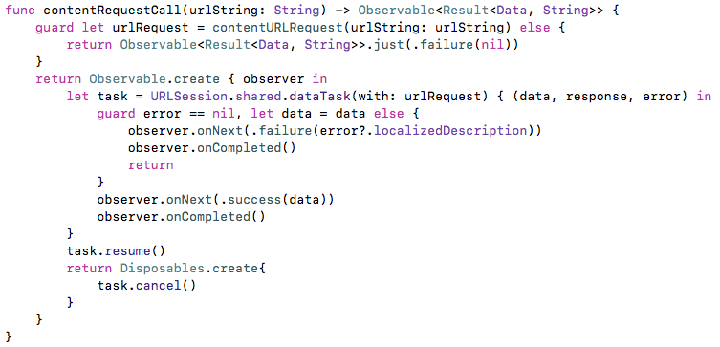
Integrate with API Call

Slide 7
Generic Enum
Generic Enum (Video)

Slide 8
Error Handling with Result Type
Error Handling with Result Type (Video)

Slide 9
Integrate with API Call
Generic Enum : Result in AlamoFire
https://github.com/Alamofire/Alamofire/blob/master/Source/Result.swift

Slide 10
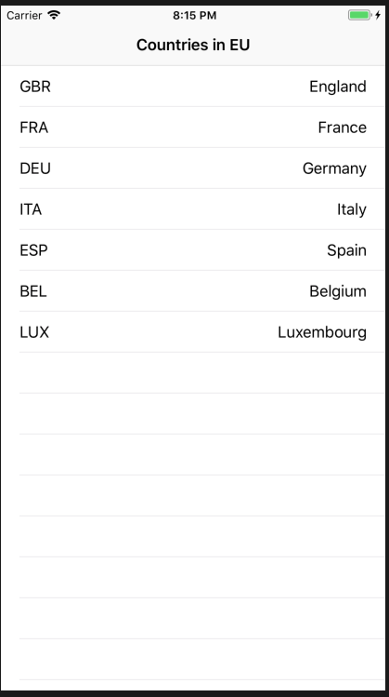
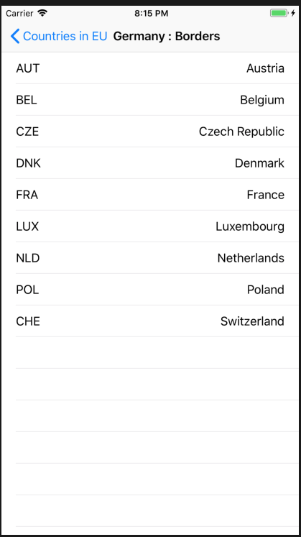
Lab

