Slide 1
RxSwift Basics – Day 1
Younghwan Kim

Slide 2

RxSwift Basics
Day 1 – Observable, Operator (Filter, Transform, Combine)
Day 2 – Subject (flatMap, flatMapFirst, flatMapLatest)
Day 3 – Two VCs communications with Subject, RxCocoa (Button)
Day 4 – Sequential, Merged Observable Calls
Day 5 – RxCocoa, UI Binding (Button, TextField, Label, TableView)

Slide 3
Advanced RxSwift
Day 1 – Protocol-Oriented Programming, Protocol Extension, Associatetype
Day 2 – Network Call, Generic Enum
Day 3 – Binding Track Activity (show / hide ‘Loading’ ), Scan Operator
Day 4 – Adding a Reactive Extension to Custom UI Element,
2 Way Binding, Advanced TableView – RxDataSources
Day 5 – Schedulers (observeOn, subscribeOn),
Unit Test (RxTest, RxBlocking)

Slide 4
Reactive Programming Overview
Reactive Programming Overview (Jafar Hussain from Netflix)
https://www.youtube.com/watch?v=dwP1TNXE6fc

Slide 5
Reactive Extensions
What are Reactive Extensions (Video)

Slide 6
Marble Diagrams
Use Marble Diagrams(Video)

Slide 7
Observable Sequence
Observable
Emits events over time
Observer
Subscribe to listen events emitted by the observable

Slide 8
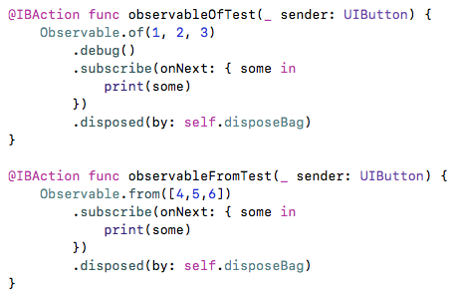
Observable Sample - 1

Slide 9
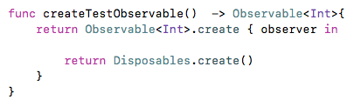
Observable Sample - 2

Slide 10
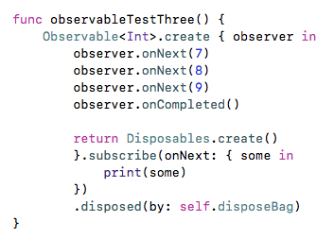
Observable Sample - 3

Slide 11
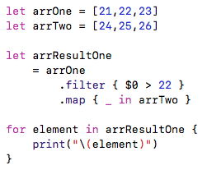
map vs flatMap - 1

Slide 12
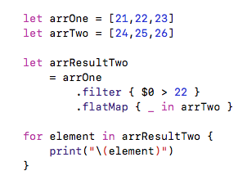
map vs flatMap - 2

Slide 13
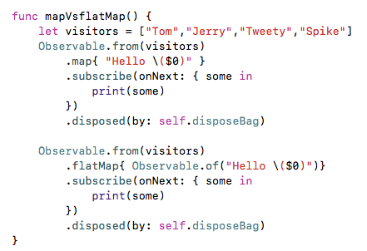
map vs flatMap - 3

Slide 14
Lab - 1
Create Observables
Pikachu, Ash, Misty, Brock, Charmander, Squirtle
of
from
create

Slide 15
Lab - 2
filter
1,2,3,4,5 => less than 3
map
1,2,3,4,5 => 10,20,30,40,50

Slide 16


Lab - 3
merge, concat
Create two observables and use merge and concat operator

Slide 17
Lab - 4
map vs flatMap
Input 1,2,3
Output 1.
[2,3]
[4,6]
[6,9]
Output 2
2
3
4
6
6
9

