Slide 1
RxSwift Basics – Day 4
Younghwan Kim

Slide 2

RxSwift Basics
Day 1 – Observable, Operator (Filter, Transform, Combine)
Day 2 – Subject (flatMap, flatMapFirst, flatMapLatest)
Day 3 – Two VCs communications with Subject, RxCocoa (Button)
Day 4 – Sequential, Merged Observable Calls
Day 5 – RxCocoa, UI Binding (Button, TextField, Label, TableView)

Slide 3
Advanced RxSwift
Day 1 – Protocol-Oriented Programming, Protocol Extension, Associatetype
Day 2 – Network Call, Generic Enum
Day 3 – Binding Track Activity (show / hide ‘Loading’ ), Scan Operator
Day 4 – Adding a Reactive Extension to Custom UI Element,
2 Way Binding, Advanced TableView – RxDataSources
Day 5 – Schedulers (observeOn, subscribeOn),
Unit Test (RxTest, RxBlocking)

Slide 4
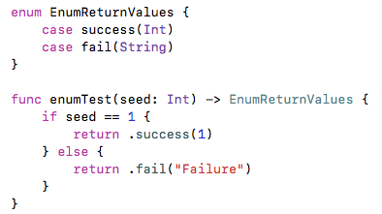
Enum - merge return values

Slide 5
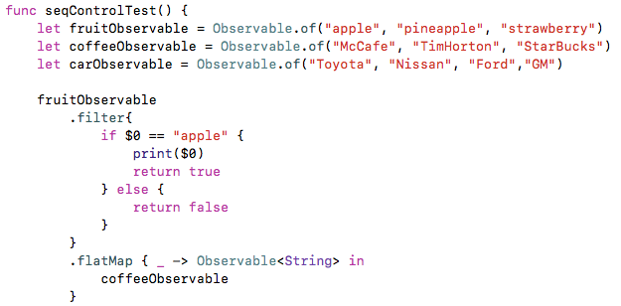
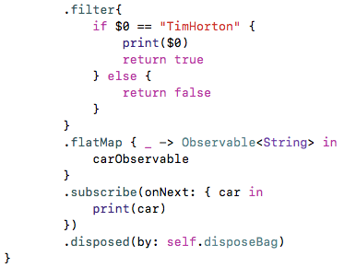
Sequential Call

Slide 6
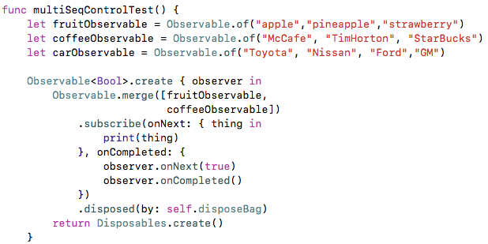
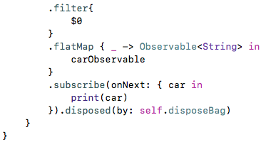
Multi- Sequential Call

Slide 7
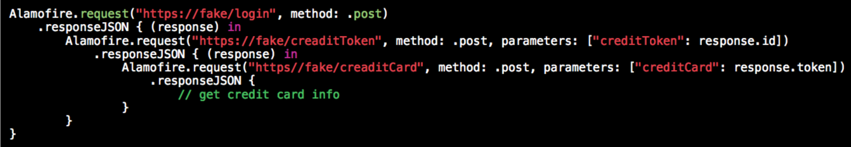
Traditional

Slide 8
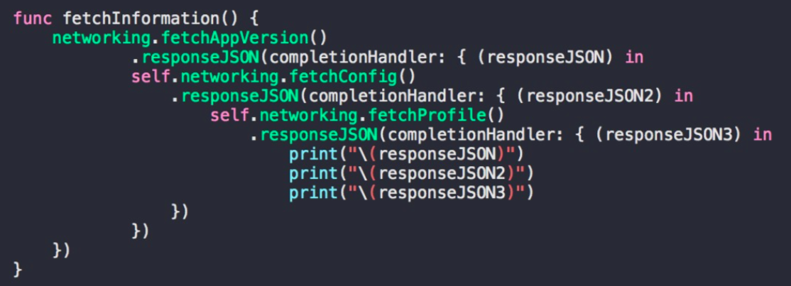
Traditional

Slide 9
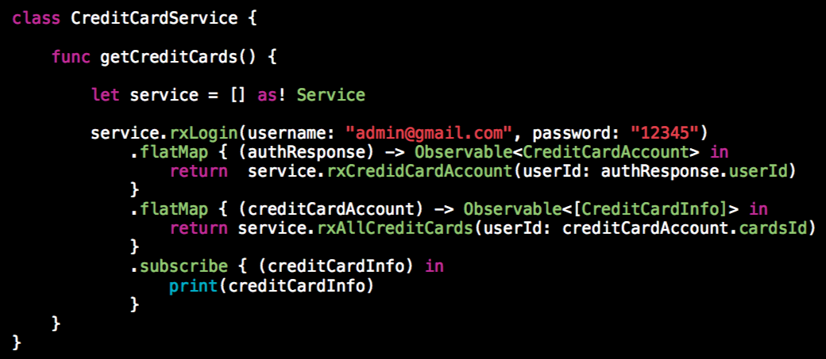
Reactive

Slide 10
Lab
Serial, Multi Calls
Different Type Observable

