Slide 1
RxSwift Basics – Day 5
Younghwan Kim

Slide 2

RxSwift Basics
Day 1 – Observable, Operator (Filter, Transform, Combine)
Day 2 – Subject (flatMap, flatMapFirst, flatMapLatest)
Day 3 – Two VCs communications with Subject, RxCocoa (Button)
Day 4 – Sequential, Merged Observable Calls
Day 5 – RxCocoa, UI Binding (Button, TextField, Label, TableView)

Slide 3
Advanced RxSwift
Day 1 – Protocol-Oriented Programming, Protocol Extension, Associatetype
Day 2 – Network Call, Generic Enum
Day 3 – Binding Track Activity (show / hide ‘Loading’ ), Scan Operator
Day 4 – Adding a Reactive Extension to Custom UI Element,
2 Way Binding, Advanced TableView – RxDataSources
Day 5 – Schedulers (observeOn, subscribeOn),
Unit Test (RxTest, RxBlocking)

Slide 4
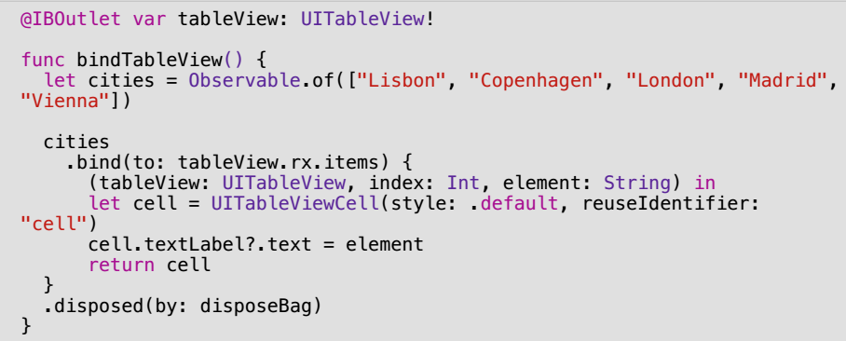
Simple Table View

Slide 5
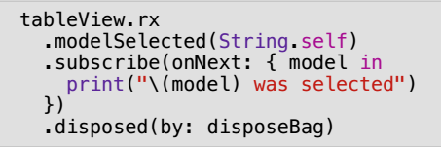
Simple Table View

Slide 6
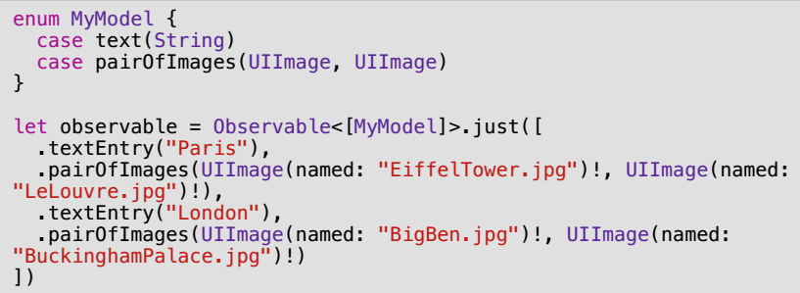
Table View – Multi Cell

Slide 7
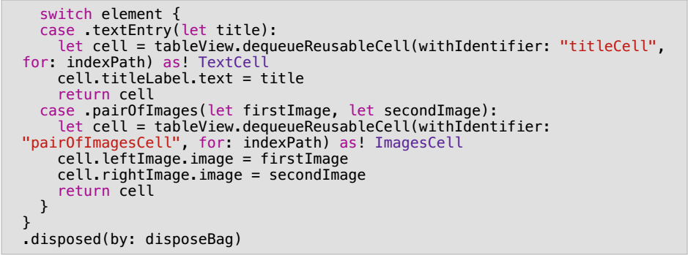
Table View – Multi Cell

Slide 8
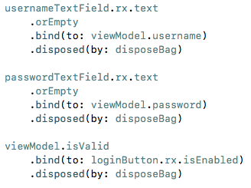
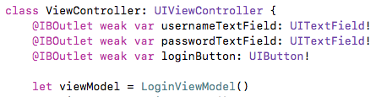
TextField – Binding

Slide 9
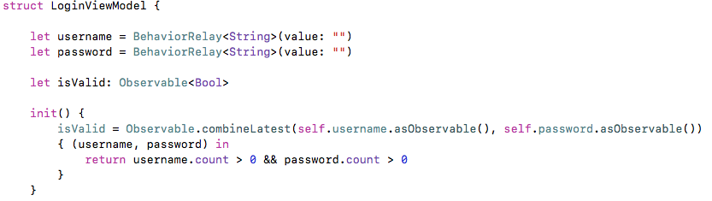
TextField – Binding

Slide 10
Comprehensive Lab
Observable
Create login and get profile observables
Sequential Call – Two Observables
RxCocoa UI Binding – button, textfield, TableView
Subject, Relay

