Slide 1
Advanced RxSwift – Day 2
Younghwan Kim

Slide 2

Integrate with API Call
API Call (create Observable)
Flow Control in API calls ( filter, flatMap operation in Observables)
Create View Model ( BehaviorSubject )
Data Model ( demo ‘Quick Type’)
UI Binding (TableView and ViewModel)

Slide 3
Integrate with API Call
API Call (create Observable)
Country Info
https://restcountries.eu/rest/v2/alpha/DEU
Border Countries
https://restcountries.eu/rest/v2/alpha?codes=DEU;FRA;ITA;

Slide 4
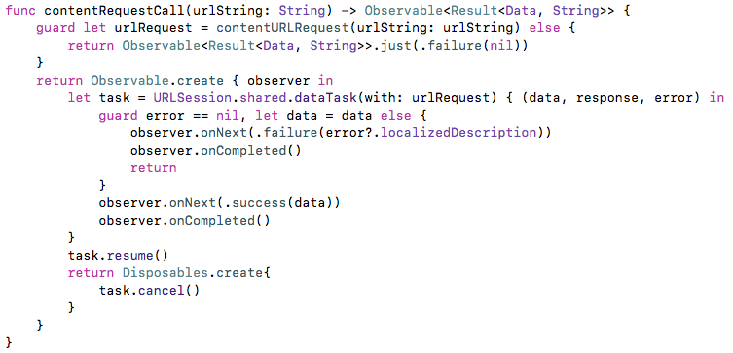
Integrate with API Call

Slide 5
Generic Enum
Generic Enum (Video)

Slide 6
Error Handling with Result Type
Error Handling with Result Type (Video)

Slide 7
Integrate with API Call
Generic Enum : Result in AlamoFire
https://github.com/Alamofire/Alamofire/blob/master/Source/Result.swift

Slide 8
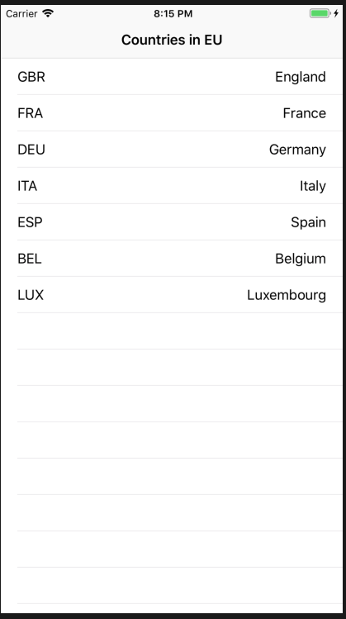
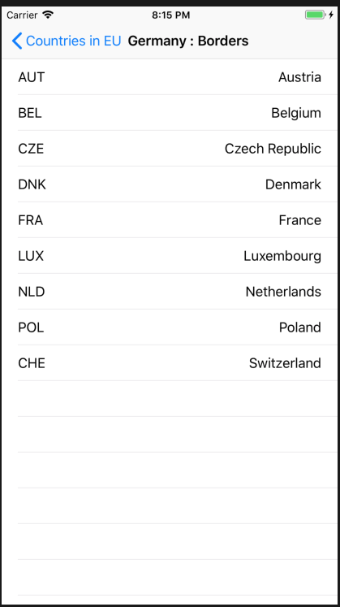
Lab

