Slide 1
RxSwift Basics – Day 5
Younghwan Kim

Slide 2

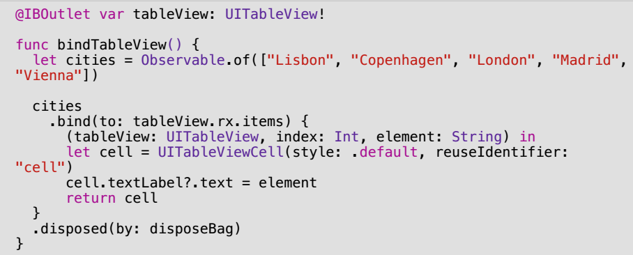
Simple Table View

Slide 3
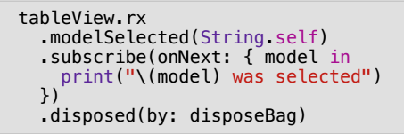
Simple Table View

Slide 4
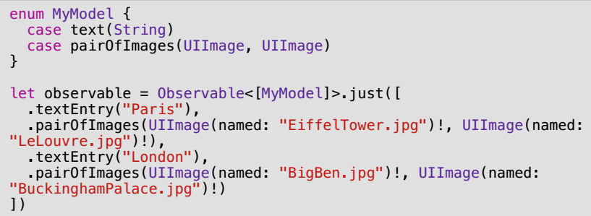
Table View – Multi Cell

Slide 5
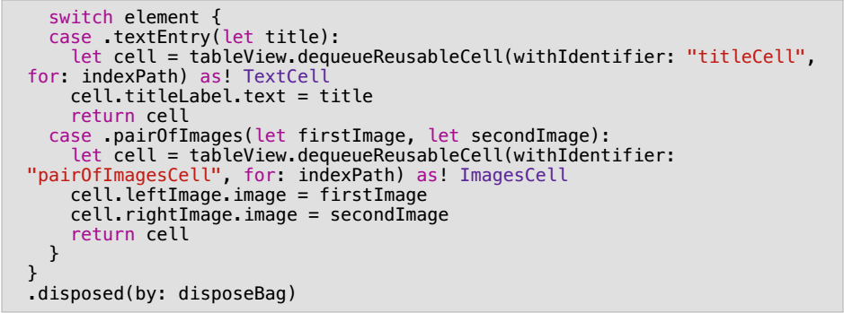
Table View – Multi Cell

Slide 6
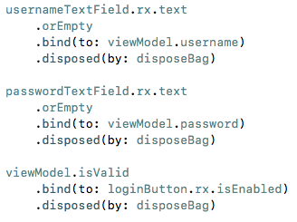
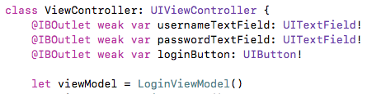
TextField – Binding

Slide 7
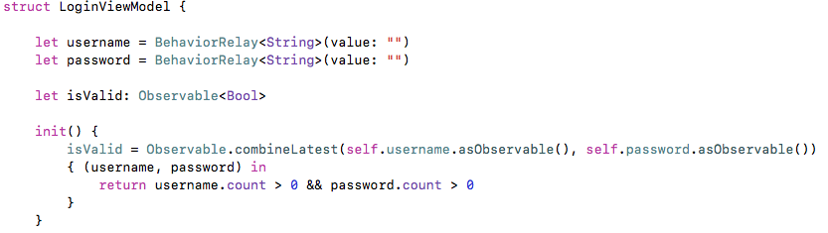
TextField – Binding

Slide 8
Comprehensive Lab
Observable
Create login and get profile observables
Sequential Call – Two Observables
RxCocoa UI Binding – button, textfield, TableView
Subject, Relay

