Slide 1
Advanced RxSwift – Day 2
Younghwan Kim

Slide 2

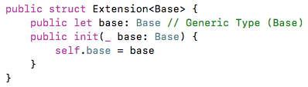
Grouping – Protocol Extension, associatetype

Slide 3

Grouping – Protocol Extension, associatetype

Slide 4
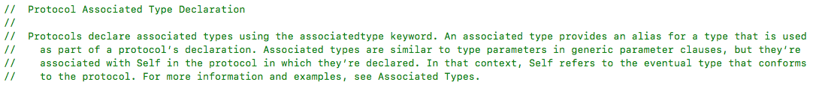
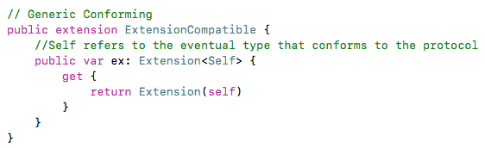
Grouping – Protocol Extension, associatetype

Slide 5
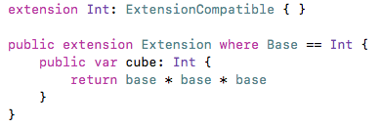
Grouping – Protocol Extension, associatetype

Slide 6
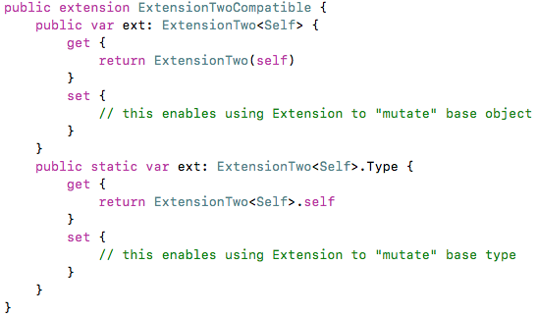
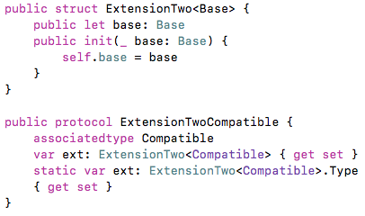
Grouping – Protocol Extension, associatetype

Slide 7
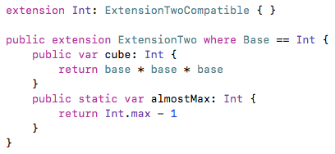

Grouping – Protocol Extension, associatetype

