Slide 1
Chaining Observables
Nov. 15. 2018 Younghwan Kim

Slide 2
Observable – typical type
func oneObservable() -> Observable<Some> {
return Observable<Some>.create { observer in
return Disposables.create()
}
}

Slide 3
Observable – Nested Observable
func oneObservable() -> Observable<Some> {
return Observable<Some>.create { observer in
nestedObservable()
.subscribe(onNext: {
observer.onNext(Some)
observer.onCompleted()
})
.disposed()
return Disposables.create()
}
}

Slide 4
Observable – merge
Observable.from([oneObservable, twoObservable]).merge()
.subscribe()
.disposed()

Slide 5
Observable – zip
Observable.zip(oneObservable, twoObservable)
.subscribe()
.disposed()

Slide 6
Observable – Observable of ZippedObservable
Func zippedOneTwoObservable() -> Observable<Some> {
return Observable<Some>.create { observer in
Observable.zip(oneObservable, twoObservable)
.subscribe(onNext: {
observer.onNext(Some)
observer.onCompleted()
})
.disposed()
return Disposables.create()
}
}

Slide 7
Chaining Observables
OneObservable
TwoObservable
ThreeObservable
Error
Success

Slide 8
Chaining Observables – typical format
OneObservable()
.filter {
}
.flatMapLatest { _ -> Observable<Two> in
TwoObservable()
}
.filter {
}
.flatMapLatest { _ -> Observable<Three> in
ThreeObservable()
}
.subscribe()
.disposed()

Slide 9
Chaining Observables - How to use the result of previous observable chain?
OneObservable()
.flatMapLatest { One -> Observable<Two> in
if Some(One) {
return Observable<Two>
} else {
TwoObservable()
}
}.filter {
}
.flatMapLatest { _ -> Observable<Three> in
ThreeObservable()
}
.subscribe()
.disposed()

Slide 10
Chaining Observables – Nested Observable, merge, zip
OneObservable
NestedObservable
Observable.zip(OneObservable, NestedObservable)
TwoObservable
ThreeObservable
MergedObservable
Observable.zip(ThreeObservable, MergedObservable)
Error
Success

Slide 11
Chaining Observables – merge, zip
OneObservable
ZippedObservable
Observable.zip(OneObservable, ZippedObservable)
TwoObservable
ThreeObservable
MergedObservable
Observable.zip(ThreeObservable, MergedObservable)
Error
Success

Slide 12
Chaining Observables – merge, zip
Observable.zip(OneObservable(),ZippedObservable())
.filter {
}
.flatMapLatest { _ -> Observable<Two> in
TwoObservable()
}
.filter {
}
.flatMapLatest { _ -> Observable<Three> in
Observable.zip(ThreeObservable(), MergedObservable())
}
.subscribe()
.disposed()

Slide 13
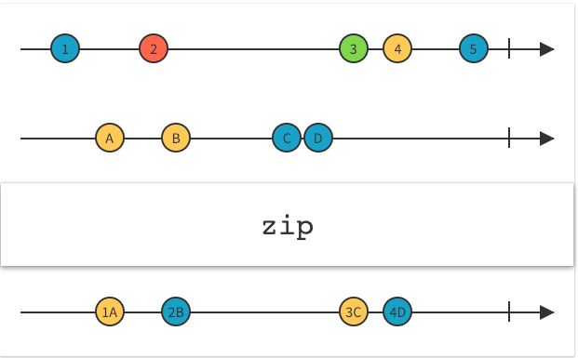
Zip
Zip
combine the emissions of multiple Observables together via a specified function and emit single items for each combination based on the results of this function

Slide 14
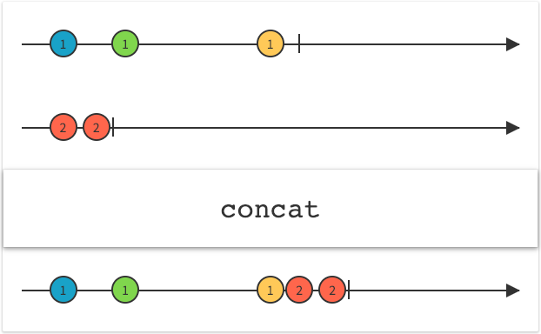
Concat
Concat
emit the emissions from two or more Observables without interleaving them

Slide 15
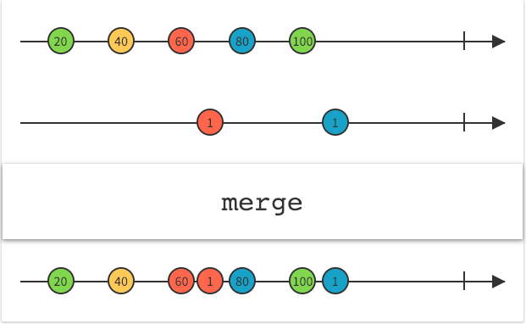
Merge
Merge
combine multiple Observables into one by merging their emissions

