Slide 1
RxSwift Basics – Day 2
Younghwan Kim

Slide 2

Subject
Observable
Observer
PublishSubject, BehaviorSubject, ReplaySubject
PublishRelay, BehaviorRelay (Variable)

Slide 3
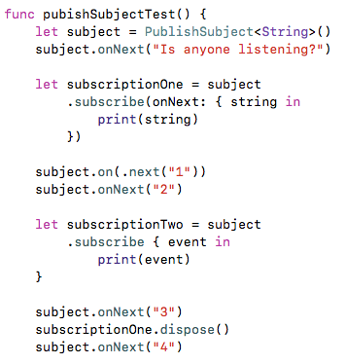
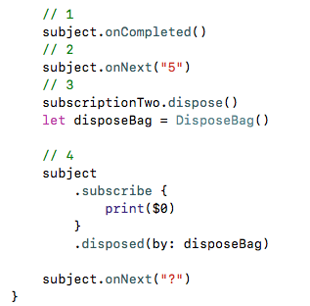
PublishSubject

Slide 4
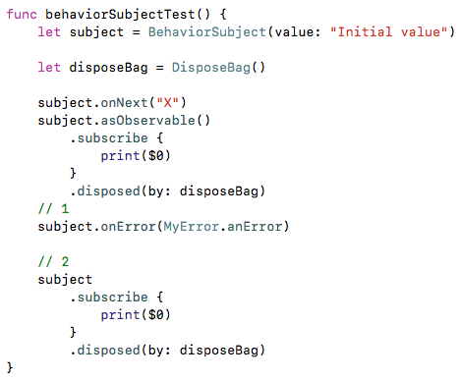
BehaviorSubject

Slide 5
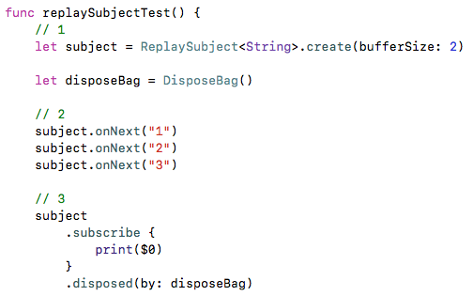
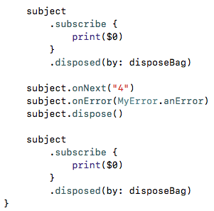
ReplaySubject

Slide 6
Lab - 1
BehaviorSubject, PublishSubject, ReplaySubject

Slide 7
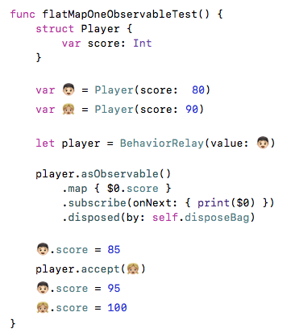
flatMap, flatMapFirst, flatMapLatest - 1

Slide 8
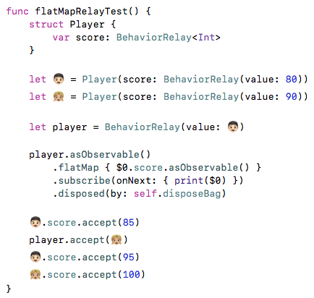
flatMap, flatMapFirst, flatMapLatest - 2

Slide 9
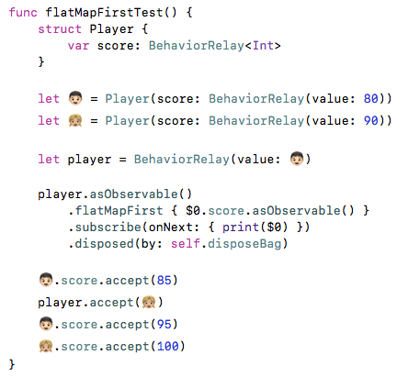
flatMap, flatMapFirst, flatMapLatest - 3

Slide 10
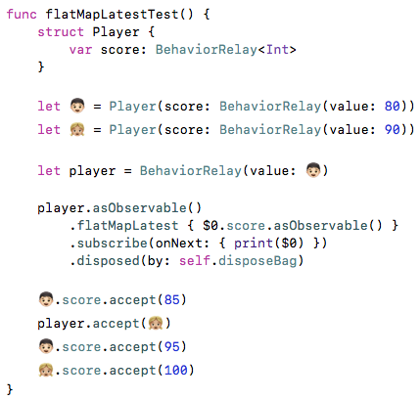
flatMap, flatMapFirst, flatMapLatest - 4

Slide 11
Lab -2
flatMap, flatMapFirst, flatMapLatest

