Slide 1
RxSwift Basics – Day 3
Younghwan Kim

Slide 2

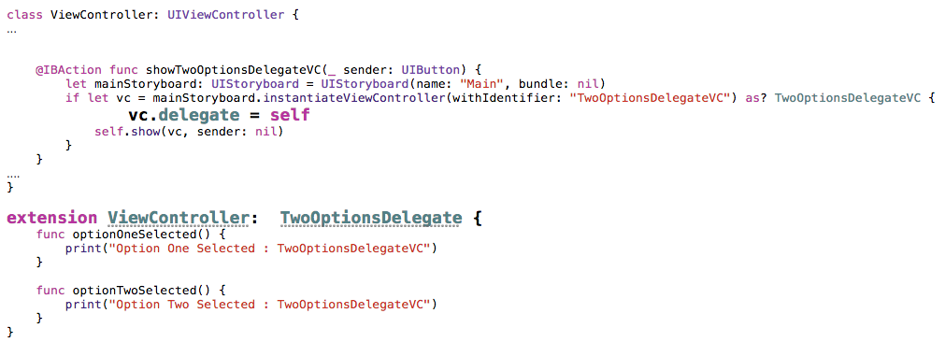
Two VCs : delegate - 1

Slide 3
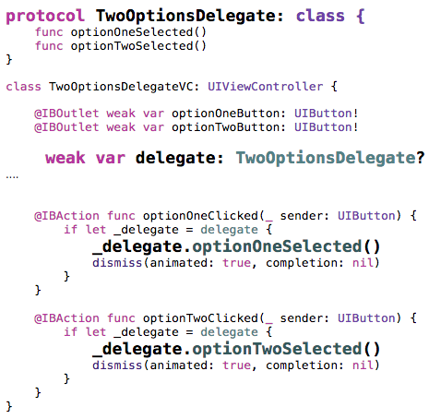
Two VCs : delegate - 2

Slide 4
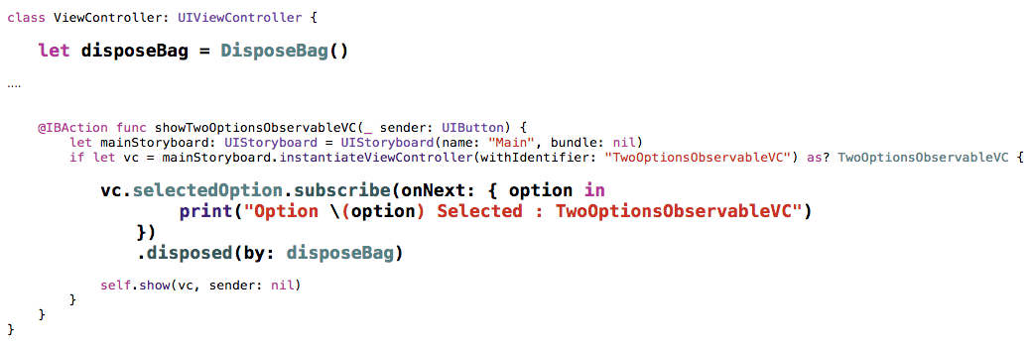
Two VCs : Observable - 1

Slide 5
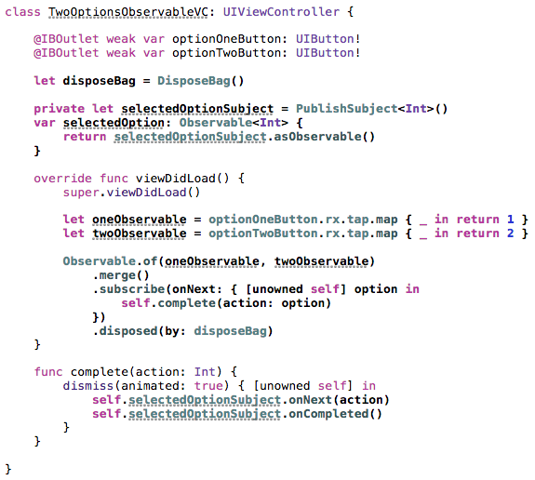
Two VCs : Observable - 2

Slide 6
Lab
Two VCs communications using subject

