Slide 1
RxSwift Basics – Day 4
Younghwan Kim

Slide 2

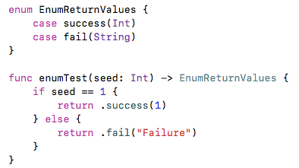
Enum - merge return values

Slide 3
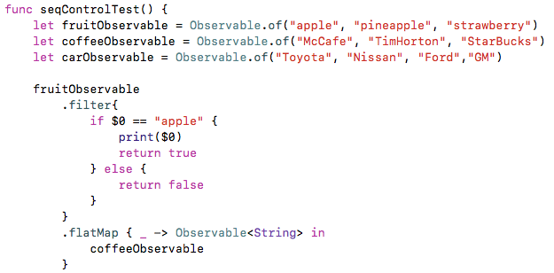
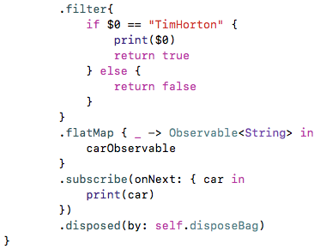
Sequential Call

Slide 4
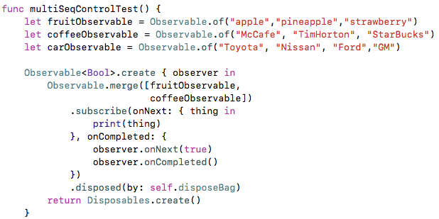
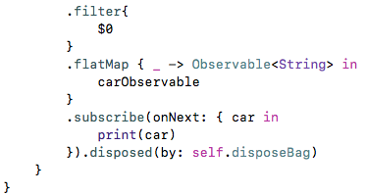
Multi- Sequential Call

Slide 5
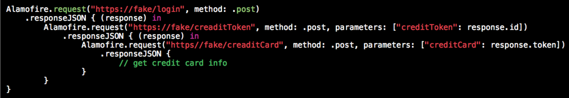
Traditional

Slide 6
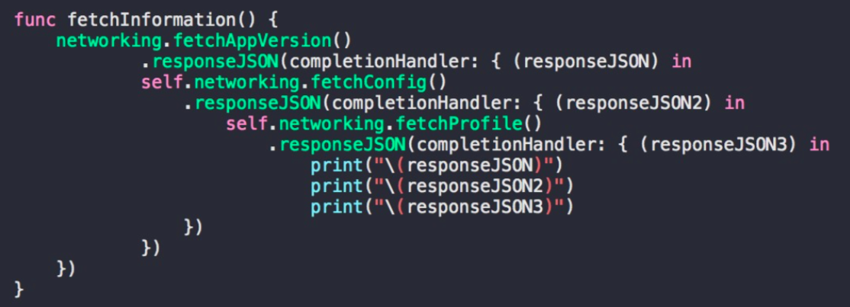
Traditional

Slide 7
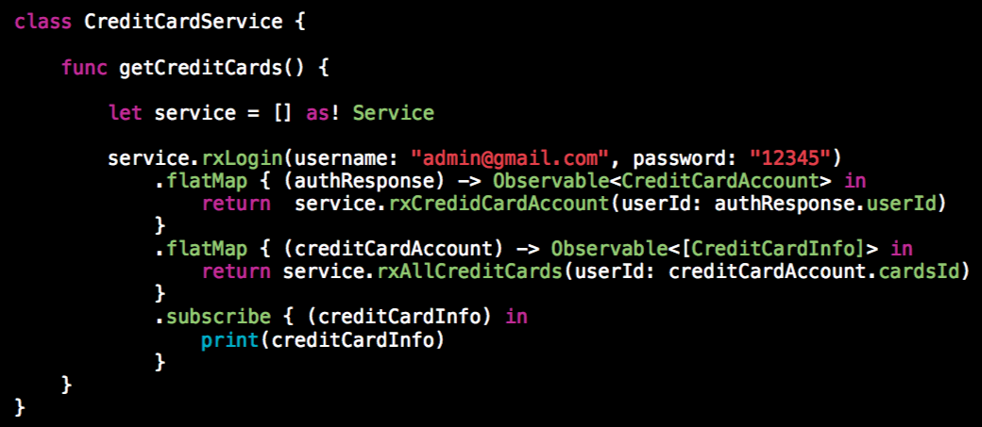
Reactive

Slide 8
Lab
Serial, Multi Calls
Different Type Observable

