Slide 1
RxSwift Basics – Day 4
Younghwan Kim

Slide 2

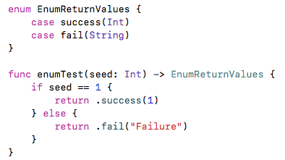
Enum - merge return values

Slide 3
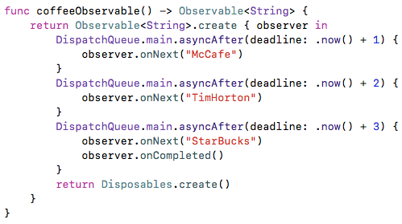
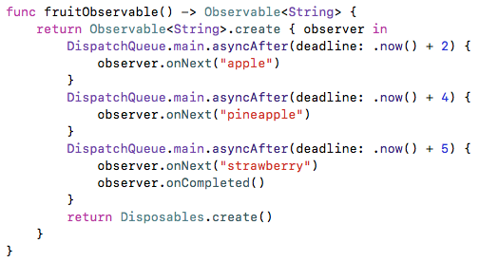
Business Logic – API Call (Serial Sequence)

Slide 4
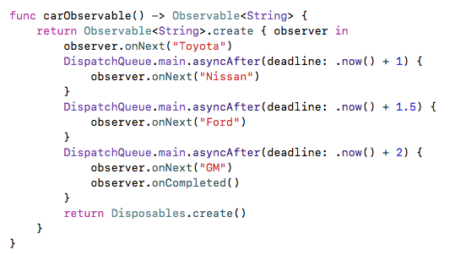
Business Logic – API Call (Serial Sequence)

Slide 5
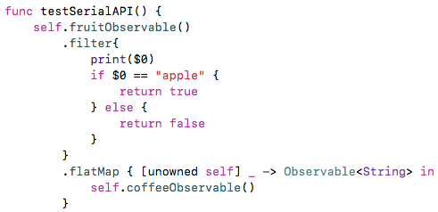
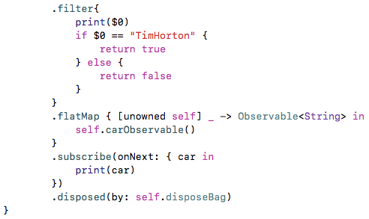
Business Logic – API Call (Serial Sequence)

Slide 6
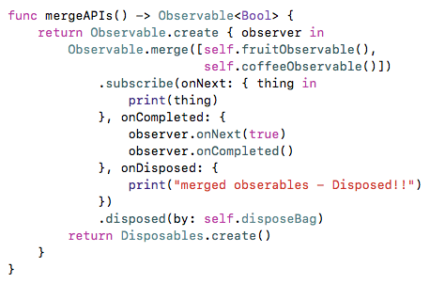
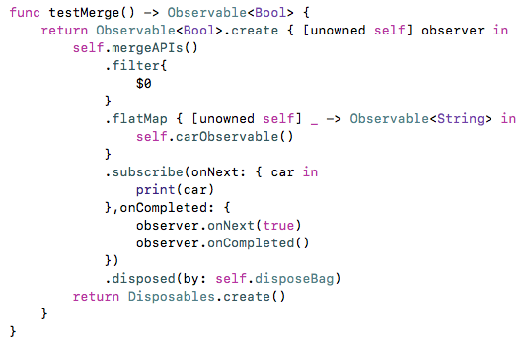
Business Logic – API Call (Multi, Serial Sequence)

