Slide 1
Advanced RxSwift – Day 5
Younghwan Kim

Slide 2

RxSwift Basics
Day 1 – Observable, Operator (Filter, Transform, Combine)
Day 2 – Subject (flatMap, flatMapFirst, flatMapLatest)
Day 3 – Two VCs communications with Subject, RxCocoa (Button)
Day 4 – Sequential, Merged Observable Calls
Day 5 – RxCocoa, UI Binding (Button, TextField, Label, TableView)

Slide 3
Advanced RxSwift
Day 1 – Protocol-Oriented Programming, Protocol Extension, Associatetype
Day 2 – Network Call, Generic Enum
Day 3 – Binding Track Activity (show / hide ‘Loading’ )
Day 4 – Advanced TableView – RxDataSources
Day 5 – Schedulers (observeOn, subscribeOn),
Unit Test (RxTest, RxBlocking)

Slide 4
Scheduler – observeOn, subscribeOn
Observable<Int>.create { observer in
print(Thread.isMainThread)
observer.onNext(1)
sleep(1)
observer.onNext(2)
return Disposables.create()
}
.observeOn(MainScheduler.instance)
.subscribeOn(ConcurrentDispatchQueueScheduler(qos: .background))
.subscribe(onNext: { el in
print(Thread.isMainThread)
}).disposed(by: disposeBag)

Slide 5
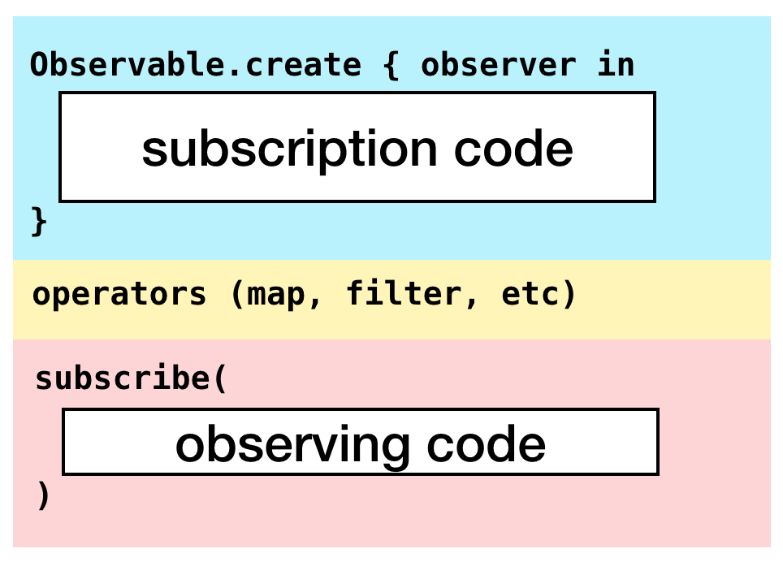
Scheduler – observeOn, subscribeOn

Slide 6
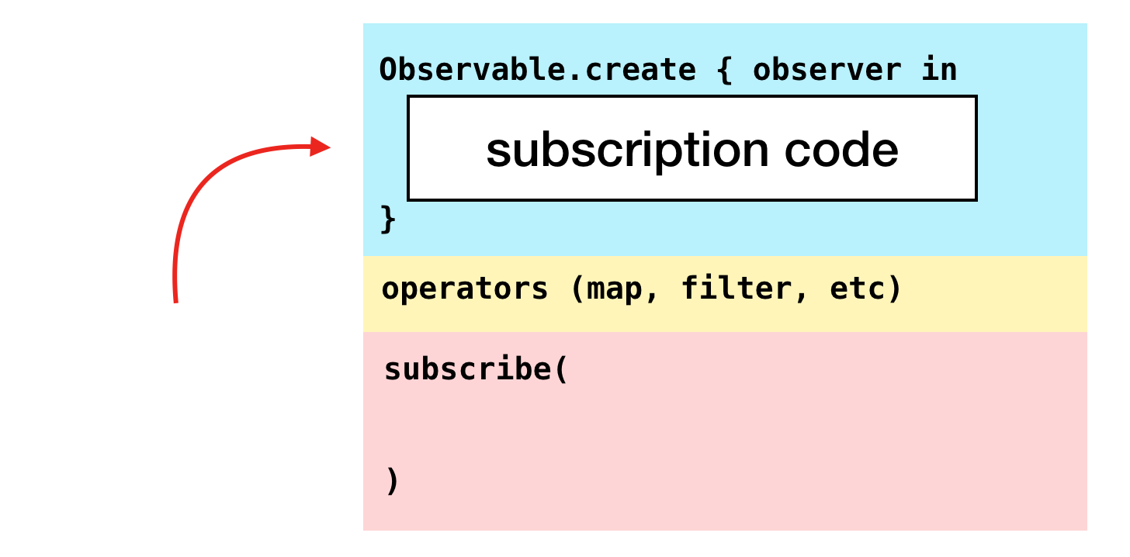
Scheduler – observeOn, subscribeOn

Slide 7
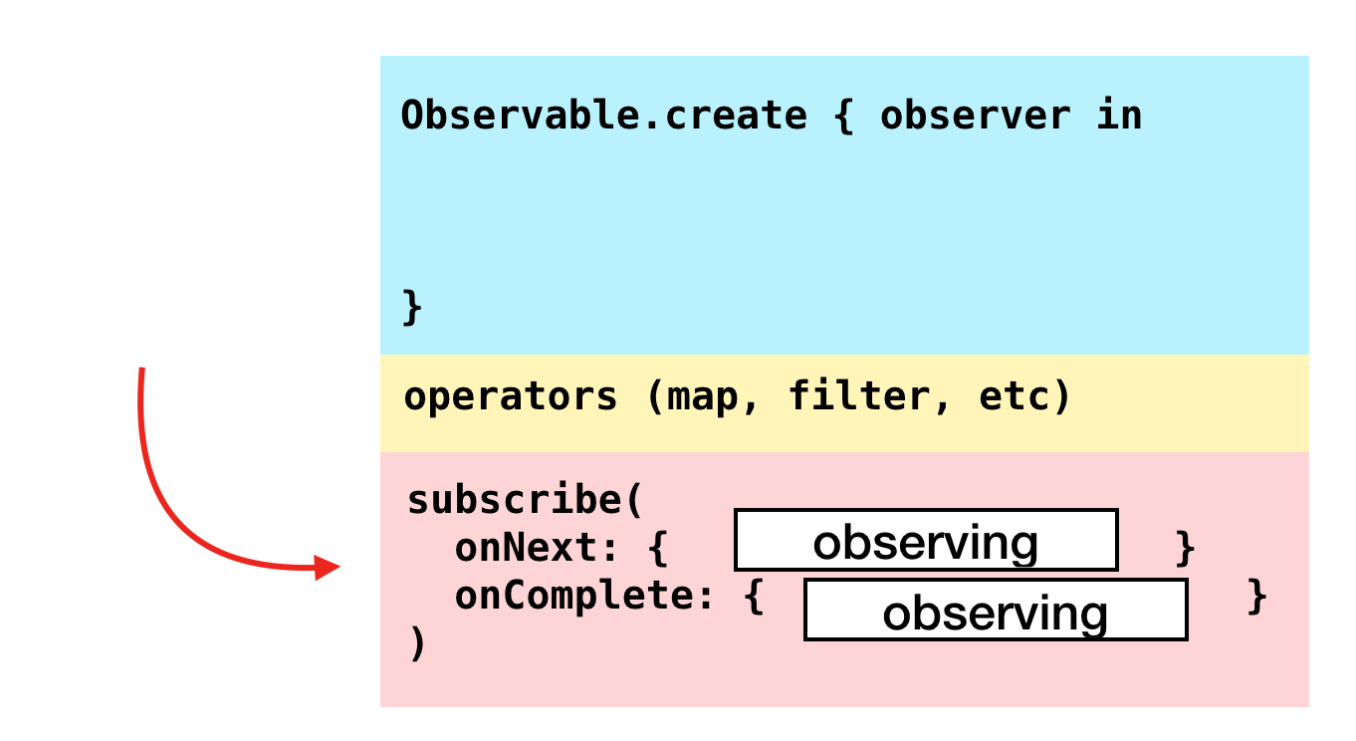
Scheduler – observeOn, subscribeOn

Slide 8
RxTest
TestableObserver<ElementType> - an observer, which records all emitted events so you can inspect them and run your asserts on those events
TestScheduler - a scheduler which let’s you control values and time, and let’s you create testable observers
TestObservable - Observable, where you can pass what events should it send at given schedule
== (lhs: Event<Element>, rhs: Event<Element>) adds Equatable implementation to Rx events so you can easily check recorded events

Slide 9
RxTest
TestableObserver<ElementType> - an observer, which records all emitted events so you can inspect them and run your asserts on those events
TestScheduler - a scheduler which let’s you control values and time, and let’s you create testable observers
TestObservable - Observable, where you can pass what events should it send at given schedule
== (lhs: Event<Element>, rhs: Event<Element>) adds Equatable implementation to Rx events so you can easily check recorded events

Slide 10
RxTest
struct CornSorter {
let barnStream: Observable<String>
init(tractorStream: Observable<String>) {
barnStream = tractorStream
.filter { $0 == "🌽" }
}
}

Slide 11
RxTest
func testCornSorter() {
var scheduler: TestScheduler!
let disposeBag = DisposeBag()
scheduler = TestScheduler(initialClock: 0)
let testObserver = scheduler.createObserver(String.self)
// Given
let observableInput = scheduler.createHotObservable([
// 2
Recorded.next(100, "🌽"),
Recorded.next(200, "🐛"),
Recorded.next(300, "🐭"),
Recorded.next(400, "🌽"),
Recorded.next(500, "🐝"),
Recorded.next(600, "🐞")
])
let cornSorter = CornSorter(tractorStream: observableInput.asObservable())

Slide 12
RxTest
// When
cornSorter.barnStream
.subscribe(testObserver)
.disposed(by: disposeBag)
scheduler.start()
// Then
let results = testObserver.events.map {
$0.value.element!
}
_ = XCTAssertEqual(results, ["🌽", "🌽"])
}

Slide 13
RxBlocking
RxBlocking on the other hand is handy in case you need to test some asynchronous functionality where you can’t control the source of asynchronisity. Often times this means you’re stepping up from unit tests to integration test.
What RxBlocking is great to is to allow you to consume an observable sequence in batches or even wait on a single element to be emitted.

Slide 14
RxBlocking
func testElements() {
let items = Observable.of(1, 5, 10, 15, 20)
let elements = try! items.toBlocking().toArray()
XCTAssertEqual([1, 5, 10, 15, 20], elements)
let results = try! items.skip(3).take(2).toBlocking().toArray()
XCTAssertEqual([15, 20], results)
}

Slide 15
RxBlocking
func testCountryInfoFlow() {
let scheduler = ConcurrentDispatchQueueScheduler(qos: .default)
do {
let myArray = try BordersBusinessLogic.shared.countryInfoFlow(code: "FRA")
.subscribeOn(scheduler)
.toBlocking()
.toArray()
if let countryInfo = myArray.first {
switch countryInfo {
case .success(_):
XCTAssert(true)
break
case .failure(_):
XCTAssert(false)
break
}
}
} catch(let e) { XCTAssert(false, e.localizedDescription)
}
}

