Slide 1
AIA Korea
OSI Team
April 2023

Slide 2
Plan For IVR Optimization
Current
Aug 1st Week | Aug 2nd Week | Aug 3rd Week | Aug 4th Week | Aug 5th Week | Sep ^{1st} Week
Cycle 1 Monitoring
데이터 업데이트
IVR 시나리오 멘트 구상
Cycle 1
(CX)
- 디지털 스코어 확
- 파일럿 시나리오 도입
(Data)
- Synapse DB 이관 후 데이터 업데이트
(CX)
- IT개발 SR/BR 작성
- 멘트 녹음 요청
(Data)
- 쿼리 전달 및 분포 확인
IT 개발 요청 및 일정 확인
IVR 실행안 확정
CCC 논의
(CX,Data )
실행안에 따른 모니터링 메트릭스 정의
실행안 확정
 | 실행안 | 개발 여부
1 | 현 시나리오를 유지하면서 전체고객 디지털 스코어 검증 디지털 스코어가 높은 고객이 실제 디지털 사용율이 높은 지 / 디지털 스코어가 낮은 고객이 실제 상담원 연결율이 높은 지 결과 데이터를 토대로 Cycle 2 기획 ( 유지,개발, 보안) | 쿼리 교체
2 | 파일럿 시나리오(20만 고객) – 디지털 스코어 High , 디지털 사용 0번 실제 Digital Conversion이 되는 지 결과 데이터를 토대로 Cycle 2 기획 ( 유지,개발, 보안) | 시나리오 변경/ 멘트 녹음
 | Plan for the next |  | Owner | Date
1 | Synapse DB -> EDW 이관 | (EDW) XOWNSPECTO.CALLRESULT 확인 - 경일님 | IT | 완료
2 | IVR 기획 planning confirm (CCC) | IVR Optimization 일정 컨펌 | OSI / CCC | ~8월 2주차
3 | IT 개발 요청 | IT 개발 일정 확인 (원봉,정희님 / 우선님) | IT | ~8월
4 | IVR 개발 및 멘트 교체

Slide 3
IVR Scenario
(2) 검증 Pool
디지털 스코어 High
디지털 사용 0번
디지털
스코어
해지스코어
(7-10점)

Slide 4

Digital Score 적용 방안
시나리오 생성 vs 각 시나리오 디지털 점수 적용
시나리오 1
시나리오 2
디지털 시나리오
시나리오 1
& 디지털 점수
시나리오 2
& 디지털 점수
시나리오 3
& 디지털 점수

Slide 5
Basic Analysis

Slide 6
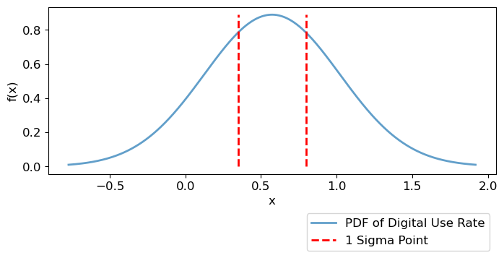
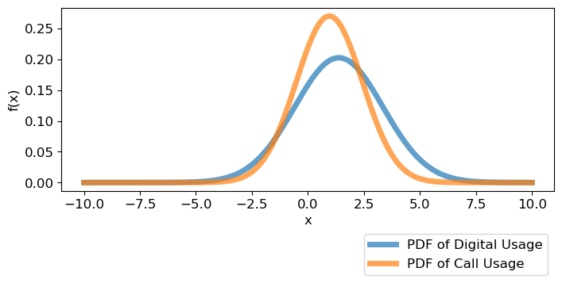
Data Analysis – IVR (General Information)
General Information & Distribution
분석 대상 및 정의
분석 대상 : 90,162 명 (2020년~2021년 가입 고객)
디지털 사용률 산출 : 디지털 서비스 이용 수 / (디지털 + 콜 서비스 이용 수)
평균 디지털 사용률 : 57.34%
중간값 : 75%
디지털 고객 정의 : 평균 + ½ Std (1 sigma)
기본 데이터 분포
콜센터 이용 고객
평균: 0.95 // 편차: 1.48
디지털 이용 고객
평균: 1.38 // 편차: 1.96
→ 고객별 서비스 이용의 편차가 평균보다 크기 때문에 향후 추가 분석 필요

Slide 7
Definitions of Each Column
No. | Column 명 | 설명
1 | AIA_가입경과월 | AIA를 최초 가입하고 경과한 개월 수
2 | ANNUITY_건 | Annuity 보험 계약 건
3 | ANH_건 | A&H 보험 계약 건
4 | 암보험_건 | 암 보험 계약 건
5 | ORDINARY_건 | ORDINARY 보험 계약 건
6 | SI_건 | SI 보험 계약 건
7 | UL_VUL_건 | UL_VUL 보험 계약 건
8 | TOTAL_ANP | 고객별 총 보험료(연간 환산)
9 | AGE | 연령
10 | MYAIA_첫사용경과월 | 가입 후 MyAIA 이용까지 걸린 개월 수
11 | CHATBOT_첫사용경과월 | 가입 후 Chatbot 이용까지 걸린 개월 수
12 | MYAIA_최근사용경과월 | 최근 MyAIA 이용한 시점부터 현재까지의 개월 수
No. | Column 명 | 설명
13 | CHATBOT_최근사용경과월 | 최근 Chatbot 이용한 시점부터 현재까지의 개월 수
14 | NUM_CALL | 고객별 콜센터 이용 횟수
15 | AVG_TIME_CALL_ | 고객별 평균 통화 시간(초)
16 | AVG_DURATION_SEC | 평균 IVR 이용/대기 시간(초)
17 | NUM_IVR | IVR 유입 횟수
18 | NUM_REQ_CS | IVR에서 콜센터 연결 요청 횟수
19 | SUM_제지급 | 총 제지급금
20 | TOTAL_USE_MAIA_SEC | 총 MyAIA 이용 시간(초)
21 | AVG_USE_PER_SECTION | MyAIA 평균 이용 시간(초)
22 | FREQ_MYAIA_ATTEMPT | MyAIA 접속 횟수
23 | FREQ_ARS_ATTEMPT | ARS 접속 횟수
24 | FREQ_CHATBOT_ATTEMPT | Chatbot 접속 횟수
* 일부 중복되는 Column은 리스트에서 삭제함
Notes:
나이가 올라갈수록 점점 디지털 비율이 떨어진다

Slide 8
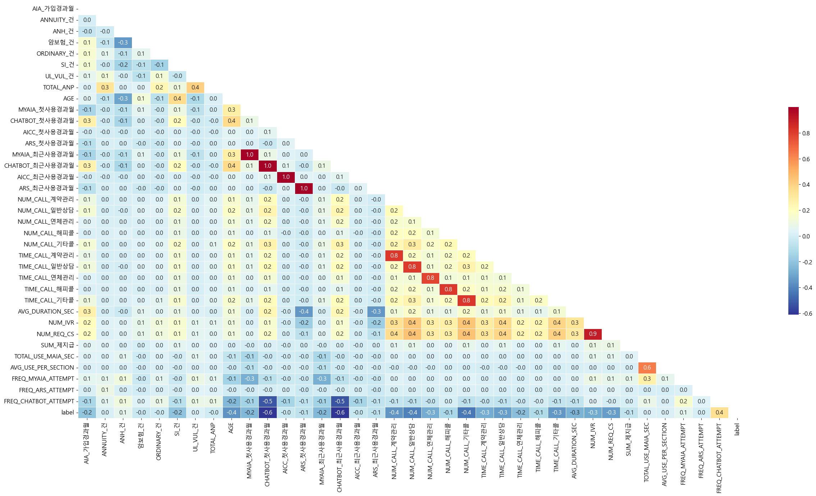
Correlation Matrix
Correlation Coefficient | Rough Guideline
+1.0 | Perfect positive + association
+0.8 to 1.0 | Very strong + association
+0.6 to 0.8 | Strong + association
+0.4 to 0.6 | Moderate + association
+0.2 to 0.4 | Weak + association
0.0 to +0.2 | Very weak + or no association
0.0 to -0.2 | Very weak – or no association
-0.2 to -0.4 | Weak - association
-0.4 to -0.6 | Moderate - association
-0.6 to -0.8 | Strong - association
-0.8 to -1.0 | Very strong - association
-1.0 | Perfect negative - association
Notes:
나이가 어린 고객 : A&H 보험 많음
연령대가 높은 고객: UL/VUL 보험 많음
나이가 어릴 수록 가입 후 Chatbot을 사용하는데 시간이 적게 걸리고
IVR로 들어가는 고객은 대부분 Call Request를 하며 연결된다
MyAIA, ARS 에 비해 Chatbot 접속이 많으면 디지털 고객이 되는 확률이 올라간다

Slide 9
EDA (Exploratory Data Analysis)

Slide 10
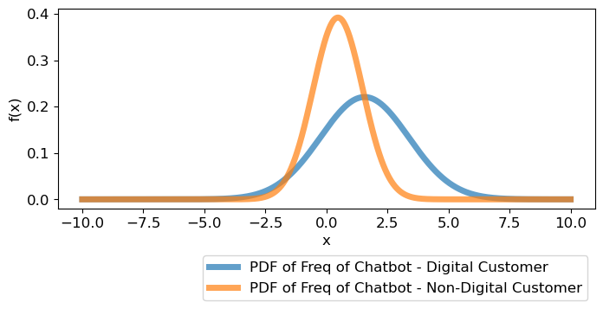
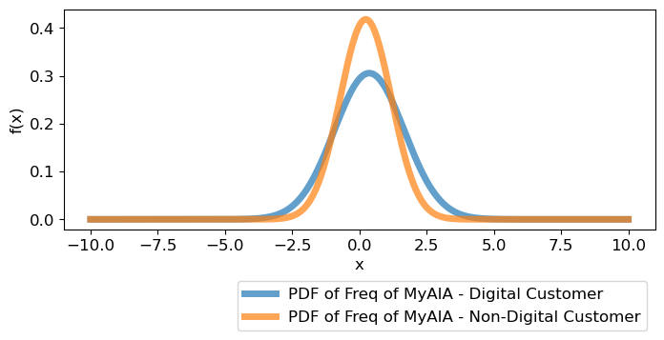
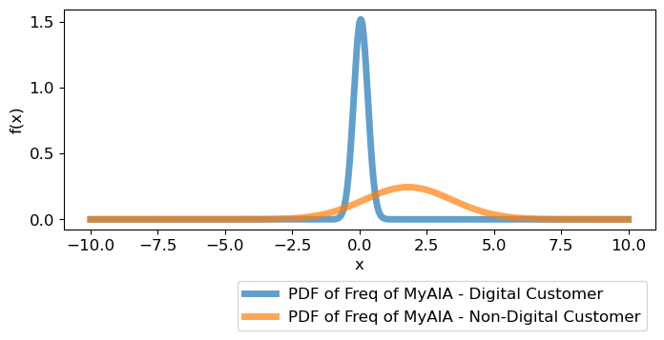
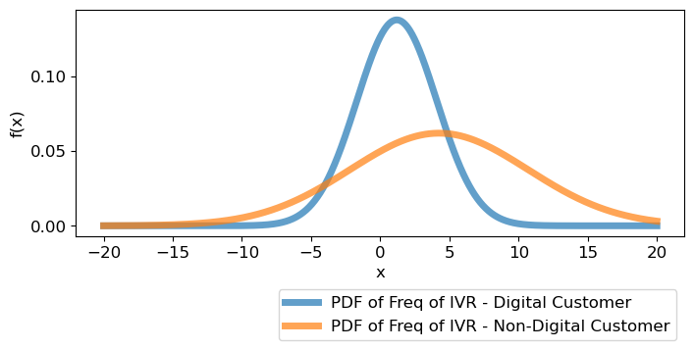
PDF(Probability Density Function) – Digital vs Non-Digital Groups
PDF – Chatbot Usage (Attempt)
PDF – MyAIA Usage (Attempt)
PDF – Call Usage (Connected Call)
PDF – IVR Usage
Notes:
디지털 vs Non 디지털 고객의 디지털/콜 사용량의 차이가 큼.
전체적인 Contact 숫자가 적기 때문에 Volatility가 큼.

Slide 11
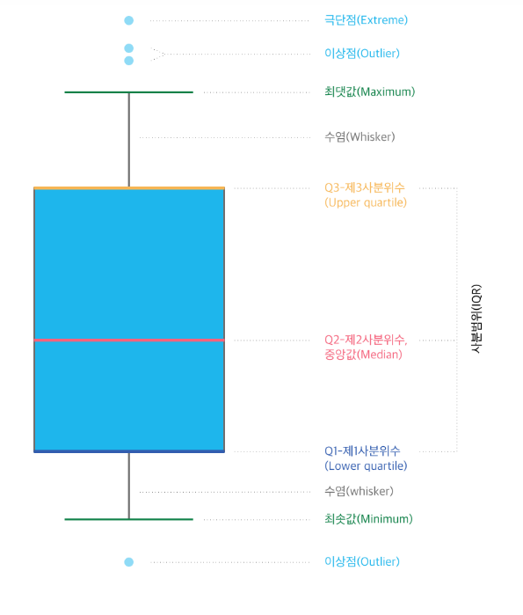
Box Plot

Slide 12
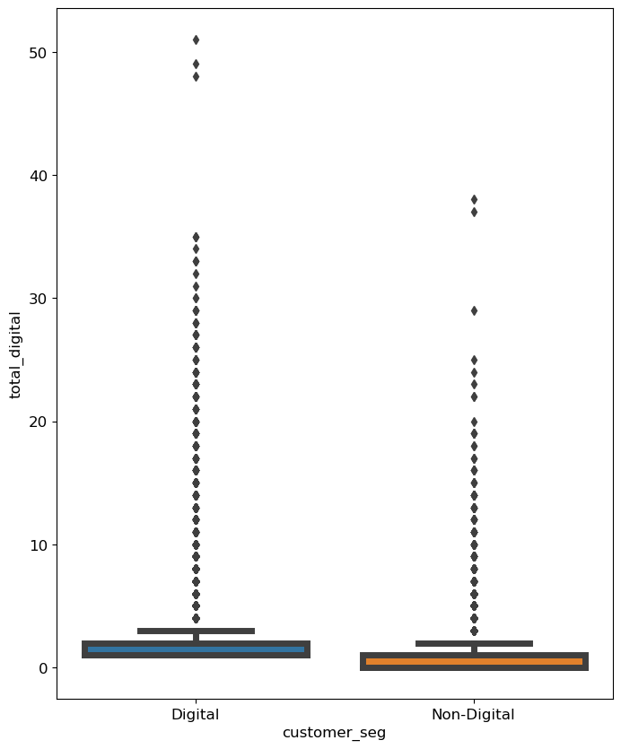
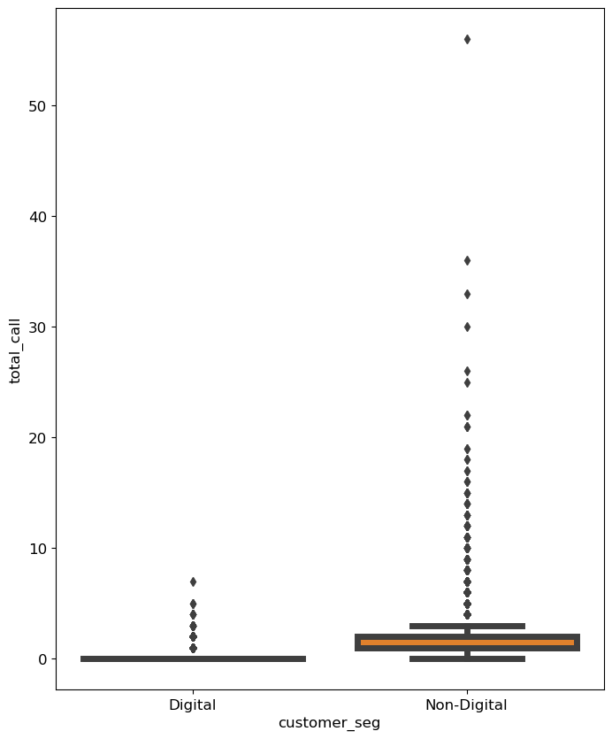
Box Plot – Digital vs Call
Box Plot –Digital Usage by Customer Seg
Box Plot – Call Usage by Customer Seg
Notes:
Box Plot의 의미

Slide 13
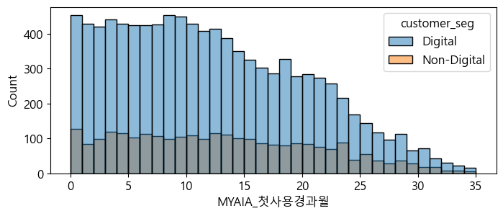
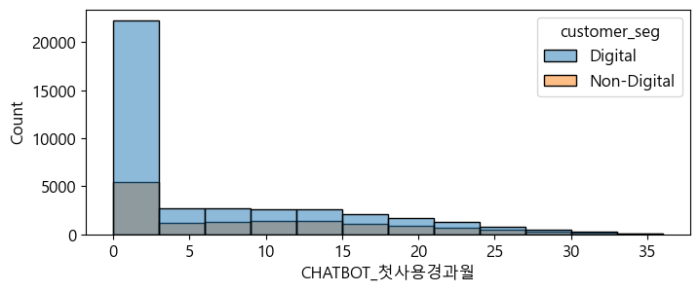
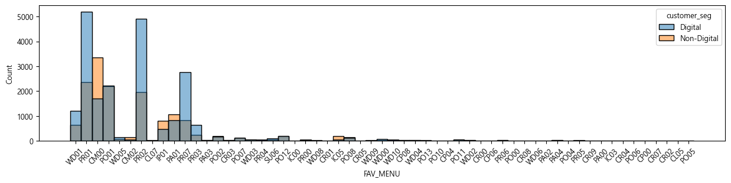
“Digital Customer” vs “Non-Digital Customer” – Duration and Most Used Menu
First MyAIA Usage After Sign-up(Duration)
First Chatbot Usage After Sign-up(Duration)
Most Used MyAIA Menu
Notes:
Encounter Digital Channel

Slide 14
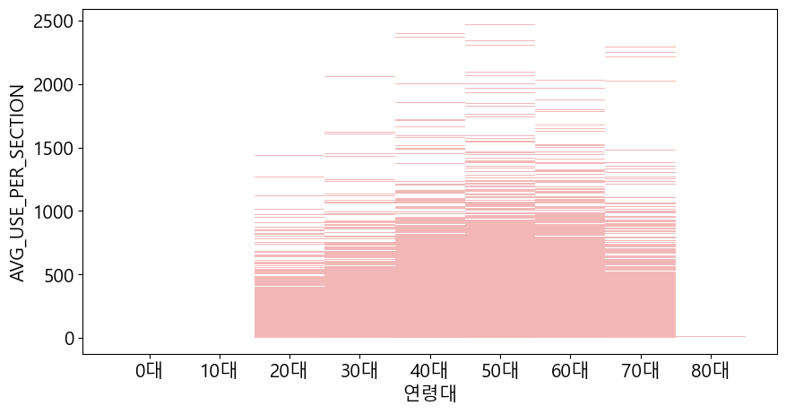
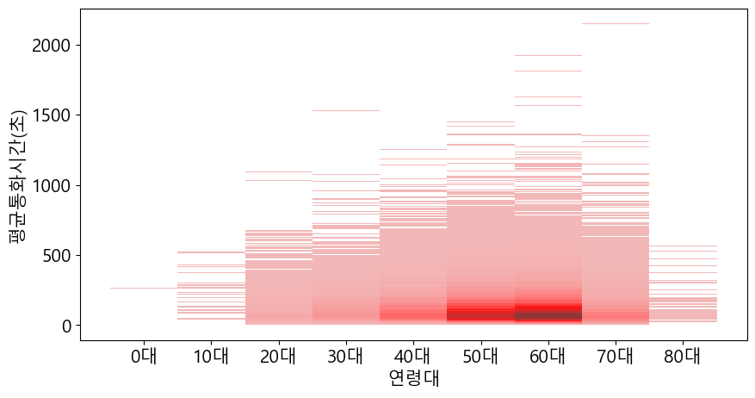
Average Usage of MyAIA & Call – by Age
Avg MyAIA Use Time
Avg Call Time
Age and Usage Time in either MyAIA and Call are Positively Correlated
Notes:
Encounter Digital Channel

Slide 15
Feature Importance using Information Value

Slide 16
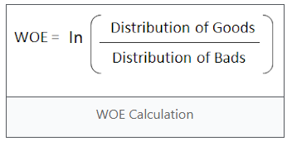
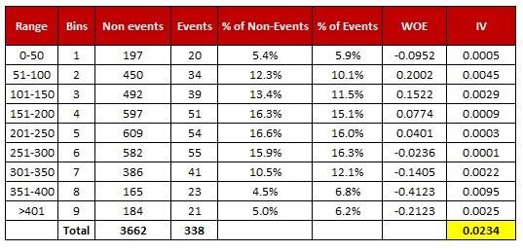
What is Information Value
Information Value is one of the most useful technique to select import variables in a predictive model. It helps to rank variables on the basis of their importance.
Formula
Rules & Example
<Formula - IV>
<Describing IV>
Information Value | Variable Predictiveness
Less than 0.02 | Not useful for prediction
0.02 to 0.1 | Weak predictive power
0.1 to 0.3 | Medium predictive power
0.3 to 0.5 | Strong predictive power
Greater than 0.5 | Suspicious predictive power
<Formula – Weight of Evidence>
<Example>

Slide 17
Information Value – Age
‘AGE’ feature has very high overall Information Value (IV)
The higher range of customers’ age brings high IV and low event rate while the lower range shows high event rate with high IV
 | Bin | Count | Count (%) | Non-event | Event | Event rate | WoE | IV
0 | (-inf, 33.50) | 8,109 | 8.99% | 2,057 | 6,052 | 74.63% | -1.06 | 0.09
1 | [33.50, 41.50) | 8,124 | 9.01% | 2,396 | 5,728 | 70.51% | -0.86 | 0.06
2 | [41.50, 44.50) | 5,128 | 5.69% | 1,645 | 3,483 | 67.92% | -0.74 | 0.03
3 | [44.50, 47.50) | 5,527 | 6.13% | 1,843 | 3,684 | 66.65% | -0.68 | 0.03
4 | [47.50, 51.50) | 9,898 | 10.98% | 3,567 | 6,331 | 63.96% | -0.56 | 0.03
5 | [51.50, 53.50) | 6,006 | 6.66% | 2,475 | 3,531 | 58.79% | -0.34 | 0.01
6 | [53.50, 55.50) | 6,161 | 6.83% | 2,768 | 3,393 | 55.07% | -0.19 | 0.00
7 | [55.50, 58.50) | 8,050 | 8.93% | 4,106 | 3,944 | 48.99% | 0.05 | 0.00
8 | [58.50, 61.50) | 8,819 | 9.78% | 5,032 | 3,787 | 42.94% | 0.30 | 0.01
9 | [61.50, 63.50) | 6,577 | 7.30% | 4,001 | 2,576 | 39.17% | 0.45 | 0.01
10 | [63.50, 66.50) | 7,691 | 8.53% | 5,378 | 2,313 | 30.07% | 0.86 | 0.06
11 | [66.50, 69.50) | 4,533 | 5.03% | 4,203 | 330 | 7.28% | 2.56 | 0.22
12 | [69.50, inf) | 5,529 | 6.13% | 5,286 | 243 | 4.40% | 3.09 | 0.35
13 | Special | - | 0.00% | - | - | 0.00% | 0.00 | 0.00
14 | Missing | - | 0.00% | - | - | 0.00% | 0.00 | 0.00
Totals |  | 90,152 | 100.00% | 44,757 | 45,395 | 50.35% |  | 0.91
Notes:
나이가 올라갈수록 점점 디지털 비율이 떨어진다

Slide 18
Information Value – 가입경과월
‘Number of Months Elapsed Since Sign Up’ feature has medium strength relationship to the Digital/Non-Digital odds ratio
There’s a sign that after a certain period of time from joining, the probability of the customer being a digital customer is low
It can be either customers in 2020 prefer phone calls over digital means OR customers needs to contact CS over time
 | Bin | Count | Count (%) | Non-event | Event | Event rate | WoE | IV
0 | (-inf, 12.50) | 4,672 | 5.18% | 1,750 | 2,922 | 62.54% | -0.50 | 0.01
1 | [12.50, 18.50) | 25,150 | 27.90% | 9,753 | 15,397 | 61.22% | -0.44 | 0.05
2 | [18.50, 20.50) | 8,277 | 9.18% | 3,368 | 4,909 | 59.31% | -0.36 | 0.01
3 | [20.50, 22.50) | 8,988 | 9.97% | 3,779 | 5,209 | 57.96% | -0.31 | 0.01
4 | [22.50, 24.50) | 7,568 | 8.39% | 4,236 | 3,332 | 44.03% | 0.25 | 0.01
5 | [24.50, 26.50) | 7,158 | 7.94% | 4,280 | 2,878 | 40.21% | 0.41 | 0.01
6 | [26.50, inf) | 28,339 | 31.43% | 17,591 | 10,748 | 37.93% | 0.51 | 0.08
7 | Special | - | 0.00% | - | - | 0.00% | 0.00 | 0.00
8 | Missing | - | 0.00% | - | - | 0.00% | 0.00 | 0.00
Totals |  | 90,152 | 100.00% | 44,757 | 45,395 | 50.35% |  | 0.19
Notes:
점점 서비스 사용하면서 콜 비중이 올라가거나 아니면 2020년 고객이 디지털을 거의 사용 안하거나

Slide 19
Information Value – 평균 통화시간(초)
‘Call History’ Feature has suspiciously high IV
In order to prevent overfitting the model, these columns might be excluded
계약관리 관련 통화
 | Bin | Count | Count (%) | Non-event | Event | Event rate | WoE | IV
0 | (-inf, 0.07) | 75,059 | 83.26% | 30,912 | 44,147 | 58.82% | -0.34 | 0.10
1 | [0.07, 85.88) | 7,123 | 7.90% | 6,419 | 704 | 9.88% | 2.22 | 0.28
2 | [85.88, inf) | 7,970 | 8.84% | 7,426 | 544 | 6.83% | 2.63 | 0.40
3 | Special | - | 0.00% | - | - | 0.00% | 0.00 | 0.00
4 | Missing | - | 0.00% | - | - | 0.00% | 0.00 | 0.00
Totals |  | 90,152 | 100.00% | 44,757 | 45,395 | 50.35% |  | 0.79
연체관리 관련 통화
 | Bin | Count | Count (%) | Non-event | Event | Event rate | WoE | IV
0 | (-inf, 0.12) | 80,389 | 89.17% | 35,796 | 44,593 | 55.47% | -0.21 | 0.04
1 | [0.12, 83.58) | 4,930 | 5.47% | 4,443 | 487 | 9.88% | 2.22 | 0.20
2 | [83.58, inf) | 4,833 | 5.36% | 4,518 | 315 | 6.52% | 2.68 | 0.25
3 | Special | - | 0.00% | - | - | 0.00% | 0.00 | 0.00
4 | Missing | - | 0.00% | - | - | 0.00% | 0.00 | 0.00
Totals |  | 90,152 | 100.00% | 44,757 | 45,395 | 50.35% |  | 0.49

Slide 20
Information Value – 평균 통화시간(초)
‘Call History’ Feature has suspiciously high IV
In order to prevent overfitting the model, these columns might be excluded
일반상담 관련 통화
 | Bin | Count | Count (%) | Non-event | Event | Event rate | WoE | IV
0 | (-inf, 0.08) | 70,498 | 78.20% | 26,674 | 43,824 | 62.16% | -0.48 | 0.18
1 | [0.08, 83.71) | 8,992 | 9.97% | 8,112 | 880 | 9.79% | 2.24 | 0.36
2 | [83.71, 166.12) | 5,777 | 6.41% | 5,371 | 406 | 7.03% | 2.60 | 0.29
3 | [166.12, inf) | 4,885 | 5.42% | 4,600 | 285 | 5.83% | 2.80 | 0.27
4 | Special | - | 0.00% | - | - | 0.00% | 0.00 | 0.00
5 | Missing | - | 0.00% | - | - | 0.00% | 0.00 | 0.00
Totals |  | 90,152 | 100.00% | 44,757 | 45,395 | 50.35% |  | 1.10

Slide 21
Information Value – IVR 연결시간(초)
‘IVR On-hold time’ Feature has suspiciously high IV
Customers who had on-hold time less then 16 sec have higher probability of being a “digital customer”
 | Bin | Count | Count (%) | Non-event | Event | Event rate | WoE | IV
0 | (-inf, 15.51) | 40,519 | 44.95% | 11,552 | 28,967 | 71.49% | -0.91 | 0.34
1 | [15.51, 48.03) | 6,001 | 6.66% | 3,163 | 2,838 | 47.29% | 0.12 | 0.00
2 | [48.03, 58.38) | 4,679 | 5.19% | 3,135 | 1,544 | 33.00% | 0.72 | 0.03
3 | [58.38, 67.83) | 5,727 | 6.35% | 4,187 | 1,540 | 26.89% | 1.01 | 0.06
4 | [67.83, 79.80) | 7,447 | 8.26% | 5,666 | 1,781 | 23.92% | 1.17 | 0.10
5 | [79.80, 89.47) | 4,804 | 5.33% | 3,586 | 1,218 | 25.35% | 1.09 | 0.06
6 | [89.47, 101.02) | 5,115 | 5.67% | 3,782 | 1,333 | 26.06% | 1.06 | 0.06
7 | [101.02, 120.58) | 6,380 | 7.08% | 4,509 | 1,871 | 29.33% | 0.89 | 0.05
8 | [120.58, 152.51) | 4,931 | 5.47% | 3,142 | 1,789 | 36.28% | 0.58 | 0.02
9 | [152.51, inf) | 4,549 | 5.05% | 2,035 | 2,514 | 55.26% | -0.20 | 0.00
10 | Special | - | 0.00% | - | - | 0.00% | 0.00 | 0.00
11 | Missing | - | 0.00% | - | - | 0.00% | 0.00 | 0.00
Totals |  | 90,152 | 100.00% | 44,757 | 45,395 | 50.35% |  | 0.72
Notes:
IVR 쪽으로 유입이 안되는 고객일수록 디지털로 알아서 한다… 그럼 IVR 시나리오에 디지털 시나리오를 태우는 것이 큰 의미가 없는 걸까?

Slide 22
Information Value – MyAIA 평균 사용시간(초)
‘Avg time use of MyAIA’ feature has a medium strength relationship to the Digital/Non-Digital odds ratio
Bin (-inf, 1.06) means customers who have never used MyAIA and their event rate is low compare to the other groups
 | Bin | Count | Count (%) | Non-event | Event | Event rate | WoE | IV
0 | (-inf, 1.06) | 55,713 | 61.80% | 32,119 | 23,594 | 42.35% | 0.32 | 0.06
1 | [1.06, 72.55) | 8,692 | 9.64% | 3,325 | 5,367 | 61.75% | -0.46 | 0.02
2 | [72.55, 119.47) | 5,305 | 5.88% | 1,703 | 3,602 | 67.90% | -0.73 | 0.03
3 | [119.47, 217.24) | 8,789 | 9.75% | 2,894 | 5,895 | 67.07% | -0.70 | 0.05
4 | [217.24, 338.46) | 5,731 | 6.36% | 2,102 | 3,629 | 63.32% | -0.53 | 0.02
5 | [338.46, inf) | 5,922 | 6.57% | 2,614 | 3,308 | 55.86% | -0.22 | 0.00
6 | Special | - | 0.00% | - | - | 0.00% | 0.00 | 0.00
7 | Missing | - | 0.00% | - | - | 0.00% | 0.00 | 0.00
Totals |  | 90,152 | 100.00% | 44,757 | 45,395 | 50.35% |  | 0.18
Notes:
MyAIA에 시도조차 안한 고객들은 디지털 고객일 확률이 낮다… 근데 전체적인 IV를 볼땐 큰 임팩트가 없다

Slide 23
Information Value – 가입 후 Chatbot 이용까지 걸린 시간 (개월)
‘Time it took customer to use chatbot for the first time ’ Feature has suspiciously high IV which will be automatically excluded when modeling
The shorter time taken to use chatbot from the point of sign-up, the higher the probability of becoming a “digital customer”
 | Bin | Count | Count (%) | Non-event | Event | Event rate | WoE | IV
0 | (-inf, 0.50) | 26,206 | 29.07% | 4,498 | 21,708 | 82.84% | -1.56 | 0.59
1 | [0.50, 8.50) | 9,349 | 10.37% | 2,493 | 6,856 | 73.33% | -1.00 | 0.10
2 | [8.50, 13.50) | 6,658 | 7.39% | 2,020 | 4,638 | 69.66% | -0.82 | 0.05
3 | [13.50, 18.50) | 5,340 | 5.92% | 1,630 | 3,710 | 69.48% | -0.81 | 0.04
4 | [18.50, 517.00) | 6,185 | 6.86% | 1,978 | 4,207 | 68.02% | -0.74 | 0.04
5 | [517.00, inf) | 36,414 | 40.39% | 32,138 | 4,276 | 11.74% | 2.03 | 1.27
6 | Special | - | 0.00% | - | - | 0.00% | 0.00 | 0.00
7 | Missing | - | 0.00% | - | - | 0.00% | 0.00 | 0.00
Totals |  | 90,152 | 100.00% | 44,757 | 45,395 | 50.35% |  | 2.07
Notes:
가입을 한 후 Chatbot을 사용하는데 까지 걸리는 시간이 적을 수록 디지털 고객의 성향이 높다. 다만 너무 높은 IV 값으로 모델에선 제외된다

Slide 24
Information Value – 가입 후 MyAIA 이용까지 걸린 시간 (개월)
‘Time to use MyAIA since sign-up ’ Feature has a medium strength relationship to the Digital/Non-Digital odds ratio.
There are only three groups which can cause underfitting.
The shorter time taken to use MyAIA from the point of sign-up, the higher the probability of becoming a “digital customer”
 | Bin | Count | Count (%) | Non-event | Event | Event rate | WoE | IV
0 | (-inf, 12.50) | 6,997 | 7.76% | 1,066 | 5,931 | 84.76% | -1.70 | 0.18
1 | [12.50, 517.00) | 5,422 | 6.01% | 1,025 | 4,397 | 81.10% | -1.44 | 0.11
2 | [517.00, inf) | 77,733 | 86.22% | 42,666 | 35,067 | 45.11% | 0.21 | 0.04
3 | Special | - | 0.00% | - | - | 0.00% | 0.00 | 0.00
4 | Missing | - | 0.00% | - | - | 0.00% | 0.00 | 0.00
Totals |  | 90,152 | 100.00% | 44,757 | 45,395 | 50.35% |  | 0.33
Notes:
MyAIA는 사용하지 않는 고객이여도 디지털 고객으로 분류되는 경우가 있다. 가입 후 1년 내로 MyAIA를 사용해본 고객의 경우 전환율이 높다.

Slide 25
Information Value – MyAIA에서 가장 많이 이용한 메뉴
‘Most Used Menu ’ Feature has a strong strength relationship to the Digital/Non-Digital odds ratio.
The menus in AIA listed below and highlighted in yellow are mostly used by Digital Customers.
 | Bin | Count | Count (%) | Non-event | Event | Event rate | WoE | IV
0 | ['PA00' 'CP00' 'IC03' 'CR07' 'PO05' 'CR02' 'CL07' 'CP04' 'CL05' 'CR04' 'PA02' 'IC05' 'CR09' 'IC00' 'CR05' 'CM02' 'CM00' 'CR01'] | 5,585 | 6.20% | 3,646 | 1,939 | 34.72% | 0.65 | 0.03
1 | ['PO13' 'IP01' 'PO00' 'PR00' '-' 'PO11' 'PA04'] | 55,208 | 61.24% | 32,007 | 23,201 | 42.02% | 0.34 | 0.07
2 | ['PA01' 'PO02' 'PO08' 'PO12' 'PO01' 'CR00' 'CP08' 'CP06' 'PO07'] | 7,563 | 8.39% | 3,642 | 3,921 | 51.84% | -0.06 | 0.00
3 | ['CR03' 'PO04' 'WD02' 'WD08' 'PR06' 'PR04' 'WD03' 'PR01' 'CR08' 'SU06' 'WD01'] | 9,900 | 10.98% | 2,832 | 7,068 | 71.39% | -0.90 | 0.08
4 | ['PA03' 'WD10' 'PR02' 'WD04' 'PO10'] | 7,034 | 7.80% | 1,772 | 5,262 | 74.81% | -1.07 | 0.08
5 | ['WD05' 'WD00' 'PR03' 'PO06' 'PR05' 'WD06' 'WD09' 'PR07’]* | 4,862 | 5.39% | 858 | 4,004 | 82.35% | -1.53 | 0.11
6 | Special | - | 0.00% | - | - | 0.00% | 0.00 | 0.00
7 | Missing | - | 0.00% | - | - | 0.00% | 0.00 | 0.00
Totals |  | 90,152 | 100.00% | 44,757 | 45,395 | 50.35% |  | 0.36
PO06 : 전자서명 조회
PR03 : 송금계좌 조회
PR05 : 금융주소 한번에 신청/변경
PR07 : 비밀번호변경
WD00 : 출금 서비스 서브메인
WD05 : 중도인출 신청
WD06 : 배당금 신청
WD09 : 만기보험금 신청
Notes:
MyAIA에서 특정 메뉴를 많이 사용하는 고객이 디지털 고객일 확률이 높다

Slide 26
Information Value – 상담원 연결 요청 횟수
‘Number of IVR ’ Feature has a strong strength relationship to the Digital/Non-Digital odds ratio.
The less customer tries IVR, more likely to be a Digital Customer
 | Bin | Count | Count (%) | Non-event | Event | Event rate | WoE | IV
0 | (-inf, 0.50) | 47,981 | 53.22% | 14,307 | 33,674 | 70.18% | -0.84 | 0.36
1 | [0.50, 1.50) | 11,349 | 12.59% | 7,416 | 3,933 | 34.66% | 0.65 | 0.05
2 | [1.50, 2.50) | 12,166 | 13.49% | 8,279 | 3,887 | 31.95% | 0.77 | 0.08
3 | [2.50, 4.50) | 9,466 | 10.50% | 7,290 | 2,176 | 22.99% | 1.22 | 0.14
4 | [4.50, inf) | 9,190 | 10.19% | 7,465 | 1,725 | 18.77% | 1.48 | 0.19
5 | Special | - | 0.00% | - | - | 0.00% | 0.00 | 0.00
6 | Missing | - | 0.00% | - | - | 0.00% | 0.00 | 0.00
Totals |  | 90,152 | 100.00% | 44,757 | 45,395 | 50.35% |  | 0.81
Notes:
IVR→ 상담원 연결 요청 횟수에 따라 당연히 디지털 고객일 확률이 낮다

Slide 27
Information Value – Job
Homemaker/Unemployed Customers/Fishery Worker have low digital usage rate while Office Worker/Students/Military Personnel have high rate of digital usage.
 | Bin | Count | Count (%) | Non-event | Event | Event rate | WoE | IV
0 | ['농림어업숙련종사자' '무직'] | 4,241 | 5.25% | 2,710 | 1,531 | 36.10% | 0.60 | 0.02
1 | ['주부' '-'] | 20,380 | 25.24% | 12,277 | 8,103 | 39.76% | 0.45 | 0.05
2 | ['단순노무종사자'] | 4,633 | 5.74% | 2,766 | 1,867 | 40.30% | 0.42 | 0.01
3 | ['서비스종사자'] | 6,166 | 7.64% | 3,507 | 2,659 | 43.12% | 0.31 | 0.01
4 | ['보험영업종사자' '장치기계저작조립' '기능원및관련기능'] | 8,180 | 10.13% | 4,062 | 4,118 | 50.34% | 0.02 | 0.00
5 | ['판매종사자'] | 6,627 | 8.21% | 3,188 | 3,439 | 51.89% | -0.05 | 0.00
6 | ['요식업자숙박' '전문가및관련종사자'] | 10,993 | 13.61% | 4,229 | 6,764 | 61.53% | -0.44 | 0.03
7 | ['사무직' '학생' '군인'] | 19,529 | 24.18% | 7,019 | 12,510 | 64.06% | -0.55 | 0.07
8 | Special | - | 0.00% | - | - | 0.00% | - | -
9 | Missing | - | 0.00% | - | - | 0.00% | - | -
Totals |  | *80,749 | 100.00% | 39,758 | 40,991 | 50.76% |  | 0.18
* 약 1,000명의 고객 탈회로 기존 분석과 모수 차이가 발생

Slide 28
Information Value – 제지급금
‘Number of IVR ’ Feature has a weak strength relationship to the Digital/Non-Digital odds ratio.
 | Bin | Count | Count (%) | Non-event | Event | Event rate | WoE | IV
0 | (-inf, 25.00) | 78,566 | 87.15% | 36,799 | 41,767 | 53.16% | -0.11 | 0.01
1 | [25.00, 490365.00) | 6,622 | 7.35% | 4,520 | 2,102 | 31.74% | 0.78 | 0.04
2 | [490365.00, inf) | 4,964 | 5.51% | 3,438 | 1,526 | 30.74% | 0.83 | 0.04
3 | Special | - | 0.00% | - | - | 0.00% | 0.00 | 0.00
4 | Missing | - | 0.00% | - | - | 0.00% | 0.00 | 0.00
Totals |  | 90,152 | 100.00% | 44,757 | 45,395 | 50.35% |  | 0.09
Notes:
제지급금이 높을수록 디지털 고객의 확률이 적다

Slide 29
Modeling and Evaluation
(Logistic Regression)

Slide 30
Binary Classification Modeling (Logistic Regression)
Score Card based on Features (Descending Order)
Variable | Bin | Score
MYAIA_첫사용경과월 | (-inf, 11.5000) | 76.05137287
MYAIA_첫사용경과월 | [11.5000, 517.0000) | 70.1852002
ARS_첫사용경과월 | (-inf, 33.5000) | 69.41933733
AGE | (-inf, 33.5000) | 56.32868958
NUM_IVR | (-inf, 0.5000) | 53.76608442
AGE | [33.5000, 41.5000) | 51.19955121
AGE | [41.5000, 44.5000) | 48.57607816
SUM_제지급 | [490365.0000, inf) | 10.83947241
AGE | [63.5000, 66.5000) | 8.693316405
NUM_IVR | [3.5000, 5.5000) | 6.230132267
NUM_IVR | [5.5000, 7.5000) | 0.729206203
NUM_IVR | [7.5000, inf) | -9.994696265
AGE | [66.5000, 69.5000) | -34.97791751
AGE | [69.5000, inf) | -50.05370368
. . .

Slide 31
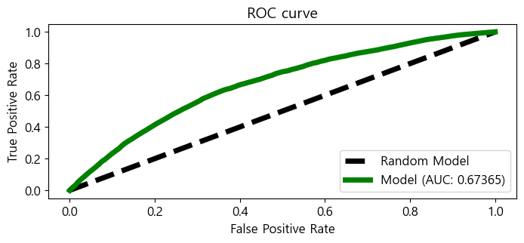
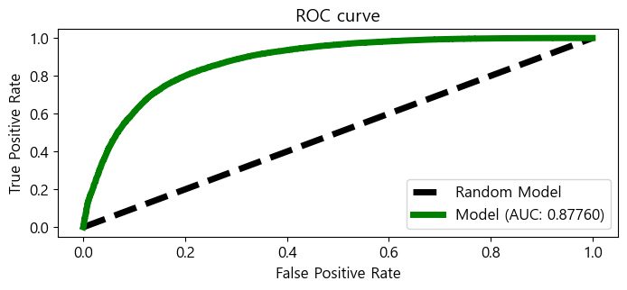
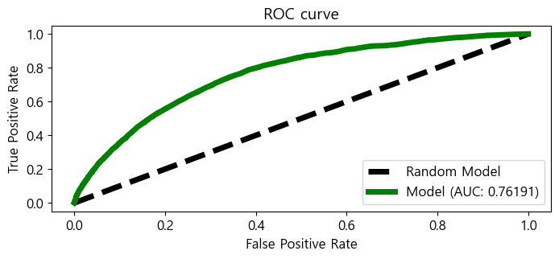
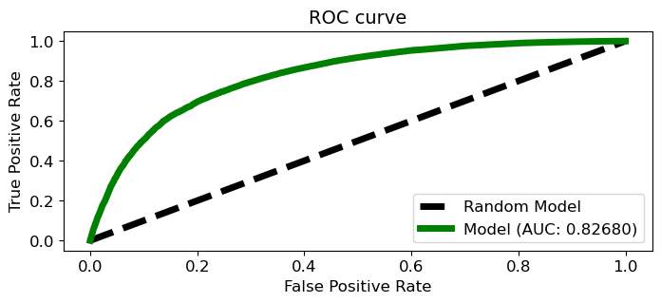
Evaluation
ROC Curve – IV from 0.01 to 0.5
ROC Curve – IV from 0.01 to 1
ROC Curve – IV from 0.01 to 0.7
ROC Curve – w/o Call Related Features

Slide 32
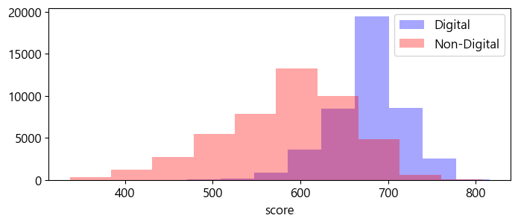
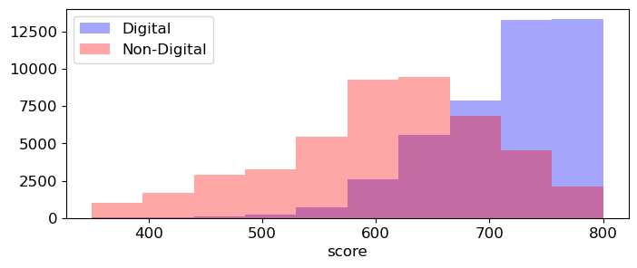
Distribution of Scores for Digital and Non-Digital Customers
Score w/ call, digital related columns
Score w/o call, digital related columns
Without call and digital related columns, accuracy of model decreases

Slide 33
Modeling and Evaluation
(Machine Learning)

Slide 34
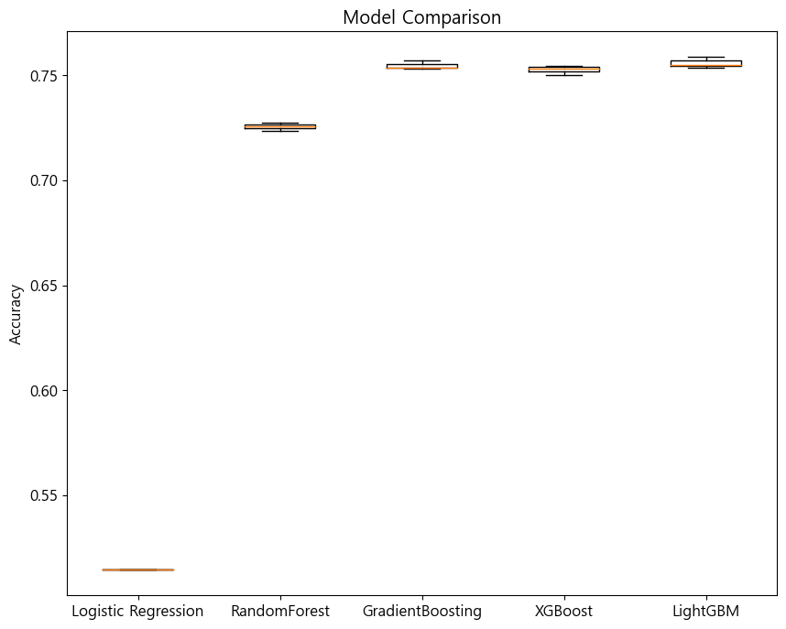
Model Performance
Logistic Regression without IV has low accuracy while tree-based models (RF, LightGBM, XGBoost) have similar performance
LightGBM is known as one of the most powerful models in terms of its accuracy and high learning rate.

Slide 35
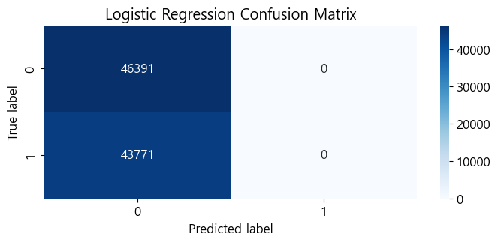
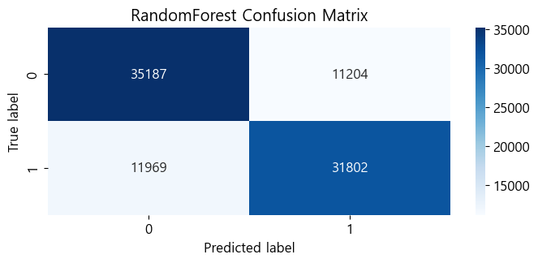
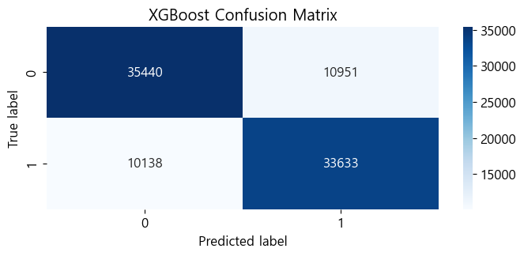

CM(Confusion Matrix) – M/L Models
CM – Logistic Regression (AUC: 0.50)
CM – Random Forest (AUC: 0.7681)
CM – XGBoost (AUC: 0.7661)
CM – LightGBM (AUC: 0.7690)

Slide 36
Summary
Important Features
Age
Chatbot related columns
Number of Months Elapsed Since Sign Up
Model
Logistic Regression(w/ IV) / Random Forest / XGBoost / LightGBM
Normalized score between 350 and 850
Set minimum IV from 0.01 to 1
Excluded columns related to calls
AUC: 0.82
Challenges
Frequency of using chatbot is high compare to the others
- Can mislead to a conclusion that the usage rate of chatbots has a significant impact on digital usage
- Need to be cautious especially when IV is too high
Lack of customer’s experience of using service
- Creates big bias and variance
“Converting customer” is a completely different task from this analysis
Proportion of Digital Usage is Heavily Dependent on Age, Months Elapsed Since Sign Up, and Chatbot Related Columns
Notes:
만약 IVR을 통해 디지털 전환을 목표로 한다면 Target에 대한 정의를 바꿔야 한다. (예: 디지털 이용률 → IVR 시나리오를 통해 디지털로 유입된 고객)

Slide 37
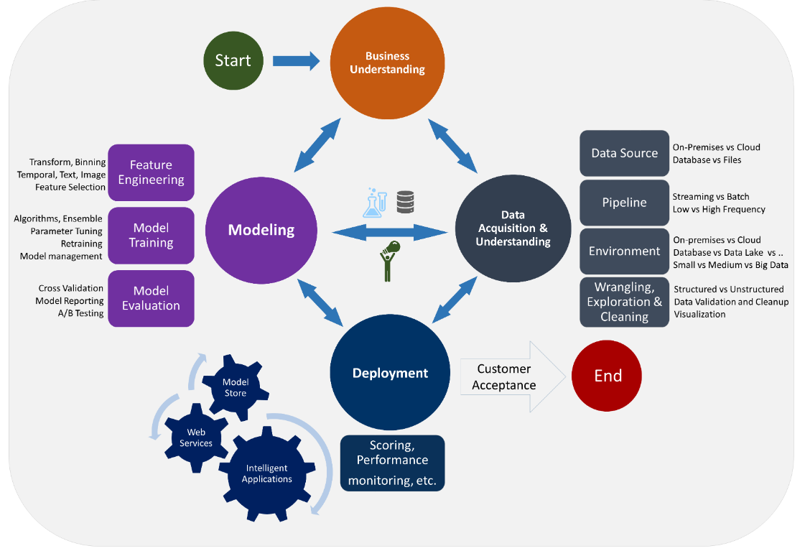
Data Analysis Process
출처: Microsoft

Slide 38
Thank You

