Slide 1

SmartTripAI / PROJECT OVERVIEW
SmartTripAI — Your trip, your way
Discover destinations, explore itineraries and plan around your needs.
01 / 10
Notes:
Open with the traveler’s need: a trip that matches their interests without manually stitching together scattered information. Screenshots show the current Vietnamese UI; slide text and notes are in English. The UI uses Be Vietnam Pro and the Vietnam silhouette logo.

Slide 2
SmartTripAI / PROJECT OVERVIEW
Choosing places is easy. Making them fit is harder.
Three pain point hypotheses from project analysis, pending user validation.
01
02
03
Scattered information
Hard to fit everything
Changes take effort
Places, opening hours, routes and costs come from different sources.
→ Constraints are easy to miss.
Balance interests, time and budget.
→ Overpacked days or unnecessary detours.
Changing one stop means checking the rest again.
→ More time spent revising.
Our focus: help travelers build and check a plan that fits their needs.
02 / 10
Notes:
These pain points are analysis hypotheses, not survey findings. Explain how a changed stop can affect visit order and the return time.

Slide 3
SmartTripAI / PROJECT OVERVIEW
The bottleneck: turning places into a workable plan
A user journey hypothesis to validate through observation.
Find places
→
Pick stops
→
Build a plan
→
Check
→
Adjust
Which stop first?
Will it fit the day?
Within budget?
Order the stops to avoid unnecessary detours.
Balance opening hours, visit times and the return time.
Add up costs and clarify what the estimate includes.
←
Add or remove a stop → rebuild the plan and check it again.
SmartTripAI aims to reduce the effort of scheduling and checking constraints.
03 / 10
Notes:
The bottleneck is combining several constraints into one workable schedule, even after places have been chosen. A change triggers another round of planning and checking. This remains a hypothesis; the frontend uses mock fixtures and does not run a real optimizer.

Slide 4
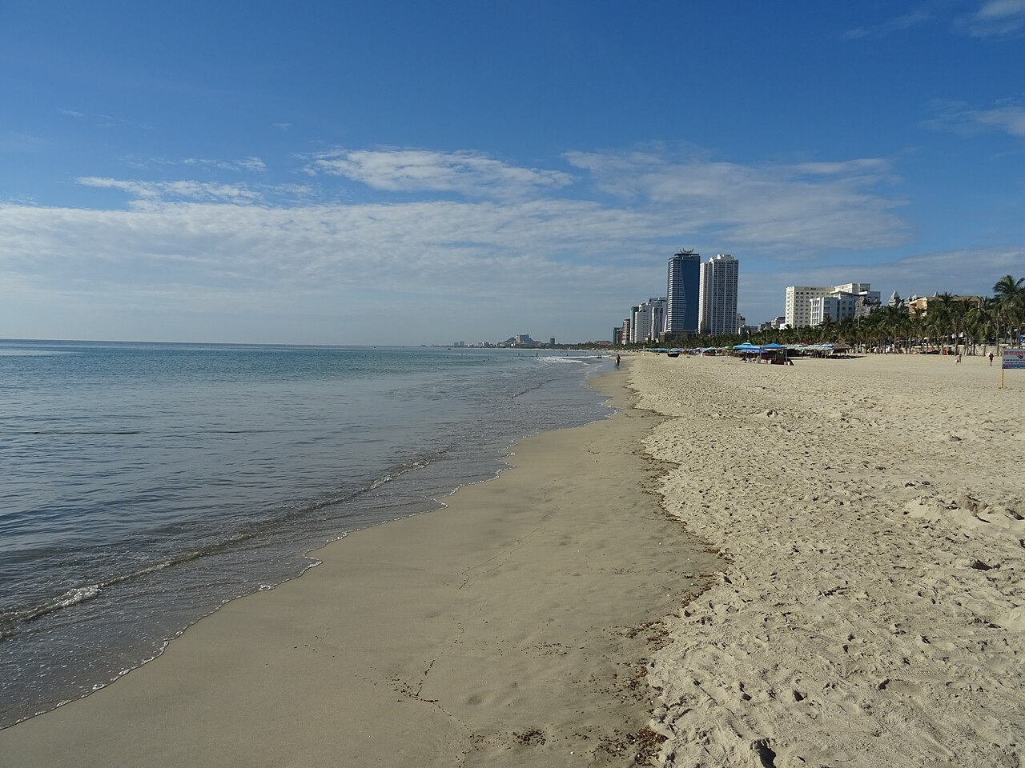
SmartTripAI / PROJECT OVERVIEW
Plan the trip from departure to return
Illustrative journey: Hanoi → Da Nang → Hanoi · 2 travelers · 3 days / 2 nights.
Where does the trip start?
Hanoi → Da Nang → Hanoi
How much time is left?
Allow for return travel and airport transfers
What does the budget cover?
Return travel, local transport, stays, meals and visits
A 3-day trip does not mean 3 full days of sightseeing.
04 / 10
Notes:
Hanoi is an illustrative origin added to explain the full journey, now entered in the UI separately from the destination fixture. Real planning needs transport mode, arrival/departure times and airport transfers. No live intercity fares are fetched; users enter their own estimates. The destination scenario comes from the Da Nang fixture. VND 6 million is the entered group budget, not an actual quote. The destination mock estimate includes accommodation and meals; return travel and transfers are entered separately. Prices and travel times are simulated. My Khe photo: Christophe95, Wikimedia Commons, CC BY-SA 4.0.

Slide 5
SmartTripAI / PROJECT OVERVIEW
AI components and the problems they solve
Proposed design: AI interprets and recommends; algorithms schedule and validate.
AI Travel Agent
Recommendation
Optimization Engine
Interpret requests, ask for missing details and call tools.
Rank places by interests, available time and budget.
Select stops, assign days and order visits under constraints.
Reduce the effort of expressing and organizing trip requirements.
Help travelers choose relevant places from many options.
Build feasible schedules and limit detours and conflicts.
An independent validator checks time, cost and required stops before saving.
The LLM must not invent prices or opening hours. The current FE uses mocks, not a real AI/solver.
05 / 10
Notes:
The Agent may use an LLM to extract requests and explain results. Recommendation can begin with content-based ranking, without an LLM. Optimization uses scheduling algorithms, such as constraint programming; it does not ask an LLM to calculate routes or costs. An independent validator checks the result. These backend components are not implemented. No measured improvements are claimed. Prices, distances and opening hours need sources or explicit estimation labels.

Slide 6
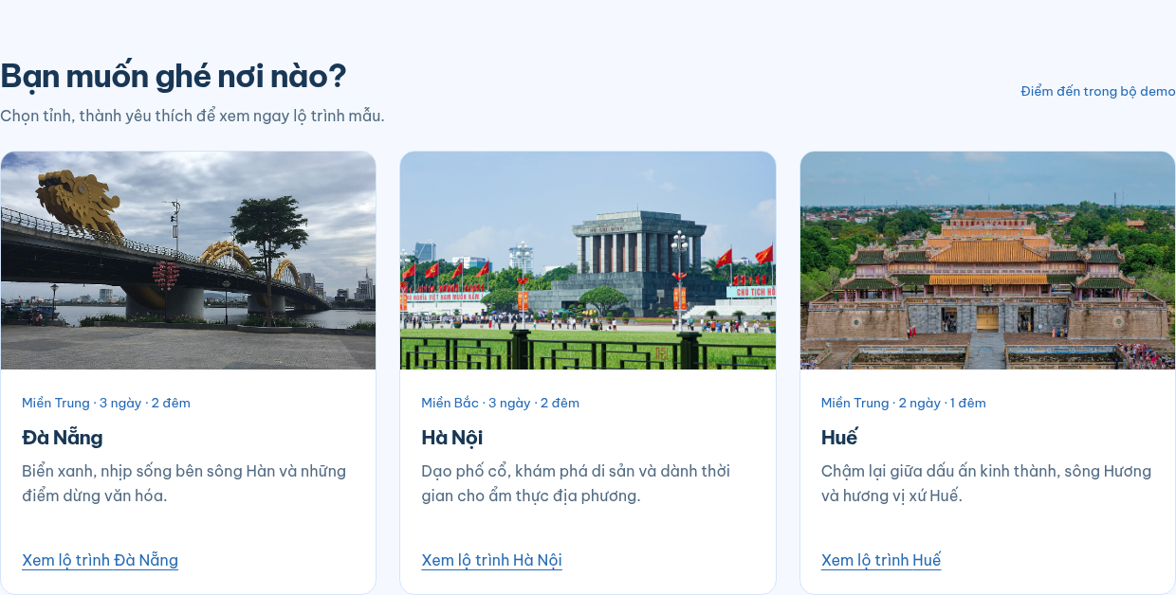
SmartTripAI / PROJECT OVERVIEW
Choose a destination. Open an itinerary.
Da Nang has a detailed mock plan; Hanoi and Hue have illustrative sample itineraries.
06 / 10
Notes:
Destination cards open itineraries directly. Da Nang photo: Christophe95, CC BY-SA 4.0; Hanoi / Ho Chi Minh Mausoleum: NKSTTSSHNVN, CC BY-SA 4.0; Hue: NguyenThanhBac123, CC0. All from Wikimedia Commons; source links are available in the frontend footer.

Slide 7
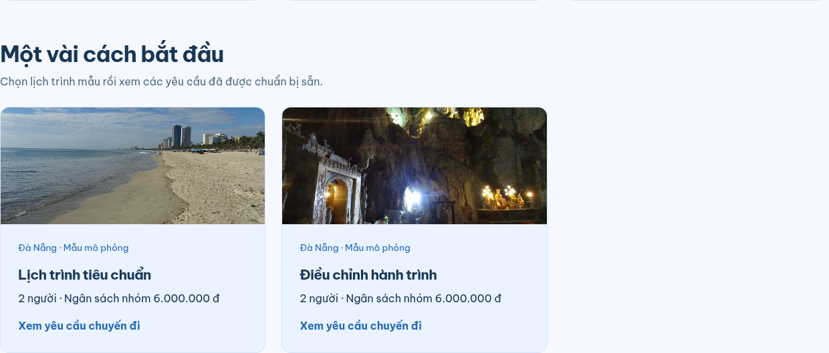
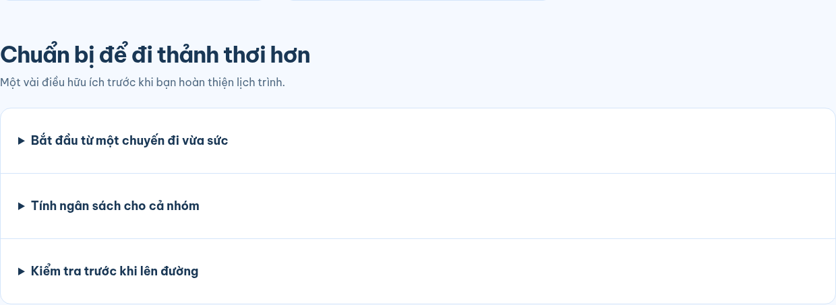
SmartTripAI / PROJECT OVERVIEW
Start with a template. Prepare with a guide.
Templates offer a quick start; guides explain budgeting and pre-trip checks.
07 / 10
Notes:
Templates open the Planner with the selected scenario. Expandable guides cover manageable schedules, group budgets and checks before travel. The prototype does not offer bookings or live prices.

Slide 8
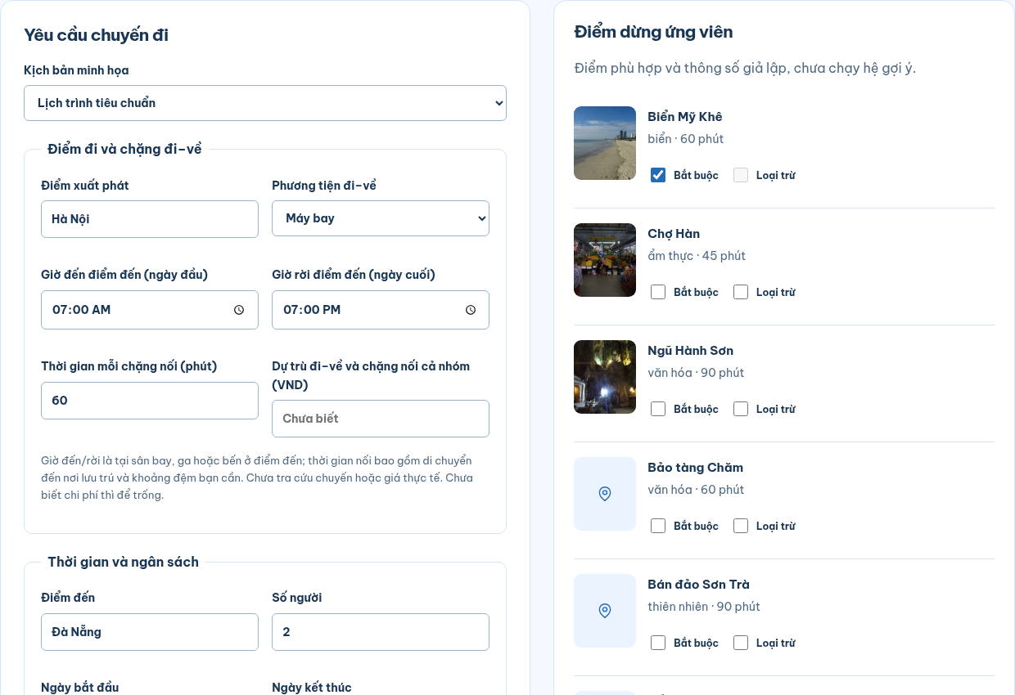
SmartTripAI / PROJECT OVERVIEW
Plan around your time and priorities
Enter origin, transport mode, arrival/departure times, transfers and group travel costs.
08 / 10
Notes:
Use a supported scenario to view results. The prototype uses structured forms and mock data, not an operational AI Agent. Requests outside available fixtures may be unsupported.

Slide 9
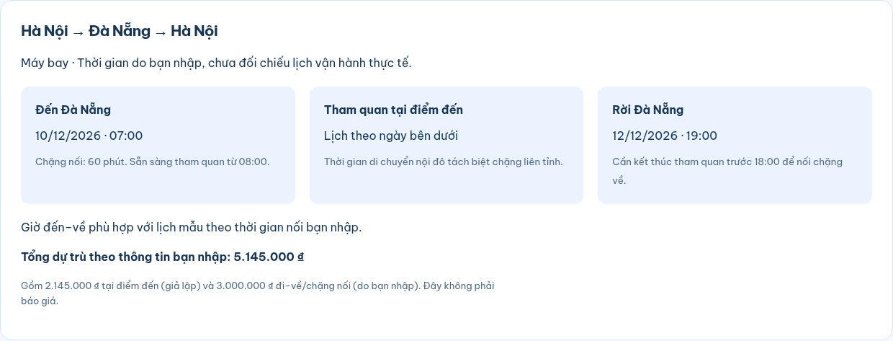
SmartTripAI / PROJECT OVERVIEW
Track the full journey and group budget
Example: VND 2,145,000 at the destination (mock) + VND 3,000,000 for travel (user input).
09 / 10
Notes:
The UI checks arrival plus transfer time against the first day, and the last day against departure minus transfer time. VND 2,145,000 is a mock destination estimate including stays, meals, visits and local transport. VND 3 million is a user-entered travel estimate, not a quote. Missing travel costs mean the full total is unknown. Journey inputs are saved with the version. Conflicting schedules are not automatically rescheduled.

Slide 10
SmartTripAI / PROJECT OVERVIEW
SmartTripAI — From travel ideas to a clear plan
Discover destinations, organize your journey and understand what needs checking.
Easy to get started
See the full journey
Know what costs cover
Explore destinations, itinerary templates and travel guides.
Origin, destination, arrival, departure and transfer time.
Separate mock estimates from user-entered travel costs.
Thank you for your attention
Discussion & questions
10 / 10
Notes:
Close with the value: getting started, seeing the full journey and understanding cost coverage. The current prototype collects requirements using a form; frontend checks are programmed rules. The AI Agent, recommendation and real optimizer are proposed components. Invite questions without claiming measured improvements.

