Slide 1

DEQUAD
AI-Powered Student Wellbeing Platform
Connecting students. Protecting wellbeing. Empowering universities.

Slide 2
Core Features
Google OAuth Authentication
Daily Mood Tracking (1-10 scale)
AI-Powered Risk Analysis
Hinge-Style Student Matching
Comment on Likes Feature
End-to-End Encrypted Chat
Safeguarding Alerts System
Super Admin Dashboard
University Admin Dashboard
Stripe Premium Subscriptions
Data Export (CSV)
Email Notifications

Slide 3
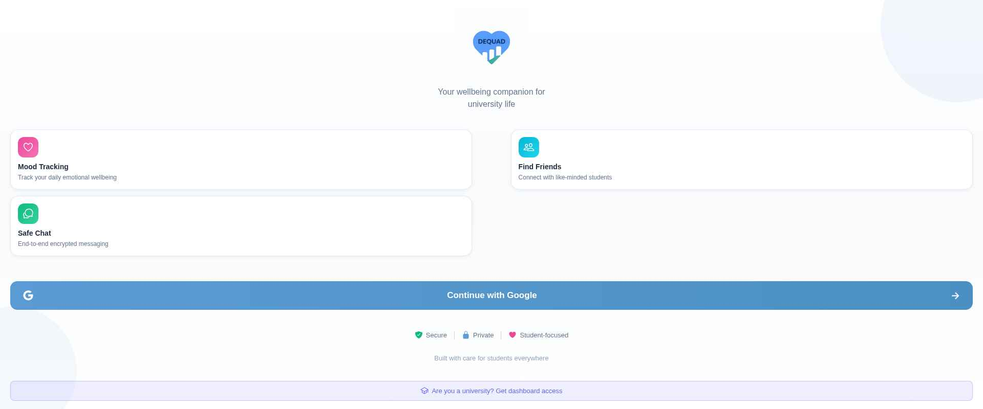
Landing Page
Clean, modern landing with Google Sign-In and university subscription entry point

Slide 4
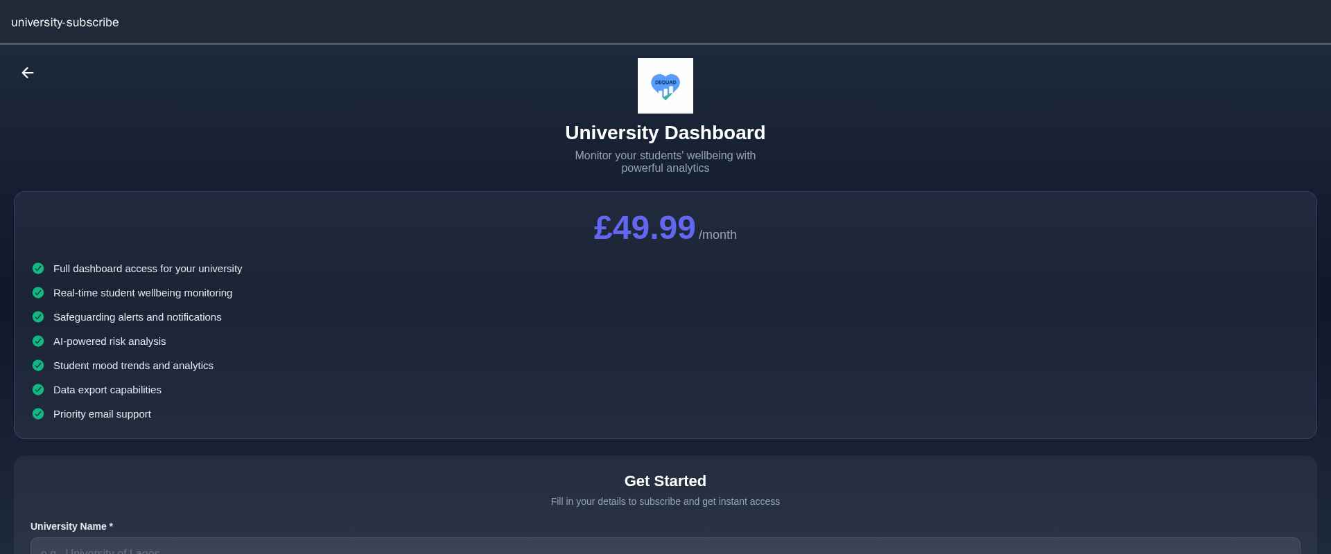
University Subscription
Universities subscribe at GBP 49.99/month to monitor student wellbeing with full dashboard access

Slide 5
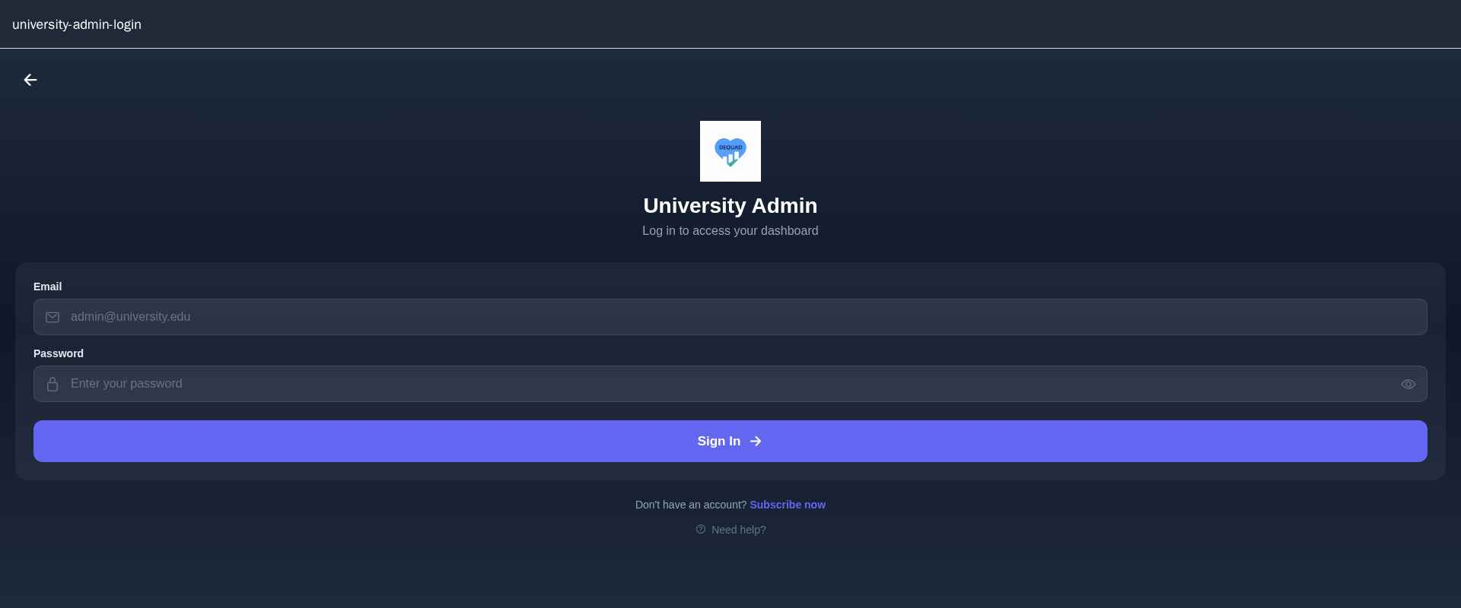
University Admin Login
Dedicated secure login portal for university administrators with auto-generated credentials

Slide 6
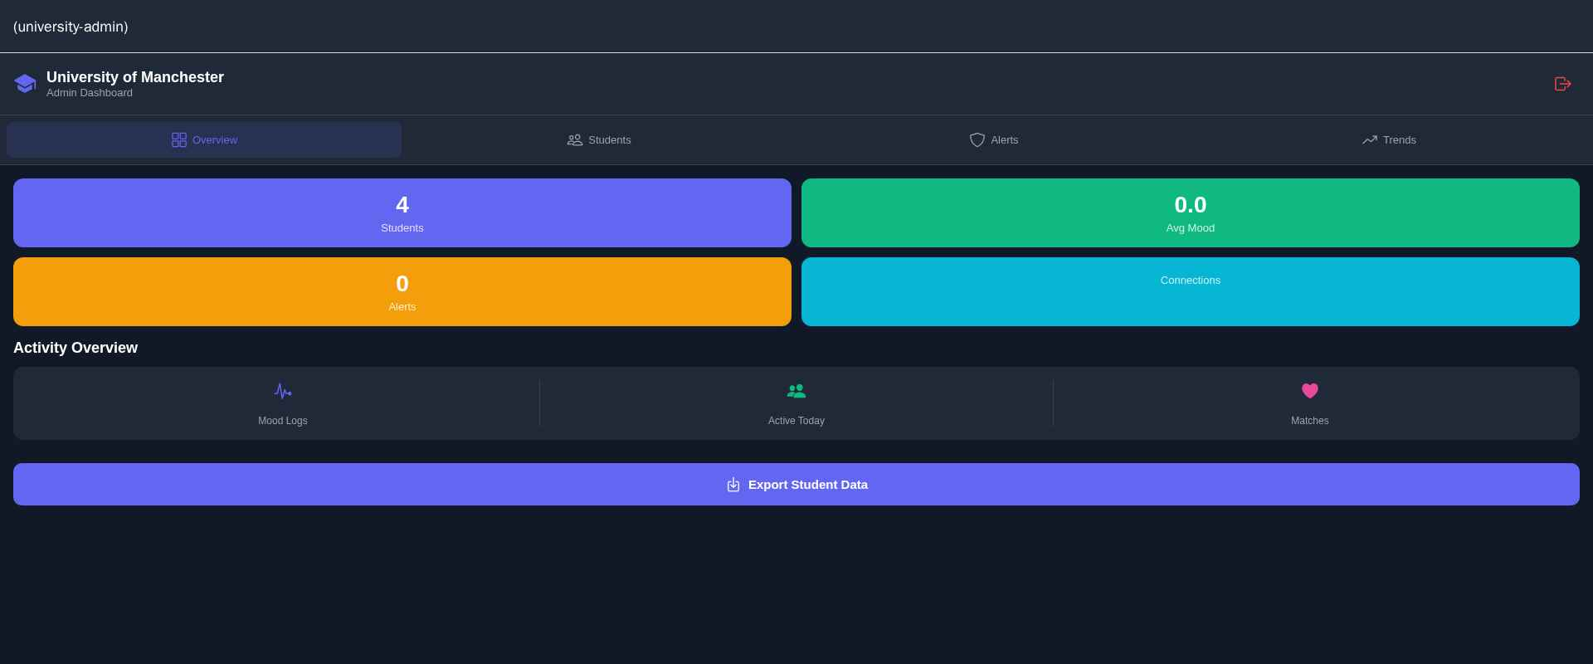
University Admin Dashboard
Real-time analytics: student count, mood trends, safeguarding alerts, and data export

Slide 7
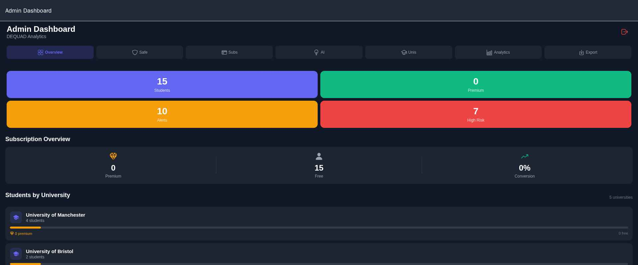
Super Admin Dashboard
Platform-wide analytics: all students, premium users, safeguarding alerts, and AI insights

Slide 8
Pricing Plans
Student Premium
University Dashboard
GBP 4.99/month
GBP 49.99/month
Unlimited matches
Priority support
Advanced AI insights
No ads
Full dashboard access
Student monitoring
Safeguarding alerts
Data export
Priority support

Slide 9
Demo User Profiles
Emma Wilson
James Chen
Sofia Martinez
Computer Science | University of Manchester
Data Science | University of Birmingham
Psychology | University of Leeds
Study: Visual Learner
Study: Night Owl
Study: Early Bird
Alex Thompson
Priya Patel
Oliver Wright
Environmental Science | University of Bristol
Business Analytics | University of Warwick
Mechanical Engineering | University of Manchester
Study: Group Study
Study: Visual Learner
Study: Night Owl
Amara Okafor
Lucas Fernandez
Zara Ahmed
Biomedical Science | University of Manchester
Architecture | University of Leeds
Law | University of Birmingham
Study: Early Bird
Study: Visual Learner
Study: Group Study
Ethan Kim
Chloe Williams
Daniel Johnson
Mathematics | University of Warwick
English Literature | University of Bristol
Music Production | University of Manchester
Study: Solo Study
Study: Early Bird
Study: Night Owl

Slide 10
Thank You
DEQUAD - Your wellbeing companion for university life
Contact: support@dequad.com

