Slide 1

PARTNERSHIP PROPOSAL · UNIVERSITY OF BEDFORDSHIRE
DEQUAD
See loneliness early.
Act before it becomes a crisis.
The verified, safeguarded student-wellbeing platform — peer connection, daily mood check-ins and an institutional dashboard that helps your wellbeing team reach students sooner.
Yusuf Quadri, CEO · Yusuff Adeagbo, CTO · dequad.co.uk
Notes:
Open by thanking the Bedfordshire team. Frame DEQUAD as a prevention layer that supports, not replaces, Student Wellbeing & Counselling services.

Slide 2
Most struggling students never ask for help
University wellbeing support is mostly reactive — it starts when a student walks through the door.
54%
34%
6.1 wks
of UK undergraduates report frequent loneliness
experience a clinically significant mental-health issue during their degree
average wait for a university counsellor
ONS, 2023
Student Minds, 2024
UUK, 2024
The gap: by the time a student presents in crisis, the friendships and early warnings that could have prevented it never formed. DEQUAD is built for the students who never walk into the counselling office.
DEQUAD × University of Bedfordshire · 2
Notes:
Statistics as cited in the DEQUAD pitch materials. Verify the latest figures before presenting.

Slide 3




Why now
Regulators and sector bodies now expect universities to evidence proactive prevention.
Office for Students
Online Safety Act 2023
Universities are expected to show proactive, preventative approaches to student mental health — not only crisis response.
Student-facing platforms need risk assessment and reporting flows. DEQUAD ships with these built in.
UUK Mental Health Charter
Loneliness persists
100+ UK universities have committed to a whole-university, data-informed approach to wellbeing.
Undergraduate loneliness remains well above its pre-pandemic baseline — commuter and first-generation students are hit hardest.
DEQUAD × University of Bedfordshire · 3

Slide 4




One app, four modules — live today
Available on iOS, Android and web at dequad.co.uk. Built with FastAPI, MongoDB and Expo.
Verified peer matching
Daily mood check-in
AI-assisted safeguarding
University dashboard
Only .ac.uk students can join. Students match by intent — friends, study buddies or support — not looks.
A 10-second 1–10 check-in with optional note and a personal weekly trend. Gentle 6 pm reminder.
Mood notes, chats and support messages are scanned for crisis language and behavioural decline, then escalated.
Cohort wellbeing, safeguarding alerts, mood trends, AI insights and CSV export for your wellbeing team.
DEQUAD × University of Bedfordshire · 4

Slide 5
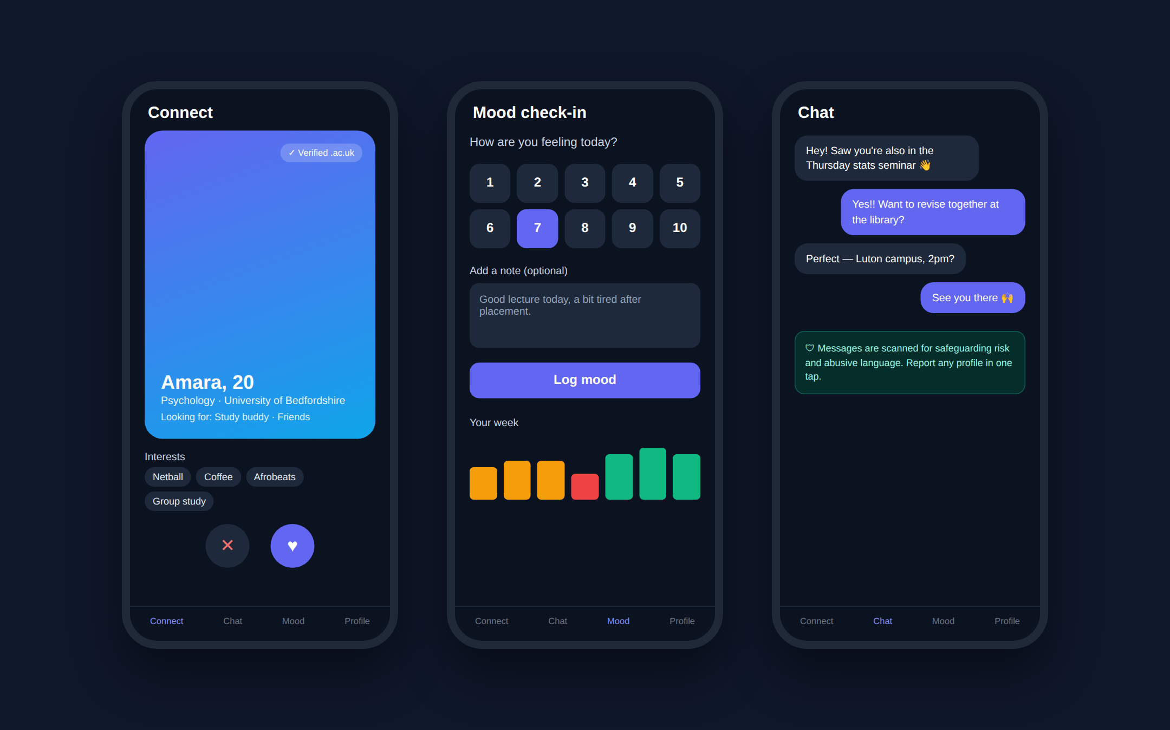
What your students see
Connect with verified Bedfordshire peers, check in daily, and chat in a safeguarded space.
Notes:
Illustrative screens of the student app. Profiles shown are fictional.

Slide 6




How it works: from check-in to support in minutes
Every step keeps the student in control and your wellbeing team informed.
1. Sign up
2. Connect
3. Check in
4. Detect
5. Alert
Student registers with a beds.ac.uk email and verifies it with a one-time code.
Finds course-mates, study partners and friends on campus.
Logs mood daily; personal trends build a baseline.
AI flags crisis language or a sustained mood decline.
Your safeguarding lead is alerted by email and in the dashboard.
Target: high-risk signals reach your designated safeguarding lead in under 60 seconds — alongside on-screen crisis resources for the student.
DEQUAD × University of Bedfordshire · 6

Slide 7
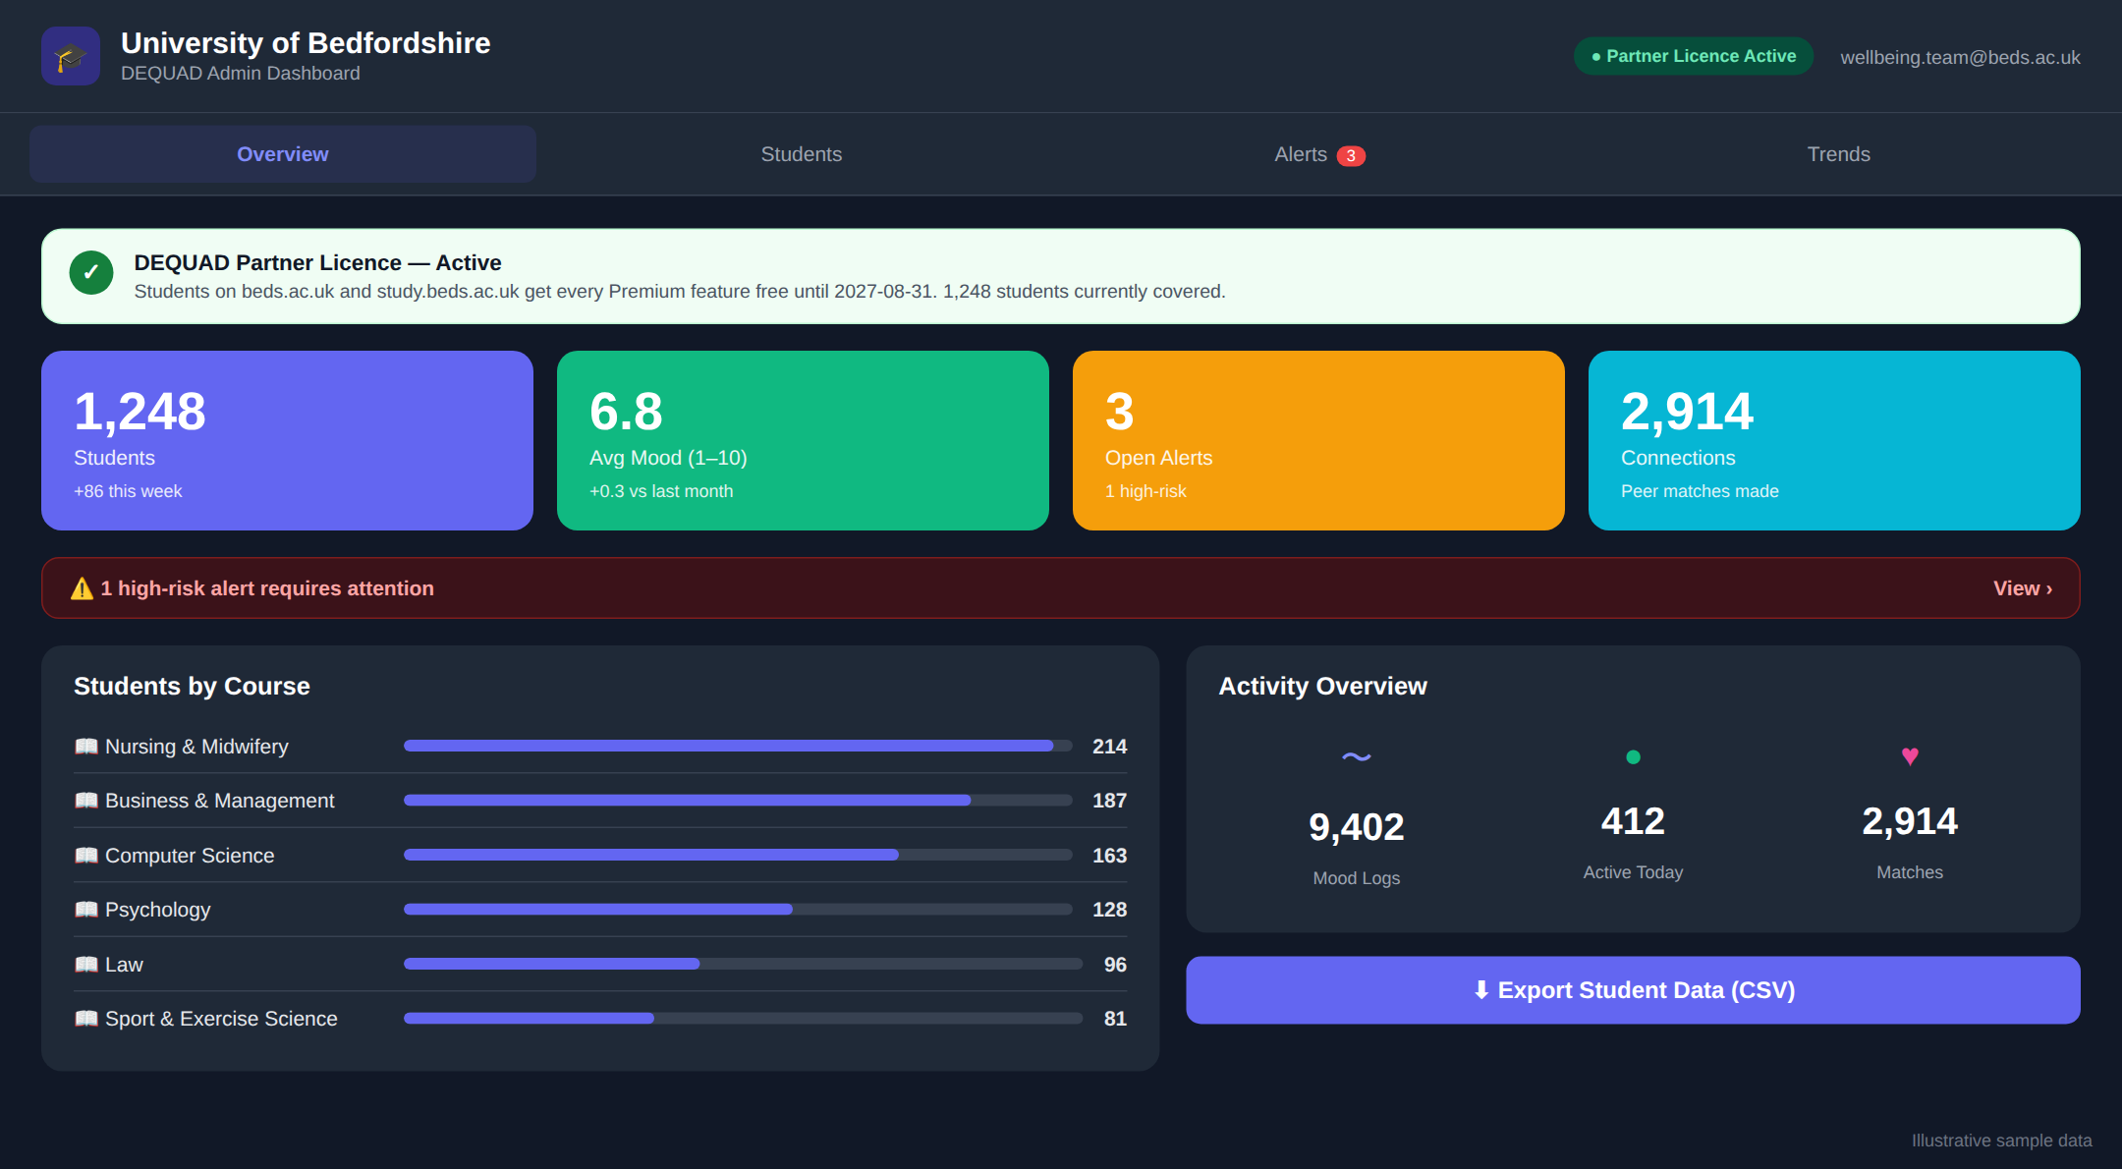



Your dashboard: the whole cohort at a glance
Live headline KPIs
Students, average mood, open alerts and peer connections.
Licence status
Shows which domains are covered and how many students benefit.
Course breakdown
Spot which programmes are engaging — and which aren't.
One-click export
CSV export for reporting to committees and governors.
Illustrative example with sample data.
DEQUAD × University of Bedfordshire · 7

Slide 8
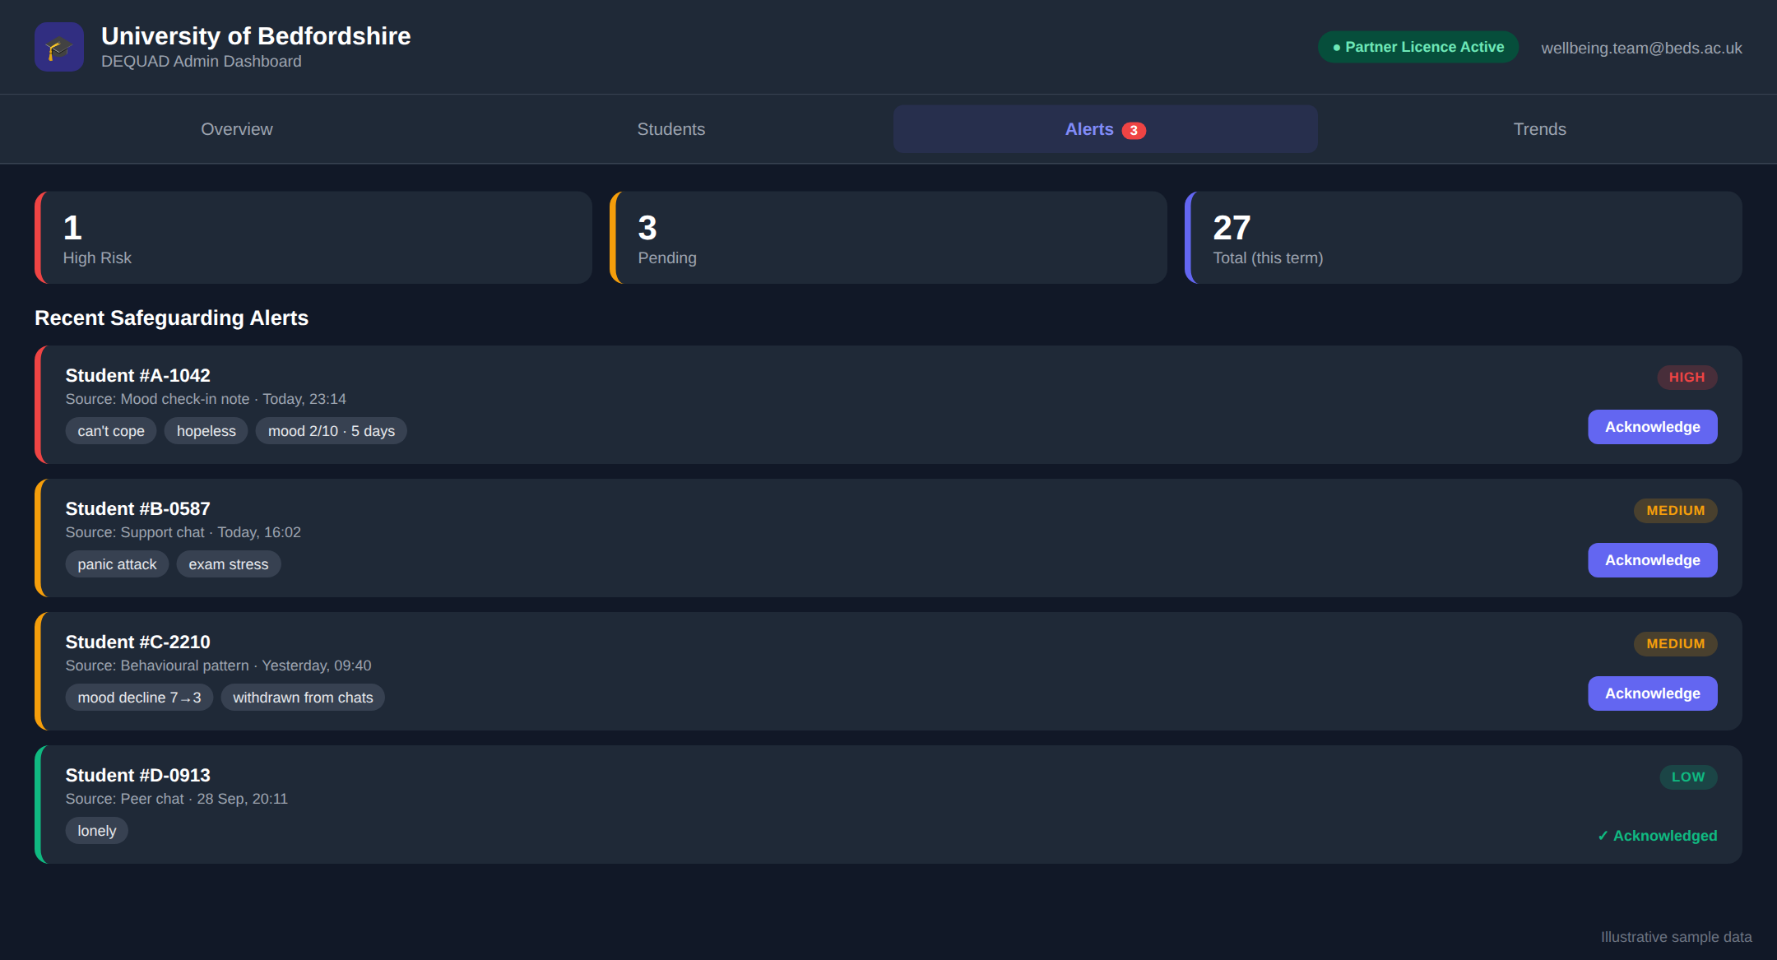
Safeguarding alerts your team can act on
Risk-rated: every alert is graded High, Medium or Low, with the keywords or pattern that triggered it.
Multiple sources: mood notes, peer chat, support chat and behavioural patterns such as a sustained mood drop.
Closed loop: staff acknowledge alerts in the dashboard; feedback trains the AI to cut false positives.
Out-of-hours: email notification to your safeguarding lead, plus crisis resources shown to the student.
Illustrative example with sample data. Student identities are pseudonymised in this mock-up.
DEQUAD × University of Bedfordshire · 8

Slide 9
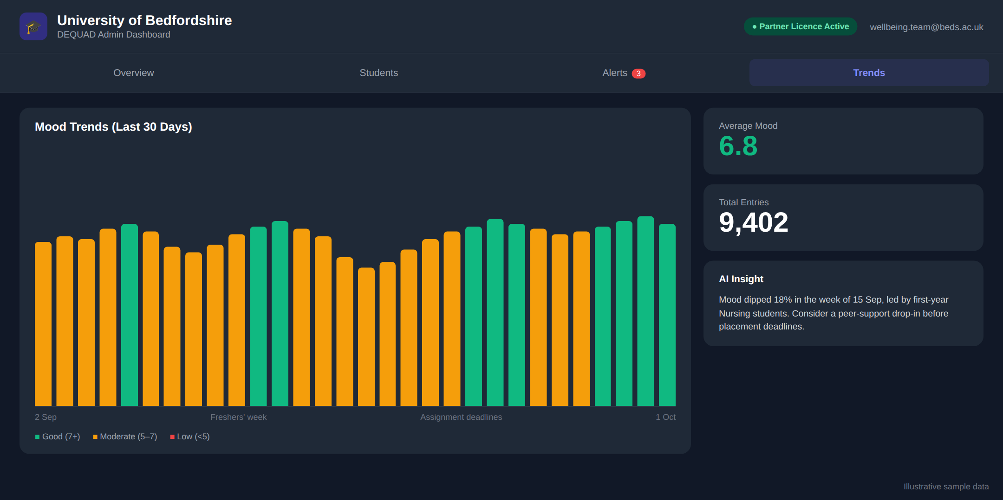
Mood trends and AI insights across the term
What it tells you
Daily cohort mood, colour-coded
Pressure points: Freshers', deadlines, placements
Plain-English AI summary + one action
Evidence for OfS and governors
Illustrative example with sample data. Reporting is aggregated; individual mood entries stay private unless a safeguarding risk is detected.
DEQUAD × University of Bedfordshire · 9

Slide 10






Safe by design
Safeguarding, privacy and compliance are built into the product, not bolted on.
Verified students only
Language filtering
Report & block
.ac.uk email + one-time code; manual review queue for edge cases.
Racist and abusive language is blocked before it is sent.
Any profile can be reported in one tap and reviewed by moderators.
Secure by default
UK GDPR & DPIA
Student control
Hashed passwords, encrypted transport, login lockout, security headers.
Data-protection impact assessment and Online Safety Act compliance pack.
Students can delete their account and data at any time.
DEQUAD × University of Bedfordshire · 10

Slide 11
Why DEQUAD
The only product combining verified peer connection, daily wellbeing data and safeguarding escalation.
Capability | DEQUAD | Togetherall | TalkCampus | UniBuddy
.ac.uk student verification | ✓ | — | — | ✓
Intent-based peer matching | ✓ | — | Limited | —
Daily mood check-ins | ✓ | — | Limited | —
AI-assisted safeguarding | ✓ | Limited | — | —
Alerts to university safeguarding lead | ✓ | — | — | —
Indicative price per university | £2 / student / yr | £40k+ | £25k | £18k
Competitor capabilities and prices are DEQUAD estimates from public information and should be treated as indicative.
DEQUAD × University of Bedfordshire · 11

Slide 12


Rooted in Bedfordshire
DEQUAD was shaped by Bedfordshire students — and by a founder who served them.
Former SU President
“
Our CEO, Yusuf Quadri, was Bedfordshire Students' Union President 2021–23, working alongside student services and safeguarding leads.
We built DEQUAD because we saw, first-hand, how many Bedfordshire students — commuters, carers, international and first-generation — were struggling quietly. We want to build the solution with Bedfordshire first.
Frontline safeguarding experience
Background in NHS clinical support and recovery coordination, with seven safeguarding and clinical-awareness certifications.
Tested with your students
A closed beta with verified Bedfordshire students shaped matching, mood check-ins and the alert flow.
Backed by accelerators
Yusuf Quadri, Founder & CEO
Santander Universities Pre-Incubator (2025) and NatWest Accelerator, London (2026).
DEQUAD × University of Bedfordshire · 12

Slide 13
Simple, per-student partnership pricing
UNIVERSITY PARTNER LICENCE
£2 per enrolled student / year
Every student on beds.ac.uk gets Premium free
Full university dashboard & CSV export
Safeguarding alerts to your designated lead
Named success manager & termly impact report
Students' own Premium otherwise £4.99 / month
Competitor figures are indicative estimates. DEQUAD = 10,000 students × £2.
DEQUAD × University of Bedfordshire · 13

Slide 14
Proposed next step: a 12-week pilot
Low-risk, measurable, and designed with your Student Wellbeing team. Start date to be agreed.
Weeks 1–2
Weeks 3–10
Weeks 11–12
Set up
Live with students
Review
Licence for beds.ac.uk, dashboard accounts, safeguarding escalation route agreed with your DSL, DPIA sign-off.
Launch via SU, Freshers / welcome channels and course reps. Weekly check-ins with your team.
Impact report: engagement, mood trends, alerts handled, student feedback. Decide on full rollout.
How we'll measure success
Sign-ups
Weekly active
Mood check-ins
Alerts
Satisfaction
verified students
students using it
completed
actioned by staff
student survey
DEQUAD × University of Bedfordshire · 14

Slide 15
The team
Safeguarding, engineering and growth experience in one founding team of five.
YQ
YA
GM
AA
CJ
Yusuf Quadri
Yusuff Adeagbo
Dr Gerald Marfo
Adedapo Ajuwon
Chinyere Jennifer
CEO · Product & Safeguarding
CTO · Engineering & IT
CMO
Senior Software Engineer
Senior Advisor
Bedfordshire SU President 2021–23. NHS clinical support and recovery coordination background.
MSc IT with Project Management (UWS); HND Computer Science.
PhD in Digital Marketing.
Full-stack and infrastructure.
Senior PM Consultant, MIGSO-PCUBED.
DEQUAD × University of Bedfordshire · 15

Slide 16
Let's build a more connected Bedfordshire — together.
What we're asking for
A 45-minute demo with Student Wellbeing, Safeguarding and the SU
Agreement in principle to a 12-week pilot
A named contact to co-design the safeguarding escalation route
Yusuf Quadri · Founder & CEO · yusuf@dequad.co.uk
Yusuff Adeagbo · Co-founder & CTO · yusuff@dequad.co.uk
dequad.co.uk
Notes:
Close with the three asks. Offer to leave a demo login with the team after the meeting.

