Slide 1
Self-Driving Hardware and Software Architectures
Module 2

Slide 2
In this module ...
Sensors for perception
Self-driving computing hardware
Designing hardware configurations（レイアウト）
Software architecture, decomposition
Environment representation for self-driving（マップ）
2

Slide 3
Sensors and Computing Hardware
Course 1, Module 2, Lesson 1

Slide 4
Sensors
Sensor: 環境のプロパティ/その変化を計測/検知するデバイス(device that measures or detects a property of the environment, or changes to a property)
Categorization:
o exteroceptive（外受容）: extero = surroundings
o proprioceptive（自己受容、固有受容）: proprio = internal
4

Slide 5

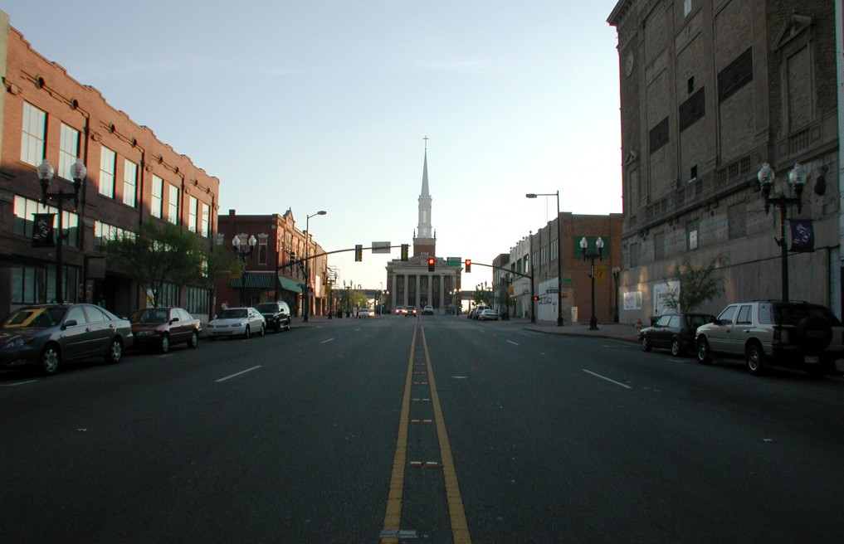
Sensors for perception
exteroceptive
Camera
Camera: passive（受動的）, light-collecting sensor
Essential for correctly perceiving environment
Comparison metrics:
Resolution
Field of view
Dynamic range（画像の一番明るい色調と一番暗い色調の差（同じ色）、高いdynamic rangeは夜の運転に大事）
Field of View: the horizontal and vertical angular extent that is visible to the camera, and can be varied through lens selection and zoom.
Resolution : the number of pixels that create the image.
Dynamic range: the difference between the darkest and the lightest tones（色調、しきちょう） in an image. High dynamic range is critical for self-driving vehicles due to the highly variable lighting conditions encountered while driving especially at night.
- A tone is one of the lighter, darker, or brighter shades of the same color
- A shade of a particular color is one of its different forms. For example, emerald green and olive green are shades of green.
Trade-off between resolution and FOV?
広いFOVは、視野を広げるが、あるオブジェクトのピクセル数が減る
Wider field of view permits a larger viewing region in the environment. But fewer pixels that absorb light from one particular object.

Slide 6

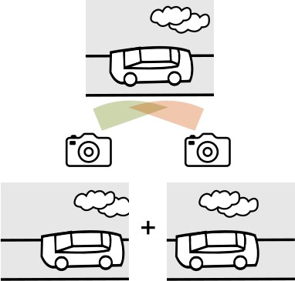
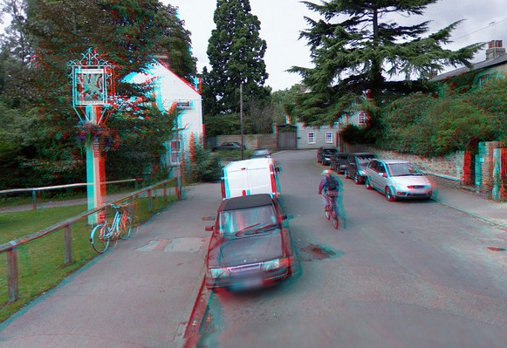
Sensors for perception
exteroceptive
Stereo
The combination of two cameras with overlapping fields of view and aligned image planes. depth estimation from synchronized image pairs.
Pixel values from image can be matched to the other image producing a disparity map（視差マップ） of the scene.
This disparity can then be used to estimate depth at each pixel.
Enables depth estimation from image data
視差マップを利用する。コース３で紹介
Left and right images

Slide 7

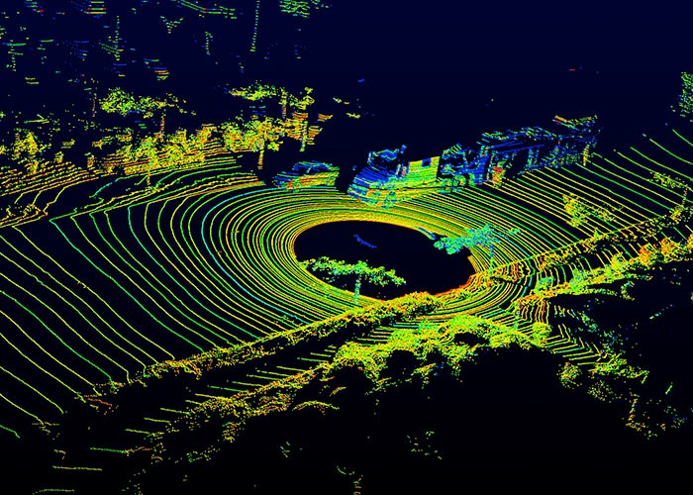
Sensors for perception
shooting light beams into the environment and measuring the reflected return. measuring the amount of returned light and time of flight of the beam.
a spinning element with multiple stacked light sources
exteroceptive
LIDAR
Detailed 3D scene geometry from LIDAR point cloud
なぜLiDARが必要？LiDARも光、Cameraも光 。
- LiDAR output a three dimensional point cloud map, which is great for assessing scene geometry.
- Because it is an active（アクティブ） sensor with its own light sources, LiDAR are not affected by the environment’s lighting. So LiDAR do not face the same challenges as cameras when operating in poor or variable lighting conditions.
Comparison metrics:
Number of beams
Points per second
Rotation rate
Field of view
Detection range (the power output of the light source)
8, 16, 32, 64
(it can collect) (the more detailed the 3D point cloud can be)
(the faster the 3D point clouds are updated)
Upcoming: Solid state LIDAR!
最新LIDAR：High-resolution, solid-state LIDAR, No rotational component；
安い：the future of affordable self-driving

Slide 8
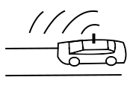
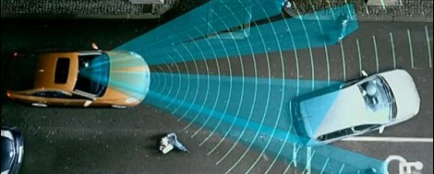
Sensors for perception
exteroceptive
RADAR
Robust Object Detection and Relative Speed Estimation
Comparison metrics:
o range
o field of view
o position and speed accuracy
Configurations:
WFOV, short range
NFOV, long range
Works in poor visibility（可視性） like fog and precipitation!

Slide 9
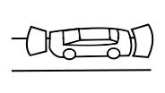
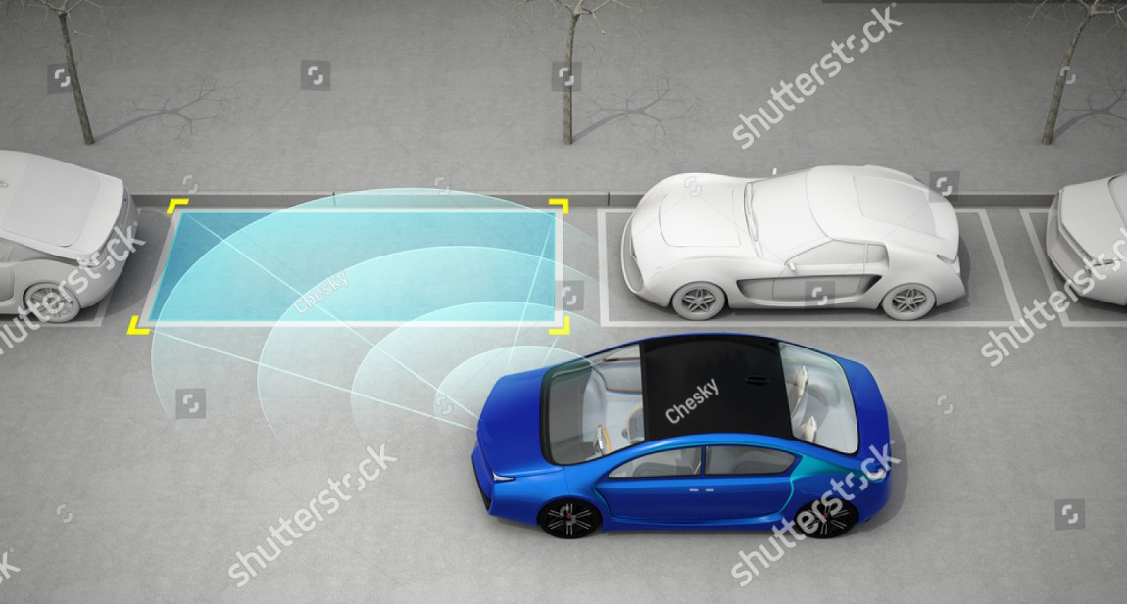
Sensors for perception （超音波、ちょうおんぱ）
exteroceptive
Ultrasonics
Short-range all-weather distance measurement
Ideal for low-cost parking solutions
Unaffected by lighting, precipitation
Comparison metrics:
Range
Field of view
Cost

Slide 10

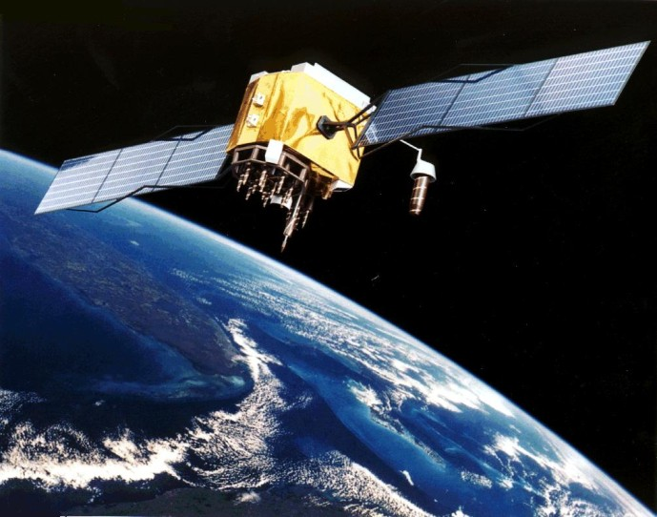
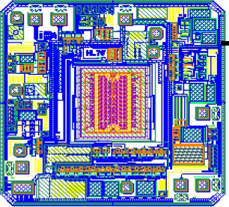
proprioceptive
Sensors for perception
GNSS/IMU
GPS or Galileo
Global Navigation Satellite Systems and Inertial measurement units（慣性計測装置）
Direct measure of ego vehicle states
o position, velocity (GNSS)
Varying accuracies: RTK, PPP, DGPS
o angular rotation rate (IMU)
o acceleration (IMU)
o heading (IMU, GPS)

Slide 11

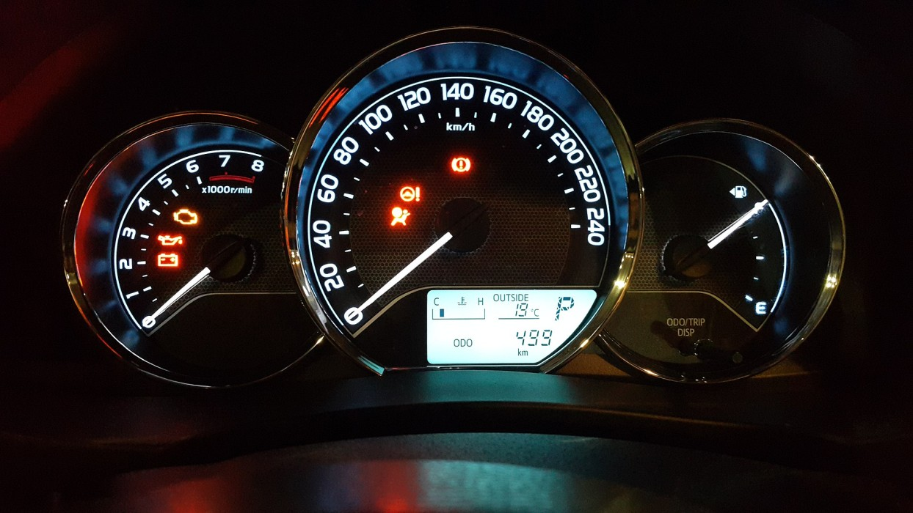
proprioceptive
Sensors needed for perception（オドメトリ）
Wheel Odometry
Tracks wheel velocities and orientation
Uses these to calculate overall speed and orientation of car
o speed accuracy
o position drift

Slide 12


Sensors needed for perception: Summary
Camera
LIDAR
RADAR
Ultrasonics
GNSS/IMU
Wheel Odometry

Slide 13
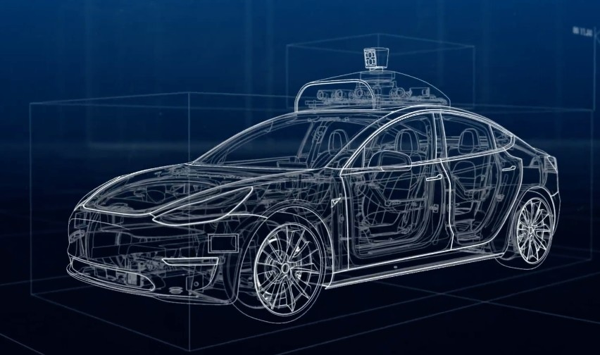
Sensors needed for perception
LIDAR
Cameras
GNSS antenna
Radar
Central Wheel Odometr^{C}y ^{omputer}
Ultrasonics

Slide 14
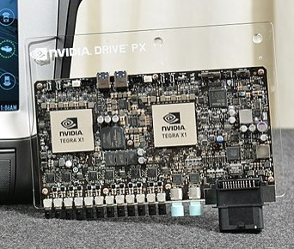
Computing Hardware
Need a “self-driving brain”
Takes in all sensor data
Computes actions
Already existing advanced systems that do self driving car processing (e.g. Drive PX/AGX(multiple GPUs), Intel & Mobileye EyeQ)
(have FPGAs to accelerate parallelizable compute tasks)

Slide 15
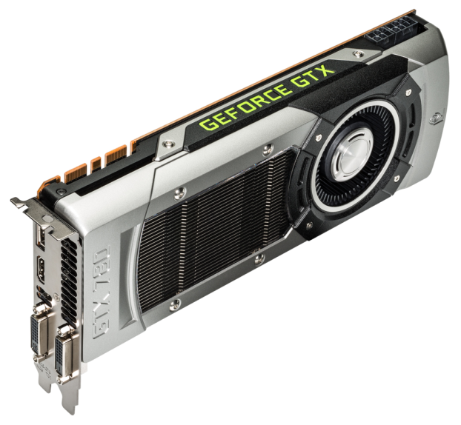
Computing Hardware
Need a “self-driving brain”
Image processing, Object detection, Mapping
GPUs - Graphic Processing Unit
FPGAs - Field Programmable Gate Array
製造後に購入者や設計者が構成を設定できる集積回路であり、広義にはPLD（プログラマブルロジックデバイス）の一種である
ASICs - Application Specific Integrated Chip（特定用途向け集積回路）
特定の用途向けに複数機能の回路を1つにまとめた集積回路の総称である
だからAny computing brain for self-driving needs both serial（シリアル） and parallel compute modules.

Slide 16
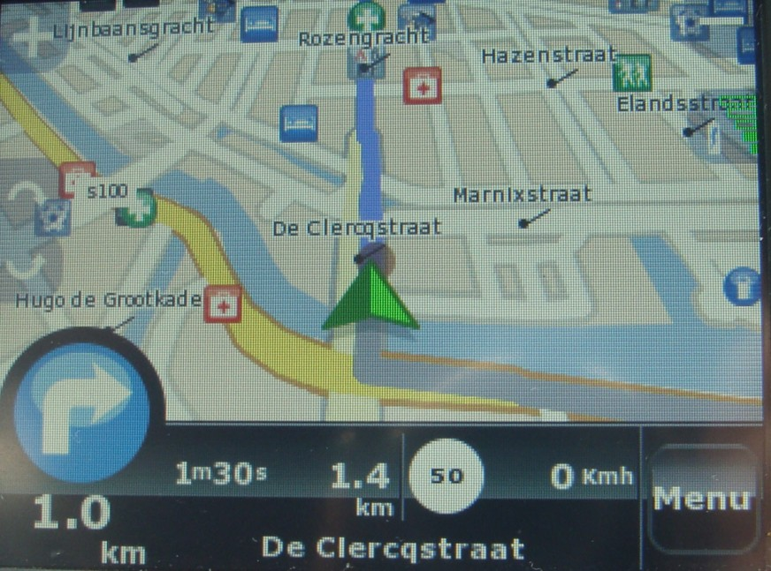
Computing Hardware
Need a “self-driving brain”
Image processing, Object detection, Mapping
GPUs, FPGAs, ASICs
Synchronization Hardware
To synchronize different modules and provide a common clock（センサーフュージョンに重要）
GPS relies on extremely accurate timing to function, and as such can act as an appropriate reference clock when available. （GPSが基準クロックになるが、GPSは使えない時もあるので、同期ハードウェアが必要）
sensor measurements must be timestamped with consistent times for sensor fusion to function correctly.（センサーの間の同期）

Slide 17
Summary
Sensors - exteroceptive and proprioceptive
o camera, LIDAR, RADAR, ultrasonics, GNSS, IMU, wheel odometry
Self-driving computing hardware
More about sensors and computing software: http://wavelab.uwaterloo.ca/sharedata/ME597/ME597_Lecture_Slides/ME597-4- Measurement.pdf
17

Slide 18
Hardware Configuration Design
Module 2, Lesson 2

Slide 19
Sensors
Sensors:
camera for appearance input,
stereo camera for depth information,
lidar for all whether 3D input,
radar for object detection,
ultrasonic for short-range 3D input,
GNSS/IMU data and wheel odometry for ego state estimation.
Camera
LIDAR
RADAR
Ultrasonics
GNSS/IMU
Wheel Odometry

Slide 20



Assumptions
Aggressive deceleration =
Comfortable deceleration =
o This is the norm, unless otherwise stated
自乗、じじょう
reasonably comfortable while still allowing the car to come to a stop quickly
Stopping distance:

Slide 21
Where to place sensors?
Need sensors to support maneuvers within our ODD
Broadly, we have two driving environments
 | Highway | Urban（都市） / Residential（住宅）
Traffic Speed | High | Low - Medium
Traffic Volume | High | Medium - High
# of lanes | More | 2-4 typically
Other Features | Fewer, gradual curves; merges | Many turns and intersections

Slide 22
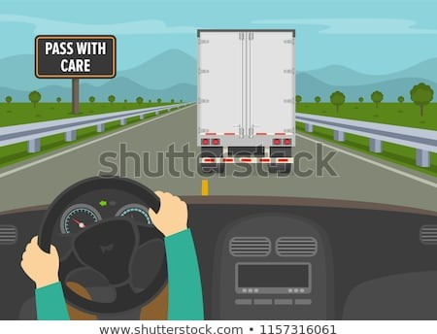
Highway Analysis
Broadly, 3 kinds of maneuvers:
Emergency Stop
Maintain Speed
Lane Change

Slide 23
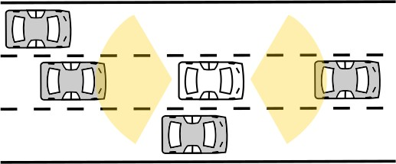
Highway Analysis: Emergency Stop
If there is a blockage ahead, we want to stop in time.
Longitudinal Coverage:
Assume we are speeding at 120 kmph.
Stopping distance could be
~110 metres; aggressive deceleration
この図によると、大きいFOVのセンサーをしている。なぜ大きいFOVが必要かまだ分かっていない
なのでMost self-driving systems aim for sensing ranges of 150 ~ 200m in front of the vehicle as a result.

Slide 24
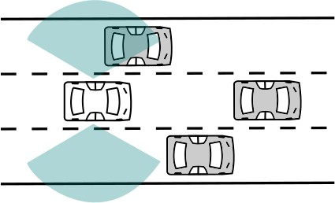
Highway Analysis: Emergency Stop
To avoid collision, either we stop or change lanes.
Lateral Coverage:
At least adjacent lanes, since we may change lanes to avoid a hard stop.

Slide 25
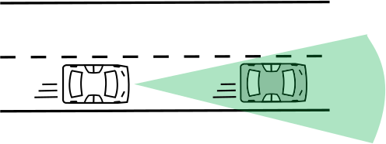
Highway Analysis: Maintain Speed
Relative speeds are typically less than 30 kmph.
Longitudinal coverage:
At least ~100 metres in front.
Both vehicles are moving, so don’t need to look as far as emergency-stop case.（この文は誤解させそうです。講師も言っていない。この文は、maintain speedのために使ったセンサーの検知距離は、emergency stopのセンサーより短いと言ってるようです。でも「overall coverage, slide 32」スライドでは逆に見えてる。個人的には、ここで検知距離より、FOVから考えたほうが理解しやすい。Maintain speedで自車線の前走車しか見る必要がないので、FOVは小さい。FOVが小さいセンサーの検知距離は長いのではないかと思っている。）

Slide 26
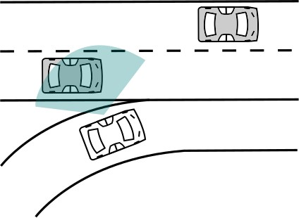
Highway Analysis: Maintain speed with Merge
Lateral Coverage:
Usually current lane
Adjacent lanes would be preferred for merging vehicle detection.
Laterally: A wide 160 to 180 degree field of view is required to track adjacent lanes and a range of 40 ~ 60m is needed to find space between vehicles.

Slide 27
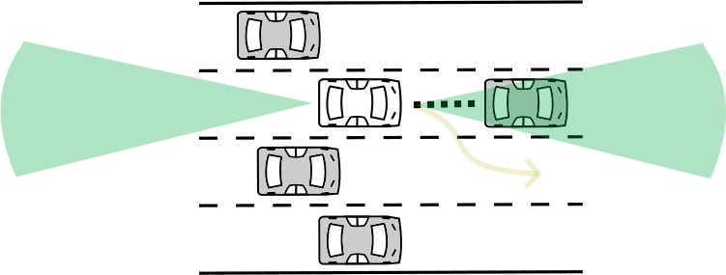
Highway Analysis: Lane Change
Longitudinal coverage: Need to look forward to maintain a safe distance.
Need to look behind to see what rear vehicles are doing.

Slide 28
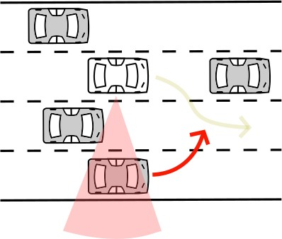
Highway Analysis: Lane Change
Laterally, we need to look not just in the adjacent lanes, but probably further.
Lateral coverage: Need wider sensing
The sensor requirements for lane changes are roughly equivalent to those in the maintain speed scenario.
what if a vehicle attempts to maneuver into the adjacent lane at the same time as we do?
what if?

Slide 29
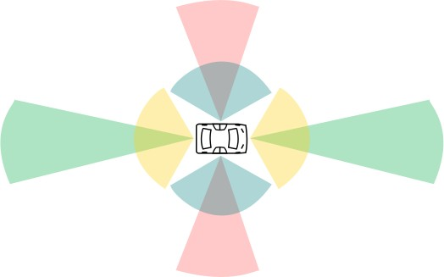




Highway Analysis: Overall Coverage
Emergency Stop
Emergency Stop, Maintain Speed
Maintain Speed, Lane Change
Lane Change

Slide 30
Urban Analysis
Broadly, 6 kinds of maneuvers:
Emergency Stop
Maintain Speed
Lane Change
Overtaking（追い越し）
Turning, crossing at intersections
Passing roundabouts(ラウンドアバウト、環状交差点)

Slide 31
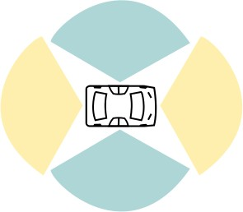
Urban Analysis
Broadly, 6 kinds of maneuvers:
Emergency Stop
Maintain Speed
Lane Change
Overtaking
Turning, crossing at intersections
Passing roundabouts
Similar to highway analysis!

Slide 32
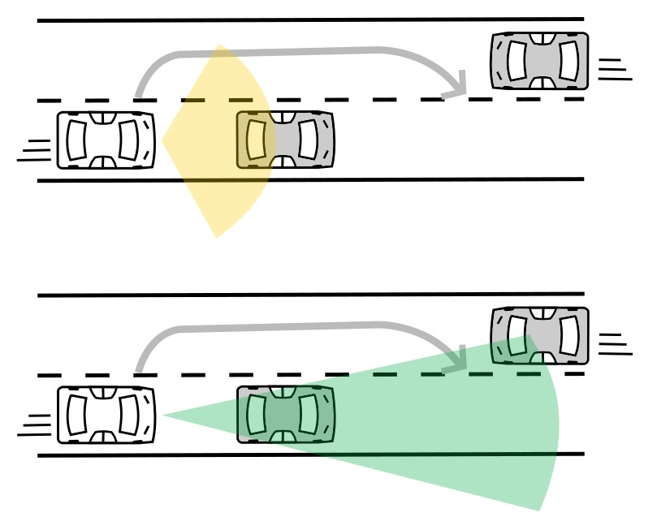
Urban Analysis: Overtaking
Longitudinal coverage:
If overtaking a parked（駐車中） or moving vehicle, need to detect oncoming traffic beyond point of return to own lane（自車レーンに戻る点より遠くの対向車を検知）.
wide short-range sensors to detect the parked car.
narrow long-range sensors to identify if oncoming traffic is approaching.

Slide 33
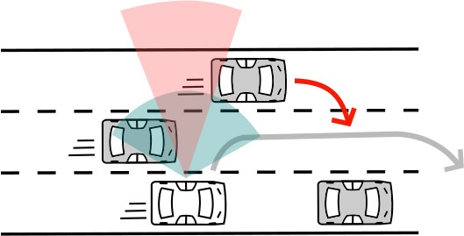
Urban Analysis: Overtaking
Lateral coverage:
Always need to observe adjacent lanes.
Need to observe additional lanes if other vehicles can move into adjacent lanes.

Slide 34
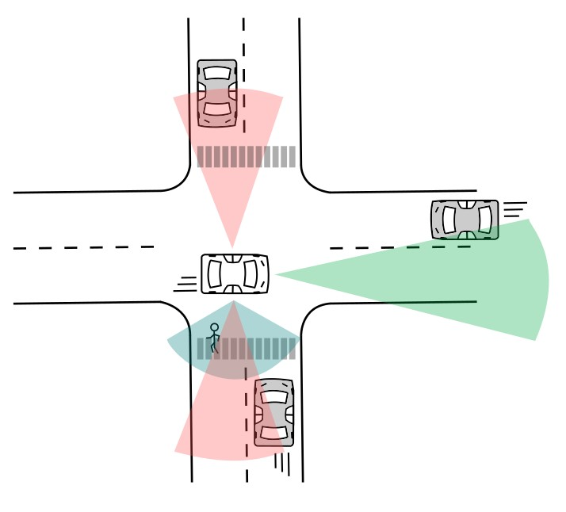
Urban Analysis: Intersections
Observe beyond intersection for approaching vehicles, pedestrian crossings, clear exit lanes.
Requires near omni- directional(全方向) sensing for arbitrary intersection angle
s.

Slide 35
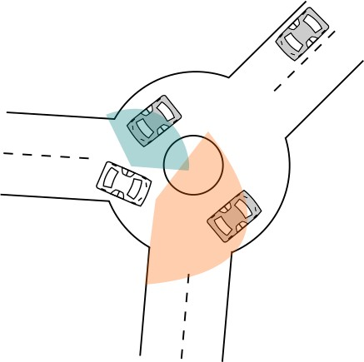
Urban Analysis: Roundabouts
Lateral coverage:
Vehicles are slower than usual, limited range requirement.
Longitudinal coverage:
Due to the shape of the roundabout, need a wider field of view.
wide-range, short distance sensor laterally since the traffic is slow.
wide-range, short distance sensor longitudinally because of how movement around the roundabout occurs.

Slide 36

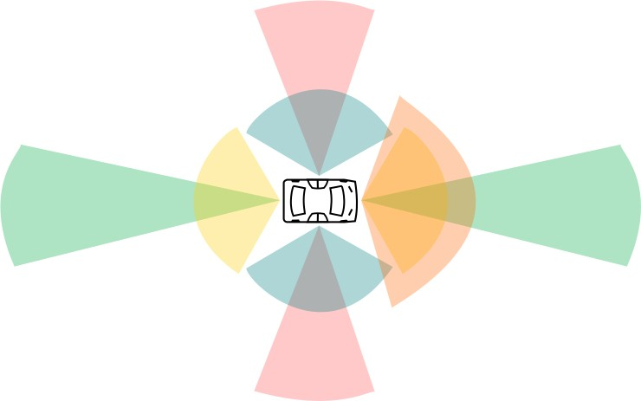

Urban Analysis: Overall Coverage
Emergency Stop, Overtaking
Emergency Stop, Maintain Speed, Lane Change, Overtaking, Intersections,
Roundabouts
Overtaking, Intersections Overtaking, Intersections Roundabouts

Slide 37
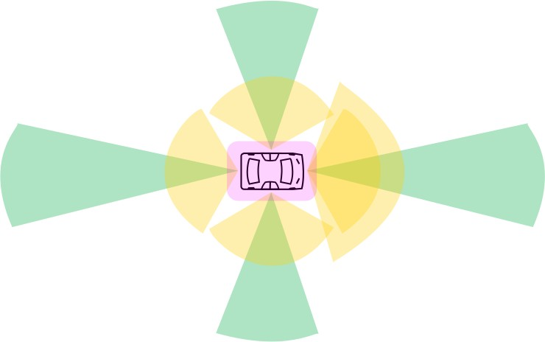



Overall Coverage & Sensors Analysis
The need for full 360 degrees sensor coverage on the short scale out to about 50m. And much longer range requirements in the longitudinal direction.
Long range
Medium range
Short range (ultrasonics)

Slide 38
Summary
Sensor coverage analysis - longitudinal and lateral coverage
o highway driving
o urban driving
More about sensing requirements for automated vehicles for highway and rural environments:
[2014] Sensing requirements for an automated vehicle for highway and rural environments.
https:// repository.tudelft.nl/ islandora/object/ uuid:2ae44ea2- e5e9-455c-8481-8284f8494e4e
K.J. Bussemaker’s master’s thesis.
23

Slide 39
Software Architecture
Course 1, Module 2, Lesson 3
1

Slide 40
Software Architecture | High-level
The environment mapping module creates a set of maps which locate objects in the environment around the autonomous vehicle for a range of different uses, from collision avoidance to egomotion tracking and motion planning.
The System Supervisor is also responsible for informing the safety driver of any problems found in the system.
Sensors Output
Actuation
Environment Mapping
System Supervisor
Environment Perception
Motion Planning
Controller
Motion Planningのmainアウトプット：a safe, efficient and comfortable planned path.
The Controller module takes the path and decides on the best steering angle, throttle position, brake pedal position, and gear settings to precisely follow the planned path.
The raw sensor measurements are passed into two sets of modules (Environment perception & mapping) dedicated to understanding the environment around the car.

Slide 41
Software Architecture | Environment Perception
タスク：
- identifying the current location of the autonomous vehicle in space
- classifying and locating important elements of the environment for the driving task.
予測の仕事はObject Motion Predictionに属する だろう。 Localizationの仕事は？ Dynamic Object Detection, Dynamic Object Tracking, Static Object Detectionの仕事はある？
Inputs
Localization
Vehicle Position
GPS / IMU / Wheel Odometry
Bounding Boxes
Object Tracks
Dynamic Objects
LIDAR
Cameras Radar
Dynamic Object Detection
Dynamic Object Tracking
Object Motion Prediction
Static Objects
Static Object Detection
HD Road Map
Environment Mapping
System Supervisor
Sensors Output
Environment Perception
Motion Planning

Slide 42
Software Architecture | Environmental Maps
Occupancy Grid Map, Localization Map, Detailed Road Mapの仕事は今どうなっている？
Occupancy Grid Map
Occupancy Grid Map（occupancy gridは走行できない場所）
Object tracks
LIDAR
Localization Map
Localization Map
Prior Road Map
Vehicle Position Segmented Image
Static Objects
Detailed Road Map
Detailed Road Map
Environment Mapping
System Supervisor
Environment PerceptionとEnvironment Mapping のinteraction
For example, the perception module provides the static environment information needed to update the detailed road map, which is then used by the prediction module to create more accurate dynamic object predictions.
Sensors Output
Environment Perception
Motion Planning

Slide 43

Software Architecture | Environmental Maps
Occupancy（占有、せんゆう） Grid Map
- a map of all static objects in the environment surrounding the vehicle (メインLIDAR)
- Filtering LIDAR: the drivable surface（路⾯） points and dynamic object points are removed.
- a set of grid cells and probability that each cell is occupied.
Occupancy Grid Map
Occupancy Grid Map
Object tracks
LIDAR
Localization Map
Localization Map
Prior Road Map
Vehicle Position Segmented Image
Static Objects
Detailed Road Map
Detailed Road Map
Environment Mapping
System Supervisor
Sensors Output
Environment Perception
Motion Planning

Slide 44
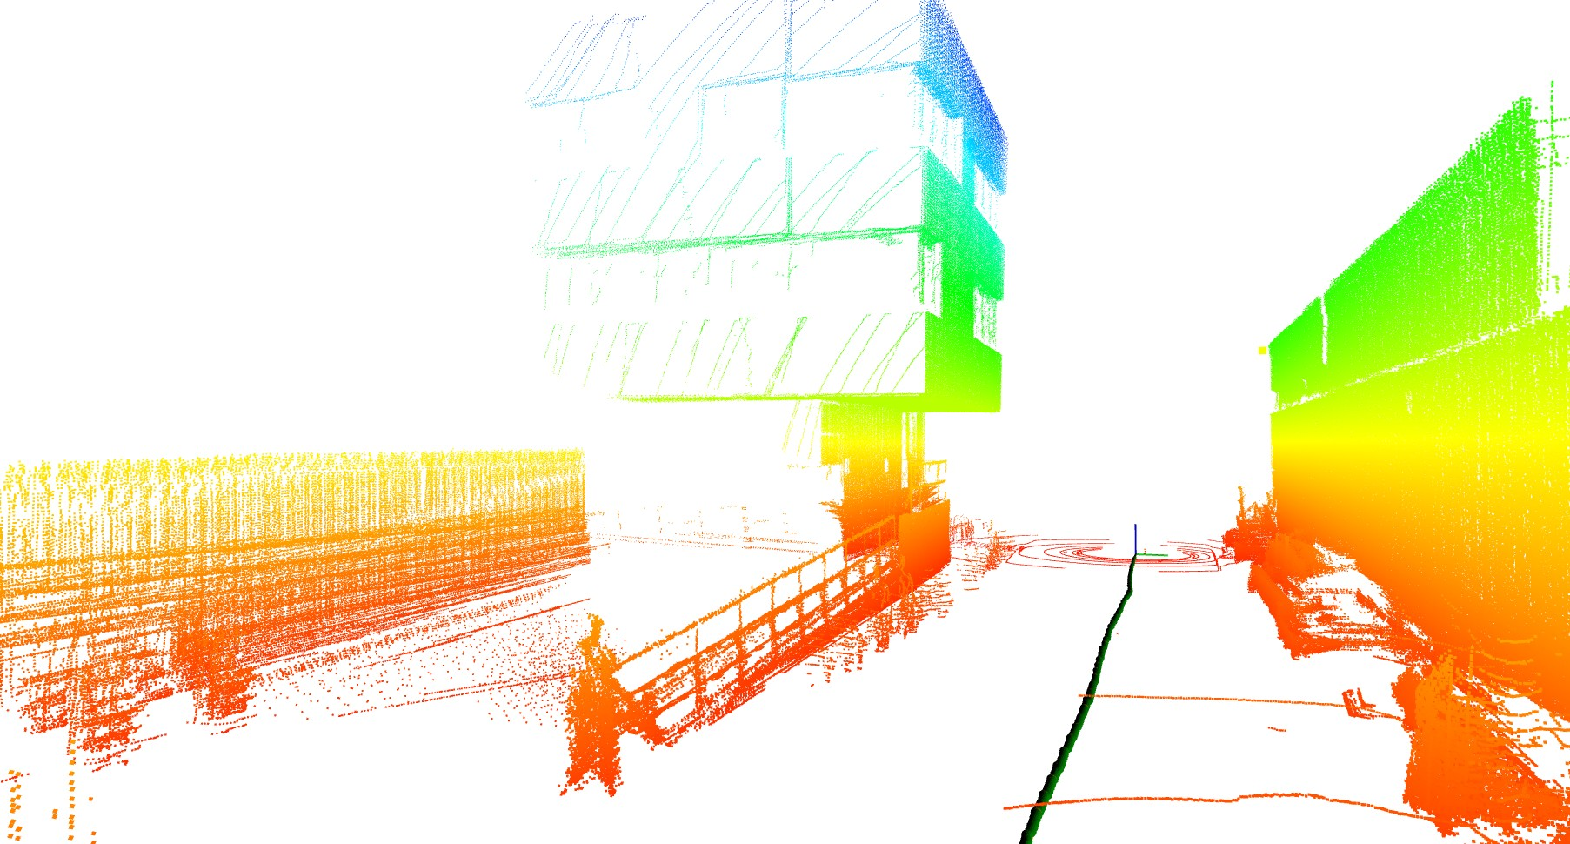
Software Architecture | Environmental Maps
Localization Map (LIDAR & Camera)
センサーデータは、Localization mapと比較して、自車のモーション（移動量）を決める。
このモーションを、GPS, IMUと一緒に自車をlocalizeする。
Sensor data is compared to this map while driving to determine the motion of the car relative to the localization map.
This motion is then combined with other proprioceptor sensor information to accurately localize the ego vehicle.
Occupancy Grid Map
Occupancy Grid Map
Object tracks
LIDAR
Localization Map
Localization Map
Prior Road Map
Vehicle Position Segmented Image
Static Objects
Detailed Road Map
Detailed Road Map
Environment Mapping
System Supervisor
Sensors Output
Environment Perception
Motion Planning

Slide 45
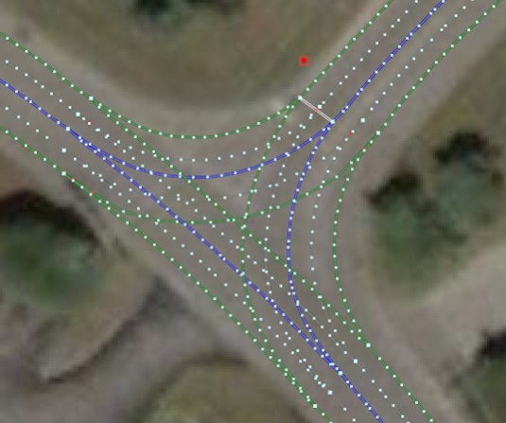
Software Architecture | Environmental Maps
Detailed Road Map（HDマップ+静的オブジェ クト）
- road segments, signs and lane markings
- a combination of prerecorded data as well as incoming information from the current static environment gathered by the perception stack (Environment Perception)
Occupancy Grid Map
Occupancy Grid Map
Object tracks
LIDAR
Localization Map
Localization Map
Prior Road Map
Vehicle Position Segmented Image
Static Objects
Detailed Road Map
Detailed Road Map
Environment Mapping
System Supervisor
Sensors Output
Environment Perception
Motion Planning

Slide 46

Software Architecture | Motion Planning
Mission Planner, Behavior Planner, Local Plannerは全部ある？
Current Goal Detailed Road Map Vehicle Position
Mission Planner
long term planning
the optimal sequence of road segments that connect your origin and destination, Behavior Plannerが使う
Mission Path
Dynamic Objects
Behavior Planner
output:
Decisions (例えば、whether the vehicle should merge into an adjacent lane given the desired speed and the predicted behaviors of nearby vehicles.),
Constraints (例えば、 how long to remain in the current lane before switching)
short term planning
Occupancy Grid
Behavior Constraints
Planned Trajectory
a specific path and velocity profile. smooth, safe, and efficient given all the current constraints.
Local Planner
Vehicle Position Dynamic Objects
immediate or reactive planning
Environment Mapping
System Supervisor
Sensors Output
Environment Perception
Motion Planning

Slide 47
Software Architecture | Motion Planning
ダイクストラ（Dijkstra）法などコース4で紹介
Current Goal Detailed Road Map | Mission Planner |  | 7 | ₄ 1 ₈
Vehicle Position Dynamic Objects | Mission Path Behavior Planner | 7 1 | 2 1 6 9 3 | 2 13 5 ₈ 9 7 8 | 9 | 1 2 | 1 2 9 | 4 | 0
11
6
Occupancy Grid
Behavior Constraints
Planned Trajectory
Local Planner
Vehicle Position Dynamic Objects
Environment Mapping
System Supervisor
Sensors Output
Environment Perception
Motion Planning

Slide 48
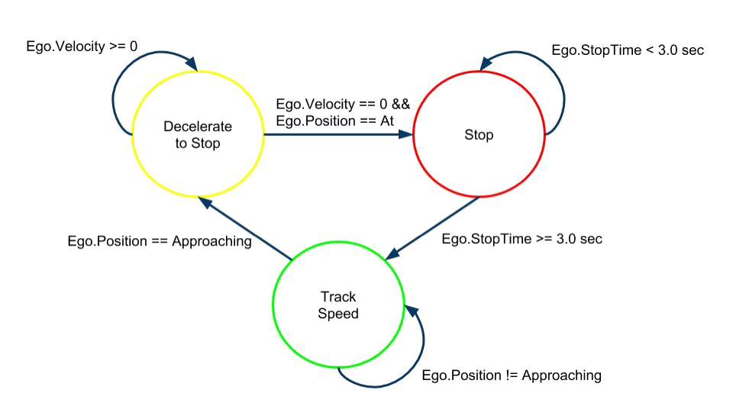
Software Architecture | Motion Planning
Current Goal Detailed Road Map Vehicle Position
Mission Planner
Mission Path
Dynamic Objects
Behavior Planner
Occupancy Grid
Behavior Constraints
Planned Trajectory
Local Planner
Vehicle Position Dynamic Objects
Environment Mapping
System Supervisor
Sensors Output
Environment Perception
Motion Planning

Slide 49
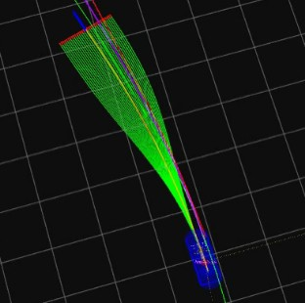
Software Architecture | Motion Planning
Conformal Lattice（格子） Planning、コース4で紹介
Current Goal Detailed Road Map Vehicle Position
Mission Planner
Mission Path
Dynamic Objects
Behavior Planner
Occupancy Grid
Behavior Constraints
Planned Trajectory
Local Planner
Vehicle Position Dynamic Objects
Environment Mapping
System Supervisor
Sensors Output
Environment Perception
Motion Planning

Slide 50
Software Architecture | Vehicle Controller
Both controllers calculate current errors and tracking performance of the local plan, and adjust the current actuation commands to minimize the errors going forward.つまりできるだけ local planner のplanned trajectoryに沿って進 むように
Throttle percentage
Velocity Controller
Brake percentage
Planned Trajectory
Vehicle Position
Steering Controller
Steering Angle
Environment Mapping
System Supervisor
Sensors Output
Environment Perception
Motion Planning

Slide 51
Software Architecture | System Supervisor
Hardware supervisor
1. hardware faults: a broken sensor, a missing measurement, degraded（劣化した） information.
2. analyze the hardware outputs for any outputs which do not match the domain which the self-driving car was programmed to perform under. ( 例 え ば 、 if one of the camera sensors is blocked by a paper bag or if snow is falling and corrupting the LIDAR point cloud data.) まだODD内か？
Environment Perception
Sensor Outputs
Environment Mapping
Software Supervisor
Hardware Supervisor
Motion Planning
analyzing inconsistencies between the outputs of all modules
Controller
Environment Mapping
System Supervisor
Sensors Output
Environment Perception
Motion Planning

Slide 52
Summary
More about AV software architecture: [2007] DAPRA Challenge Technical Paper: https://pdfs.semanticscholar.org/c10a/cd8c64790f7d040ea6f01d7b26b1d9a442db.pdf
Describe the basic architecture of a self-driving software system
Environment Perception
Environment Mapping
Motion Planning
Controller
System Supervisor
Next: Closer look at Environment Mapping

Slide 53

Environment Representation
JULY 28, 2018
PREPARED BY MARKO ILIEVSKI

Slide 54
Environmental Map Types
Localization of vehicle in the environment.
Localization point cloud or feature map.
Collision avoidance with static objects.
Occupancy grid map.
Path planning.
Detailed road map.
feature map、つまりカメラを使う場合
- detailed positions for all regulatory elements, regulatory attributes（ 例 え ば right turn markings or crosswalks） and lane markings

Slide 55
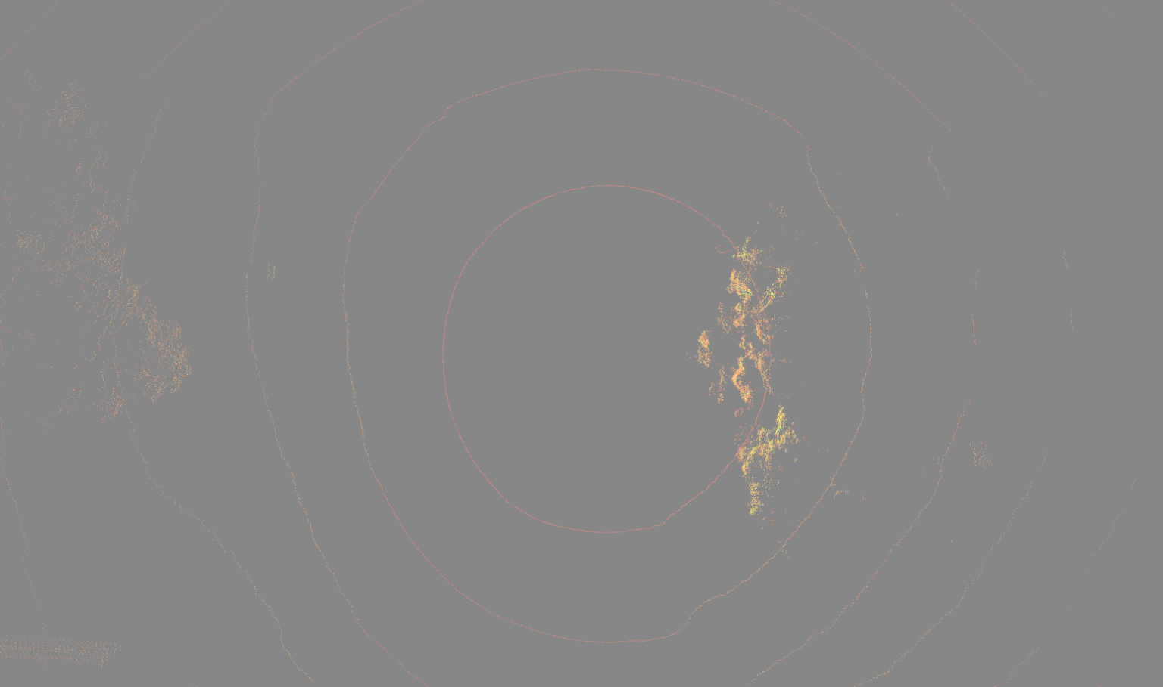
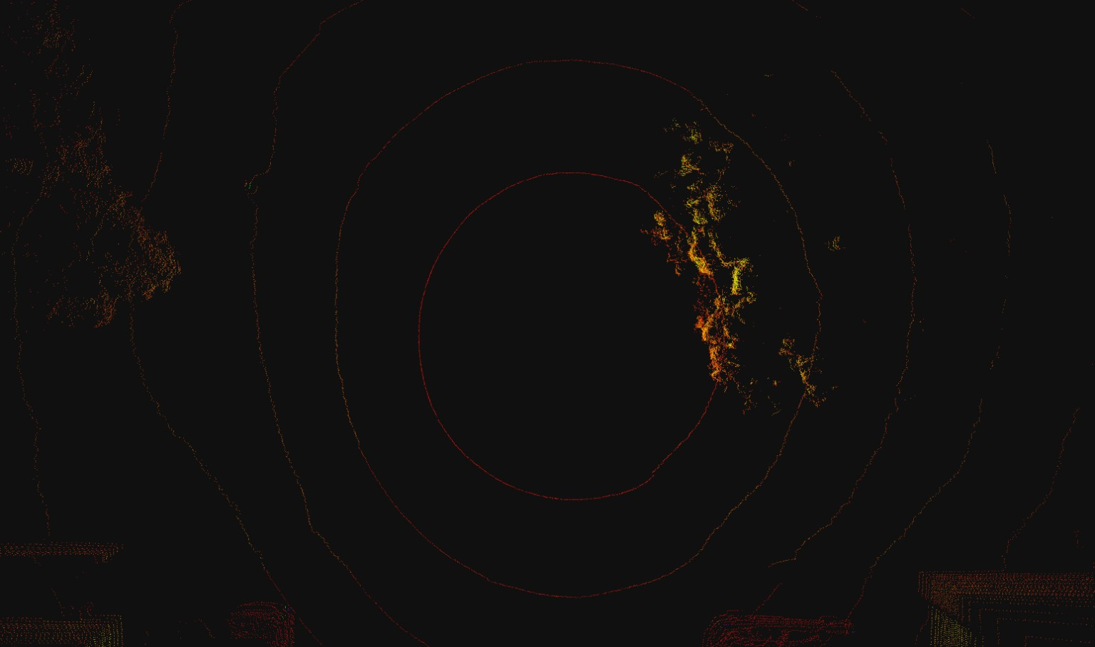
Point cloud or Feature Map (Localization Map)
- created using a continuous set of LIDAR points or camera image features
- used in combination with GPS, IMU and wheel odometry by the localization module to accurately estimate the precise location of the vehicle at all times
Collects continuous sets if LIDAR
The difference between LIDAR maps is used to calculate the movement of the autonomous vehicle
- The localization map can be quite large, and many methods exist to compress its contents and keep only those features that are needed for localization.
ORB_SLAMもfeature mapの場合の１つだろう

Slide 56
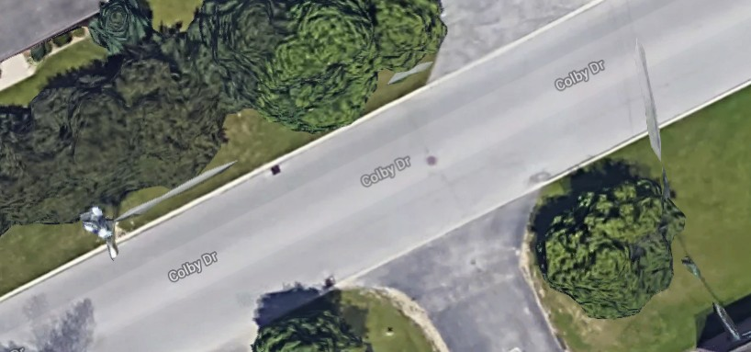
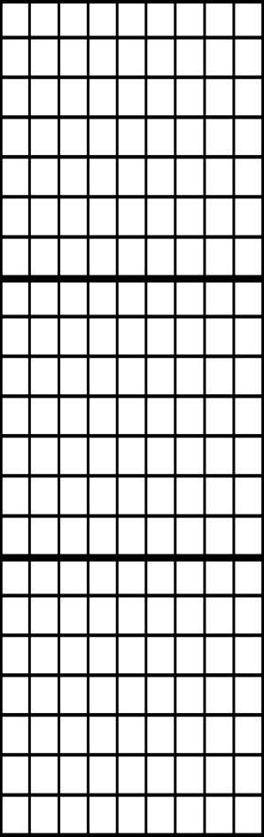
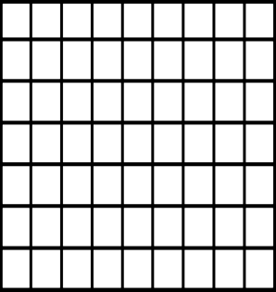
Occupancy Grid
- a continuous set of LIDAR points, all static obstacles.
- Dynamic objects be removed: by removing all LIDAR points that are found within the bounding boxes of detected dynamic objects identified by the perception stack.
- all stationary objects such as poles, buildings, and parked cars, are shown as occupied grid cells.
Occupied
Free
Discretized fine grain grid map
Can be 2D or 3D
Occupancy by a static object
Trees and buildings
Curbs and other non drivable surfaces
Dynamic objects are removed

Slide 57
Detailed Roadmap
3 Methods of creation:
Fully Online
rarely used due to the complexity of creating such a map in real time
Fully Offline
unable to react or adapt to a changing environment
Created Offline and Updated Online
- highly accurate
- 作り⽅：Specialized vehicles with high accuracy sensors are driven along roadways regularly to construct offline maps. Once the collection is complete, the information is then labelled with the use of a mixture of automatic labeling from static object perception and human annotation and correction.
- storing all the information present in a detailed roadmap called the lane length model
僕が開発しているMapAPIはDetailed Roadmap の一部になっている。静的な物体がないから
More about a highly detailed map used for autonomous driving:
[2014] Lanelets: Efficient map representation for autonomous driving
https://ieeexplore.ieee.org/abstract/document/6856487

Slide 58
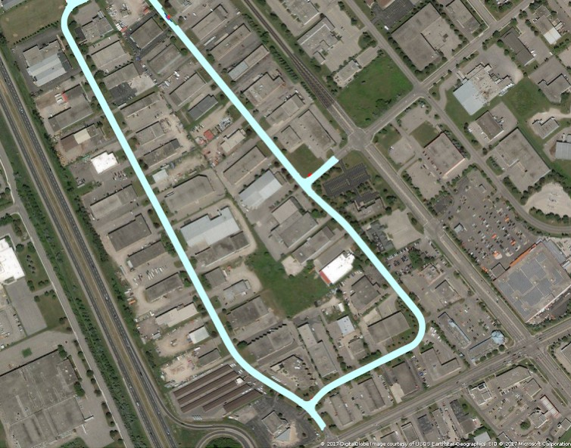
Detailed Roadmap
Traffic regulation Lane Boundaries

Slide 59
Summary
Environmental maps used by self driving cars
Localization point cloud or feature map
Occupancy grid map
Detailed roadmap

Slide 60
Module Summary
Understand various sensor and computing hardware used for autonomous driving
The relative strengths and weaknesses
Understand the design of hardware sensor configurations for autonomous driving
Describe the basic architecture of a typical self-driving software system
Understand the standard decomposition for each software module
Define the different types of maps used in autonomous driving

