Slide 1
コース 2
State Estimation and Localization for Self-Driving Cars
Localizationの定義：the method by which we determine the position and orientation of a vehicle within the world.
State Estimationの定義：the process of computing a physical quantity (that changes over time) like a position from a set of measurements.
Parameter Estimationの定義：a parameter is constant over time. 例えば、position and orientation are states of a moving vehicle, while the resistance of a particular resistor（抵抗器） in the electrical sub-system of a vehicle would be a parameter.

Slide 2
Module 1
Least Squares

Slide 3
Module 1 | Least Squares（最小二乗法）
In this module
The history of the method of least squares
Ordinary and weighted（加重） least squares
Recursive（再帰的） least squares（Kalman Filterに使われている）
Maximum likelihood and the method of least squares

Slide 4
Module 1 | Lesson 1 (Part 1)
The Squared Error（2乗誤差） Criterion and the Method of Least Squares

Slide 5



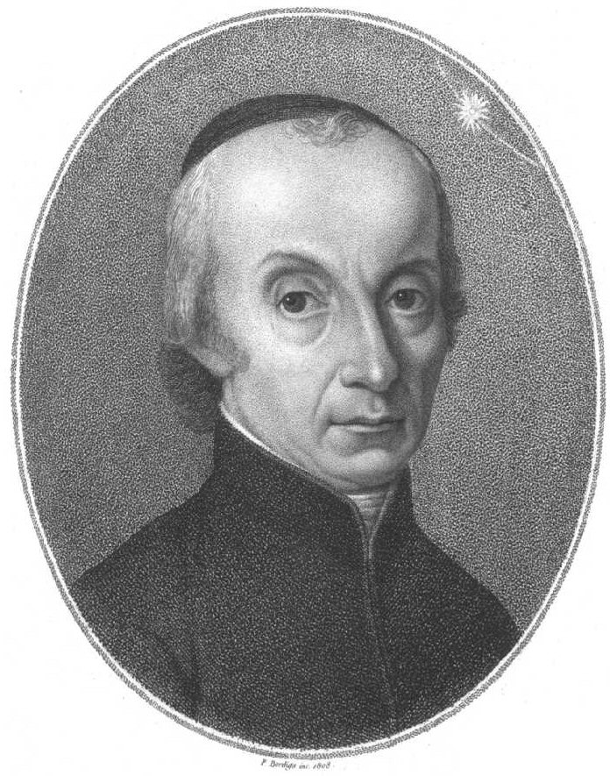

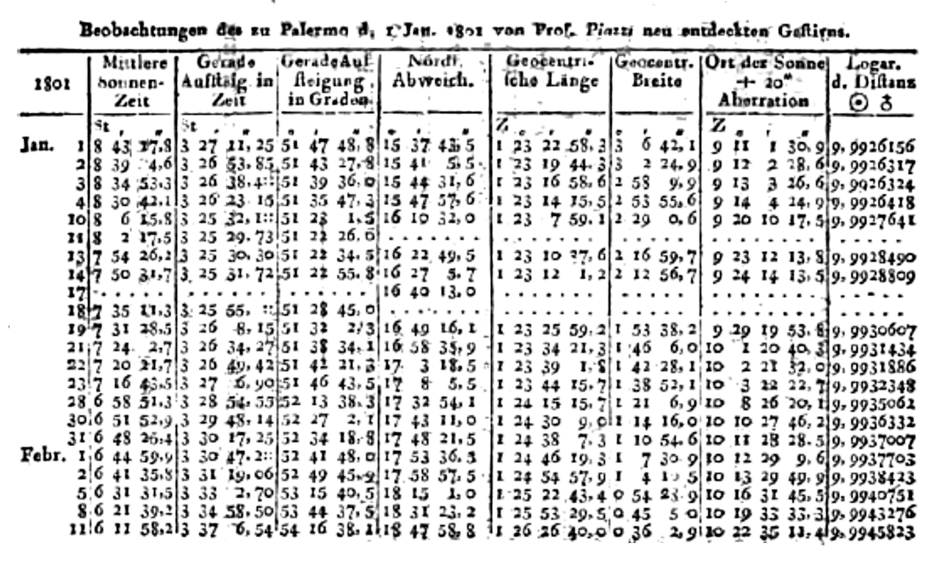
Giuseppe Piazzi and Ceres
Ceres（ケレス）: the smallest dwarf planet（準惑星） in the solar system, located in the asteroid belt（小惑星帯）. It has a diameter of 930 kilometers.
準惑星：太陽の周囲を公転する惑星以外の天体のうち、それ⾃身の重⼒によって球形になれるだけの質量を有するもの。
Ceres
Piazzi made 24 telescope（望遠鏡） observations of this new object over 40 days before it was lost in the glare（まぶしい光） of the sun.
- Since Ceres is only about 900km in diameter, finding it again was extremely challenging.
- This meant that other astronomers（天文学者、てんもん） could not confirm Piazzi’s discovery.
Giuseppe Piazzi
ジュゼッペ・ピアッツィ
Piazzi’s 24 observations

Slide 6

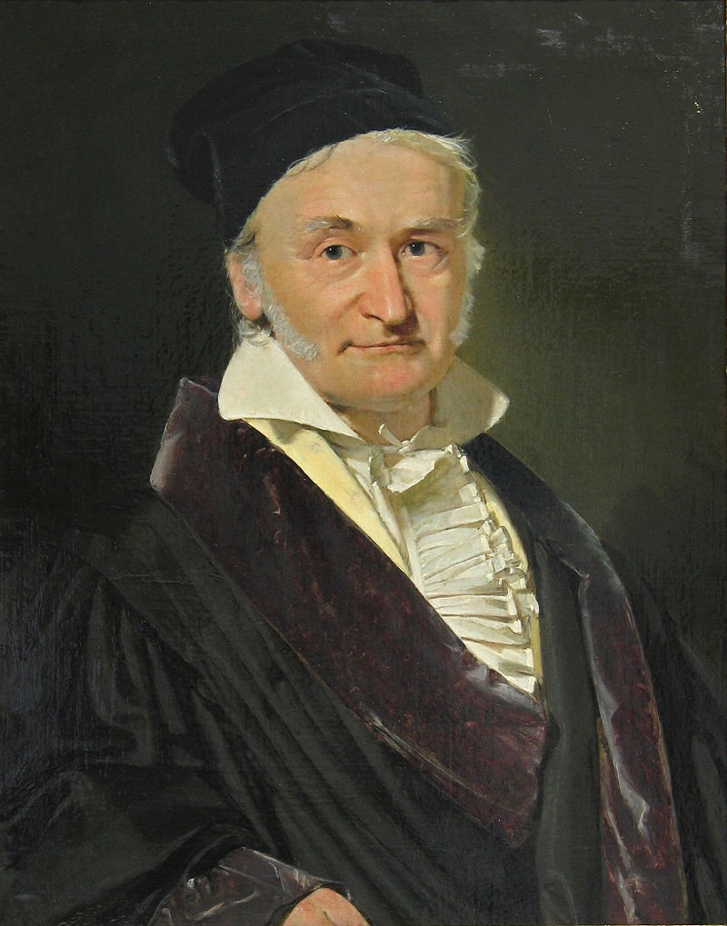
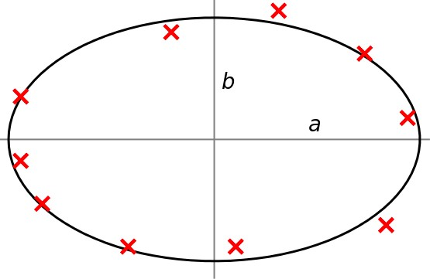
Karl Friedrich Gauss
Gauss used the method of least squares to determine the orbital parameters of Ceres.
Carl Friedrich Gauss used a method of least squares to accurately estimate Ceres orbital（軌道） parameters based on Piazzi’s published measurements.
Karl Friedrich Gauss ‘Princeps mathematicorum’

Slide 7
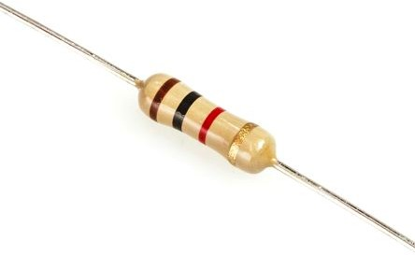


Estimating Resistance
Measurement | Resistance (Ohms)
1 | 1068
2 | 988
3 | 1002
4 | 996
R?
the resistor has a gold band, which indicates that it can vary by as much as 5%.

Slide 8
Estimating Resistance
Measurement | Resistance (Ohms)
1 | 1068
2 | 988
3 | 1002
4 | 996
Let x be the resistance. Assume it is a constant, but unknown.
We make measurements, y, of the resistance.
We model our measurements as corrupted by noise .
y = x + v

Slide 9
Estimating Resistance
Measurement Model
‘Actual’ resistance Measurement noise
y₁ = x + v₁ y₂ = x + v₂ y₃ = x + v₃
y₄ = x + v₄
Measurement | Resistance (Ohms)
1 | 1068
2 | 988
3 | 1002
4 | 996

Slide 10
Estimating Resistance
# | Resistance (Ohms)
1 | 1068
2 | 988
3 | 1002
4 | 996
Measurement Model
Squared Error
y₁ = x + v₁
e² = (y₁ − x)²
1
y₂ = x + v₂
y₃ = x + v₃ y₄ = x + v₄
e² = (y₂ − x)²
2
e² = (y₃ − x)²
3
e² = (y₄ − x)²
4
The squared error criterion:
x = argmin
2
2
2
2
LS
x
(
e +
e + e + e
)
= ℒ (x)
1 2 3 4
LS
The ‘best’ estimate of resistance is the one that minimizes the sum of squared errors

Slide 11
Minimizing the Squared Error Criterion
x = argmin
2
2
2
2
LS
x
(
e + e + e + e
)
= ℒ (x)
1
2
3
4
LS
Let’s re-write our criterion using vectors:
This matrix is called the ‘Jacobian’
e₁ e₂ e₃ e₄
e =
= y − Hx
y₁ y₂ y₃ y₄
1
1
1
1
=
−
x

Slide 12
Minimizing the Squared Error Criterion
x = argmin
2
2
2
2
LS
x
(
e + e + e + e
)
= ℒ (x)
1
2
3
4
LS
Now, we can express our criterion as follows,
ℒ_{LS}(x) = e² + e² + e² + e² = e^{T}e
1 2 3 4
= (y − Hx)^{T}(y − Hx)
= y^{T} y − x^{T}H^{T} y − y^{T}Hx + x^{T}H^{T}Hx
Transpose（転置）

Slide 13
Minimizing the Squared Error Criterion
ℒ(x) = e^{T}e = y^{T} y − x^{T}H^{T} y − y^{T}Hx + x^{T}H^{T}Hx
To minimize this, we can compute the partial derivative（偏微分） with respect to our parameter, set to 0, and solve for an extremum:
∂ℒ
∂x
= − y^{T}H − y^{T}H + 2x^{T}̂ H^{T}H = 0
−2y^{T}H + 2x^{T}̂ H^{T}H = 0
x=x
Re-arranging, we arrive at:
x_{LS} = (H^{T}H)⁻¹H^{T} y
x-hat minimizes our squared error criterion!

Slide 14
Minimizing the Squared Error Criterion
逆行列
_{H}T_{H is not singular（特異行列）.}
Careful! We will only be able to solve for x̂ if
(H^{T}H)⁻¹ exists.
If we have m
measurements, and n
unknown parameters, then:
_{H ∈ ℝ}m×n
_{H}T_{H ∈ ℝ}n×n
This means that (H^{T}H)⁻¹ exists only if there are at least as many measurements as there are unknown parameters:
m ≥ n
僕の理解、 (H^{T}H)⁻¹ が存在、つまりH^{T}H!=0. H^{T}Hはm個方程式によって構成されて、未知数の数はn.
なので、m個方程式=0, n個未知数の場合、m<nなら必ず方程式の解が存在する。
measurementsの数は最低parametersの数、これは当たり 前だ。
This will usually not be a problem. In fact, often face the challenge of dealing with too many measurements.

Slide 15
Minimizing the Squared Error Criterion
Returning to our problem, we see that:
# | Resistance (Ohms)
1 | 1068
2 | 988
3 | 1002
4 | 996
1068
988
1002
996
1
1
1
1
y =
H =
x_{LS} = (H^{T}H)⁻¹H^{T} y
−1
1
1068
988
1002
996
= [1111] ¹
[1111]
= ¹ (1068 + 988 + 1002 + 996) = 1013.5 Ohms
1
1
4
The least squares solution is just the mean of our measurements!

Slide 16
Method of Least Squares | Assumptions
Our measurement model, y = x + v, is linear.
Measurements are equally weighted.
(we do not suspect that some have more noise than others).
often broken in complex systems.

Slide 17
Summary | The Method of Least Squares
Pioneered by Gauss to determine the orbit of the planetoid（小惑星） Ceres
Least squares finds the parameters which minimize the Least Squares Criterion（基準）
Ordinary least squares assumes that measurements are weighted equally, measurement model is linear

Slide 18
Module 1 | Lesson 1 (Part 2)
Weighted Least Squares

Slide 19

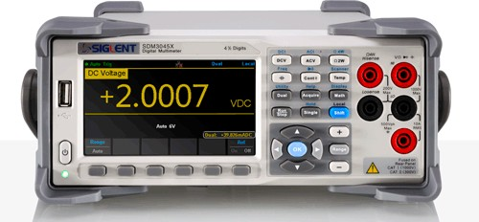
Method of Weighted Least Squares
Suppose we take measurements with multiple multimeters （回路計）, some of which are better than others
vs.

Slide 20
Method of Weighted Least Squares
Consider the general linear measurement model for m measurements and n unknowns:
y₁ x₁ v₁
⋮ = H ⋮ + ⋮
y_{m} x_{n} v_{m}
y = Hx + v
In regular least squares, we implicitly assumed that each noise term was of equal variance（分散）:
_{σ}2
0
0
_{σ}2
𝔼[v²] = σ²
(i = 1,…, m)
R = 𝔼[vv^{T}] =
⋱
i
One way to interpret the ordinary method of least squares is to say that we are implicitly assuming that each noise term is an independent random variable across measurements and has an equal variance or standard deviation. つまりI.I.D.条件。

Slide 21
Method of Weighted Least Squares
If we assume each noise term is independent, but of different variance,
_{σ}2
0
1
R = 𝔼[vv^{T}] = ⋱
𝔼[v²] = σ², (i = 1,…, m)
i i
0
_{σ}2
m
Then we can define a weighted least squares criterion as:
ℒ_{WLS}(x) = e^{T}R⁻¹e
e₁ y₁ x₁
⋮ = e = ⋮ − H ⋮
e_{m} y_{m} x_{n}
_{e}2 _{e}2 _{e}2
where
₌ 1 ₊ 2 _{+ … +} m
_{σ}2 _{σ}2
_{σm}2
1
2
The higher the expected noise, the lower the weight we place on the measurement. （ノイズの分散が高ければ高いほど、ノイズに低い重みを置く）
Each squared error term is now weighted by the inverse of the variance associated with the corresponding measurement.
In other words, the lower the variance of the noise, the more strongly its associated error term will be weighted in the loss function.
We care more about errors which come from low noise measurements since those should tell us a lot about the true values of our unknown parameters.

Slide 22
Re-deriving regular least squares
What happens if all of our variances are the same?
_{e}2 _{e}2 _{e}2
ℒ_{WLS}(x) = ¹ + ² + … + ^{m}
_{σ}2 _{σ}2 _{σ}2
1
_{σ}2
=
2 2
(e + … + e )
1
m
Since our variance is constant, it will not affect our final estimate! This results in the same estimate as regular least squares:
σ² = σ² = …σ² = σ² → x̂_{WLS} = x̂_{LS} = argmin _{x} ℒ_{LS}(x) = argmin _{x} ℒ_{WLS}(x)
1 2
m

Slide 23
Minimizing the Weighted Least Squares Criterion
Expanding our new criterion,
ℒ_{WLS}(x) = e^{T}R⁻¹e
= (y − Hx)^{T}R⁻¹(y − Hx)
We can minimize it as before, but accounting for the new weighting term:
∂ℒ
∂x
x̂ = argmin _{x} ℒ(x)
= 0 = − y^{T}R⁻¹H + x̂^{T}H^{T}R⁻¹H
x=x̂
H^{T}R⁻¹Hx̂_{WLS} = H^{T}R⁻¹y
The weighted normal equations!

Slide 24
Method of Weighted Least Squares
The weighted normal equations
x̂ = (H^{T}R⁻¹H)⁻¹H^{T}R⁻¹y
Let’s adapt our example:
 | Resistance Measurements (Ohms)
# | Multimeter A ( σ = 20 Ohms ) | Multimeter B ( σ = 2 Ohms )
1 | 1068
2 | 988
3 |  | 1002
4 |  | 996

Slide 25
Method of Weighted Least Squares
_{σ}2
Once we define the relevant quantities, we plug-and-chug to get:
1
1
1
1
1068
988
1002
996
1
400
2
σ₂
400
H =
y =
R =
_{σ}2
=
4
4
3
2
σ₄
x_{WLS} = (H^{T}R⁻¹H)⁻¹H^{T}R⁻¹y
−1
−1
−1
400
1
1
1
1
400
1068
988
1002
996
400
400
= [1111]
[1111]
4
4
4
4
1
1/400 + 1/400 + 1/4 + 1/4
1068 ₊ 988 ₊ 1002 ₊ 996
400 400 4 4
=
(
)
= 999.3 Ohms
It’s important to be comfortable working with different measurement variances（分散）and also with measurements that are sometimes correlated（相関）.
A self-driving car will have a number of different and complex sensors on board and we need to make sure that we model our error sources correctly.

Slide 26
Ordinary versus Weighted Least Squares
Least Squares
Weighted Least Squares
Loss / Criterion
ℒ_{LS}(x) = e^{T}e
ℒ_{WLS}(x) = e^{T}R⁻¹e
Solution
x̂_{LS} = (H^{T}H)⁻¹H^{T} y
x̂_{WLS} = (H^{T}R⁻¹H)⁻¹H^{T}R⁻¹y
m ≥ n
m ≥ n
Limitations
σ² > 0
i
Accurate noise modelling is crucial to utilize various sensors effectively!

Slide 27
Summary | Weighted Least Squares
Measurements can come from sensors that have different noisy characteristics
Weighted least squares lets us weight each measurement according to noise variance

Slide 28
Module 1 | Lesson 2
Recursive（再帰的） Least Squares
1

Slide 29
Batch Least Squares
In our previous formulation, we assumed we had all of our measurements available when we computed our estimate:
 | Resistance Measurements (Ohms)
# | Multimeter A ( σ = 20 Ohms ) | Multimeter B ( σ = 2 Ohms )
1 | 1068
2 | 988
3 |  | 1002
4 |  | 996
‘Batch Solution’
x_{WLS} = (H^{T}R⁻¹H)⁻¹H^{T}R⁻¹y

Slide 30
Recursive Estimation
What happens if we have a stream（ストリーム） of data? Do we need to re-solve for our solution every time? Can we do something smarter?
 | Resistance (Ohms)
Time | Multimeter A | Multimeter B
t = 1 sec | 1068
t = 2 sec | 988
t = 3 sec |  | 1002
t = 4 sec |  | 996
x₁̂ = (H^{T}R⁻¹H)⁻¹H^{T}R⁻¹y₁
x₂̂ = (H^{T}R⁻¹H)⁻¹H^{T}R⁻¹y_{1:2}
⋮

Slide 31





Linear Recursive Estimator
We can use a linear recursive estimator
Suppose we have an optimal estimate, x̂k−1, of our unknown parameters at time interval k -1
Then we obtain a new measurement at time k : y_{k} = H_{k}x + v_{k}
^{y}k−1
y_{k}
Goal: compute x̂_{k} as a function of y_{k} and x̂_{k−1} !
^{x̂}k−1
x̂_{k}
k - 1
k
time

Slide 32



Linear Recursive Estimator
^{y}k−1
y_{k}
We can use a linear recursive update:
^{x̂}k ^{= x̂}k−1 ^{+ K}k (^{y}k ^{− H}k^{x̂}k−1)
^{x̂}k−1
x̂_{k}
the term in brackets: innovation（測量値の差に近い意味）
- Innovation quantifies how well current measurement matches previous best estimate.
k - 1
k
We update our new state as a linear combination of the previous best guess and the current measurement residual（残余） (or error), weighted by a gain matrix （利得行列）K_{k}

Slide 33
Recursive Least Squares
But what is the gain matrix K_{k} ?
We can compute it by minimizing a similar least squares criterion, but this time we’ll use a probabilistic formulation.
We wish to minimize the expected value of the sum of squared errors of our current estimate at time step k :
ℒ_{RLS} = 𝔼[(x_{k} − x_{k}̂ )²]
= σ²
k
unknown parameters at time step k ,we generalize this to
ℒ_{RLS} = 𝔼[(x_{1k} − x₁̂ _{k})² + … + (x_{nk} − x_{n}̂ _{k})²]
= Trace(P_{k})
Estimator covariance（共分散）
If we have n
Trace（跡、せき）: In linear algebra, the trace (often abbreviated to tr) of a square matrix A is defined to be the sum of elements on the main diagonal （主対角線）(from the upper left to the lower right) of A.

Slide 34
Recursive Least Squares
Using our linear recursive formulation, we can express covariance as a function of K_{k}
P_{k} = (1 − K_{k}H_{k})P_{k−1}(1 − K_{k}H_{k})^{T} + K_{k}R_{k}K^{T}
証明なし
k
We can show (through matrix calculus) that this is minimized when
K_{k} = P_{k−1}H^{T}(H_{k}P_{k−1}H^{T} + R_{k})⁻¹
k k
With this expression, we can also simplify our expression for P_{k} :
証明なし
^{P}k ^{= P}k−1 ^{− K}k^{H}k^{P}k−1
= (1 − K_{k}H_{k})P_{k−1}
Our covariance ‘shrinks’ with each measurement
The larger the gain matrix , the smaller the new estimator covariance will be. （利得行列が大きければ大きいほど、次周期の共分散が小さくなる）
Intuitively, think this gain matrix as balancing the information from prior estimate and the information from new measurement.

Slide 35
Recursive Least Squares | Algorithm
1. Initialize the estimator
x̂₀ = 𝔼[x]
P₀ = 𝔼[(x − x̂₀)(x − x̂₀)^{T}]
This initial guess could come from the first measurement and the covariance could come from technical specifications.
2. Set up the measurement model, defining the Jacobian and the measurement
covariance matrix:
y_{k} = H_{k}x + v_{k}
and the covariance P_{k}
Linearモデル
3. Update the estimate of x̂_{k}
using:
K_{k} = P_{k−1}H^{T}(H_{k}P_{k−1}H^{T} + R_{k})⁻¹
k k
^{x̂}k ^{= x̂}k−1 ^{+ K}k (^{y}k ^{− H}k^{x̂}k−1) P_{k} = (1 − K_{k}H_{k})P_{k−1}
Important! Our parameter covariance ‘shrinks’ with each measurement
Recursive Least SquaresのImportance
Minimize computational effort in estimation process.
Forms the update step of the linear Kalman filter.

Slide 36
Summary | Recursive Least Squares
RLS produces a ‘running estimate’ of parameter(s) for a stream of measurements
RLS is a linear recursive estimator that minimizes the (co)variance of the parameter(s) at the current time
ランタイム予測

Slide 37
Module 1 | Lesson 3
Least Squares and Maximum Likelihood

Slide 38
Revisiting the Least Squares Criterion
Recall the least squares criterion
ℒ_{LS}(x) = (y₁ − x)² + (y₂ − x)² + … + (y_{m} − x)²
We’ve said that the optimal estimate, x̂ , is the one that minimizes this ‘loss’:
•
2 2 2
x_{LS} = argmin ℒ (x) = argmin e + e + … + e
x LS x
(
1
2
m
)
Why squared errors?
計算簡単：If the measurement model is linear, minimizing the squared error criterion amounts to solving a linear system of equations.
Probability and a deep connection between least squares and maximum likelihood estimators under the assumption of Gaussian noise.

Slide 39

Least Squares and Maximum Likelihood
Gauss showed the connection between his method of least squares and maximum likelihood with Gaussian measurement models
Karl Friedrich Gauss ‘Princeps mathematicorum’

Slide 40
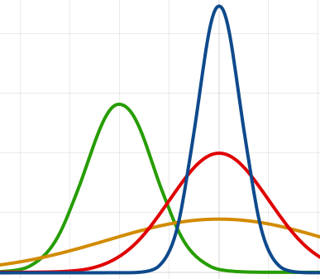
The Method of Maximum Likelihood（尤度）
We can ask which x makes our measurement (y) most likely. Or, in other words,
which x
maximizes the conditional probability of y :
x̂ = argmax _{x} p(y | x)
^{y}meas
p(y | x_{b})
Which x is the most likely given the measurement?
p(y | x_{a})
p(y | x_{c})
p(y | x_{d})
y

Slide 41
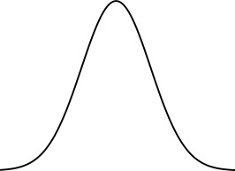
Measurement Model
Recall our simple measurement model:
y = x + v
We can convert this into a conditional probability on our measurement, by assuming some probability density for v . For example, if
v ∼ 𝒩(0, σ²)
Then:
p(y | x) = 𝒩(x, σ²)
p(y | x)
The unknown parameter x becomes the mean of this density, and the variance is noise variance.
y = x

Slide 42
Least Squares and Maximum Likelihood
Probability density function（確率密度関数） of a Gaussian is:
1
−(z − μ)²
2σ²
2
𝒩(z; μ, σ ) = e
σ 2π
Our conditional measurement likelihood is
p(y | x) = 𝒩(y; x, σ²)
1
2πσ²
=
e
−(y − x)²
2σ²
If we have multiple independent measurements, then:
p(y | x) ∝ 𝒩(y₁; x, σ²)𝒩(y₂; x, σ²) × … × 𝒩(y_{m}; x, σ²)
1 (2π)^{m}σ^{2m}
−∑^{m} (y_{i} − x)²
=
exp
(
i=1
2σ²
)

Slide 43
Least Squares and Maximum Likelihood
The maximal likelihood estimate (MLE, 最尤推定) is given by
x_{MLE} = argmax _{x} p(y | x)
Instead of trying to optimize the likelihood directly, we can take its logarithm:
x_{MLE} = argmax _{x} p(y | x)
= argmax _{x} log p(y | x)
The logarithm is monotonically increasing!（単調増加）
Resulting in:
log p(y | x) = − ¹ ₍(y − x)² + … + (y − x) ² ) + C
1 m
足し算
2σ²

Slide 44


Least Squares and Maximum Likelihood
Since
argmax _{z} f(z) = argmin _{z (}−f(z)₎
The maximal likelihood problem can therefore be written as
x_{MLE} = argmin _{x} − ₍log p(y | x)₎
1
= argmin _{x (}(y₁ − x)² + … + (y_{m} − x)²₎
2σ²

Slide 45



Least Squares and Maximum Likelihood
So:
1
x = argmin
2
2
MLE
x
(
(y − x) + … + (y
− x)
)
2σ
2
1
m
Finally, if we assume each measurement has a different variance, we can derive
$$\frac{1}{2}$$
(y₁ − x)² _{+ … +} (y_{m} − x)²
x̂ = argmin
MLE
x
$$σ_{1}^{2}$$
$$σ_{m}^{2}$$
In both cases, 最尤推定の答えと最小二乗の答えが一緒！
x_{MLE} = x_{LS} = argmin _{x} ℒ_{LS}(x) = argmin _{x} ℒ_{MLE}(x)

Slide 46
The Central Limit Theorem（中心極限定理）
In realistic systems like self driving cars, there are many sources of ‘noise’
Central Limit Theorem: When independent random variables are added, their normalized sum tends towards a normal distribution. 独立の確率変数の正規された和が正規分布になりそう。
model system probabilistically and yet maintain simplicity in calculations.
Why use the method of least squares?
Central Limit Theorem: sum of different errors will tend be ‘Gaussian’-ish
Least squares is equivalent to maximum likelihood under Gaussian noise

Slide 47
Least Squares | Some Caveats（警告）
‘Poor’ measurements (e.g. outliers, 外れ値) have a significant effect on the method of least squares
It’s important to check that the measurements roughly follow a Gaussian distribution
Under the Gaussian PDF, samples ‘far away’ from the mean are ‘very improbable’
# | Resistance (Ohms)
1 | 1068
2 | 988
3 | 1002
4 | 996
# | Resistance (Ohms)
1 | 1068
2 | 988
3 | 1002
4 | 996
5 (outlier) | 1430
x̂ = 1013.
x̂ = 1096.8

Slide 48
Summary | Least Squares and Maximum Likelihood
LS and WLS produce the same estimates as maximum likelihood assuming Gaussian noise
Central Limit Theorem states that complex errors will tend towards a Gaussian distribution.
Least squares estimates are significantly affected by outliers

