Slide 1
MODULE 2
LINEAR AND NONLINEAR KALMAN FILTERS

Slide 2
Module 2 | Linear and Nonlinear Kalman Filters
In today’s world of advanced machine learning, the Kalman filter remains an important tool to fuse measurements from several sensors to estimate in real-time the state of a robot system such as a self-driving car.
In this module…
A brief history and overview of the (linear) Kalman filter
Kalman filter as the BLUE
Extending the Kalman filter to nonlinear systems through linearization
Limitations of linearization
Unscented Kalman filter
(best Linear Unbiased Estimator)
a modern alternative to linearization through the unscented transform.

Slide 3
MODULE 2 LESSON 1
THE KALMAN FILTER

Slide 4

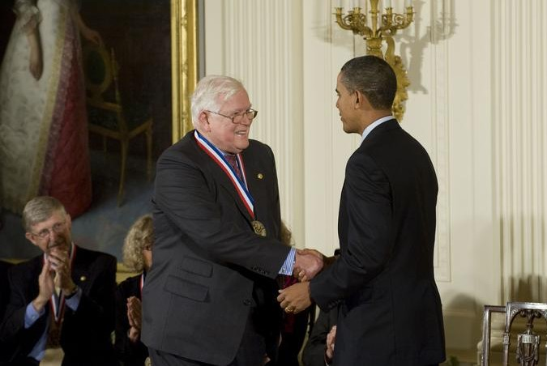
The Kalman Filter
Rudolf E. Kálmán receiving the National Medal of Science

Slide 5

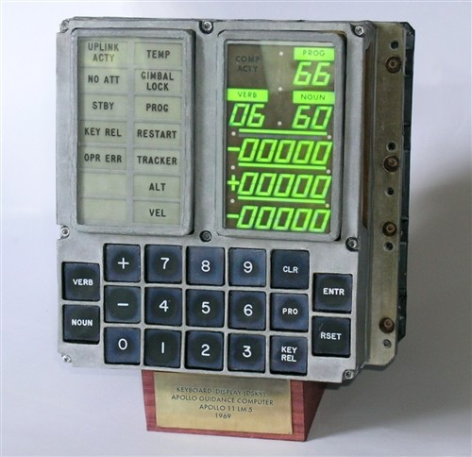

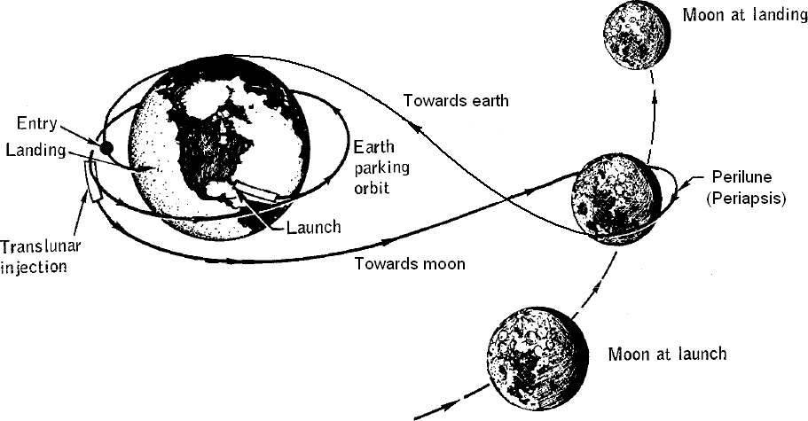
The Kalman Filter
The (extended) Kalman Filter became widely known after its use in the Apollo Guidance Computer（アポロ誘導コンピューター） for circumlunar（月の周りをまわる） navigation.
Apollo Guidance Computer

Slide 6








The Kalman Filter | Prediction and Correction
1D Example（⼤事）
Starting from an initial probabilistic estimate at time k-1, the goal is to use a motion model which could be derived from wheel odometry or inertial sensor measurements to predict our new state.
Use the observation model derived from GPS for example, to correct that prediction of vehicle position at time k.
Each of these components, the initial estimate, the predicted state, and the final corrected state are all random variables that will be specified by their means and covariances. （各状態は確率変数として、平均値や共分散で表す）
  In this way, Kalman filter can be seen as a technique to fuse information from different sensors to produce a final estimate of some unknown state, taking into account uncertainty in motion and in measurements.
3. Fusion
2. Measurement
PDF
1. Prediction
𝒩(x_{k}̂ ₋₁, P̂_{k−1})
𝒩(xˇ_{k}, P^{ˇ}_{k})
𝒩(x_{k}̂ , P̂_{k})
𝒩(y_{k}, R_{k})
Position(p)
Estimate at (k - 1)
Prediction
(Motion Model)
Estimate at (k)
Measurement
(Observation Model)
e.g.,
wheel odometry, inertial navigation
e.g., GPS,
Lidar
The Kalman filter is very similar to the linear recursive least squares filter. 僕はMPCを思いついた。
While recursive least squares updates the estimate of a static parameter, Kalman filter is able to update the estimate of an evolving state.

Slide 7



The Kalman Filter | Linear Dynamical System
The Kalman Filter requires the following motion and measurement models:
u: an external signal that affects the evolution of system state. In the context of self-driving vehicles, this may be a wheel torque（車輪トルク） applied to speed up and change lanes, for example. Actuator signal (throttle / brake / steering)でしょう。
control input
zero-mean noise
Motion model:
^{x}k ^{= F}k−1^{x}k−1 ^{+ G}k−1^{u}k−1 ^{+ w}k−1
input
noise
y_{k} = H_{k}x_{k} + v_{k}
noise
Measurement model:
With the following noise properties:
w_{k} ∼ 𝒩(0, Q_{k})
Process or Motion Noise
v_{k} ∼ 𝒩(0, R_{k})
Measurement Noise

Slide 8
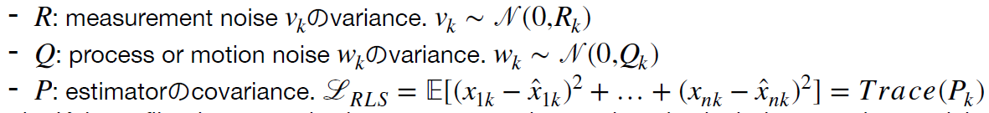
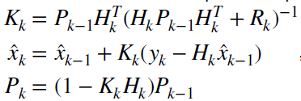
The Kalman Filter | Recursive Least Squares
+ Process Model
The Kalman filter is a recursive least squares estimator that also includes a motion model
1 Prediction: Use the process model (motion model) to predict how states (evolving states and non-state parameters) evolved since the last time step. Propagate mean and uncertainty (covariance).
因みにrecursive least squaresのoptimal gainの計算式は：
1
Prediction
2a Optimal Gain
^{xˇ}k ^{= F}k−1^{x}k−1 ^{+ G}k−1^{u}k−1
K_{k} = P^{ˇ}_{k}H^{T}(H_{k}P^{ˇ}_{k}H^{T} + R_{k})⁻¹
k k
̂ _{F}T
Kalman Filterは前周期の共分散ではなく、現在周期の Motion Modelのノイズを考慮したあとの共分散を使っている。
P^{ˇ} = F P
+ Q
k k−1 k−1
k−1
k−1
2b
Correction
xˇ
Prediction
k (given motion model)
at time k
x̂_{k} = xˇ_{k} + K_{k}(y_{k} − H_{k}xˇ_{k})
P̂_{k} = (1 − K_{k}H_{k})P^{ˇ}_{k}
x̂_{k}
Corrected prediction (given measurement) at time k
(y_{k} − H_{k}xˇ_{k})
is often called the ‘innovation’
2b Correction: use optimal gain to propagate the state covariance from prediction to corrected state.

Slide 9
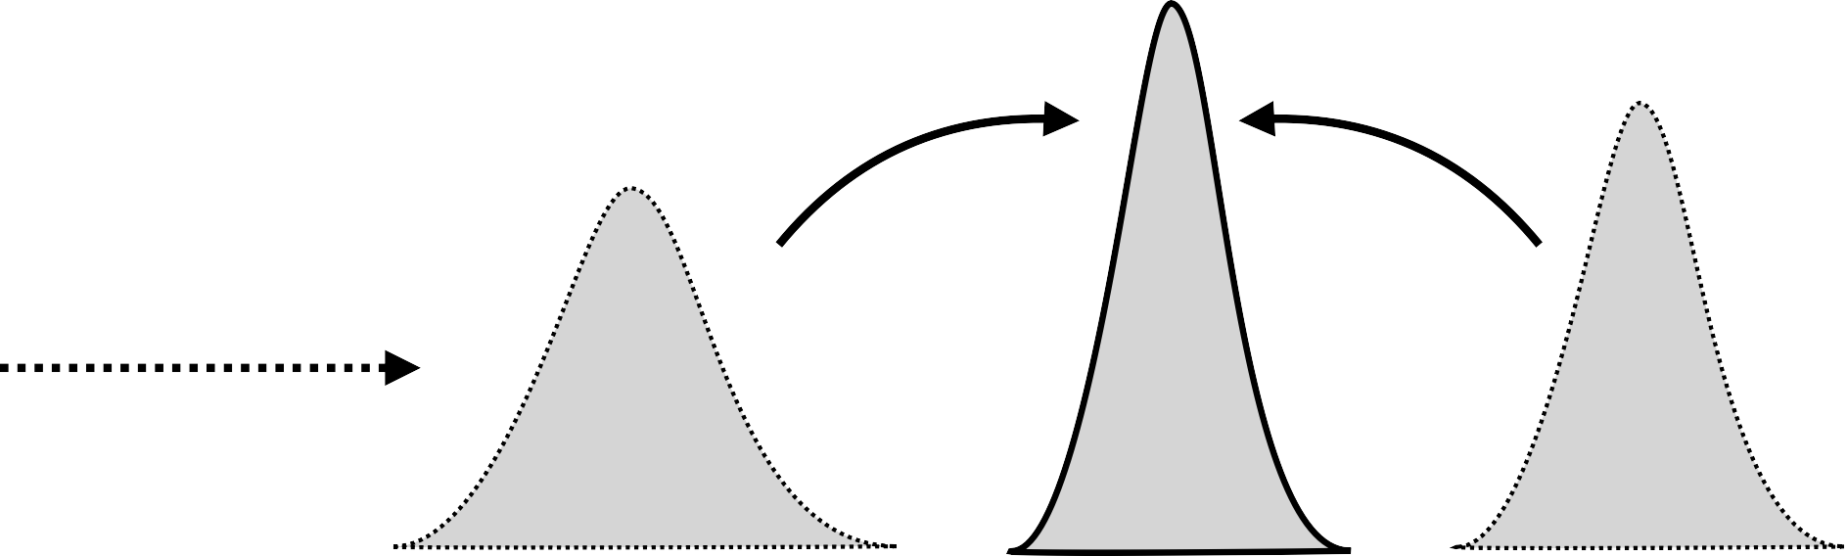
The Kalman Filter | Prediction & Correction
3. Correction
2. Measurement
PDF
1. Prediction
𝒩(x_{k}̂ ₋₁, P̂_{k−1})
𝒩(xˇ_{k}, P^{ˇ}_{k})
𝒩(x_{k}̂ , P̂_{k})
𝒩(y_{k}, R_{k})
Position(x)
1. Prediction
2,3. Measurement & Correction
{
^{xˇ}k ^{= F}k−1^{x}k−1 ^{+ G}k−1^{u}k−1
K_{k} = P^{ˇ}_{k}H^{T}(H_{k}P^{ˇ}_{k}H^{T} + R_{k})⁻¹
{ x̂ = xˇ + K (y − H xˇ )
Kはまず測量モデルのノイズを伝播している。また、測量値（厳密にいうと、Innovation）が新状態での割合も決めている。
ˇ
̂
k k
P
= F P
F
T
^{+ Q}k−1
k
k−1 k−1
k−1
k k k k k k
P̂_{k} = (1 − K_{k}H_{k})P^{ˇ}_{k}

Slide 10


The Kalman Filter | Short Example
Motion/Process Model
x =
[
1 Δt
0
u + w
] [
]
PDF
k
0 1
^{x}k−1 ⁺
Δt
k−1
k−1
F
G
Position Observation
Position(p)
y_{k} = [1 0] x_{k} + v_{k}
Noise Densities
v_{k} ∼ 𝒩(0, 0.05)
H
pだけを観察している
p
= p
2
x =
[
dp
·
]
u = a = ^{d p}
w_{k} ∼ 𝒩(0, (0.1)1_{2×2})
dt
dt²
Q
R

Slide 11
The Kalman Filter | Short Example
Data
̂
0 0.01 0
x ∼ 𝒩(
[ ]
,
[
]
)
PDF
0
5
0 1
Δt = 0.5s
u₀ = − 2 [m/s²]
y₁ = 2.2 [m]
Position(p)

Slide 12
The Kalman Filter | Short Example Solution
Prediction
^{xˇ}k ^{= F}k−1^{x}k−1 ^{+ G}k−1^{u}k−1
pˇ₁
₌ 1 0.5 0 ₊
[
]
[ ] [ ] [
] [ ]
·
⁰ (−2) = ^{2.5}
ˇ
0 1 5 0.5 4
p
1
^{Pˇ}k ^{= F}k−1^{P̂}k−1^{FT + Q}k−1
k−1
1 0.5 0.01 0 1 0.5
T
0.1 0
0.36 0.5
ˇ
P
=
[ ] [
] [
+
=
1
0 1 0 1
] [
] [
]
0 1
0 0.1
0.5 1.1

Slide 13
The Kalman Filter | Short Example Solution
Correction
K₁ = P^{ˇ}₁H^{T}(H₁P^{ˇ}₁H^{T} + R₁)⁻¹
1 1
−1
=
0.36 0.5 1
[ ]
0.36 0.5
1
+ 0.05
)
[
] [ ]
(
1 0
[
] [ ]
0.5 1.1 0
0.5 1.1 0
=
0.88
[
1.22
]
位置の予測値は2.5m, 測量値が2.2m, Kalman Filterは2.24mに修正した。
x̂₁ = xˇ₁ + K₁(y₁ − H₁xˇ₁)
Bonus!
P̂₁ = (1 − K₁H₁)P^{ˇ}₁
corrected state variance is smaller. This uncertainty reduction occurs because measurement model is fairly accurate. つまりv_{k}
のvariance (0.05)が小さい。
p̂₁
₌ 2.5 ₊ 0.88 _{(2.2 − [1 0]} 2.5 ₎ ₌ 2.24
[
·
]
[ ] [
] [ ] [ ]
̂
4
1.22 4
3.63
p
1
0.04 0.06
=
[
]
0.06 0.49

Slide 14
Summary | The Kalman Filter
The Kalman Filter is very similar to RLS but includes a motion model that tells us how the state evolves over time. RLSの方はstateが変わらない。
The Kalman Filter updates a state estimate through two stages:
  prediction using the motion model
  Correction（訂正、修正） using the measurement model

Slide 15
MODULE 2 LESSON 2
THE KALMAN FILTER: BIAS BLUES

Slide 16



Bias in State Estimation
Process/Motion:
^{x}k ^{= F}k−1^{x}k−1 ^{+ G}k−1^{u}k−1 ^{+ w}k−1 y_{k} = H_{k}x_{k} + v_{k}
k = 0, 1, …. K
Measurement:
Drive the car for K time steps, record estimation error, repeat…..
We say an estimator or filter is unbiased if it produces an ‘average’ error of zero at a particular time step k, over many trials（同じタイミングのトライアル）

Slide 17

Bias in State Estimation
Bias
E[p̂_{k}] − p_{k}
Build a histogram of the positions that the filter reports over multiple trials.
Compute the difference between the average of these estimates and the true position.
If this difference does approach zero as repeating this experiment many more times, and if this happens for all time intervals, then the filter is unbiased.
PDF
{p̂_{k}}
E[p̂_{k}]
Mean of Estimated Position Values
p_{k}
True
Position
Position (at time k)
This filter is an unbiased if for all k,
E[e_{k}̂ ] = E[p̂_{k} − p_{k}] = E[p̂_{k}] − p_{k} = 0

Slide 18
Bias in State Estimation
How can we compute this analytically for the Kalman filter?
Consider the error dynamics:
eˇ_{k} = xˇ_{k} − x_{k}
Predicted state error
e_{k}̂ = x̂_{k} − x_{k}
Corrected estimate error
Using the Kalman Filter equations, we can derive:
^{eˇ}k ^{= F}k−1^{eˇ}k−1 ^{− w}k
e_{k}̂ = (1 − K_{k}H_{k})eˇ_{k} + K_{k}v_{k}
証明なし…

Slide 19
Bias in State Estimation
For the Kalman filter, for all k,
E[eˇ_{k}] = E[F_{k−1}eˇ_{k−1} − w_{k}]
= F_{k−1}E[eˇ_{k−1}] − E[w_{k}]
E[e_{k}̂ ] = E[(1 − K_{k}H_{k})eˇ_{k} + K_{k}v_{k}]
= (1 − K_{k}H_{k})E[eˇ_{k}] + K_{k}E[v_{k}]
= 0
= 0
Unbiased predictions!
E[v] = 0 E[w] = 0
+ white, uncorrelated noise
この条件だった ら、証明は簡単。
So long as E[e₀̂ ] = 0
Note: this does not mean that the error on a given trial will be zero, but that, with enough trials, our expected error is zero!

Slide 20
Consistency in State Estimation
予測器でサンプリングしたサンプルの分散の期待値が、予測されたパラメータ自体の分散と同じ。
2
E[e²̂ ] ? P
E[e_{k}̂ ]
_{k} =
k
PDF
{p̂_{k}}
Position (at time k)
This filter is consistent if for all k,
Practically, this means that our filter is neither overconfident, nor under confident in the estimate it has produced.
overconfident filter: essentially place too much emphasis on its own estimate and be less sensitive to future measurement updates.
easy to see how an overconfident filter might have a negative or dangerous effect on the performance of self-driving car.
E[e²̂ ] = E[(p̂_{k} − p_{k})²] = P̂_{k}
k

Slide 21
Consistency in State Estimation
One can also show (with more algebra!) that for all k,
E[eˇ_{k}eˇ^{T}] = P^{ˇ} _{k} E[e_{k}̂ e^{T}̂ ] = P̂_{k}
k k
Consistent predictions!
Provided,
Pはxの共分散
証明なし…
E[e₀̂ e^{T}̂ ] = P^{ˇ} ₀
E[v] = 0 E[w] = 0
+ white noise
0

Slide 22
The Kalman Filter is the BLUE
Best Linear Unbiased Estimator
We’ve shown that given our linear formulation, and zero-mean, white noise the Kalman Filter is unbiased
We can also say that the filter is consistent:
E[e_{k}̂ ] = 0
E[e_{k}̂ e^{T}̂ ] = P̂_{k}
k
例えば、AWGN,加算性白色ガウス雑音
In general, if we have white, uncorrelated zero-mean noise, the Kalman filter is the best (i.e., lowest variance（これも証明なしだろう…）) unbiased estimator that uses only a linear combination of measurements
For this reason, we call it the BLUE (best linear unbiased estimator)
However, most real systems are not linear.
For self-driving cars, generally need to estimate non-linear quantities like vehicle poses, position, and orientation in 2D and 3D.

Slide 23
Summary | The Kalman Filter and The Bias BLUEs
The Kalman filter is
unbiased
consistent
the lowest variance estimator that uses a linear combination of measurements: Best Linear Unbiased Estimator (BLUE)

Slide 24
MODULE 2 LESSON 3
GOING NONLINEAR: THE EXTENDED KALMAN FILTER

Slide 25
Recap | The Linear Kalman Filter
Linear motion / process model
^{x}k ^{= F}k−1^{x}k−1 ^{+ G}k−1^{u}k−1 ^{+ w}k−1
Linear measurement model
y_{k} = H_{k}x_{k} + v_{k}
current state
previous inputs state
process noise
measurement
state
measurement noise
w_{k} ∼ 𝒩(0, Q_{k})
v_{k} ∼ 𝒩(0, R_{k})
3. Correction
2. Measurement
PDF
1. Prediction
Linear discrete-time Kalman Filter:
𝒩(x_{k}̂ ₋₁, P̂_{k−1})
1. Prediction
𝒩(xˇ_{k}, P^{ˇ}_{k})
𝒩(x_{k}̂ , P̂_{k})
𝒩(y_{k}, R_{k})
Position(x)
{P^{ˇ} = F P
{
2/3. Measurement & Correction
xˇ = F x + G u
K_{k} = P^{ˇ}_{k}H^{T}(H_{k}P^{ˇ}_{k}H^{T} + R_{k})⁻¹
k k−1 k−1 k−1 k−1
k k
̂ _{F}T
+ Q
x̂ = xˇ_{k} + K_{k}(y − H_{k}xˇ_{k})
k k−1 k−1
k−1
k−1
k k
P̂_{k} = (1 − K_{k}H_{k})P^{ˇ}_{k}

Slide 26
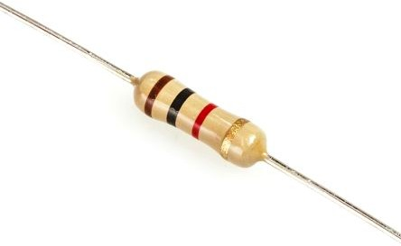
Nonlinear Kalman Filtering
Linear regime
Nonlinear regime
Linear systems do not exist in reality!
Current
Ohm’s Law（オームの法則）:
I = V/R
Voltage
^{x}k ^{= f}k−1^{(x}k−1^{, u}k−1^{, w}k−1⁾
How can we adapt the Kalman Filter to nonlinear discrete-time systems?
current state
previous inputs state
process noise
y_{k} = h_{k}(x_{k}, v_{k})
measurement
state
measurement noise

Slide 27

EKF | Linearizing a Nonlinear System
f(x)
Choose an operating point a and approximate the nonlinear function by a tangent line at that point
f(a)
slope = ^{∂f(x)}
∂x
x=a
x
a
Mathematically, we compute this linear approximation using a first-order Taylor expansion:
First-order（一次） terms
Higher-order terms

Slide 28
EKF | Linearizing a Nonlinear System
For the EKF, we choose the operating point to be our most recent state estimate, our known input, and zero noise:
Linearized motion model
wは0で展開しているので、w-0=w
uは既知（きち）なので、u-u=0
^{x}k ^{= f}k−1^{(x}k−1^{, u}k−1^{, w}k−1^{) ≈ f}k−1^{(x̂}k−1^{, u}k−1^{, 0) + ∂fk−1}
(x_{k−1} − x̂_{k−1}) + ^{∂fk−1}
^{w}k−1
^{∂x}k−1
^{∂w}k−1
^{x̂}k−1^{,u}k−1^{,0}
^{x̂}k−1^{,u}k−1^{,0}
^{F}k−1
^{L}k−1
Linearized measurement model
y_{k} = h_{k}(x_{k}, v_{k}) ≈ h_{k}(xˇ_{k}, 0) + ^{∂hk}
(x_{k} − xˇ_{k}) + ^{∂hk} v_{k}
∂x_{k}
∂v_{k}
xˇ_{k},0
xˇ_{k},0
H_{k} M_{k}
We now have a linear system in state-space! The matrices F_{k–1}, L_{k–1}, H_{k}, and M_{k} are called the Jacobian matrices of the system

Slide 29
EKF | Computing Jacobian Matrices
In vector calculus, a Jacobian matrix is the matrix of all first-order partial derivatives of a vector-valued function
∂f₁
∂x₁
∂f₁
∂x_{n}
⋯
⋮ ⋱ ⋮
∂f_{m ⋯} ∂f_{m}
∂f
[ ∂f
∂x₁
∂f
⋯
∂x ]
=
∂x ⁼
n
∂x₁ ∂x_{n}
Intuitively, the Jacobian matrix tells you how fast each output of the function is changing along each input dimension
For example:
∂f₁ ∂f₁
∂x₁ ∂x₂
f
x + x
∂f ₌
1 1
f(x) =
1
=
1 2
2
]
[ ] [
∂f₂ ∂f₂
∂x₁ ∂x₂
=
[
]
f
x₁
∂x
2x 0
2
1

Slide 30
EKF | Putting It All Together
With our linearized models and Jacobians, we can now use the Kalman Filter equations!
Linearized motion model
^{x}k ^{= f}k−1^{(x̂}k−1^{, u}k−1^{, 0) + F}k−1 (^{x}k−1 ^{− x̂}k−1) ^{+ L}k−1^{w}k−1
Prediction
xˇ_{k} = f_{k−1}(x̂_{k−1}, u_{k−1}, 0)
Linearized measurement model
y_{k} = h_{k}(xˇ_{k}, 0) + H_{k (}x_{k} − xˇ_{k)} + M_{k}v_{k}
Optimal gain
Nonlinear伝播の部分
K_{k} = P^{ˇ}_{k}H^{T}(H_{k}P^{ˇ}_{k}H^{T} + M_{k}R_{k}M^{T})⁻¹
k k k
^{Pˇ}k ^{= F}k−1^{P̂}k−1^{FT} 1 ^{+ L}k−1^{Q}k−1^{LT} 1
k− k−
Correction
x̂_{k} = xˇ_{k} + K_{k}(y_{k} − h_{k}(xˇ_{k}, 0))
P̂_{k} = (1 − K_{k}H_{k})P^{ˇ}_{k}
Prediction (given motion model)
at time k
xˇ_{k}
Linear Kalman Filterの式との区別
First, in the prediction and correction steps, still use the nonlinear models to propagate the mean of the state estimate and to compute the measurement residual or innovation.
  理由：linearize motion model about the previous state estimate, linearize the measurement model about the predicted state.
  By definition, the linearized model exactly coincides with the nonlinear model at the operating point.
Second, the appearance of L and M Jacobians related to the process and measurement noise.
  In many cases, both of these matrices will be identity（単位行列） since noise is often assumed to be additive（加算）. （つまり非線形システムの中にもノイズは+w / +vの形で、w, vに対するヤコビ行列は単位行列になる）
̂ Corrected prediction
x
k (given measurement)
at time k

Slide 31


EKF | Short Example
Motion modelはまだlinear, Measurement modelはnonlinear.
Motion/Process model
x_{k} = f(x_{k−1}, u_{k−1}, w_{k−1})
Height
S
1 Δt 0
=
[ ]
x +
[ ]
u + w
k−1
k−1
k−1
ϕ
0 1 Δt
Landmark measurement model
y_{k} = ϕ_{k} = h(p_{k}, v_{k})
Position
p
D
S
p
··
= tan⁻¹ + v_{k}
加算ノイズ、なのでvに対するヤコビ行列は単位行列になる。
x =
[ ]
u = p
( D − p )
·
k
p
Noise densities
v_{k} ∼ 𝒩(0, 0.01)
S and D are known in advance
w_{k} ∼ 𝒩(0, (0.1)1_{2×2})

Slide 32

EKF | Short Example
Motion model Jacobians
Height
∂f
^{F}k−1 ⁼
1 Δt
=
[
]
^{∂x}k−1
0 1
S
^{x̂}k−1^{,u}k−1^{,0}
ϕ
∂f
^{∂w}k−1
L =
= 1
k−1
2×2
Position
^{x̂}k−1^{,u}k−1^{,0}
p
D
Measurement model Jacobians
_{H =} ∂h
S
=
[
0
]
k
(D − pˇ )
∂x_{k}
2
2
+
k
+ S
xˇ_{k},0
∂h
M_{k} =
= 1
∂v_{k}
xˇ_{k},0

Slide 33

EKF | Short Example
Height
Data
x̂₀ ∼ 𝒩
0 0.01 0
(
[ ]
,
[
]
)
S
5
0 1
ϕ
Δt = 0.5 s
u₀ = − 2 [m/s²]
S = 20 [m]
y₁ = π/6 [rad]
D = 40 [m]
Position
p
D
Using the Extended Kalman Filter equations, what is our updated position?
p̂₁

Slide 34

EKF | Short Example Solution
Prediction
xˇ₁ = f₀(x̂₀, u₀, 0)
This is the same result as in the linear Kalman Filter example because the motion model is already linear!
pˇ₁
1 0.5
0
0
2.5
=
[
+
(−2) =
[
ˇ·
]
] [ ] [ ]
[
]
p
0 1 5 0.5
4
1
P^{ˇ}₁ = F₀P̂₀F^{T} + L₀Q₀L^{T}
0 0
ˇ
1 0.5 0.01 0 1 0 1 0 0.1 0 1 0
0.36 0.5
P
=
+
=
1
[ ] [
] [
] [ ] [
] [ ] [
0.5 1.1
]
0 1 0 1 0.5 1 0 1 0 0.1 0 1

Slide 35
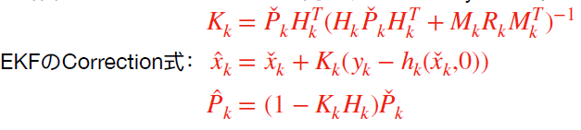
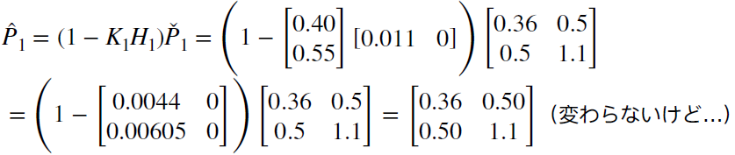
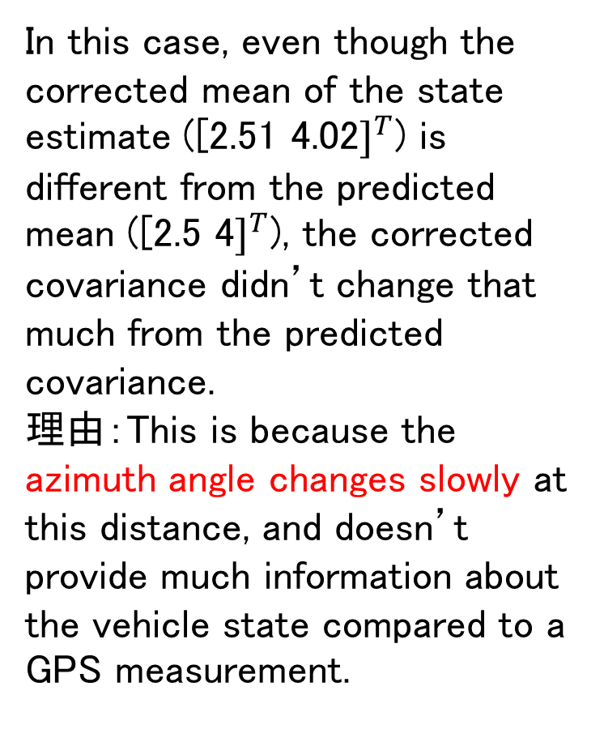
EKF | Short Example Solution
Correction
K₁ = P^{ˇ}₁H^{T}(H₁P^{ˇ}₁H^{T} + M₁R₁M^{T})⁻¹
1 1 1
In this case, even though the corrected mean of the state estimate ([2.51 4.02$]^{T}$) is different from the predicted mean ([2.5 4$]^{T}$), the corrected covariance didn’t change that much from the predicted covariance.
理由：This is because the azimuth angle changes slowly at this distance, and doesn’t provide much information about the vehicle state compared to a GPS measurement.
−1
=
0.36 0.5 0.011
[
]
0.36 0.5 0.011
+ 1(0.01)(1)
)
[ ] [
]
(
0.011 0
[
] [
]
0.5 1.1 0
0.5 1.1
0
=
0.40
[
0.55
]
Bonus!
P̂₁ = (1 − K₁H₁)P^{ˇ}₁
x̂₁ = xˇ₁ + K₁(y₁ − h₁(xˇ₁, 0))
0.36 0.50
=
[
]
0.50 1.1
p̂₁
[
]
= ^{2.5} + ^{0.40} (0.52 − 0.49) = ^{2.51}
·
̂
[ ] [
] [ ]
p
4
0.55
4.02
1

Slide 36
Summary | Extended Kalman Filter (EKF)
The EKF uses linearization to adapt the Kalman filter to nonlinear systems
Linearization works by computing a local linear approximation（近似） to a nonlinear function about a chosen operating point
Linearization relies on computing Jacobian matrices, which contain all the first- order partial derivatives of a function

Slide 37
MODULE 2 LESSON 4
AN IMPROVED EKF: THE ERROR- STATE EXTENDED KALMAN

Slide 38
What’s in a State?
We can think of the vehicle state as composed of two parts:
x = x̂ + δx
True State
Nominal State (“Large”)
Error State (“Small”)
Position
We can continuously update the nominal state by integrating the motion model
Error state δ
True state
̂ • Modelling errors and process noise
Nominal state x
Time
accumulate into the error state

Slide 39
The Error-State Extended Kalman Filter
The Error-State Extended Kalman Filter estimates the error state directly and uses it as a correction to the nominal state:
Linearized motion model
^{x}k ^{= f}k−1^{(x̂}k−1^{, u}k−1^{, 0) + F}k−1 (^{x}k−1 ^{− x̂}k−1) ^{+ L}k−1^{w}k−1
Linearized measurement model
y_{k} = h_{k}(xˇ_{k}, 0) + H_{k (}x_{k} − xˇ_{k)} + M_{k}v_{k}
^{x}k ^{− f}k−1^{(x̂}k−1^{, u}k−1^{, 0) = F}k−1 (^{x}k−1 ^{− x̂}k−1) ^{+ L}k−1^{w}k−1
y_{k} = h_{k}(xˇ_{k}, 0) + H_{k (}x_{k} − xˇ_{k)} + M_{k}v_{k}
δx_{k}
δx_{k}
^{δx}k−1
Error state
Error state
Motion modelの式からError stateは線形モデルで伝播していると思う。Measurement modelの式はEKFと同じくLocal Linearizationで計算している。

Slide 40
The Error-State Extended Kalman Filter
Loop:
1. Update nominal state with motion model
xˇ_{k} = f_{k−1}(x_{k−1}, u_{k−1}, 0)
This could be
^{xˇ}k−1 ^{or x̂}k−1
measurementはまだ（センサーから）来ていないかもしれないから。

Slide 41
The Error-State Extended Kalman Filter
Loop:
Update nominal state with motion model
Propagate uncertainty
^{Pˇ} k ^{= F}k−1^{P}k−1^{FT} 1 ^{+ L}k−1^{Q}k−1^{LT} 1
k− k−
This could be
^{Pˇ} k−1 ^{or P̂}k−1
Motion modelでのerror stateの伝播は共分散Pの中に行われていると思う。
depending on whether we used a measurement to do a correction step

Slide 42
The Error-State Extended Kalman Filter
Loop:
Update nominal state with motion model
Propagate uncertainty
If a measurement is available:
  Compute Kalman Gain
K_{k} = P^{ˇ} _{k}H^{T}(H_{k}P^{ˇ} _{k}H^{T} + R)⁻¹
k k
Repeat 1, 2 until a measurement is available and we want to do a correction
Mがない、 多分Identityだから、EKFと⼀緒

Slide 43

The Error-State Extended Kalman Filter
Loop:
Update nominal state with motion model
Propagate uncertainty
If a measurement is available:
  Compute Kalman Gain
  Compute error state
δx̂_{k} = K_{k}(y_{k} − h_{k}(xˇ_{k}, 0))

Slide 44
The Error-State Extended Kalman Filter
Loop:
Update nominal state with motion model
Propagate uncertainty
If a measurement is available:
  Compute Kalman Gain
  Compute error state
  Correct nominal state
x̂_{k} = xˇ_{k} + δx̂_{k}

Slide 45
The Error-State Extended Kalman Filter
Loop:
Update nominal state with motion model
Propagate uncertainty
If a measurement is available:
  Compute Kalman Gain
  Compute error state
  Correct nominal state
  Correct state covariance
P̂_{k} = (1 − K_{k}H_{k})P^{ˇ} _{k}
（EKFと⼀緒）

Slide 46
Why Use the ES-EKF?
Motion modelの適用周期やMeasurement modelの適用周期が一緒だったら、EKFと一緒だと思う。
1. Better performance compared to the vanilla EKF
The “small” error state is more amenable（従順、じゅうじゅん） to linear filtering than the “large” nominal state, which can be integrated nonlinearly
自分の考え：小さい値の方を線形でモデリングしやいと言っていると思う。例えばθが小さい時、非線形のsinθ, tanθなどをθでモデリングしても問題なさそうです。
2. Easy to work with constrained quantities (e.g., rotations in 3D)
We can also break down the state using a generalized composition operator
x = x̂ ⊕ δx
この点について更に説明はできていないですが、以前2輪ロボットの運動はtanθ=dy/dxで拘束されることを紹介していました。
（generalized composition（合成） operatorで具体的にどこ変わったかまだ分かっていない）
True State
Nominal State (Overparametrized, constrained)
Error State (Minimal parametrization,
unconstrained)

Slide 47
Summary | The Error-State EKF (ES-EKF)
The error-state formulation separates the state into a “large” nominal state and a “small” error state.
The ES-EKF uses local linearization to estimate the error state and uses it to correct the nominal state.
The ES-EKF can perform better than the vanilla EKF, and provides a natural way to handle constrained quantities like rotations in 3D.
the evolution of the error state tends to be closer to linear.

Slide 48
MODULE 2 LESSON 5
LIMITATIONS OF THE EXTENDED KALMAN FILTER
1

Slide 49
Limitations of the EKF | Linearization error
The EKF works by linearizing the nonlinear motion and measurement models to update the mean and covariance of the state
f(x)
Linearization error
The difference between the linear approximation and the nonlinear function is called linearization error
f(a)
slope = ^{∂f(x)}
∂x
In general, linearization error depends on
How nonlinear the function is
How far away from the operating point the linear approximation is being used（operating pointでの値と同じ、離れたら線形化エラーが大きくなる）
x=a
x
a
f(x) ≈ f(a) + ^{∂f(x)}
(x − a)
x=a
∂x

Slide 50
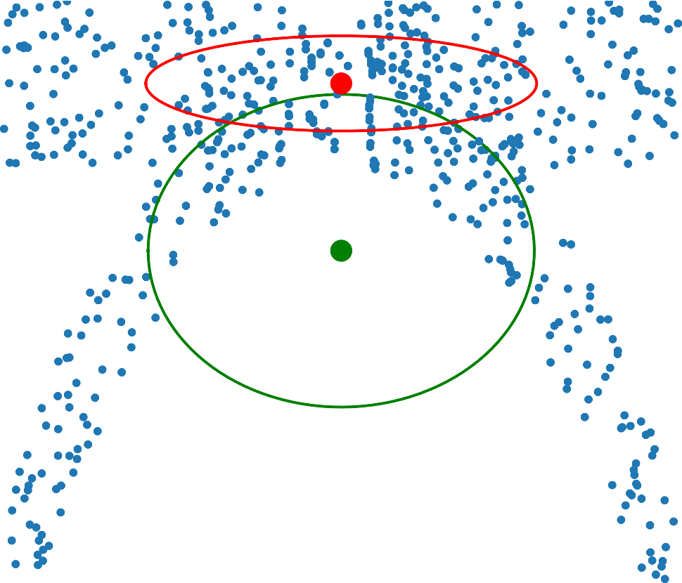

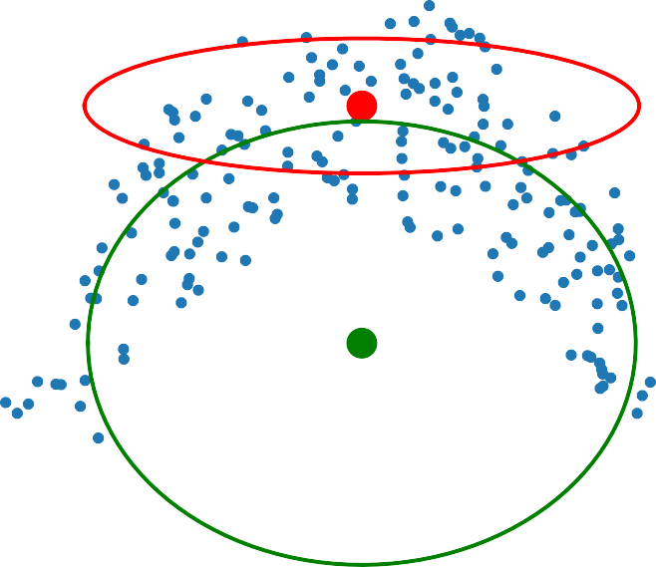


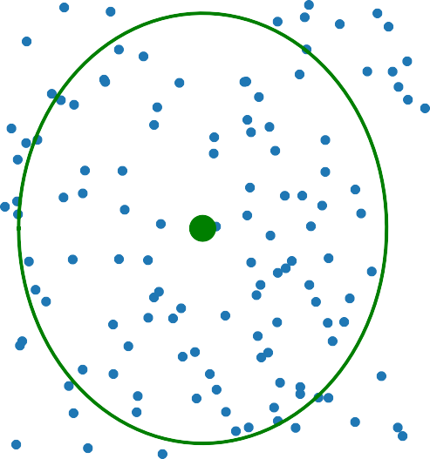



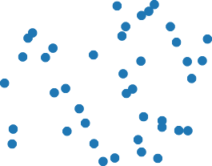


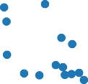


Linearization Error | Example
Let’s look at an example of how linearization error affects the mean and covariance of a random variable transformed by a nonlinear function:
Linearized
^{covariance} Cartesian coordinates（直交座標系）
Linearized mean
Polar coordinates（極座標系）
1.01
1.01
1.00
0.99
0.98
y0.97
0.96
0.95
0.94
0.93
—0.4 —0.2 0.0 0.2 0.4
x
1.01
1.00
0.99
0.98
y0.97
0.96
0.95
0.94
0.93
—0.4 —0.2 0.0 0.2 0.4
x
1.01
1.00
0.99
0.98
y0.97
0.96
0.95
0.94
0.93
—0.4 —0.2 0.0 0.2 0.4
x
1.01
1.00
0.99
0.98
y0.97
0.96
0.95
0.94
0.93
—0.4 —0.2 0.0 0.2 0.4
x
1.01
1.00
0.99
0.98
y0.97
0.96
0.95
0.94
0.93
—0.4 —0.2 0.0 0.2 0.4
x
Nonlinear transformation
1.01
1.00
0.99
0.98
y0.97
0.96
0.95
0.94
0.93
—0.4 —0.2 0.0 0.2 0.4
x
1.9
1.9
1.8
1.7
1.6
✓
1.5
1.4
1.3
1.2
0.985 0.990 0.995 1.000 1.005 1.010 1.015
r
1.9
1.8
1.7
1.6
✓
1.5
1.4
1.3
1.2
0.985 0.990 0.995 1.000 1.005 1.010 1.015
r
x = r cos θ y = r sin θ
1.00
1.8
0.99
1.7
0.98
True mean
1.6
0.97
✓
y
1.5
Linearized transformation
0.96
True mean
True covariance
1.4
x ≈ r¯ cos θ¯ + cos θ¯ (r − r¯)
−r¯ sin θ¯ (θ − θ¯)
y ≈ r¯ sin θ¯ + sin θ¯ (r − r¯)
+r¯ cos θ¯ (θ − θ¯)
0.95
1.3
0.94
1.2
0.93
0.985 0.990 0.995 1.000 1.005 1.010 1.015
^{r} True covariance
—0.4
—0.2
0.0
x
0.2
0.4
この例のpolar coordinatesからcartesian coordinatesへの変換はLidarに関するmeasurementによく ある。
結果：The mean of the linearized distribution is in a very different place from the true mean, and the linearized covariance seriously underestimates （過小評価） the spread of the true output distribution along the y dimension.
問題シーン：For example, the estimated position of lane markers produced from a laser scanner might differ significantly from the actual positions, leading our car to drive over the center line.

Slide 51
Limitations of the EKF | Linearization Error
The EKF is prone to linearization error when
The system dynamics are highly nonlinear
The sensor sampling time is slow relative how fast the system is evolving（つまりMotionモデルがhigh rate, Measurementがlow rate）
This has two important consequences:
The estimated mean state can become very different from the true state
The estimated state covariance can fail to capture the true uncertainty in the state
For self-driving cars moving very fast relative to the sampling time of your sensors, you’re going to get more linearization error than if it’s moving slowly.
If your car’s estimator diverges while driving, it could easily drive off the road into a ditch（溝） or cause a collision with another vehicle.
Linearization error can cause the estimator to be overconfident in a wrong answer!

Slide 52

Limitations of the EKF | Computing Jacobians
Computing Jacobian matrices for complicated nonlinear functions is also a common source of error in EKF implementations!
Analytical differentiation is prone to human error
Numerical differentiation（数値微分） can be slow and unstable
Automatic differentiation (e.g., at compile time) can also behave unpredictably
What if one or more of our models is non-differentiable?
Do we really need linearization for nonlinear Kalman filtering?
例えば

Slide 53
Summary | Limitations of the EKF
The EKF uses analytical local linearization and, as a result, is sensitive to linearization errors
For highly nonlinear systems, the EKF estimate can diverge（逸れる、それる） and become unreliable
Computing complex Jacobian matrices is an error-prone process and must be done with substantial care
6

Slide 54
MODULE 2 LESSON 6
AN ALTERNATIVE TO THE EKF: THE UNSCENTED KALMAN FILTER
Unscented: 無臭（むしゅう）、無香料（こうりょう）
Unscented Transform gives much higher accuracy than analytical EKF style linearization, for a similar amount of computation, and without needing to compute any Jacobians.
1

Slide 55

The Unscented Transform
“It is easier to approximate a probability distribution than it is to approximate an arbitrary nonlinear function” — S. Julier, J. Uhlmann, and H. Durrant-Whyte (2000)
These aren’t random samples, they’re deterministic samples chosen to be a certain number of standard deviations away from the mean.
The Unscented Transform is sometimes called the Sigma Point Transform.
p(x)
1. Choose sigma points
p(y)
3. Compute weighted mean and covariance of transformed sigma
points
y = h(x)
2. Transform sigma points
σ σ_{y}
σ_{x} σ_{x}
y
y
μ_{x}
μ_{y}

Slide 56




The Unscented Transform | Choosing Sigma Points
For an N-dimensional PDF 𝒩(μ_{x}, Σ_{xx}) , we need 2N + 1 sigma points:
p(x)
x₀
1. Compute the Cholesky Decomposition of the covariance matrix（共分散P）
σ_{x} σ_{x}
LL^{T} = Σ_{xx}
Cholesky Decomposition（コレスキー分解）を計算するため、chol function in Matlab, or the Cholesky function in NumPyを利⽤する。
x
x
(L lower triangular)
2
1
2. Calculate the sigma points
μ_{x} − 3σ_{x}
μ_{x}
μ_{x} + 3σ_{x}
x = μ
0 x
x_{i} = μ_{x} +
x_{i+N} = μ_{x} −
N + κ col_{i}L
N + κ col_{i}L
i = 1, …, N i = 1, …, N
𝒩(μ_{x}, Σ_{xx})
x₂
x₁
x
0
μ
x
x₃
x₄
κ = 3 − N
The parameter $κ$ is a tuning parameter
for Gaussian PDFs

Slide 57
The Unscented Transform | Transforming and Recombining
Next we pass each of our 2N + 1 sigma points through the nonlinear function h(x)
y_{i} = h(x_{i}) i = 0, …, 2N
And finally compute the mean and covariance of the output PDF
2N
Mean:
μ_{y} = ∑ α_{i}y_{i}
i=0
2N
T
Covariance:
Σ_{yy} = ∑ α_{i (}y_{i} − μ_{y) (}y_{i} − μ_{y)}
i=0
κ
N + κ
1
2 (N + κ)
i = 0
otherwise
Weights:
α_{i} =

Slide 58
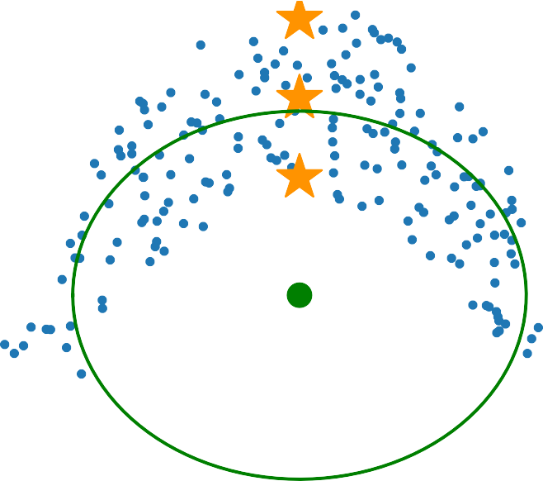
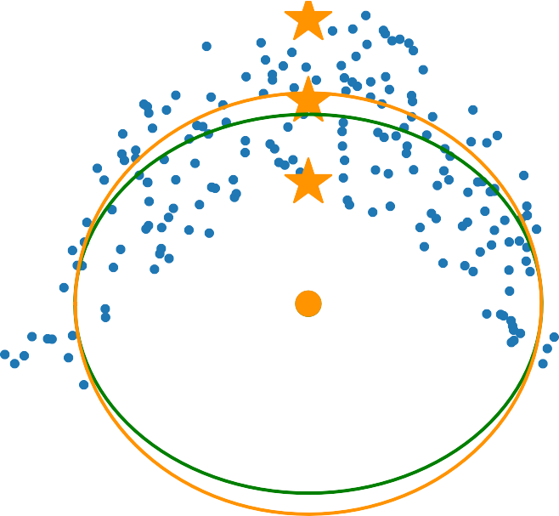
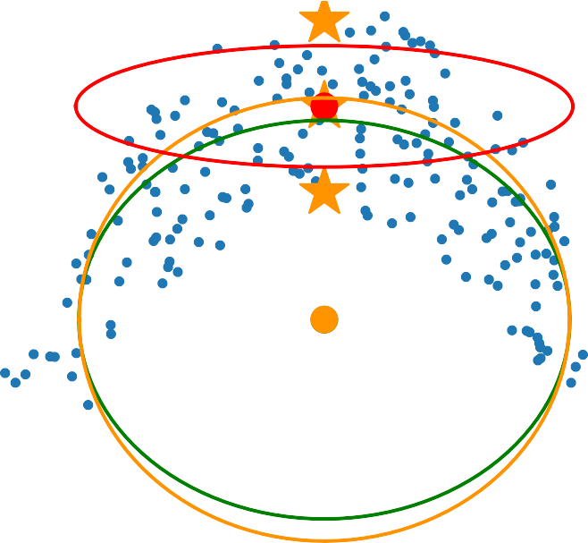
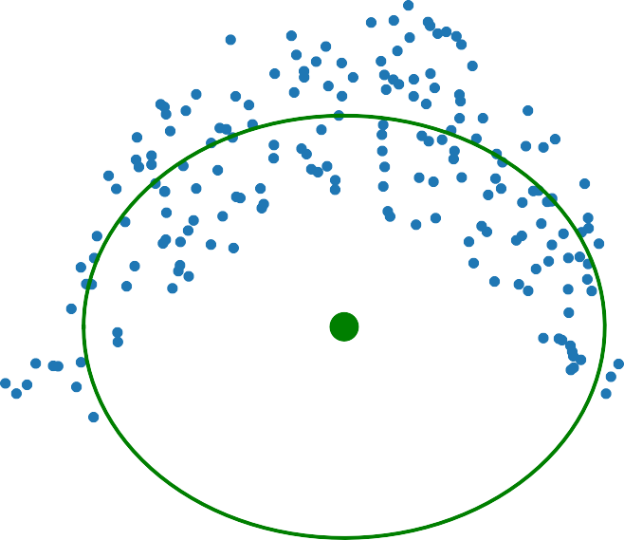

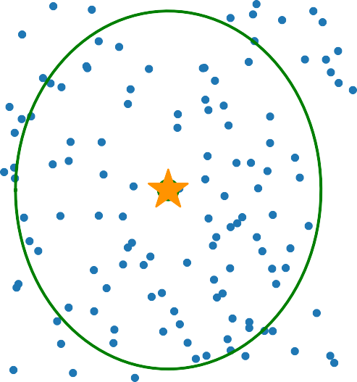

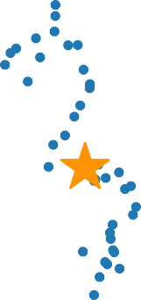



The Unscented Transform vs. Linearization
Let’s revisit our nonlinear transformation example from the previous video.
Polar coordinates
Cartesian coordinates
1.01
1.01
1.00
0.99
0.98
y0.97
0.96
0.95
0.94
0.93
—0.4 —0.2 0.0 0.2 0.4
x
1.01
1.00
0.99
0.98
y0.97
0.96
0.95
0.94
0.93
—0.4 —0.2 0.0 0.2 0.4
x
1.01
1.00
0.99
0.98
y0.97
0.96
0.95
0.94
0.93
—0.4 —0.2 0.0 0.2 0.4
x
1.9
Nonlinear transformation
Linearized
1.9
1.8
1.7
1.6
✓
1.5
1.4
1.3
1.2
0.985 0.990 0.995 1.000 1.005 1.010 1.015
r
x = r cos θ y = r sin θ
1.00
1.8
True
True
0.99
1.7
0.98
1.6
0.97
✓
y
1.5
0.96
1.4
Unscented transform
sigma points
Unscented
0.95
1.3
0.94
1.2
0.93
0.985 0.990 0.995 1.000 1.005 1.010 1.015
r
—0.4
—0.2
0.0
x
0.2
0.4
The Unscented Transform gives a much better approximation for similar work!

Slide 59
The Unscented Kalman Filter (UKF)
We can easily use the Unscented Transform in our Kalman Filtering framework with nonlinear models:
Nonlinear motion model
^{x}k ^{= f}k−1^{(x}k−1^{, u}k−1^{, w}k−1⁾ w_{k} ∼ 𝒩(0, Q_{k})
Nonlinear measurement model
y_{k} = h_{k}(x_{k}, v_{k})
v_{k} ∼ 𝒩(0, R_{k})
２つ非線形モデルなので、Unscented Transformも2回行う。
Instead of approximating the system equations by linearizing, we will calculate sigma points and use the Unscented Transform to approximate the PDFs directly!

Slide 60
UKF | Prediction step
To propagate the state from time (k – 1) to time k, apply the Unscented Transform using the current best guess for the mean and covariance
1. Compute sigma points
3. Compute predicted mean and covariance
κ
N + κ
1 1
2 N + κ
2N
^{L̂}k−1^{L̂T = P̂}k−1
i = 0
otherwise
k−1
x̂⁽⁰⁾ = x̂_{k−1}
_{α}(i) ₌
k−1
_{x̂}(i)
= x̂_{k−1} +
N + κ col_{i}L̂_{k−1}
N + κ col_{i}L̂_{k−1}
i = 1...N
i = 1...N
k−1
x̂^{(i+N)} = x̂_{k−1} −
ˇ
(i) (i)
k−1
x
= α xˇ
k
∑
k
共分散の計算も理論的な式じゃなくて、統計学的な方法で計算していると思う。
i=0 2N
2. Propagate sigma points
ˇ
(i)
T
xˇ^{(i)} − xˇ + Q
P
= α
xˇ^{(i)} − xˇ
k)
k
∑
( k
^{k}) ( k
k−1
xˇ^{(i)} = f_{k−1}(x̂^{(i)} , u_{k−1}, 0)
k k−1
i = 0...2N
i=0
Additive process noise!

Slide 61
UKF | Correction step
To correct the state estimate using measurements at time k, use the nonlinear measurement model and the sigma points from the prediction step to predict the measurements
To compute the Kalman gain, need the cross-covariance between the predicted state and the predicted measurements, which tells how the measurements are correlated with the state.
1. Predict measurements from (redrawn) propagated sigma points
3. Compute cross-covariance and Kalman gain
2N
ŷ^{(i)} = h (xˇ^{(i)}, 0) i = 0, …, 2N
P = α
(i)
̂
T
k
xˇ^{(i)} − xˇ ŷ^{(i)} − y
k)
k k
xy
∑
( k ^{k}) ( k
i=0
With process noise considered!
K_{k} = P P⁻¹
xy y
2. Estimate mean and covariance of predicted measurements
4. Compute corrected mean and covariance
x̂_{k} = xˇ_{k} + K_{k (}y_{k} − ŷ_{k)}
P_{k} = P_{k} − K_{k}P_{y}K_{k}
2N
_{α}(i)_{ŷ}(i)
ŷ_{k} =
∑
k
̂ ˇ
T
i=0 2N
P = α
(i)
ŷ^{(i)} − y
̂
T
( k
̂ ŷ^{(i)} − y
k)
+ R
y
∑
^{k}) ( k
k
Sigma pointsは常にコレスキ分解で取らないといけない！Prediction stepで伝播した結果を使ってはいけません！
Step 4だけで測量値を使っている。
i=0
Additive measurement noise!

Slide 62


UKF | Short example
Motion/Process model
x_{k} = f(x_{k−1}, u_{k−1}, w_{k−1})
Height
₌ 1 Δt _{xk−1 +} 0
[0 1 ] [Δt]
S
^{u}k−1 ^{+ w}k−1
ϕ
Landmark measurement model
y_{k} = ϕ_{k} = h(p_{k}, v_{k})
S
Position
p
D
= tan⁻¹
+ v
k
p
( D − p_{k} )
··
x = _{[p· ]}
u = p
Noise densities
v_{k} ∼ 𝒩(0, 0.01)
S and D are known in advance
w_{k} ∼ 𝒩(0, (0.1)1_{2×2})

Slide 63

UKF | Short example
Height
Data
x̂₀ ∼ 𝒩
0 , 0.01 0
S
₍[5] [
0
1]₎
ϕ
Δt = 0.5s
u₀ = − 2 [m/s²]
S = 20 [m]
y₁ = π/6 [rad]
D = 40 [m]
Position
p
D
Using the Unscented Kalman Filter equations, what is our updated position?
p̂₁

Slide 64
UKF | Short Example Solution
Prediction
N = 2, κ = 3 − N = 1
x̂⁽⁰⁾ = x̂₀
0
(i)
̂
̂
x = x̂
0
+ N + κ col_{i}L̂₀
N + κ col_{i}L̂₀
i = 1 …, N
i = 1, …, N
L̂ L^{̂T} = P
0
0
0
0
x̂^{(i+N)} = x̂₀ −
0
0.1 0 0.1 0 ^{T}
[ 0 1] [ 0 1]
= [
0.01 0
0
1]
_{x̂}(0) ₌ 0
0
[5]
初期共分散をコレスキ分解する
x̂⁽¹⁾ = ⁰ +
₃ 0.1 ₌ 0.17
[5]
[ 0 ] [ ]
0
5
x̂⁽²⁾ = ⁰ + 3 ⁰ =
0
[6.73]
0
[5]
[1]
x̂⁽³⁾ = ⁰ −
₃ 0.1 ₌ −0.17
0
[5]
[ 0 ] [
5
]
x̂⁽⁴⁾ = ⁰ − 3 ⁰ =
0
[3.27]
0
[5]
[1]
Motion modelのsigma pointsを選択する

Slide 65
UKF | Short Example Solution
Prediction
xˇ^{(i)} = f₀(x̂^{(i)}, u₀, 0) i = 0,…, 2N
1 0
κ ₌ 1 ₌ 1
N + κ 2 + 1 3
1 1 1 1 1
i = 0
otherwise
_{α}(i) ₌
_{xˇ}(0) ₌
1 0.5 0 0
2.5
[ 4 ]
1
[0 1 ] [5]
+
[0.5]
(−2) =
2 N + κ ⁼ 2 2 + 1 ⁼ 6
_{xˇ}(1) ₌ 1 0.5
0.17 ₊ 0
(−2) = ^{2.67}
[0 1 ] [
5
]
[0.5]
[ ]
1
4
_{xˇ}(2) ₌ 1 0.5 0
+
0
(−2) = ^{3.37}
1
[0
1 ] [6.73]
[0.5]
[5.73]
2N
xˇ_{k} =
_{α}(i)_{xˇ}(i)
₌ 1 0.5
−0.17 ₊ 0
∑
k
xˇ
(3)
1
[0 1 ] [
(−2) = ^{2.33}
i=0
] [ ]
5 [0.5] 4
₌ ¹ 2.5 ₊ ¹ 2.67 ₊ ¹ 3.37 ₊ ¹ 2.33 ₊ ¹ 1.63 ₌ 2.5
3 [ 4 ] 6 [
] 6 [ ] [ 4 ]
_{xˇ}(4) ₌ 1 0.5 0
0
4 6 [5.73] 4 6 [2.27]
[0
+
(−2) = ^{1.63}
1
1 ] [3.27]
[0.5]
[2.27]
非線形Transform後サンプルの平均値を計算する、予測値として使う
非線形Motion modelをsigma pointsに適用（この例では線形Motion modelを使っているけど）

Slide 66
UKF | Short Example Solution
Prediction
ˇ
2N
T
xˇ^{(i)} − xˇ + Q
P
= α
(i)
xˇ^{(i)} − xˇ
k)
k
∑
( k ^{k}) ( k
k−1
i=0
₌ 1
T
2.5 ₋ 2.5
2.5 ₋ 2.5
+
3 ₍[ 4 ] [ 4 ]₎ ₍[ 4 ] [ 4 ]₎
1
T
₊ 1
T
2.67 ₋ 2.5 2.67 ₋ 2.5
3.37 ₋ 2.5
3.37 ₋ 2.5
+
] [ 4 ]₎ ₍[ ] [ 4 ]₎
6 ([5.73]
[ 4 ]₎
6 ([
4 4
[ 4 ]) ([5.73]
1
T
₊ 1
T
2.33 ₋ 2.5
2.33 ₋ 2.5
1.63 ₋ 2.5
1.63 ₋ 2.5
₊ 0.1 0
0.1]
6 ([
4
] [ 4 ]₎ ₍[
4
] [ 4 ]₎
6 ([2.27]
[ 4 ]) ([2.27]
[ 4 ]₎
[ 0
₌ 0.36 0.5
[ 0.5 1.1]
This is the same result as in the linear Kalman Filter example because the motion model is already linear!
非線形Transform後サンプルの分散を計算する

Slide 67
UKF | Short Example Solution
Correction
L^{ˇ} _{k}L^{ˇ T} = P^{ˇ}_{k}
k
0.60 0 0.60 0 ^{T} ₌ 0.36 0.5
y⁽̂ ^{i)} = h (xˇ^{(i)},0)
i = 0,…, 2N
1
[0.83 0.64] [0.83 0.64]
[ 0.5 1.1]
Redrawn sigma points!
1 1
(0)
2.5
_{y}(̂ 0)
₁ = tan
−1
20
xˇ₁
⁼ [ 4 ]
( 40 − 2.5 ) ^{= 0.49}
20
xˇ⁽¹⁾ = ^{2.5} +
₃ 0.60 ₌ 3.54
y⁽̂ ¹⁾ = tan⁻¹
= 0.50
1
[ 4 ]
[0.83]
0
[0.64]
[5.44]
2.5
[5.10]
1
( 40 − 3.54 )
20
( 40 − 2.5 )
xˇ⁽²⁾ = ^{2.5} + 3
=
y⁽̂ ²⁾ = tan⁻¹
= 0.49
1
[ 4 ]
1
₃ 0.60 ₌ 1.46
20
( 40 − 1.46 )
xˇ⁽³⁾ = ^{2.5} −
[0.83]
0
[0.64]
[2.56]
2.5
[2.90]
y⁽̂ ³⁾ = tan⁻¹
= 0.48
1
[ 4 ]
1
20
( 40 − 2.5 )
xˇ⁽⁴⁾ = ^{2.5} − 3
=
y⁽̂ ⁴⁾ = tan⁻¹
= 0.49
1
[ 4 ]
1
Measurement modelのsigma pointsを選択する。Motion modelでsigma pointsを変換した結果を使ってはいけません。違う分散をコレスキ分解するから。
Sigma pointsを非線形Measurement modelで変換する

Slide 68
UKF | Short Example Solution
Correction
2N
y₁̂ =
_{α}(i)_{y}(̂ i)
∑
1
i=0
= ¹ (0.49) + ¹ (0.50) + ¹ (0.49) + ¹ (0.48) + ¹ (0.49)
3 6 6 6 6
= 0.49
2N
T
P = α
(i)
y⁽̂ ^{i)} − ŷ y⁽̂ ^{i)} − ŷ
k)
+ R
y
∑
( 1 ^{k}) ( 1
k
i=0
= ¹ (0.49 − 0.49)² + ¹ (0.50 − 0.49)² + ¹ (0.49 − 0.49)² + ¹ (0.48 − 0.49)² + ¹ (0.49 − 0.49)² + 0.01
3 6 6 6 6
= 0.01
変換後Sigma pointsの平均値や分散を計算する

Slide 69
UKF | Short Example Solution
Correction
2N
P = α
(i)
xˇ^{(i)} − xˇ y⁽̂ ^{i)} − ŷ
T
xy
∑
( k ^{k}) ( 1
k)
i=0
₌ 1
2.5 ₋ 2.5
(0.49 − 0.49) + ¹
3.54 ₋ 2.5
₍0.50 − 0.49₎ + ¹
2.5 ₋ 2.5
(0.49 − 0.49)
3 ₍[ 4 ] [ 4 ]₎
6 ([5.44]
[ 4 ]₎
6 ([5.10]
[ 4 ]₎
₊ 1
1.46 ₋ 2.5
(0.48 − 0.49) + ¹
2.5 ₋ 2.5
(0.49 − 0.49)
6 ([2.56]
[ 4 ]₎
6 ([2.90]
[ 4 ]₎
0.004
⁼ [0.006]
K
= P P
−1
=
0.004 ¹ ₌ 0.40
[0.006] 0.01 [0.55]
1
xy y
p̂₁
[p·̂₁]
x̂ = xˇ + K ₍y − ŷ ₎ = ^{2.5} + ^{0.40} (0.52 − 0.49) = ^{2.51} =
1 1 1 1 1
[ 4 ]
[0.55] [4.02]
X, y共分散の計算、gain matrixの計算、予測値の補正

Slide 70
Summary | Unscented Kalman Filter (UKF)
The UKF uses the unscented transform to adapt the Kalman filter to nonlinear systems.
The unscented transform works by passing a small set of carefully chosen samples（sigma points） through a nonlinear system, and computing the mean and covariance of the outputs.
The unscented transform does a better job of approximating the output distribution than analytical local linearization, for similar computational cost.

Slide 71
Summary | Kalman Filtering
3. Correction
2. Measurement
PDF
1. Prediction
𝒩(x_{k}̂ ₋₁, P̂_{k−1})
𝒩(xˇ_{k}, P^{ˇ}_{k})
𝒩(x_{k}̂ , P̂_{k})
𝒩(y_{k}, R_{k})
Position (x)
The Kalman filter (KF) is a form of recursive least-squares estimation that allows us to combine information from a motion model and sensor measurements.
The KF uses the motion model to make predictions of the state, and uses the measurements to make corrections to the predictions.
The KF is the Best Linear Unbiased Estimator (BLUE).

Slide 72
Summary | Nonlinear Kalman Filtering
EKF
ES-EKF
UKF
Unscented Transform
Best
Not required Slightly slower
Linearization (Full State)
Linearization (Error State)
Operating Principle
Accuracy
Good
Better
Jacobians
Required
Required
Speed
Slightly faster
Slightly faster
Because of UKF’s accuracy and simplicity, recommend using the UKF over the EKF whenever possible in projects.

