Slide 1
The Requirements for Autonomy
Module 1
1

Slide 2
In this module ...
Taxonomy（分類学） of driving automation
Requirements for perception
Driving decisions and actions

Slide 3
Taxonomy of Driving Automation
Module 1, Lesson 1
1

Slide 4
Terms and Definitions
Driving task
Perceiving the environment
Planning how to reach from point A to point B
Controlling the vehicle
Operational Design Domain (ODD)
運用条件を決める。
The ODD constitutes the operating conditions under which a given system is designed to function.
例えば、どんな環境、時間（昼/夜）、道路（高速道路か）でシステムが安定で動 けるか。特にシステムの安全性に大事。なので、事前のODDの設計は大事。

Slide 5
How to classify driving system automation?
Driver attention requirements（運転手の注意がどれ程必要か）
Driver action requirements（運転手の操作がどれ程必要か）
What exactly makes up a driving task?

Slide 6
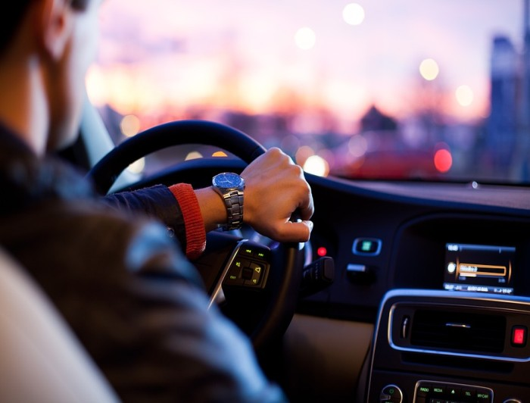
What makes up a driving task?
Lateral control - steering

Slide 7
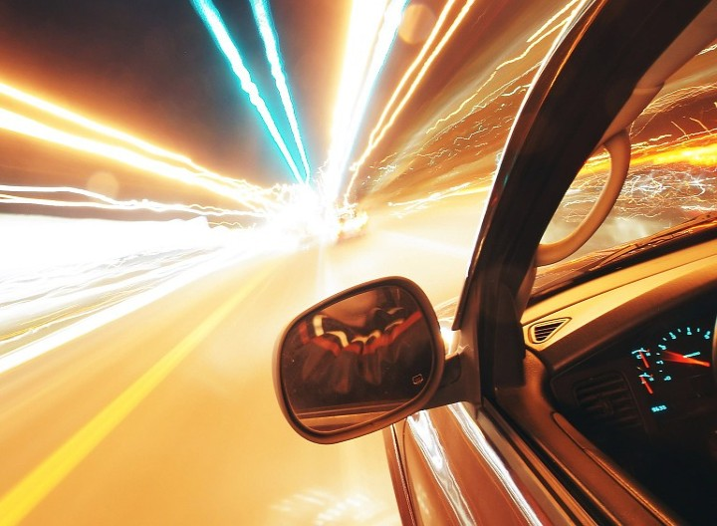
What makes up a driving task?
Lateral control - steering
Longitudinal control - braking, accelerating
7

Slide 8
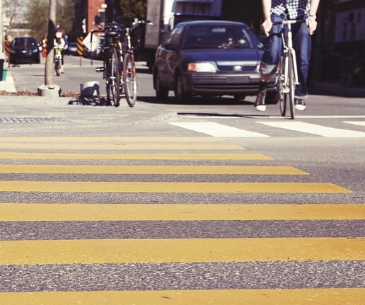
What makes up a driving task?
Lateral control - steering
Longitudinal control - braking, accelerating
Object and Event Detection and Response (OEDR): detection, reaction
8

Slide 9
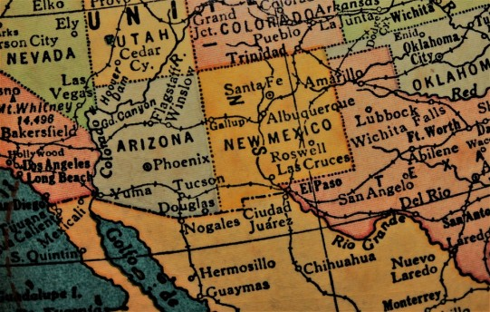
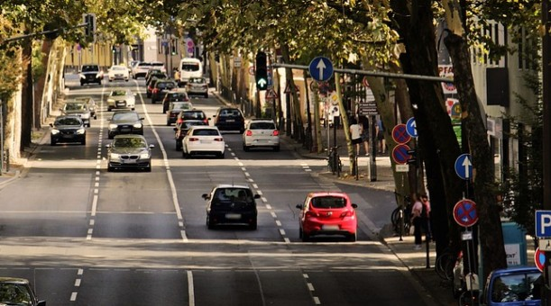
What makes up a driving task?
lateral control - steering
longitudinal control - braking, accelerating
object and event detection and response (OEDR): detection, reaction
planning
long term (route)
short term
例えばlane change, intersection crossing.
9

Slide 10
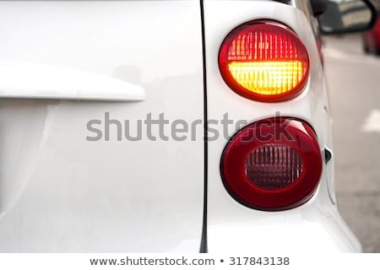
What makes up a driving task?
lateral control - steering
longitudinal control - braking, accelerating
object and event detection and response (OEDR): detection, reaction
planning
long term (route)
short term
Miscellaneous（雑多）
signaling with indicators. ウィンカー

Slide 11
Autonomous Capabilities
自動化レベルを決めるために参考する項目
Automated lateral control?
Automated longitudinal control?
OEDR
Automatic emergency response
Driver supervision
Complete vs Restricted ODD

Slide 12
Level 0 - No Automation
Regular vehicles, no automation

Slide 13


Level 1 - Driving Assistance
Lateral Control
Longitudinal Control
Either, but not both
Adaptive Cruise Control（クルーズコントロール）
can control speed, driver has to steer
Examples
Lane Keeping Assistance
can help you stay in your lane, if you drift

Slide 14
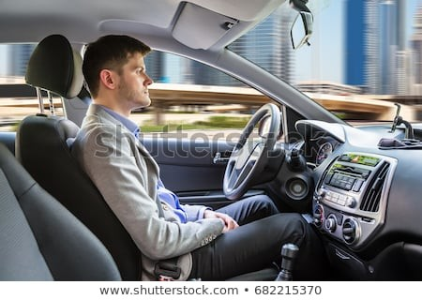
Level 2 - Partial Driving Automation
Lateral Control
Longitudinal Control
Both
GM Super Cruise
Nissan ProPilot Assist
...
Examples

Slide 15
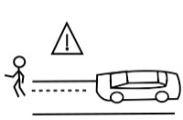
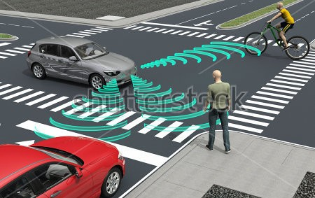
Level 3 - Conditional Driving Automation
in the case of failure the control must be taken up by the driver. This is a controversial level of automation as it is not always possible for an autonomy system to know when it is experiencing a failure.
Lateral Control
Longitudinal Control
OEDR
Includes automated object and event detection and response
Examples
Audi A8 Sedan
...

Slide 16
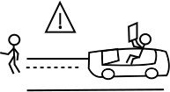
Level 4 - High Driving Automation
(fall 2018) only Waymo!
Lateral Control
Longitudinal Control
OEDR
フォールバック：システム設計において、障害が発生しても、必要最小限の機能を維持して処理を続けられるようにしようとする考え方のこと。
Fallback
Handles emergencies autonomously, driver can entirely focus on other tasks.
レベル４は完全に緊急事態を対応できるが、運転手自分で対応するのも可能。
Level 4 system can handle emergencies on their own but may still ask drivers to take over to avoid pulling over（路肩に寄せる） to the side of the road unnecessarily.
自動運転における「フォールバック 」とは、自動運転から運転の権限が運転者に 委譲（いじょう）されるまでの間、自動運転システムの機能を制限した状態で稼働させることを指す。

Slide 17
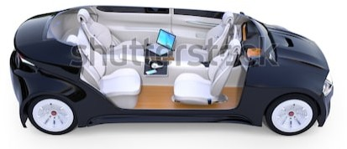

Level 4 - High Driving Automation
Lateral Control
Longitudinal Control
OEDR
Fallback
Example
1
7

Slide 18
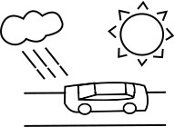
Level 5 - Full Driving Automation
Lateral Control
Longitudinal Control
OEDR
Fallback
Unlimited ODD

Slide 19
Limitations of this taxonomy
ODD and safety record are more important!
具体的なODDが含まれてないので、２つシステムが共 にlevel 4のADが実現できたと言っても、 ODD上の能力の差が大きい可能性もある。
It is possible for two car models to claim level 4 autonomy but have very different capabilities in ODDs.

Slide 20
Summary
Basic definitions
Driving task
Taxonomy requirements
Levels of automation, taxonomy

Slide 21
Requirements for Perception（認知）
Module 1, Lesson 2

Slide 22
Roughly ...
Analyze ego motion & environment (perception)
Decide on and plan a maneuver (planning)
Input
Drive

Slide 23
What is perception?
the quality of being aware of things through the physical senses, especially sight.
We want to make sense of the environment and ourselves
Two things:
o identification（識別）
o understanding motion（予測）
Why?
o to inform our driving decisions

Slide 24
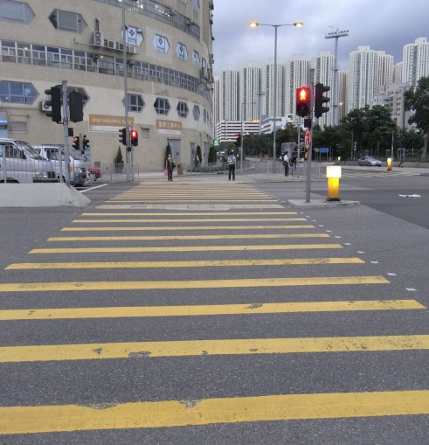
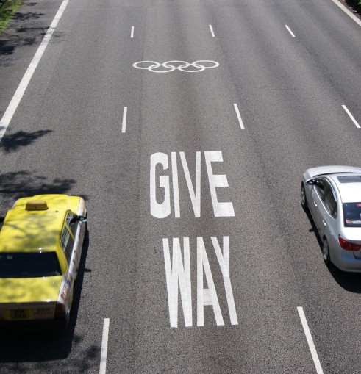
Goals for perception
Static objects
o Road and lane markings (on-road)

Slide 25
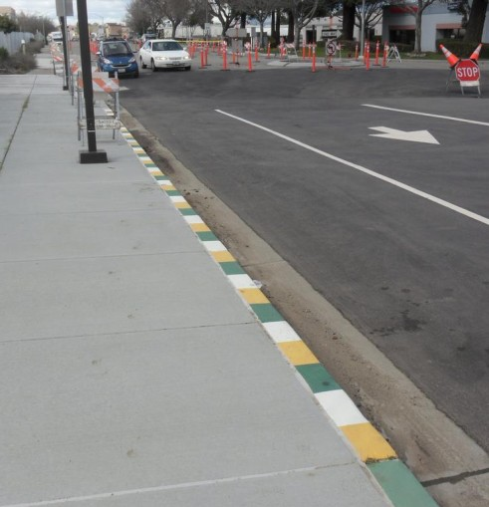
Goals for perception
Static objects
Road and lane markings (on-road)
Curbs（縁石、えんせき） (off-road)
curbs define the boundaries within which we can drive.

Slide 26
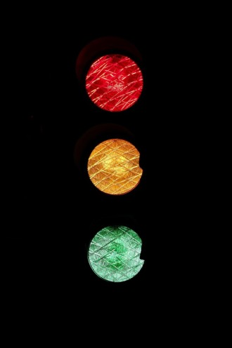
Goals for perception
Static objects
Road and lane markings (on-road)
Curbs (off-road)
Traffic lights (off-road)

Slide 27
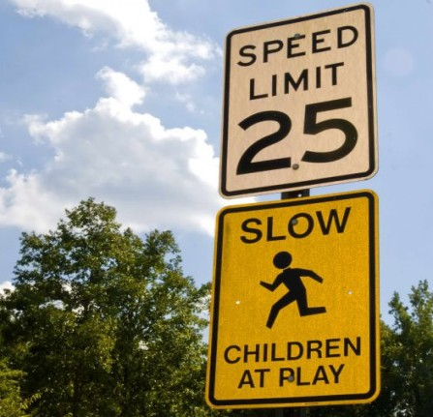
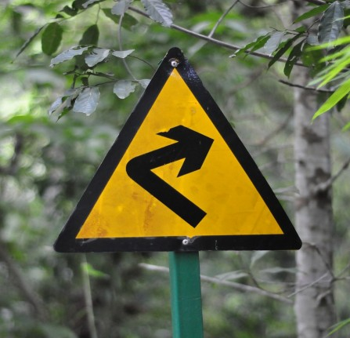
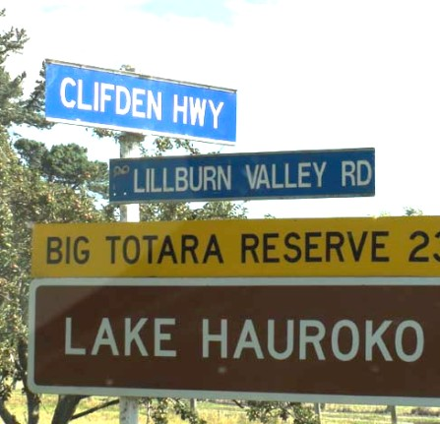
Goals for perception
Static objects
Road and lane markings (on-road)
Curbs (off-road)
Traffic lights (off-road)
Road signs (off-road)

Slide 28
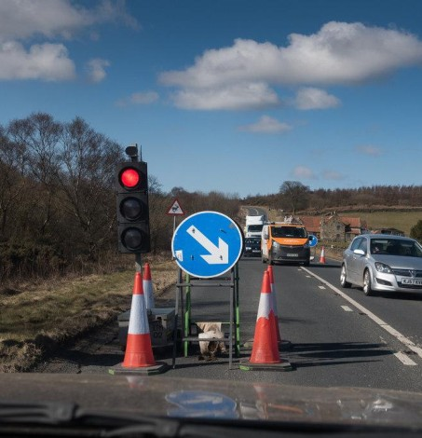

Goals for perception
Static objects
Road and lane markings (on-road)
Curbs (off-road)
Traffic lights (off-road)
Road signs (off-road)
Construction signs, obstructions（障害物）, and more (on-road)

Slide 29
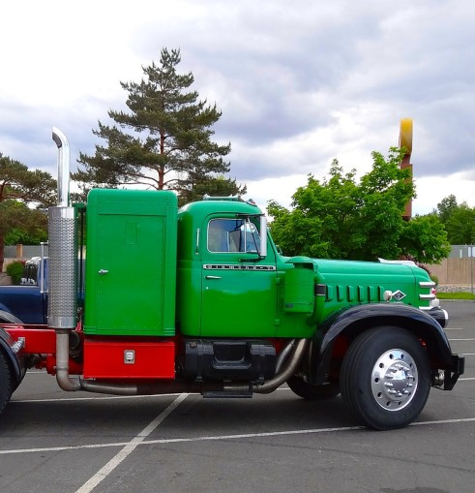
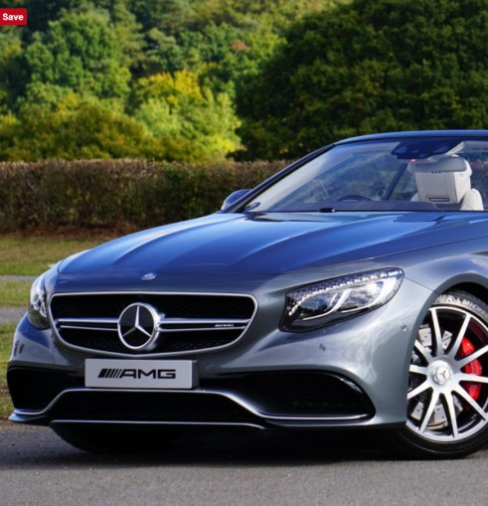
Goals for perception
Dynamic objects (on-road)
Vehicles
4 wheelers (cars, trucks …)

Slide 30
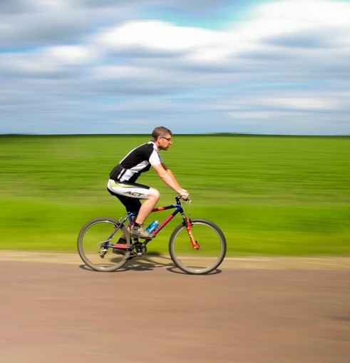

Goals for perception
Dynamic objects (on-road)
Vehicles
4 wheelers (cars, trucks …)
2 wheelers (motorbikes, bicycles, …)
16

Slide 31
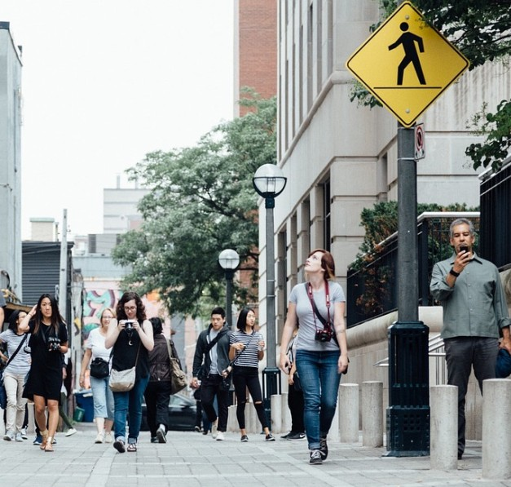
Goals for perception
Dynamic objects (on-road)
Vehicles
4 wheelers (cars, trucks …)
2 wheelers (motorbikes, bicycles, …)
Pedestrians

Slide 32
Goals for perception
Ego localization
Position
Velocity, acceleration
Orientation, angular motion

Slide 33

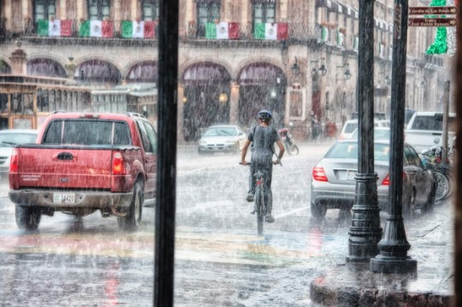
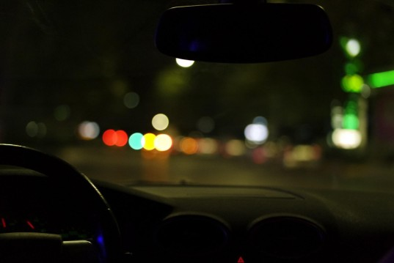
Challenges to perception
With more training data, our segmentation and detection models perform better and more robustly, but collecting and labeling data for all possible vehicle types, weather conditions, and road surfaces is a very expensive and time-consuming process.
Robust（壮健） detection and segmentation
Sensor uncertainty
Occlusion, reflection
Illumination（照明）, lens flare（レンズフレア）
Weather, precipitation（降水）
These can confuse perception methods with ambiguous information that is challenging to resolve into accurate estimates of object locations. ambiguous: 曖昧。
レンズフレア (lens flare) は、カメラによって写真・映像を撮影する際に、極めて明るい光源がレンズに向けて当てられている時や、画角内に極めて明るい光源が存在する場合に生じる、暗部（あんぶ）への光の漏れである。

Slide 34
Summary
Perception
Goals for perception
Static and dynamic elements, prediction
Ego localization
Challenges to perception
KITTI Vision Benchmark Suite: http://www.cvlibs.net/datasets/kitti/

Slide 35
Driving Decisions and Actions（計画）
Module 1, Lesson 3

Slide 36
Planning: Examples
Making decisions
Long term
How to navigate from New York to Los Angeles?
Short term
Can I change my lane to the lane right of me?
Can I pass this intersection and join the left road?
Immediate（即座、そくざ）
Can I stay on track on this curved road?（今の速度でこのカーブを通れるか）
Accelerate or brake, by how much?

Slide 37
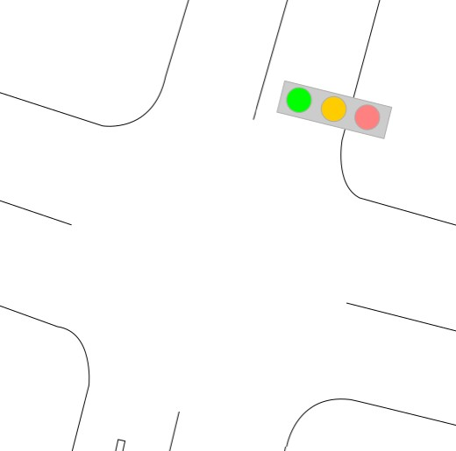
Example: Turning left at an intersection
Approaching an intersection to turn left.
Assume
o Intersection has traffic lights

Slide 38
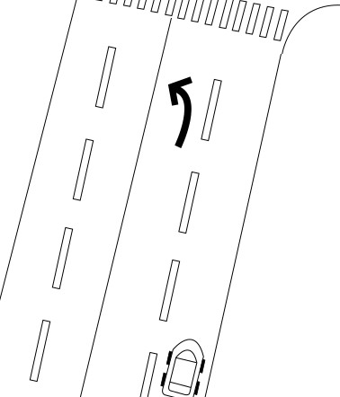
Example: Turning left at an intersection
Identify turning lane for left turn.

Slide 39
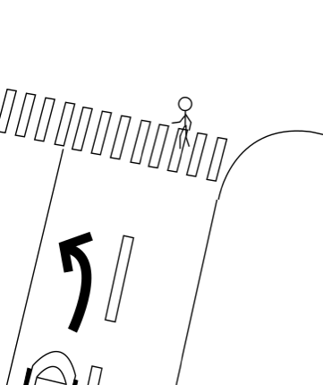
Example: Turning left at an intersection
Identify turning lane for left turn.
Approach the intersection, decelerate smoothly to the stop line.

Slide 40




Example: Turning left at an intersection
Identify turning lane for left turn.
Approach the intersection, decelerate smoothly to the stop line.
What if
Vehicle enters turn lane?
Pedestrians are crossing?

Slide 41
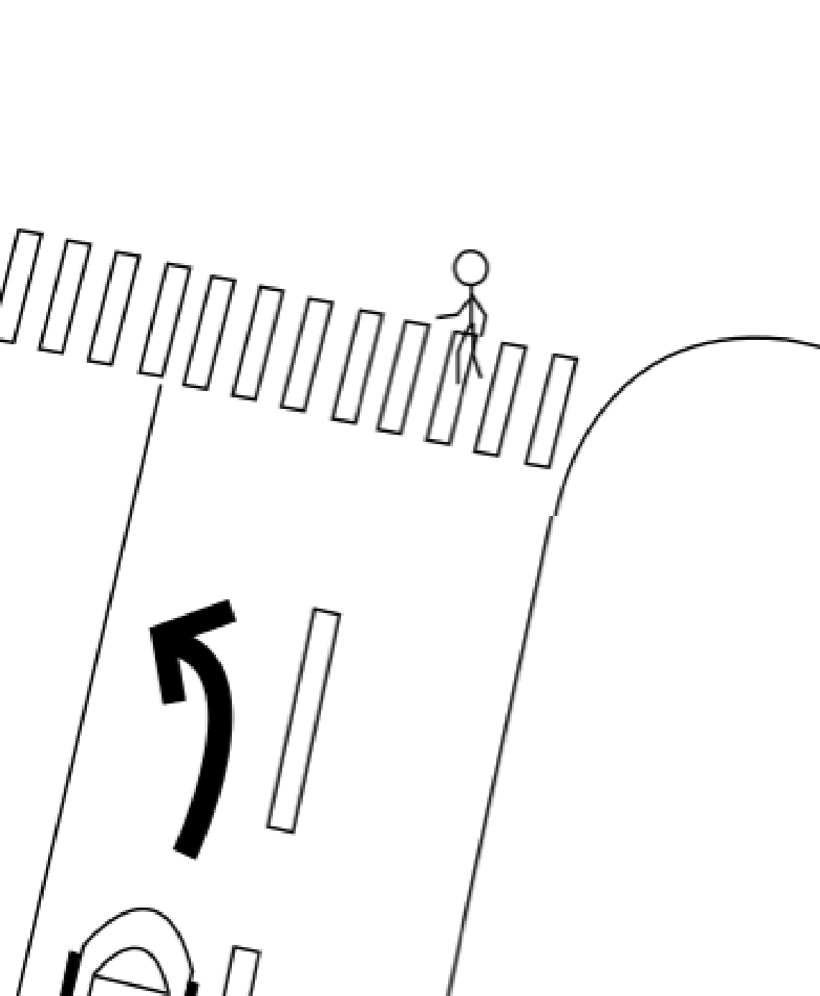

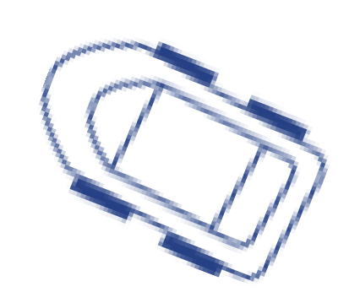






Example: Turning left at an intersection
Identify turning lane for left turn.
Approach the intersection, decelerate smoothly to the stop line.
What if
Vehicle enters turn lane?
Pedestrians are crossing?
There are cars behind you?

Slide 42
Example: Turning left at an intersection
This was a simple maneuver（操縦、そうじゅう）, yet it takes 3-4 levels of decisions and control to execute
Consider how many rules would it take to drive
o safely
o efficiently
o following all listed traffic rules
o only follow those rules everyone else is following!…（誰も守っているルールのみ守る）
Driving decision making is complicated!

Slide 43
Reactive（反応） Planning
What we just did was rule based planning
Involved decision trees!
In reactive rule based planning, we have rules that take into account the current state of ego and other objects and give decisions.
Examples:
If there is a pedestrian on the road, stop.
If speed limit changes, adjust speed to match it.
current stateのみを考える。将来は考えない。

Slide 44
Predictive Planning
predictive planning is the predominant（優勢な） method for self-driving cars, as it greatly expands the scenarios a vehicle can handle safely.
Make predictions about other vehicles and how they are moving. Then use these predictions to inform our decisions.
Example:
That car has been stopped for the last 10 seconds. It is going to be stopped for the next few seconds.
Pedestrian is jaywalking. She will enter our lane by the time we reach her.
ジェイウォークは、歩行者が、適切な交差点以 外の場所、または交通規則を無視して交通量 のある道路を歩いたり、横断したりしたとき に発生します。

Slide 45
Summary
Long term, short term, immediate planning
Simple intersection "making a left turn" scenario
Driving is hard!
Reactive planning, predictive planning
12

Slide 46
Module Summary
Paper: [2008] Autonomous driving in urban environments: Boss and the Urban Challenge. discusses one of the very early mixed planning systems. It was also the winner of the DAPRA Urban Challenge. https://onlinelibrary.wiley.com/doi/epdf/10.1002/rob.20255
Paper: [2016] A Survey of Motion Planning and Control Techniques for Self-Driving Urban Vehicles
https://ieeexplore.ieee.org/abstract/document/7490340
In this module,
Basic autonomous driving terminology（用語）
Taxonomy to characterize self-driving capabilities
The driving task and the major components of driving: perception, planning and execution.
The elements and agents in the environment we need to identify and track for perception.
Planning with its different horizons, and looked at some decision making approaches.
driving task; ODD.
static objects; dynamic object; ego localization.
short term, long term, immediate.
自動運転エンジニアになるため に ： fluent in C++ and Python
machine learning experience
be a proud software engineer about the quality of the code that you’re writing and you will do well.

