Slide 1


Safety Assurance for Autonomous Vehicles
Module 3

Slide 2
In this module ...
Autonomous vehicle crash reports（Uber人身事故）
Safety concepts
Hazard（危険） sources
Industry perspectives on safety
Safety frameworks for self driving

Slide 3
Safety Assurance for Self Driving
Module 3, Lesson 1

Slide 4
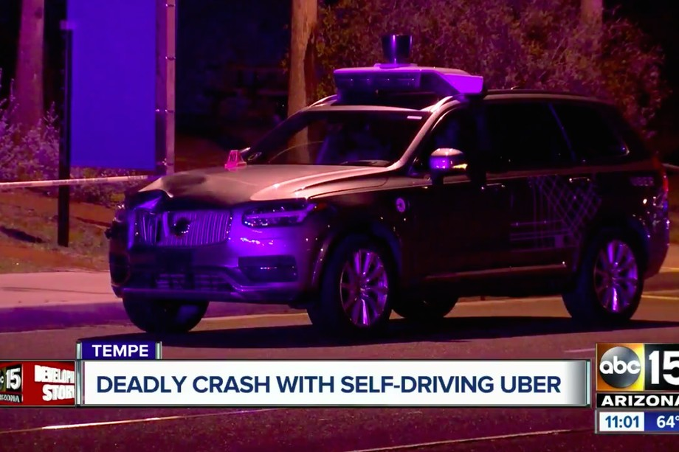
Examples of Automated Vehicle Crashes
Image Source: The Verge Based on NTSB Report (2018)
March 2018, Arizona

Slide 5
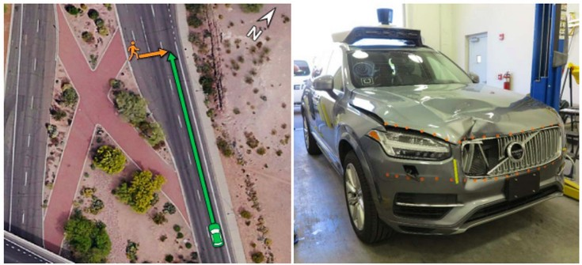
Uber Crash
Source: The Verge

Slide 6
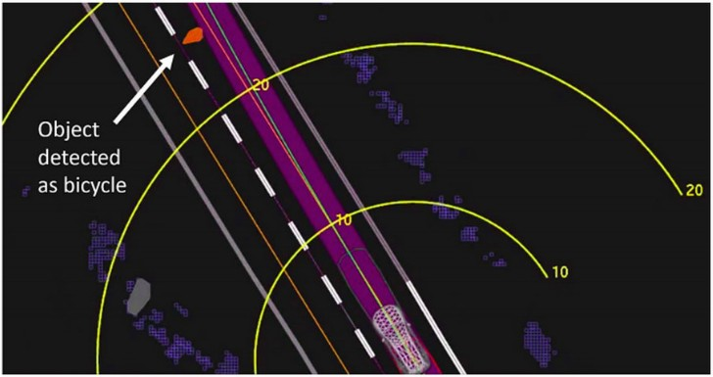
Uber Crash: Multiple Things Gone Wrong
失敗した点（できなかったところ）：
the perception system to correctly identify the pedestrian with a bicycle;
the planning system to avoid the detective object even though its class was uncertain;
the lack of human or emergency braking backup.
No real time checks on safety drivers
After the woman was detected on the road (6 sec before)
o first classified as unknown object
o then misclassified as a vehicle
o then a bicycle
1.3 sec before, Volvo(ボルボ) system tried to do emergency braking maneuver
o but Uber had disabled（無効にする） it for testing
in the end, the decision made by the autonomy software was to ignore the detections possibly because they were too unreliable
(理由：it is not safe to have multiple collision avoidance systems operating simultaneously during testing)

Slide 7



Basic Safety Terms
Harm
Risk
Probability Severity
Safety - “absence of unreasonable risk of harm（不合理な障害リスク）”
Hazard - “potential source of unreasonable risk of harm”

Slide 8








Major Hazard Sources
自動運転における「フォールバック 」とは、自動運転から運転の権限が運転者に 委譲（いじょう）されるまでの間、自動運転システムの機 能を制限した状態で稼働させることを指す。 多分フォールバックができるかどうかという ことでしょう。
Mechanical
Electrical
Hardware
Software
Perception
Planning
Fallback
Cyber

Slide 9




NHTSA: Safety Framework(12項目)
Systems engineering approach to safety
Autonomy Design
Testing & Crash Mitigation
Based on NHTSA: A Vision For Safety 2.0 (2017)

Slide 10




NHTSA: Autonomy Design
ODD
OEDR
Fallback
Traffic Laws
Cybersecurity
HMI
HMIで表示すべき項目（ユーザーを知らせるべきこと）：
(whether all sensors are operational,
what the current motion plans are, which objects in the environment are affecting our driving behavior…)

Slide 11





NHTSA: Testing & Crash Mitigation
https://www.nhtsa.gov/sites/nhtsa.dot.gov/files/documents/13069a-ads2.0_090617_v9a_tag.pdf
Crashes remain a reality of public road driving and autonomy systems that can minimize crash energy and exceed passenger safety standards in terms of restraints, airbags, and crashworthiness should be the norm.
simulation, close track testing, public road driving
Testing
Crashworthiness
Post crash
Entities engaging in testing or deployment should consider methods of returning ADSs to a safe state immediately after being involved in a crash.
Data recording
Consumer Ed
クラッシュ・ワージネス（英: crashworthiness） とは、飛行機や車両など、特にヘリコプター において、衝突の衝撃から乗員の安全性を確 保する性能のことである。

Slide 12
Summary
Autonomous driving accidents
Safety terms - harm, risk, hazard, safety
Major hazard sources
NHTSA safety framework
NTSB’s Report on the 2018 Uber Crash: https://www.ntsb.gov/investigations/AccidentReports/Reports/HWY18MH010-prelim.pdf
non-mandatory safety guidelines for autonomous cars in the NHTSA - Automated Driving Systems: A Vision for Safety 2.0 report: https://www.nhtsa.gov/sites/nhtsa.dot.gov/files/documents/13069a-ads2.0_090617_v9a_tag.pdf

Slide 13
Industry Methods for Safety Assurance & Testing
Module 3, Lesson 2

Slide 14
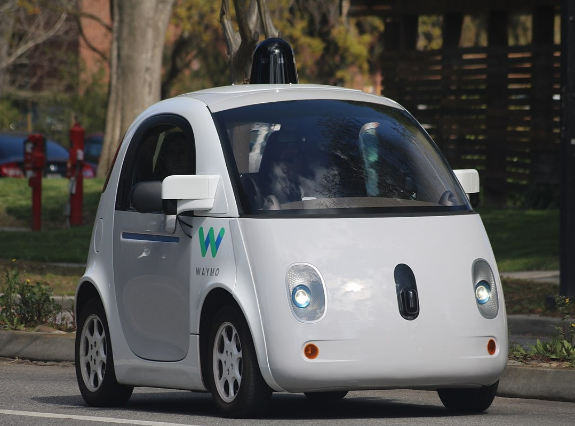
Waymo Safety Perspective
https://waymo.com/safety/
Based on Waymo Safety Report (2017)

Slide 15




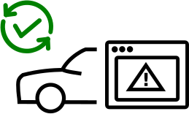

Waymo: Safety Levels
https://storage.googleapis.com/sdc-prod/v1/safety-report/Safety%20Report%202018.pdf
p11
Crash safety, or crashworthiness, refers to the ability of vehicles to protect passengers inside the vehicles through a variety of measures, ranging from a structural design that shields people inside, to features like seat restraints（シートベルト） and airbags that mitigate injury or prevent death. （クラッシュでも乗客を保護できるか）
Crash Safety
Behavioral safety refers to the driving decisions and behavior of our vehicles on the road.（自車の運転決定や行動が安全か）
Behavioral Safety
Operational Safety
(interfaces are usable, convenient, intuitive)
Functional Safety
Non collision
safety
system designs that minimize the danger to people that may interact with the system in some way, first responders（ファースト・レスポンダーとは災害や事故が起きた際に 最初に対応する警察や消防隊員）, mechanics（メカニック、整備員）, hardware engineers…
(backups and redundancies) - even if a fault or failure occurs, the car can switch to a secondary component or a backup process to minimize the severity of failures and return the vehicle to a safe state, continuing the drive if possible.

Slide 16
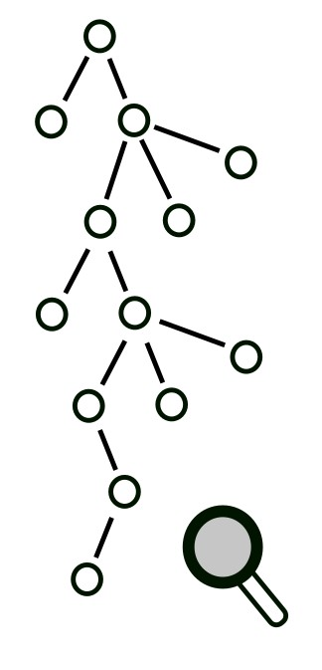
Waymo: Safety Processes
Identify hazard scenarios & potential mitigations
Use hazard assessment methods to define safety requirements
Preliminary(予備的) hazard analysis (PHA)
Fault tree
Design Failure Modes & Effects Analyses
Conduct extensive testing to make sure safety requirements are met
リスクアセスメント手法一覧：
https://thinkit.co.jp/cert/article/0607/11/1/table.htm
(top down) フォルトツリー解析
(bottom up) assess the effects of small subsystem failures on the overall capabilities of the system
これまでのハザードまたは故障の経験、知識を、将来、危害やハザードを招くおそれのある事象の特定を行い、さらに現時点で与えられている生産活動、施設、製品、システムの条件下でそれらが発生する可能性を特定する手法である。PHAは開発プロジェクトの初期段階で、設計の詳細や操作手順について情報がほとんどない場合に一般的に用いられる。

Slide 17
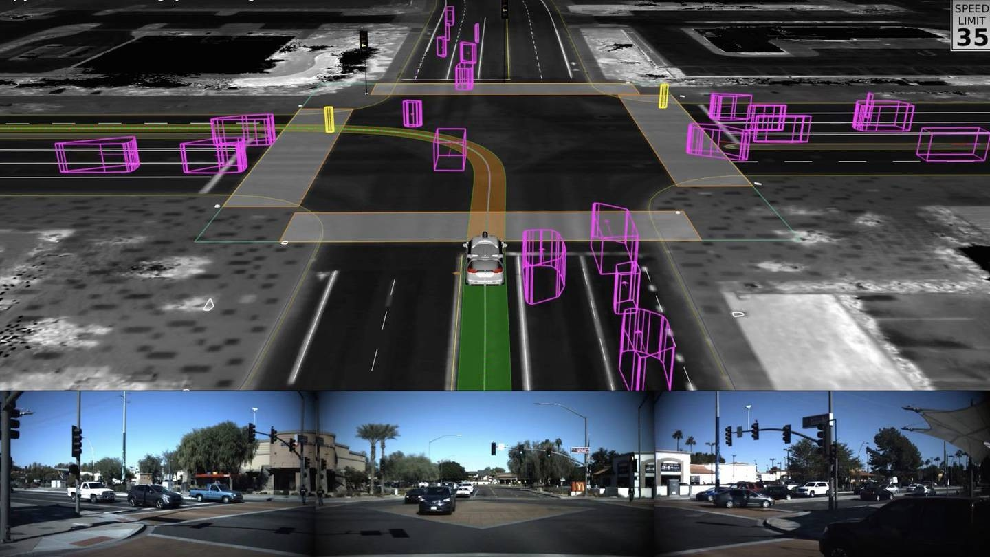
Waymo: Levels of testing to ensure safety
Waymoへの好評：the most publicly visible and well-documented program
Simulation testing: on the order of 10 million miles of simulation per day
- mine all of their on-road experiences for challenging scenarios and perform systematic scenario fuzzing, which changes the position and velocity parameters of other vehicles and pedestrians randomly.
- useful for finding hard edge cases.
Simulation testing
o Test rigorously with simulation, thousands of variations, fuzzing of neighbouring vehicles
ファジングとは、ソフトウェアの不具合（とく に脆弱（ぜいじゃく）性を意図することが多 い）を発見するためのテスト手法の一つであ る。ファズ（英語: fuzz）（予測不可能な入 力データ）を与えることで意図的に例外を発 生させ、その例外の挙動を確認するという方 法を用いる。ファズテストと呼ばれることも ある。

Slide 18
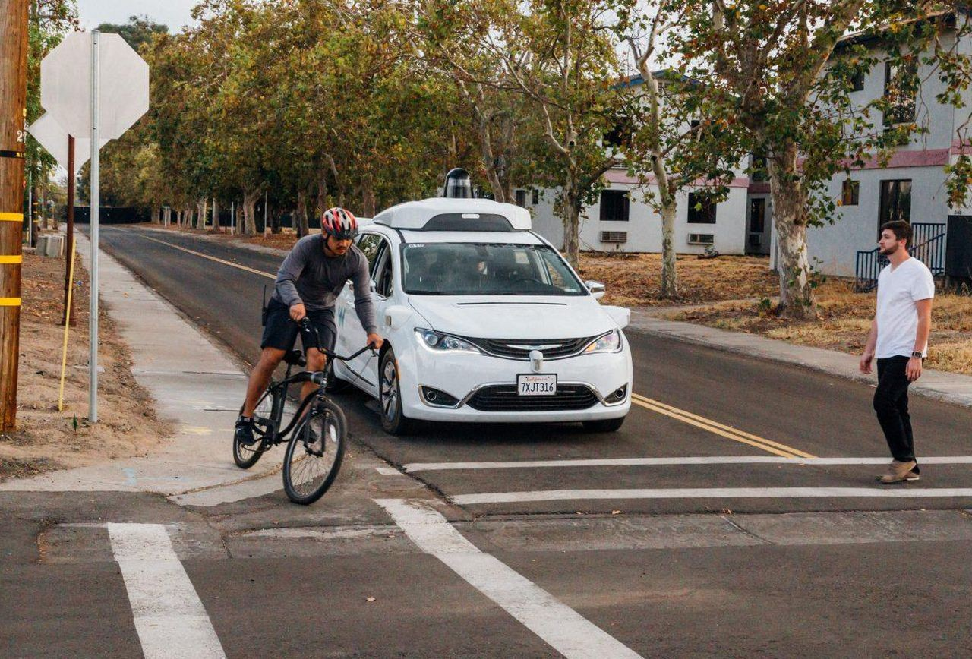
Waymo: Levels of testing to ensure safety
Closed-course testing（テストコース）
Follow 28 core + 19 additional scenario competencies on private test tracks
Focus on four most common crashes:
Rear-end(追突), intersection, road departure(車線逸脱、いつだつ), lane change
(84% crashes )

Slide 19
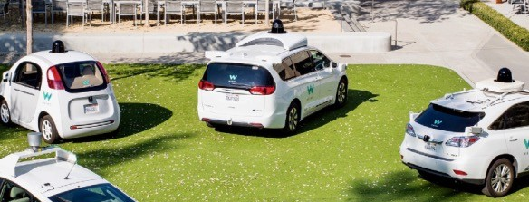
Waymo: Levels of testing to ensure safety
Real-world driving
Start with smaller fleet, expand steadily
Already testing thousands of vehicles, with more on the way.
increase public confidence in the technology

Slide 20

General Motors Safety Perspective
Based on GM Safety Report (2018)

Slide 21

GM: Safety
Address all 12 elements of NHTSA Safety Framework
Iterative Design
Analyze
Build
Improve
Simulate
Control car production!
Drive
(Waymo relies on OEMs to design its vehicles and only discuss mechanical and electrical hazards related to its autonomy hardware. GM manufactures their cars entirely themselves and so can enforce a more integrated design with consistent quality standards throughout the self-driving hardware.)
Waymoより強いポイント

Slide 22
GM: Safety
Safety through Comprehensive Risk Management and Deep Integration
o identify and address risks, validate solutions
o prioritize elimination of risks, not just mitigation（緩和だけじゃなく、リスクの排除を優先する）
All hardware, software systems meet
o self-set standards for performance, crash protection, reliability（信頼性、故障や障害などによるシステムの停止や機能不全の発生しにくさ）, serviceability（保守性、障害復旧やメンテナンスのしやすさ）, security, safety
Deep integrationはよくわからない

Slide 23

GM: Safety Processes
この3手法は「Safety Frameworks for Self Driving」で紹介する
Deductive（演繹的、えんえき） Analysis
fault tree analysis
Inductive（帰納的、きのう） Analysis
Design & Process FMEA
Exploratory（探索的） Analysis
HAZOP: Hazard & Operability Study
通常状態からのズレ（設定の温度や濃度）が発生した場合にその原因と発生する結果の事象を特定する。

Slide 24
GM: Safety Thresholds
All GM vehicles are equipped with two key safety thresholds:
Fail safes（失敗しても安全） - There is redundant functionality (second controllers, backup systems etc) such that even if primary systems fail, the vehicle can stop normally
SOTIF - All critical functionalities are evaluated for unpredictable（予測不可能な） scenarios

Slide 25
GM: Testing
Performance testing at different levels
Requirements validation of components, levels
Fault injection（注入） testing of safety critical functionality
Intrusive（侵入的） testing such as electromagnetic（電磁、でんじ） interference（干渉、かんしょう）, etc.
Durability testing and simulation based testing
Is it really possible to truly precisely assess whether an autonomous car is safe? Or at least safer than a human driver?

Slide 26
Analytical vs Data Driven: Definitions
- example: Space Shuttle（スペースシャトル ） programのanalytical failure rates
- results need to be validated through experience(data driven).
Analytical Safety
Ensuring the system works in theory and meets safety requirements found by hazard assessment
Data driven safety
Safety guarantee due to the fact that the system has performed autonomously without fail on the roads for a very large number of kms
these desired failure rates can be tied to human level driving performance.

Slide 27
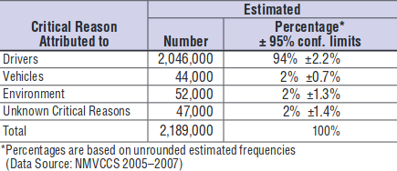
Are autonomous cars safer?
逆にhumans are also extremely good at driving, and indeed, the entire driving environment has been designed based on human perception and planning abilities.
Driving is still dangerous!
Car accidents are mostly caused due to human errors (NHTSA Report, 2015)
In US, on average
1 fatal collision per 146 million（1億以上） km
1 injury collision per 2.1 million km
~ 1 collision per 400,000 km
(90%) a lack of judgement, a failure of human perception

Slide 28

Are autonomous cars safer?
Disengagement: when either this autonomy software requests the driver to take over control or the safety driver feels the need to intervene（介入する）.
Consider California disengagement rates:
In 2017, Waymo had
Driven 563,000 km autonomously in California
63 disengagements
1 disengagement every 9,000 km
In 2017, GM had
Driven 210,000 km autonomously in California
105 disengagements
1 disengagement every 2,000 km
disengagement状況の分類：
- unwanted vehicle maneuvers
- perception discrepancy（食い違い、相違）
- hardware issue
- software issue
- behavior predictions
- reckless（無謀、むぼう: doing something dangerous and not worrying about the risks and the possible results） road user (1 case)

Slide 29
The Dilemma
Question: How many miles (years) would autonomous vehicles have to be driven to demonstrate with 95% confidence their failure rate to within 20% of the true rate of 1 fatality per 146 million km?
Answer: ~400 years, with a fleet of 100 vehicles travelling all the time (total ~8 billion miles)
o [How Many Miles of Driving Would It Take to Demonstrate Autonomous Vehicle Reliability? (Kalra et al., 2016) ]

Slide 30
Summary
Waymo Safety Report https://waymo.com/safety/
GM Safety Report https://www.gm.com/content/dam/company/docs/us/en/gmcom/gmsafetyreport.pdf
あとUber, FordのSafety Report
Industry perspectives
Waymo - 5 safety levels, processes, testing
GM - iterative design, processes, testing
Data driven safety
Disengagement rates and road testing requirements

Slide 31
Safety Frameworks for Self Driving
Module 3, Lesson 3

Slide 32
In this lesson, we will cover
Generic Safety Frameworks
Fault Trees, FMEA, HAZOP
Autonomous/Automotive Safety Frameworks
Functional Safety, Safety of Intended Functionality

Slide 33


Car crash
Generic Safety Frameworks
Fault Tree Analysis
Top down deductive failure analysis
Boolean logic
Software Failure
OR
Hardware Failure
Manufacturing
defects(欠陥、けっかん)
Bad code
Hacked!

Slide 34
Probabilistic Fault Tree Analysis
Assign probabilities to fault “leaves”
Use logic gates to construct failure tree
- assign probabilities of occurrence per hour or per mile of operation
P(A) + P(B)
P(A) ᐧ P(B)
AND
OR
P(A)
P(B)
P(A)
P(B)

Slide 35
Failure Mode and Effects Analyses (FMEA)
Bottom up process to identify all the effects of faults in a system
Failure Mode
Modes or ways in which a component of the system may fail
Effects Analysis
Analyzing effects of the failure modes on the operation of the system

Slide 36
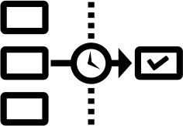
FMEA: Idea
Categorize failure modes by priority
How serious（深刻さ） are their effects?: Severity(S)
How frequently do they happen?: Occurrence(O)
How easily can they be detected?: Detection(D)
Eliminate or reduce failures, starting with top priority

Slide 37



FMEA: Steps
2. question the purpose of the system and list all failure possibilities
List failure modes
3
2
For each failure mode
Discuss with field experts
1
6
identify effects
Create FMEA table
RPN = S ᐧ O ᐧ D
Severity? (S)
4. For each consequence, identify the possible root causes; for each root cause, assign Occurrence (O, 1~10)
5
For each root cause
For each prevention method
5. identify all the ways in which the failure mode can be detected by operator, maintenance, inspection, or a fault detection system. overall mode detection likelihood before it can causes an effect, Detection (D, 1~10, 10: impossible to detect)
4
Detection? (D)
Occurrence? (O)

Slide 38
FMEA: Example
Consider following failure mode
System encounters gravel（砂利、じゃり）, controller failure
Severity: physical crash (S=10)
Occurrence: whenever construction encountered, out of ODD, so somewhat likely (O=4)
Detection: can check status monitor to identify if this happens with certainty (D=10)
Risk priority number (RPN) = 10x4x10 = 400
簡単に検知できる。簡単に検知できればDは小さいはず。 https://en.wikipedia.org/wiki/Failure_mode_and_effects_analysis

Slide 39
FMEA: Example
Similarly there could be other failure modes, for example:
Sign perception failure (RPN = 100)
GPS synchronization failure (RPN=300)
Incorrect motion prediction (RPN=150)
Final RPN List:
Control failure
GPS failure
Motion prediction
Sign perception

Slide 40
HAZOP – a variation on FMEA
- HAZOP is more of a qualitative process as compared to FMEA (quantitative).
- HAZOP is often used earlier in the design process to guide the conceptual design phase.
Hazard and operability（操作性） study (HAZOP)
Qualitative brainstorming process, needs “imagination”
Uses guide words to trigger brainstorming (guide wordsの例：not, more, less etc.)
Applied to complex 'processes'
o Sufficient design information is available, and not likely to change significantly

Slide 41
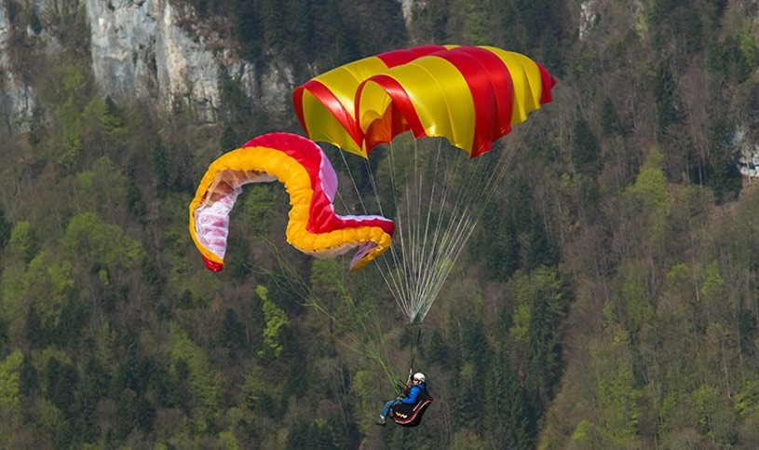
Automotive Safety Frameworks
ISO 26262 - Functional Safety Standard
ISO/PAR 21448.1 – Safety of the Intended Functionality
Functional Safety is defined as:
o safety due to absence of unreasonable risk
o only concerned about malfunctioning（故障） system
ISO 26262 defines Automotive Safety Integrity Levels (ASIL)
o ASIL-D most stringent, ASIL-A least stringent

Slide 42





























Functional Safety Process
Summary Functional Safety Assessment
Requirements Specification
System Integration and V&V
Design-phase verification
Software Integration（統合） and testing
Distinction between:
- Validation testing (Are we building the right product?)妥当性確認する
- ensure that the product actually meets the user’s needs and that the specifications were correct in the first place
ユーザー要望を満たせているか
- Verification testing (Are we building the product right?)検証する
- ensure that the product is being built according to the requirements and design specifications
設計通り実現しているか。
Architectural design
Design-phase verification
Unit design & implementation
Unit testing
ISO 26262

Slide 43






























Functional Safety Process
Summary Functional Safety Assessment
Hazard and Risk Assessment (HARA)
Requirements Specification
System Integration and V&V
Design-phase verification
Identify（識別） faults
(FMEA or HAZOP)
Architectural design
Software Integration and testing
Identify scenarios
(ODD)
Design-phase verification
Assess risks
Unit design & implementation
Unit testing
Define worst-case scenarios
Main idea behind functional safety: focus on worst-case requirements and then implement hardware and software that can at least handle these worst-case requirements.
ISO 26262

Slide 44
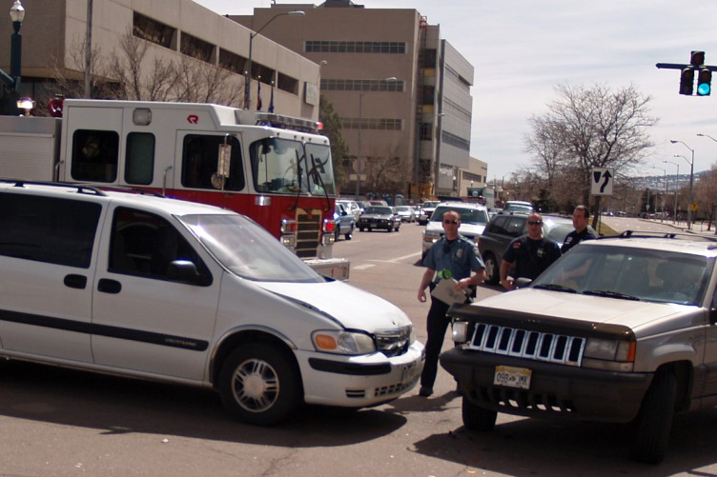
Safety of the Intended Functionality (SOTIF)
ISO/PAS 21448.1
Failures due to performance limitations and misuse
Sensor limitations
Algorithm failures / insufficiencies
User misuse – overload（過負荷）, confusion, overconfidence
Designed for level 0-2 autonomy
Extension of FuSa（機能安全の拡張）
V-shaped process
Employs HARA

Slide 45
Summary
FMEA (failure mode and effects analysis):
https://asq.org/quality-resources/fmea
Function Safety for Road Vehicles: ISO 26262-1:2018（システム、hardware and softwareに関する安全） https://www.iso.org/standard/68383.html
Road Vehicles - Safety of the intended functionality: ISO/PAS 21448:2019（limitations and misuse に関する安全） https://www.iso.org/standard/70939.html
RAND Corporation Report on Driving to Safety How many miles of driving would it take to demonstrate autonomous vehicle reliability? https://www.rand.org/pubs/research_reports/RR1478.html
Simple analytic frameworks
o fault trees and probabilistic fault trees
Failure modes and effects analysis
Functional safety frameworks
FuSa HARA - safety requirements through risk analysis
SOTIF – behavior risk assessment
Many of us would have known family members or people who’ve had an accident whilst driving a car. That’s a bad thing but after that accident, your neighbor doesn’t necessarily get a better driver.
But with driverless cars in 20 years time, I’ll be able to get into driverless cars that have the benefit of all the miles the other driverless cars have ever driven, and we exactly don’t have that with humans.
So there’s so many reasons why we want to fix transports in cities and when you’re in a plane and you look down out of a window, look how much of the infrastructure that we have built on our nations is because we want to move stuff.
Address hazards in:
- design
- implementation
- operation
Example, Difference from Aerospace:
In aerospace you have a pilot who is highly trained and essentially the automation does all the easy medium staff, pilot is still there for all the hard staff. In self-driving case, we want to essentially automate everything.

Slide 46
Module Summary
Motivation for safety
Formal definitions for safety concepts
NHTSA safety recommendations, 2017
Waymo and GM safety perspectives
Analytical and data-driven assessment
Common safety assessment frameworks
12個安全項目

