Slide 1

Vehicle Longitudinal Control
コース１Module 5

Slide 2









•
o o
o
線型時不変
比率P, 積分I, 微分D
フィードフォワード制御、フィードバック制御

Slide 3







Slide 4


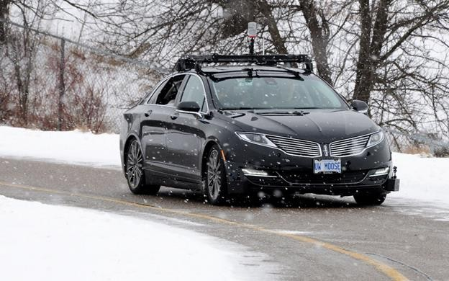





Regulate some of these states of the vehicle by sensing the current state variables and then generating actuator signals to satisfy the commands provided.
For longitudinal control, the controller senses the vehicle speed and adjust the throttle and brake commands to match the desired speed set by the autonomous motion planning system.
予測した状態と測量した状態をフュージョンした自車状態に基づいて、計画したプロファイルに近づくように、コマンドを出す（僕の理解）
actuator signal
運転手が運転する場合のみ（僕の理解、自動運転の場合はreference速度などがinput）
状態予測（僕の理解）
風、路面、車両負荷
Kinematic, Dynamicモデルの機能：
These models aim to capture how the dynamic system reacts to input commands from the driver such as steering, gas and brake, and how it reacts to disturbances（擾乱、じょうらん） such as wind, road surfaces and different vehicle loads.
The effects of the inputs and disturbances on the states such as velocity and rotation rate of the vehicle are defined by the kinematic and dynamic models we developed. コマンド・擾乱に対して、状態（速度、回転率）がどう変わるか。

Slide 5









The controller can be seen as a mathematical algorithm that generates actuator signals so that the error signal is minimized and the plant state variables approach the desired state variables.
Reference Inputs
G_{c} s
Outputs (State Variables)
補償器
Error
Actuators
+
-
The output estimates are compared to the desired or reference output variables, and the difference or error is passed to the controller.
outputs are measured by sensors.
estimators are used to fuse measurements into accurate output estimates.
つまり測量値は真値とは限らない
カルマンフィルタを利用するでしょう、コース2で紹介する

Slide 6











Laplace transform（ラプラス変換）を使う理由：allow easier analysis of an input-output relation and is useful in understanding control performance.
Having the controlled system components written in Laplace form makes it easier to determine the transfer function of the system.（各部分がLaplace formを使えば、結合してシステム全体のLaplace formを出すのが簡単。P13 Closed-loop responseの式から分かる）
•
o o o
•
o
state-space form: track the evolution of an internal state to connect the input to the output
transfer function: model the input to output relation directly. （state-space formだと、stateを経由しないといけない）
利用条件：the system must be linear and time-invariant
伝達関数
Plantだけじゃなく、Controllerでも伝達関数法を利用している
𝑌 𝑠 =G(s)U(s)
𝑠 = 𝜎 + 𝑗𝜔
complex variable（複素数）
transfer functionの2 form: polynomial（多項式） or factorized (zero-pole-gain, 零点-極（きょく）-ゲイン) form
ここはzero-pole-gain (factorized) form is used.
o
𝑁 𝑠
𝑌 𝑠 = 𝐺 𝑠 𝑈 𝑠 =
𝑈(𝑠)
𝐷 𝑠
o
分子
分母
https://www.mathworks.com/help/control/ug/transfer-functions.html

Slide 7








simple: constant gain multiplication（PID制御）, lookup tables, linear equations
complex: non-linear functions and optimization over finite prediction horizons （MPC制御）
•
•
o
o
•
o
o
進み遅れ
Particularly useful for non-linear system models, time-varying models, or models with constraints that limit output selection.
後退
モデル予測制御
https://jp.mathworks.com/discovery/model-predictive-control.html
Optimization-based methods are heavily used in autonomous driving

Slide 8







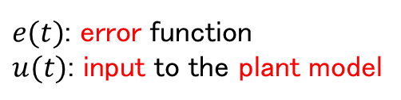
•
Not all gains need to be used for all systems. If one or more of the PID gains are set to zero, the controller can be referred to as P, PD or PI.
𝑢 𝑡
𝐾_{𝑃} 𝐾_{𝐼}
= 𝐾_{𝑃}𝑒 𝑡
𝐾_{𝐷}
$e(t)$: error function
$u(t)$: input to the plant model
second-order numerator（2次多項式）なので、rootは2つあるのだ！つまり2つzerosだ。
•
𝐾
この式から明らかにLaplace domainの式がtime domainの式より便利だのはすぐ分かれるだろう：a single transfer function for PID control.
この式はtime domainの式と逆のようだね
Multiplying s in the Laplace domain is equivalent to taking a derivative in the time domain.
Dividing by s is equivalent to taking the integral.
𝑈 𝑠
= 𝐺 𝑠 𝐸 𝑠 = 𝐾 +
𝐼
+ 𝐾 𝑠
𝐸 𝑠
𝑐
𝑃
𝑠
𝐷
𝐾_{𝐷}𝑠² + 𝐾_{𝑃}𝑠 + 𝐾_{𝐼}
two zeros added
=
𝐸 𝑠
𝑠
one pole added

Slide 9









𝐾_{𝐷}𝑠² + 𝐾_{𝑃}𝑠 + 𝐾_{𝐼}
two zeros added
𝐺_{𝑐} 𝑠 =
𝑠
one pole added
•
•
•
•
複素平面
to achieve the desired output or performance based on the model for the plant

Slide 10

















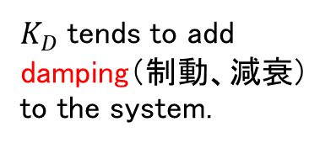
入力信号がシステムに入った後,出力信号が安定状態値を中心とした5%範囲の中におさまるまでに要する時間
denotes the response of a system when the controller decides the inputs to apply to the plant model.
the time it takes to reach 90% of the reference value
the maximum percentage the output exceeds this reference
the time to settle to within 5% of the reference
the error between the output and the reference at steady-state.
立ち上がり時間
行き過ぎ
落ち着き時間
定常偏差
$K_{D}$ tends to add damping（制動、減衰） to the system.
このtableについての解説：下記のページは講師の解説より良い
http://ctms.engin.umich.edu/CTMS/index.php?example=Introduction&section=ControlPID

Slide 11
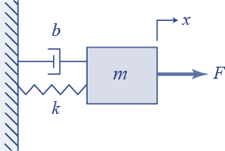










Plant system
$$m\ddot{x} + b\dot{x} + kx = F,$$
𝑥 0 = 0
自乗
𝑚𝑠²𝑋 𝑠 + 𝑏𝑠𝑋 𝑠 + 𝑘𝑋 𝑠 = 𝐹(𝑠)
a second-order system with two poles defined by the mass, spring constant（ばね定数） and damping coefficient（減衰係数）.
Fはinput, Xはoutput
𝑋 𝑠 1
= =
𝐹 𝑠 𝑚𝑠² + 𝑏𝑠 + 𝑘
𝐺 𝑠

Slide 12


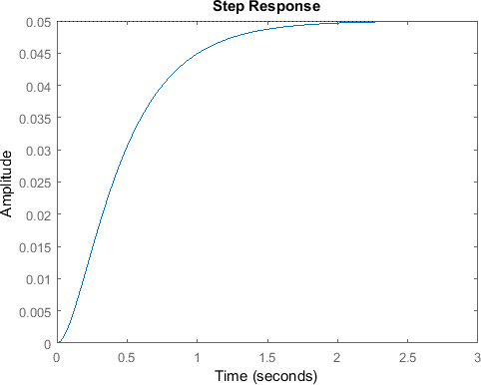
To evaluate the system characteristics, we excite the system by using a unit step input.
This is normally the first step to evaluate the dynamic characteristics of a plant.
This response is called the open-loop response since there is no controller applied to the system at this point.（controllerがなかったら、フィードバックもいらないので、loopはいらない）
•
Plantのみ、Controllerまだ追加していない
controllerは２つ機能があると思う：
plant systemは固定なので、inputとoutputの関係も固定。controllerを追加することで、inputとoutputの関係を最適化できる。
行動計画が生成したreference（速度）をplantのinput（Throttleなど）に変換できる。
Y(s)
Input
Output

Slide 13






𝐻 𝑠 = 1
定義：If a controller is added to the plant and the output of the model is measured and compared with the desired output or reference signal.
The poles of the open-loop system define the characteristics of the closed-loop response.
•
𝑌 𝑠
𝐺 𝑠 𝐺_{𝑐} 𝑠
1 + 𝐺 𝑠 𝐺_{𝑐} 𝑠
=
𝑅 𝑠
G_{c} s
𝑌 𝑠
𝑅 𝑠
+
-

Slide 14





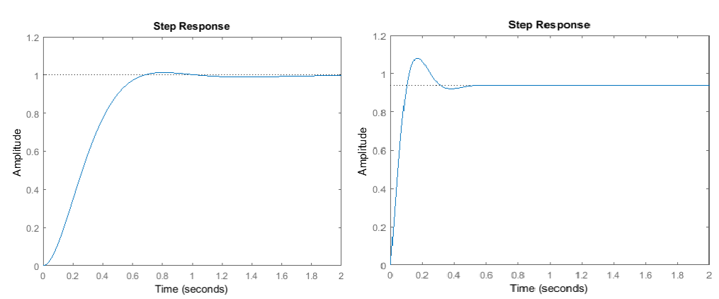
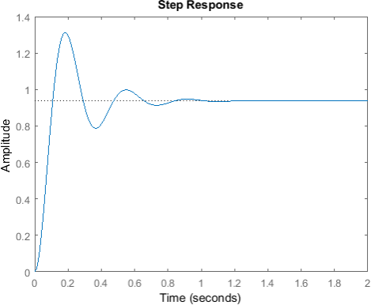




まだcontrollerだけのstep responseをテストしている、controller+plantのstep responseは次のスライド。
結論：The simple PI control is an excellent design for the spring-mass damper system.
a fast rise time, significant overshoot and prolonged oscillation（振動） leading to a long settling time.
improves the step response in terms of overshoot and settling time but slows down the rise time.
maintains a short rise time and is able to reduce oscillations and overshoot leading to a fast settling time as well.

Slide 15
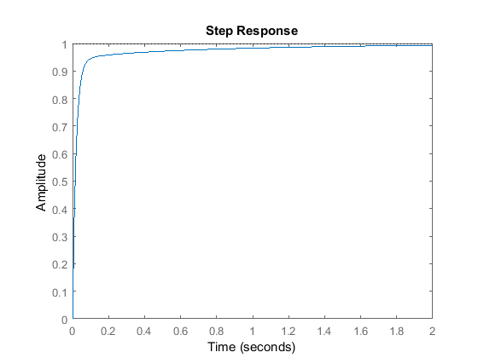

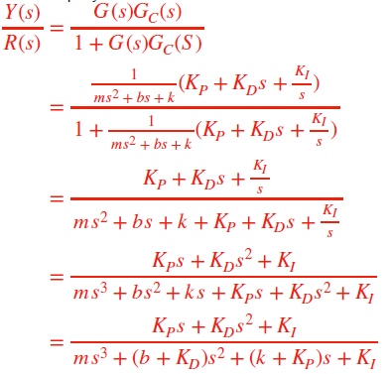


•
𝐾
𝐺 𝑠 = 𝐾 + 𝐾 𝑠 +
𝐼
𝑃𝐼𝐷
𝑃
𝐷
𝑠
•
𝐾_{𝐷}𝑠² + 𝐾_{𝑃}𝑠 + 𝐾_{𝐼}
^{𝐺}𝐶𝐿
𝑠 =
𝑠³ + 10 + 𝐾_{𝐷} 𝑠² + 20 + 𝐾_{𝑃}
𝑠 + 𝐾
𝐼

Slide 16


•
•

Slide 17


Slide 18













The path and the speed profiles are the reference inputs needed by our controllers.
For both the lateral and longitudinal control of an autonomous vehicle, the only task that needs to be performed is to follow the plan as precisely as possible, and thereby minimize the error between the actual and reference path and speed.
Reference velocity
Reference position in X-Y
Longitudinal Velocity
Throttle angle
Brake position
Steering angle

Slide 19




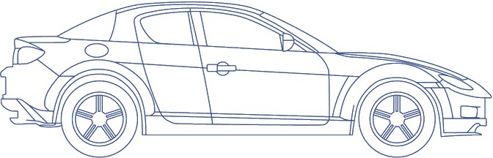



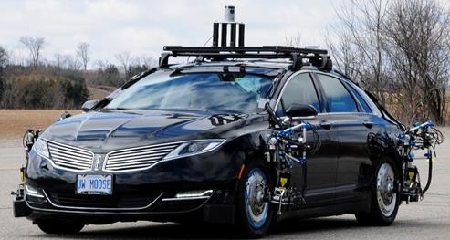







定義：A cruise control system performs the function of maintaining a fixed reference speed using throttle commands, and accelerating or decelerating to a new reference speed as requested by the driver. When the vehicle is subjected to different loads and resistances, the throttle angle will be changed by the cruise controller accordingly. High and low-level control structure based on PID and engine maps.
バリアント：
Adaptive（適応） cruise control: can vary the reference point based on measurements of a lead vehicle
semi autonomous system, like traffic jam assist: can operate throughout the vehicle speed range and create spacing gaps for merging vehicles.
•
+ ₋
The low level controller gets the vehicle acceleration and generates a throttle or braking actuation to track the reference acceleration.
two-stage approachの効果：allows us to go beyond just PID control and impose limits or profiles directly on the accelerations that are requested of the vehicle in order to maintain speed.
The low level controller is not essential to the control task.
The high level controller takes the difference between the set point velocity and the vehicle actual velocity, and generates the desired vehicle acceleration to close the gap.

Slide 20

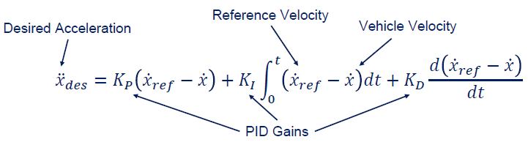


疑問：伝達関数使わないの？伝達関数だったら、どう実装するだろう？
実装：To implement such a controller in software, we discretize（離散化） the controller
積分部：changing the integral to a summation over a fixed length time steps.
微分部：The derivative term can be approximated with the finite difference over a fixed time step if either the reference acceleration or the estimated vehicle acceleration is not available. 加速度があれば、加速度の差を利用する。なければ、速度の差を利用する。
•
+ ₋

Slide 21




only throttle is needed to manage the speed of the vehicle during cruise control, and that the driver will take over（引き継ぐ） if braking is required to avoid an incident.
•
o
•
o o o
operate in gear 3 or higher such that the torque converter is locked, meaning that torque from the engine passes directly to the transmission without loss.
as cruise control motions are typically gentle.
+ ₋

Slide 22






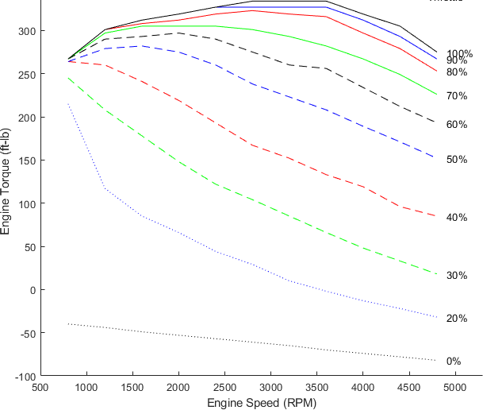


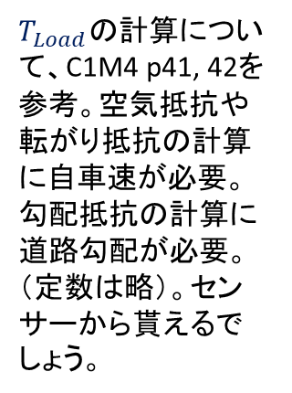
The low-level controller seeks to generate the desired acceleration from the high level controller by increasing or decreasing the torque produced by the engine.
The desired acceleration is translated to a torque demand, and the torque demand is then converted to a throttle angle command.
The steady-state engine map: generated in testing the engine at different operating points- In these standard maps, the desired engine torque and the current engine RPM define the required throttle position, and can be interpolated if needed. - This approach is a data-driven approximation, but it works quite well in practice.
$T_{Load}$の計算について、C1M4 p41, 42を参考。空気抵抗や転がり抵抗の計算に自車速が必要。勾配抵抗の計算に道路勾配が必要。（定数は略）。センサーから貰えるでしょう。
Engine Maps
Vehicle Drivetrain Dynamics (Previous Module)
𝐽_{𝑒}
𝑇
𝐸𝑛𝑔𝑖𝑛𝑒
=
$${\ddot{x}}_{des}+T_{Load}$$
(𝑟_{𝑒𝑓𝑓})(𝐺𝑅)
C1M4 p42のLongitudinal acceleration式＋p44のEngine dynamic model式

Slide 23











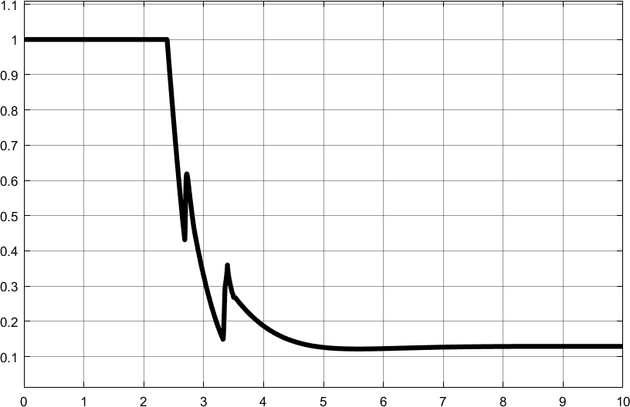
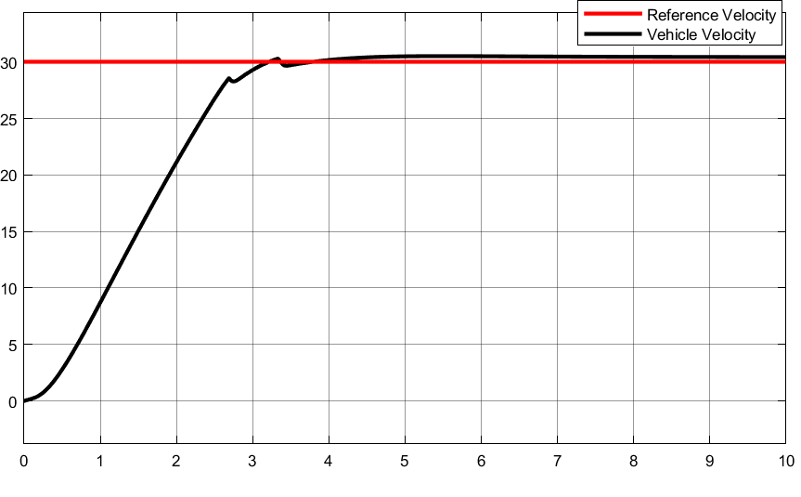



Because of the engine map non-linearity, we see some interesting artifacts in the vehicle response as it closes in on the reference speed.
You’ll see even more interesting effects in the simulated vehicles in Carla during the final assessment for this course, with gear changes causing big challenges for pure PID control.
+ ₋

Slide 24


•
•

Slide 25



Slide 26














Slide 27








You can think of feedforward control as providing the necessary inputs (a predictive response) expected to keep the plant tracking its reference signal, and the feedback controller correcting for errors that result from either disturbances or inaccuracies in the plant model used by the feedforward controller.
The input to the plant is simply the addition of the feedforward and feedback inputs.
Feedforward controllers provide a predictive response as they produce a reference output to achieve a particular tracking response, particularly when the required inputs are non-zero.
Feedback controllers provide a reactive response, which eliminates control errors due to the disturbances as they occur.
The combination of feedback and feedforward control is widely used because of this complementary （補足的な）relationship.
またカルマンフィルタに近い考え方：Prediction + Correction
連想：Planningは2種類：Reactive Planning, Predictive Planning
•
o
o
速度維持のためにnon-zeroのThrottleが必要
non-zero offsetの意味 - Because autonomous vehicles require non-zero steering commands to maintain a constant radius turn and a constant throttle or brake command to maintain constant speed or deceleration rates, feedforward commands are extremely beneficial in improving tracking performance in automated driving.
Predictive
Reactive
補償
+
₊ +
-

Slide 28











The reference speed or drive cycle is defined by a higher level planner.
The reference velocity is the input to the feedforward block, and the velocity error is the input to the feedback or PID control block.
Both controllers produce two vehicle actuation signals, the throttle and brake commands.
The role of the low-level controller achieving the desired acceleration through the use of a mapping from accelerations to engine commands is now going to be handled by the feedforward block.
•
o
P19のhigh-low level制御と違って、acceleration経由していない、feedforward-feedback両方直接にthrottle/brake信号を出す
Predictive
Reactive
+
₊ +
-

Slide 29









Feedforward block:
The feedforward block gets only the reference signal as input, and its primary objective is to accurately set the inputs of the plan.
やり⽅：Convert the entire longitudinal dynamics model into a fixed lookup table or reference map, that maps the reference velocity to the corresponding actuators signals assuming the vehicle is at steady state.
•
o
^{𝒖}𝒇𝒇
^{𝒖}𝒇𝒃
^{𝑽}𝒓𝒆𝒇
^{𝒖}𝒇𝒇
^{𝒖}𝒇𝒇
^{𝑽}𝒓𝒆𝒇
𝑽_{𝒓𝒆𝒇} − 𝑽
^{𝒖}𝒇𝒃
^{𝒖}𝒇𝒇 ^{+ 𝒖}𝒇𝒃
+
+
+
-

Slide 30




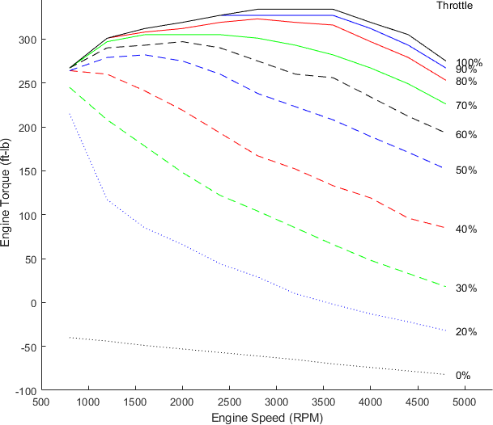


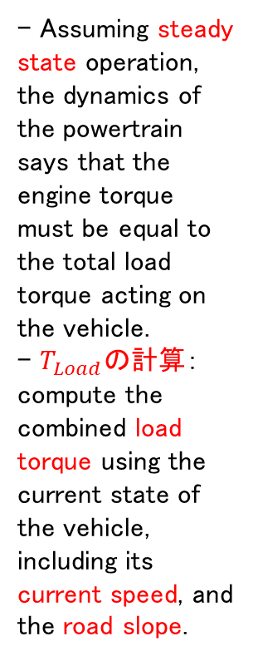

^{𝑉}𝑟𝑒𝑓
This feedforward approach works well at steady state, but ignores the internal dynamics of the vehicle powertrain. 逆にp19 High-Low level制御はちゃんとpowertrainモデルを利用できている（欲しい加速度からEngine torqueを計算する時、p22）。
Vehicle Drivetrain Dynamics
𝐽_{𝑒}
^{𝑉}𝑟𝑒𝑓 ^{= 𝑟}𝑒𝑓𝑓^{𝜔}𝑤
𝜔 =
𝑇
𝐸𝑛𝑔𝑖𝑛𝑒
=
$${\ddot{x}}_{des}+T_{Load}$$
- Assuming steady state operation, the dynamics of the powertrain says that the engine torque must be equal to the total load torque acting on the vehicle.
- $T_{Load}$の計算：compute the combined load torque using the current state of the vehicle, including its current speed, and the road slope.
𝑤
𝑟
(𝑟_{𝑒𝑓𝑓})(𝐺𝑅)
𝑒𝑓𝑓
この部分は考慮していない（加減速ない場合と同様）。なので、steady state時使える。
𝜔_{𝑤}
𝜔 =
𝜔 = 𝐺𝑅 𝜔
𝑒
𝑤
𝑒
𝐺𝑅
- The engine map is defined for discrete steady state values of engine torque and RPM.
- And is interpolated as needed, based on the current vehicle operating point.
^{𝑇}𝐸𝑛𝑔𝑖𝑛𝑒 ^{= 𝑇}𝐿𝑜𝑎𝑑
𝜔_{𝑒}
^{𝑇}𝐸𝑛𝑔
Θ
𝑡ℎ𝑟𝑜𝑡𝑡𝑙𝑒

Slide 31
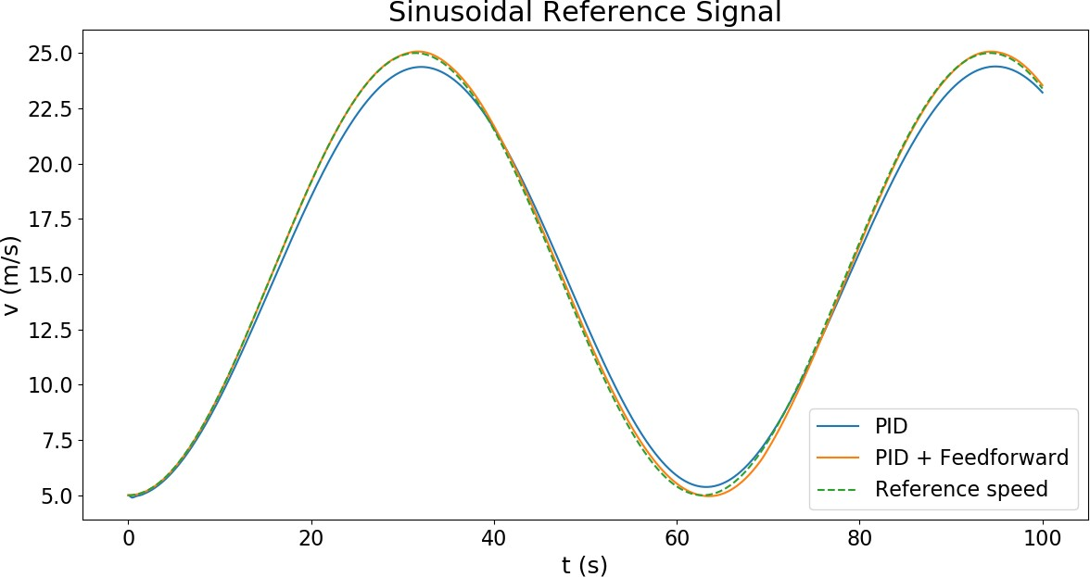
PIDとPID+FeedforwardのSimulation⽐較
Because the PID controller needs errors to exist before it can correct them, its response lag（遅れ） the feedforward approach, which immediately applies the relevant input reference values.
The feedforward tracking is still not perfect, however, as the vehicle response is ultimately governed by its inertia（車のリスポンスは最終的に車の慣性に支配される）, and the feedforward approach we’ve presented relies on steady state modeling of the car.

Slide 32



•
•
Feedforward制御の目的

Slide 33


古典制御論は、伝達関数と呼ばれる線形（p6 伝達関数の利用条件：線形、時不変）の入出力システムとして表された制御対象を中心に、周波数応答（線形システムに正弦波入力を加えたとき，出力もまた正弦波となるが，その振幅および位相は入力と異なる。入出力の振幅比および位相のずれが，周波数によって変化する様子をシステムの周波数応答という）などを評価して望みの挙動を達成する制御理論である。
•
•
•
古典制御

