Slide 1
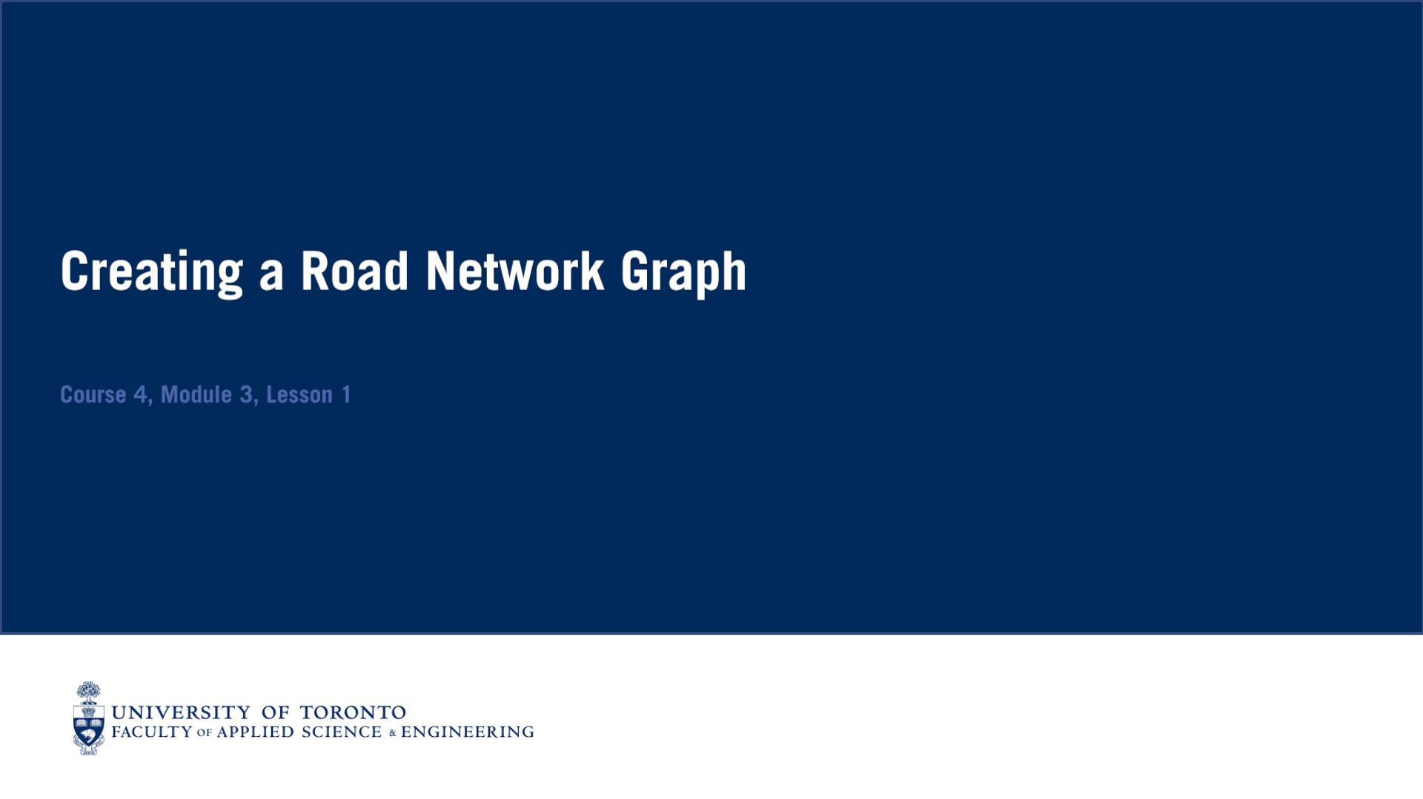

Slide 2
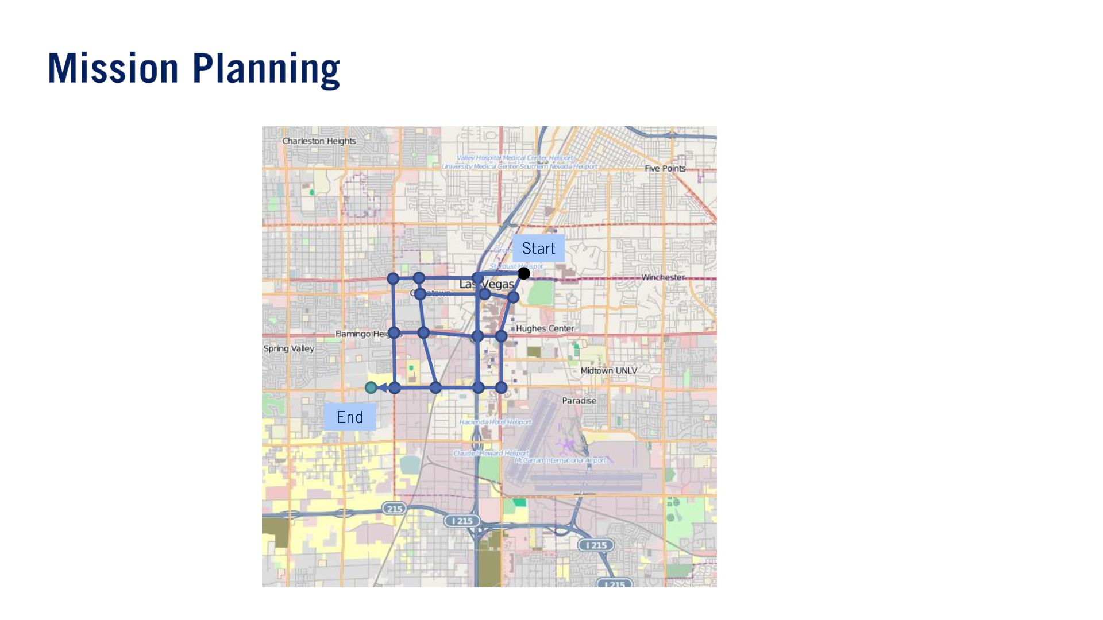
The mission planner will focus on aspects of the road network when planning, such as speed limits and road lengths, traffic flow rates and road closures.
単語
Closure（通行止め「どめ」）: The closure of a road or border is the blocking of it in order to prevent people from using it.

Slide 3
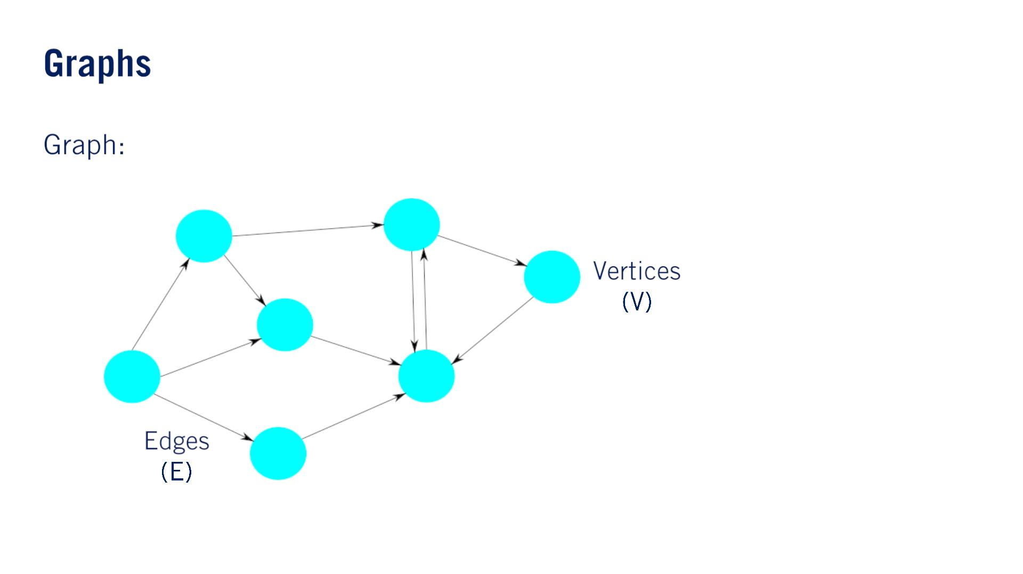
퐺 = (푉, 퐸)

Slide 4
Since our graph formulation is currently unweighted, a good candidate algorithm is the Breadth-First Search（幅優先探索） or BFS.
퐺 = (푉, 퐸)
푡
푠

Slide 5
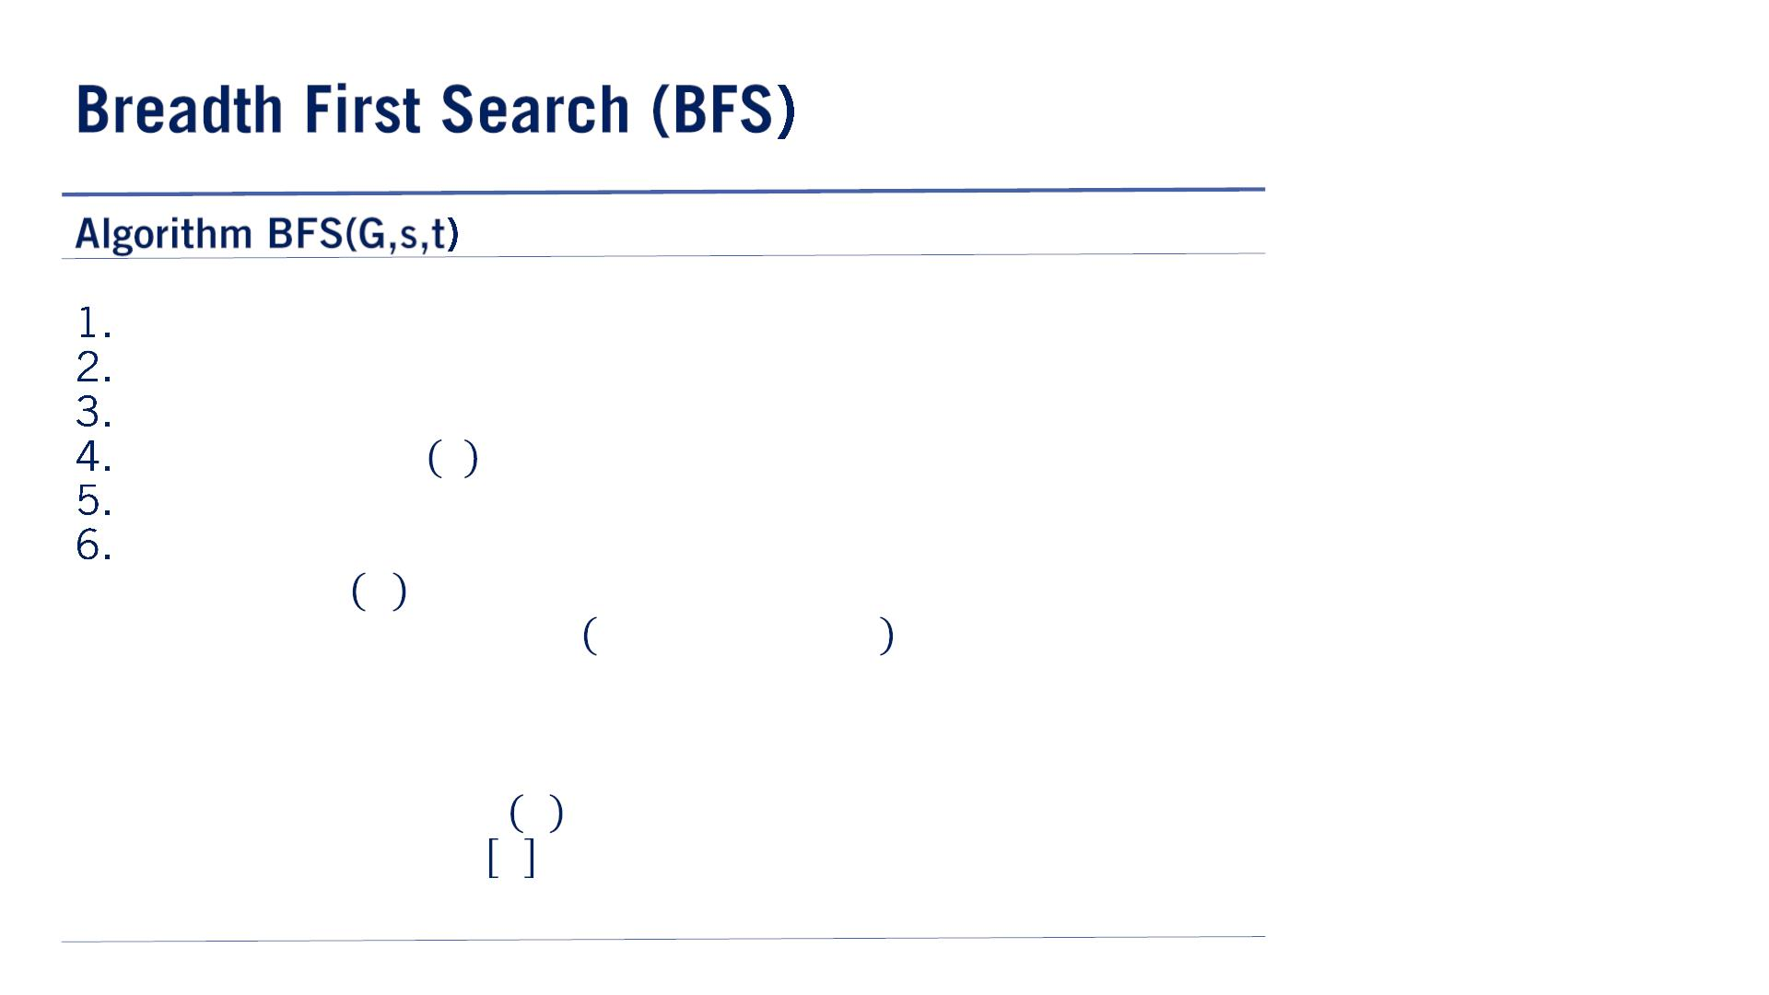

At a high level, BFS can be thought of as iterating through all of the vertices in the graph but doing so in a manner such that all adjacent vertices are evaluated first before proceeding deeper into the graph.
複数のpredecessorの可能性はないはず。なぜなら、$vertexは$open queueに入れられる時（1回）predecessorが付けられる。
でもloopがあったら？（$if v∈closed or v∈open, then continue$はこれを防ぐ）
This prevents us from getting stuck in cycles during the graph search.
9~13は未処理&&キューにない後継ノードをキューに入れている。
幅優先だから、終点にたどり着いたら、深さは一番浅い（つまり最短）。
処理待ちキュー
open ← Queue()
closed ← Set()
predecessors ← Dict()
open. enqueue 푠
퐰퐡퐢퐥퐞 ! open. isEmpty() 퐝퐨
푢 ← open. dequeue()
퐢퐟 isGoal 푢 퐭퐡퐞퐧
7.
8.
9.
10.
11.
12.
13.
return extractPath 푢, predecessors
퐟퐨퐫 퐚퐥퐥 푣 ∈ 푢. successors()
퐢퐟 푣 ∈ closed 표푟 푣 ∈ open 퐭퐡퐞퐧
continue
A dictionary is an unordered set of key-value pairs and for each node in the closed set, stores a predecessor（前任者） vertex that will identify momentarily.
Because we use a queue to store open vertices, we ensure that all adjacent vertices at the current depth in the search are processed before proceeding deeper into the graph.
open. enqueue 푣
predecessors 푣 ← 푢
14. closed. add(푢)

Slide 6
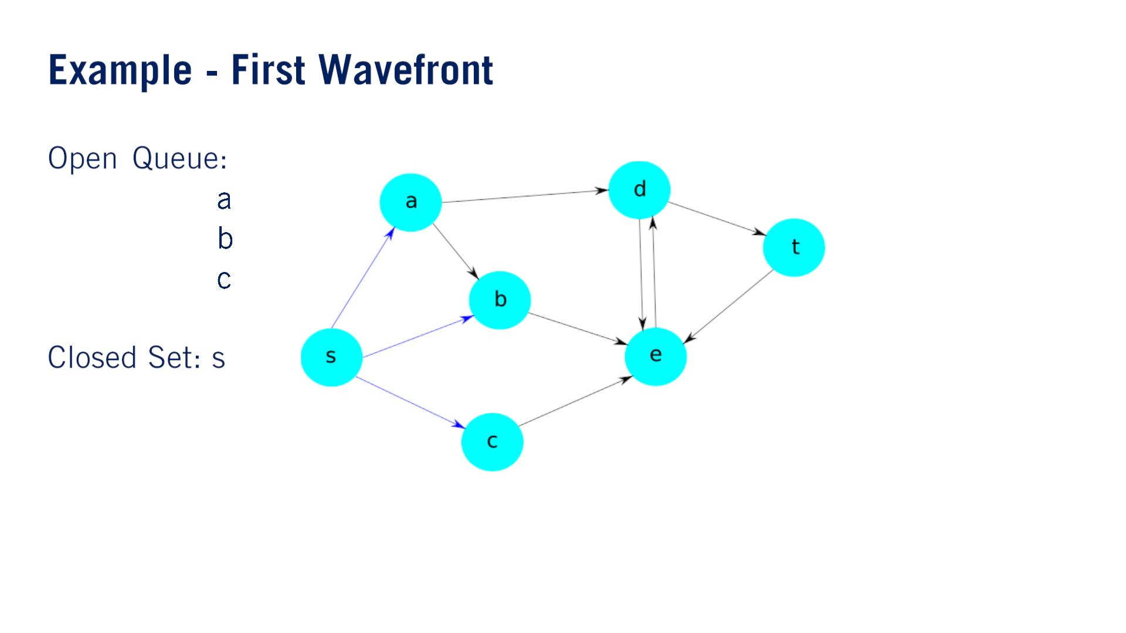

Slide 7
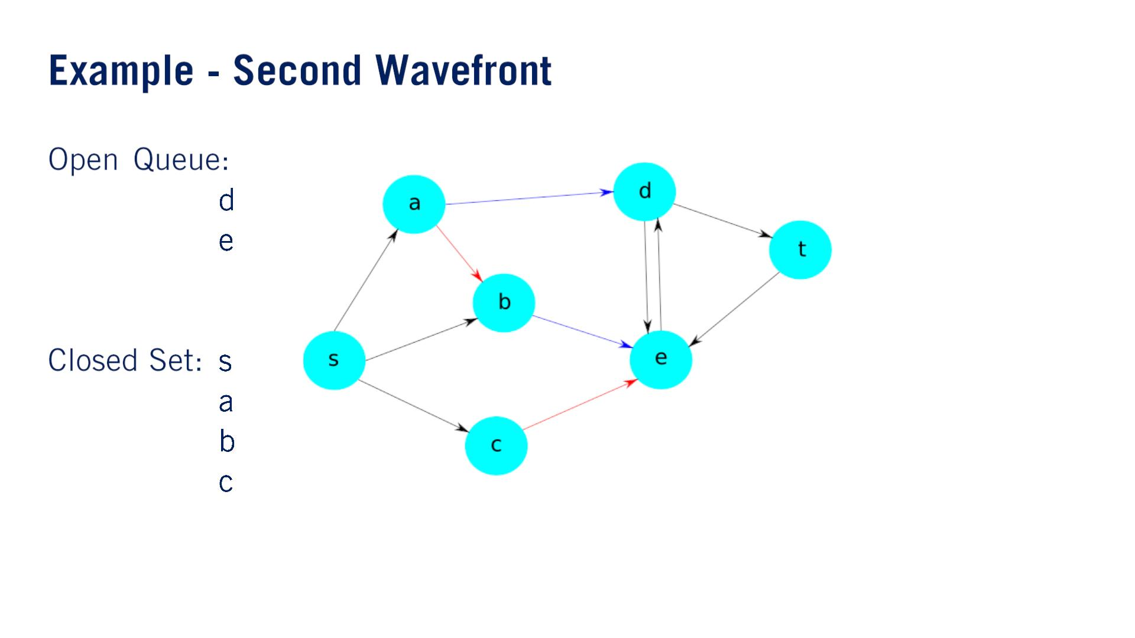

Slide 8
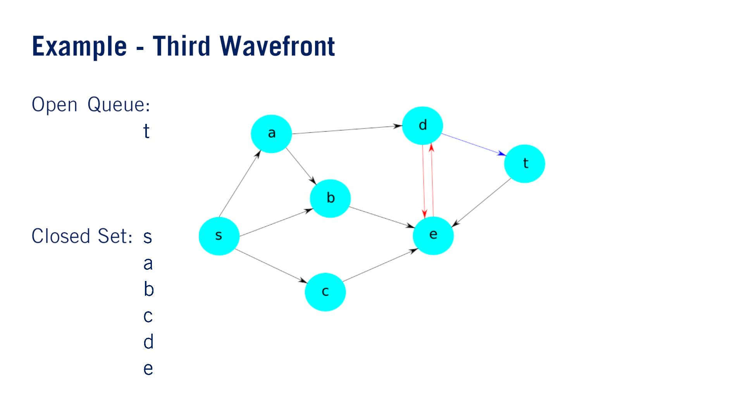

Slide 9
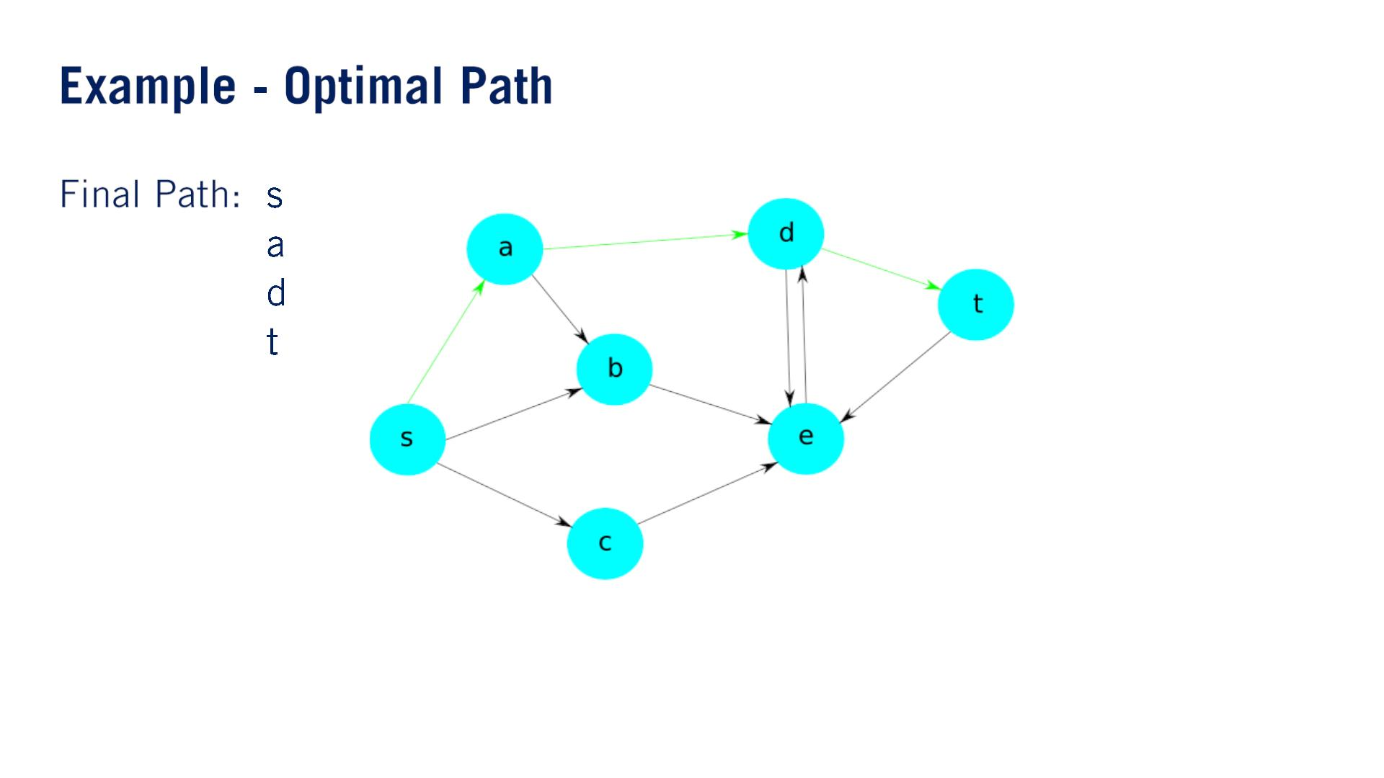

Slide 10
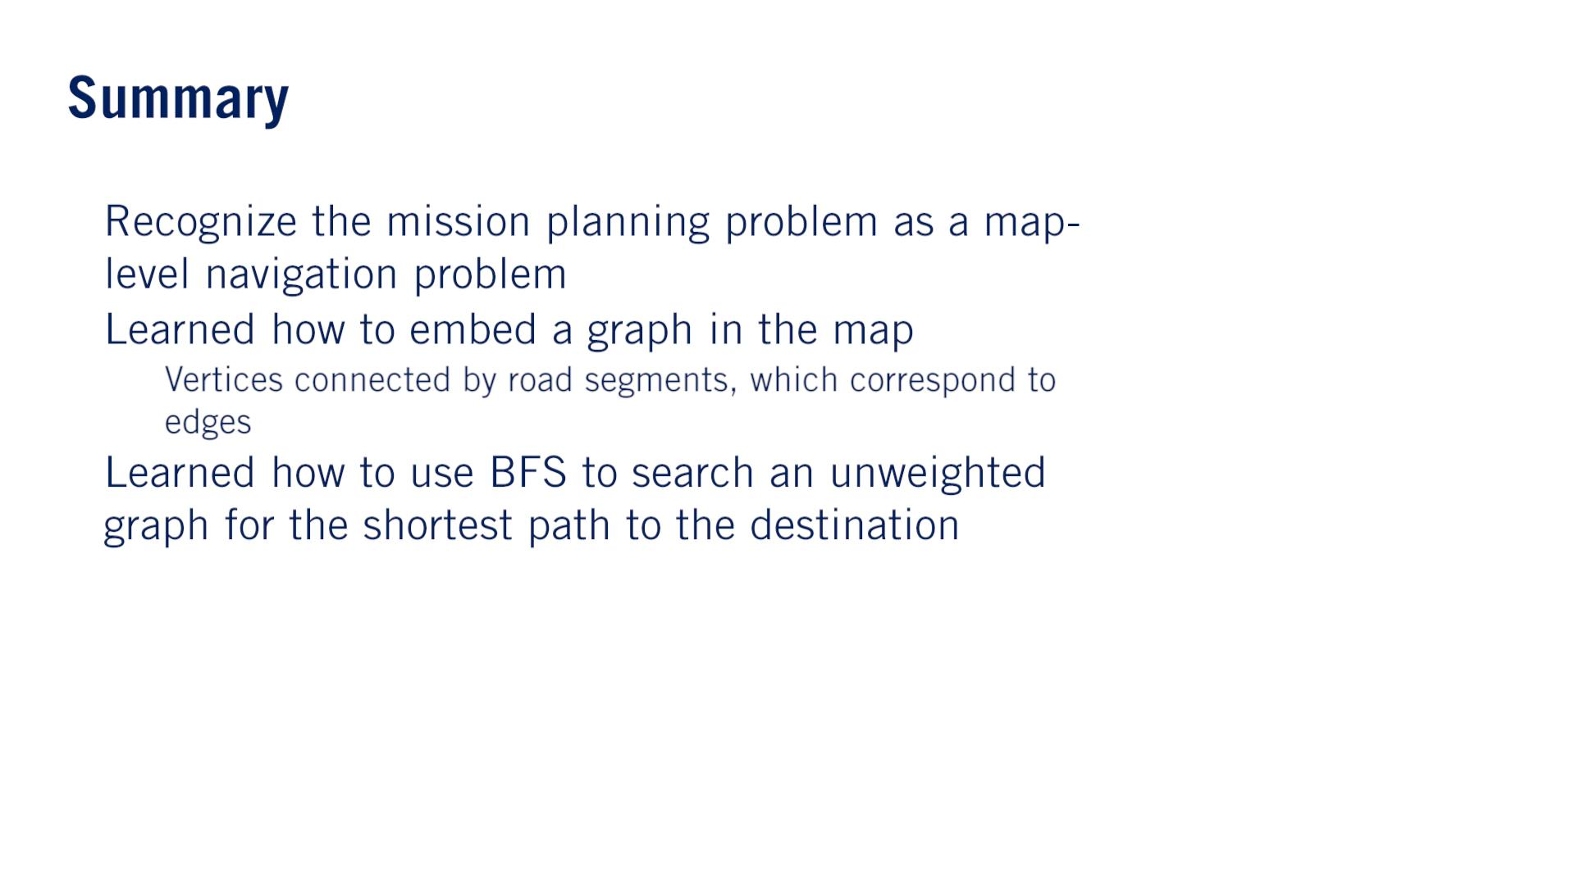
•
•
o
•

Slide 11


Slide 12
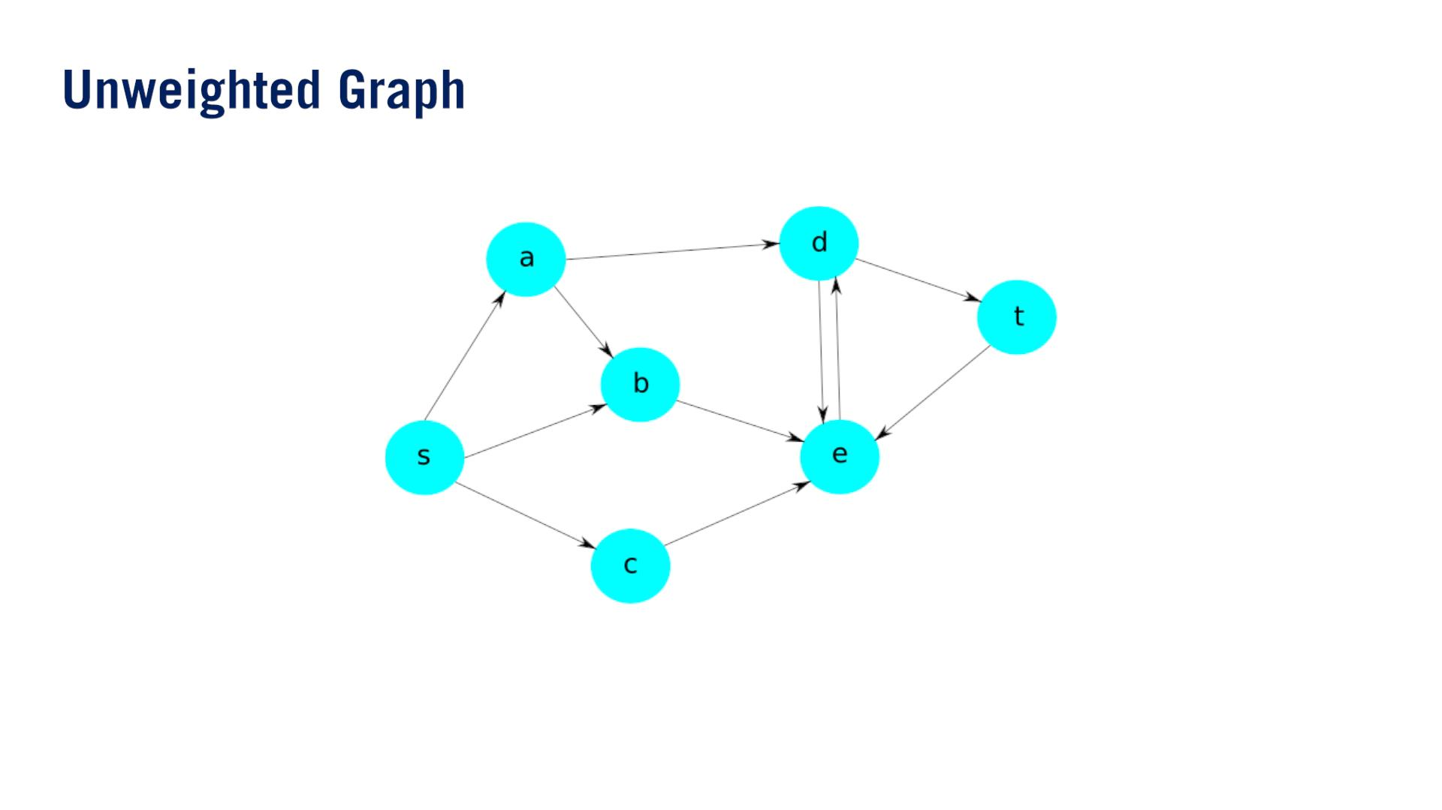

Slide 13
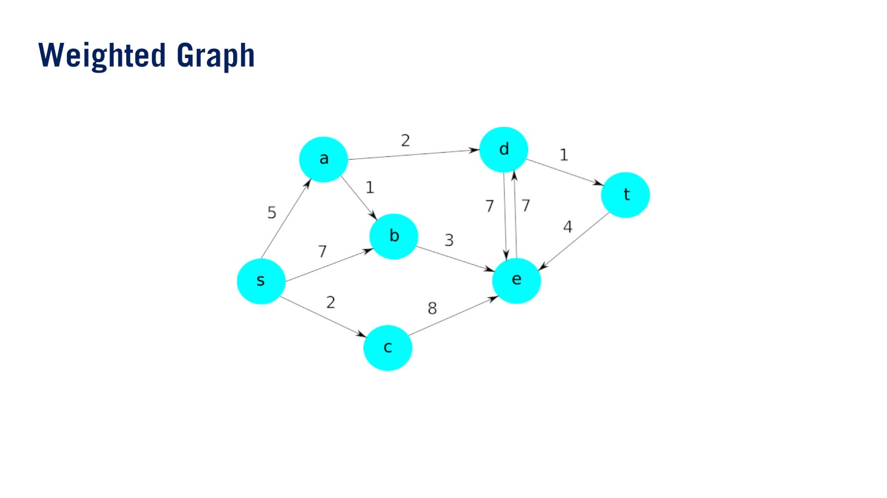
The units of the weights are arbitrary, as long as they are common to all edges.

Slide 14
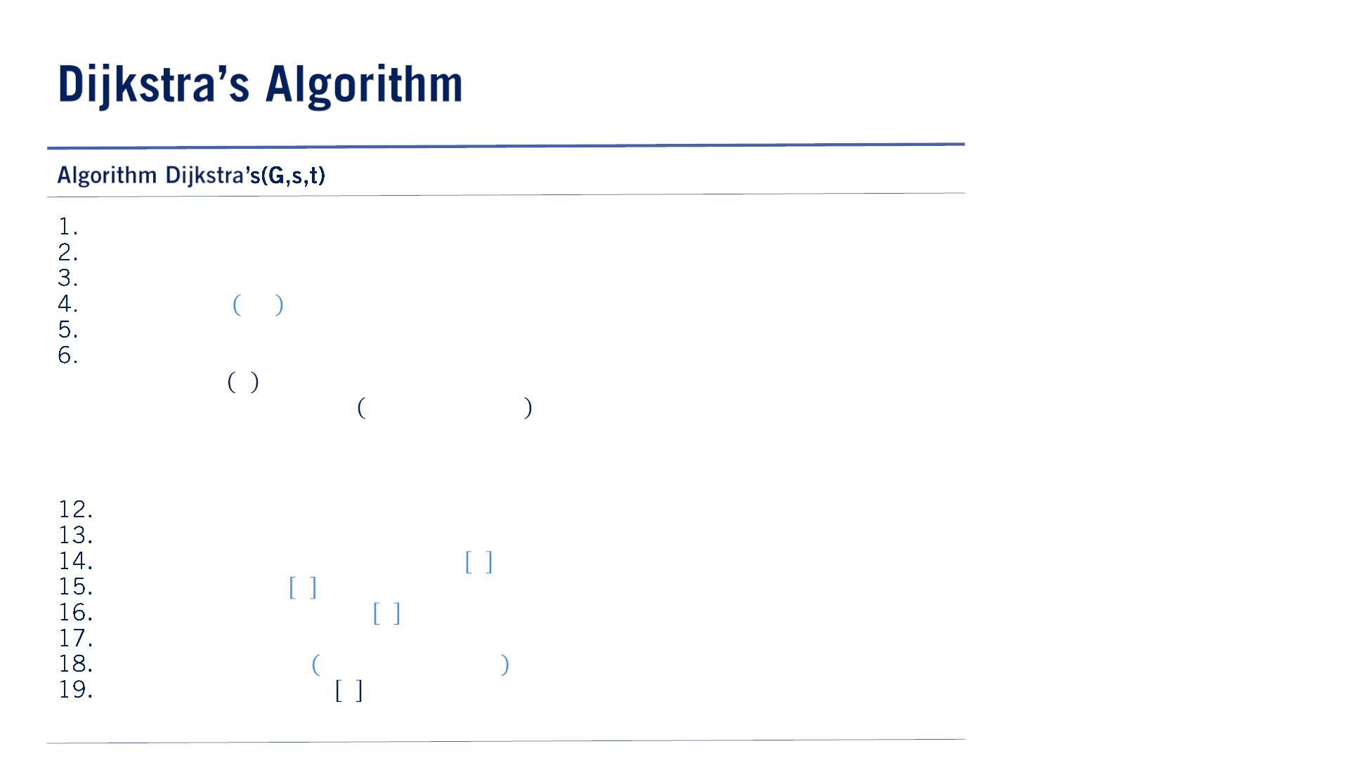
（⼤事、先⽣の説明が凄い）
The main difference is in the order we process the vertices.
A MinHeap is a data structure that stores keys and values, and sort the keys in terms of their associated values from smallest to largest.
In our case, the values of each key vertex in the graph will correspond to the distance it takes to reach that vertex, along the shortest path to that vertex we’ve found so far.
In this sense, Dijkstra’s algorithm processes vertices with a lower accumulated cost before other ones.
Thus unlike BFS, a vertex that was added later in the search can be processed before when that was added earlier, so long as its accumulated cost is lower.
処理順番はaccumulated costです。挿⼊順番じゃない。
One interesting case however, is if we find a new path to a vertex that is already in the open heap but has not been processed yet.
In this case, we have to check if the newly found path to this vertex is cheaper than the older path.
Once we process the goal vertex, we must have necessarily processed all possible predecessor vertices of the goal node.
Since a predecessor must have accumulated distance less than or equal to the goal vertex.
この保証は処理順番によるんだ。つまりもしあるnodeが本当に最短パスに位置したら、この nodeはgoal nodeの処理前必ず既に処理された。このnodeまでのcostがgoal nodeまでのcost より絶対低いから。つまり先に処理される。
Since all predecessor vertices have been processed, we will have found the shortest path to the goal vertex.
open ← MinHeap()
closed ← Set()
predecessors ← Dict()
open. push 푠, 0
퐰퐡퐢퐥퐞 ! open. isEmpty() 퐝퐨
푢, 푢Cost ← open. pop()
퐢퐟 isGoal 푢 퐭퐡퐞퐧
7.
8.
9.
10.
11.
return extractPath 푢, predecessors
퐟퐨퐫 퐚퐥퐥 푣 ∈ 푢. successors()
퐢퐟 푣 ∈ closed 퐭퐡퐞퐧
continue
푢푣Cost ← edgeCost(G, 푢, 푣)
퐢퐟 푣 ∈ open 퐭퐡퐞퐧
퐢퐟 푢Cost + 푢푣Cost < open 푣 퐭퐡퐞퐧
open 푣 ← 푢Cost + 푢푣Cost
predecessors 푣 ← 푢
else
open. push 푣, 푢Cost + 푢푣Cost
predecessors 푣 ← 푢
closed. add(푢)
20.

Slide 15
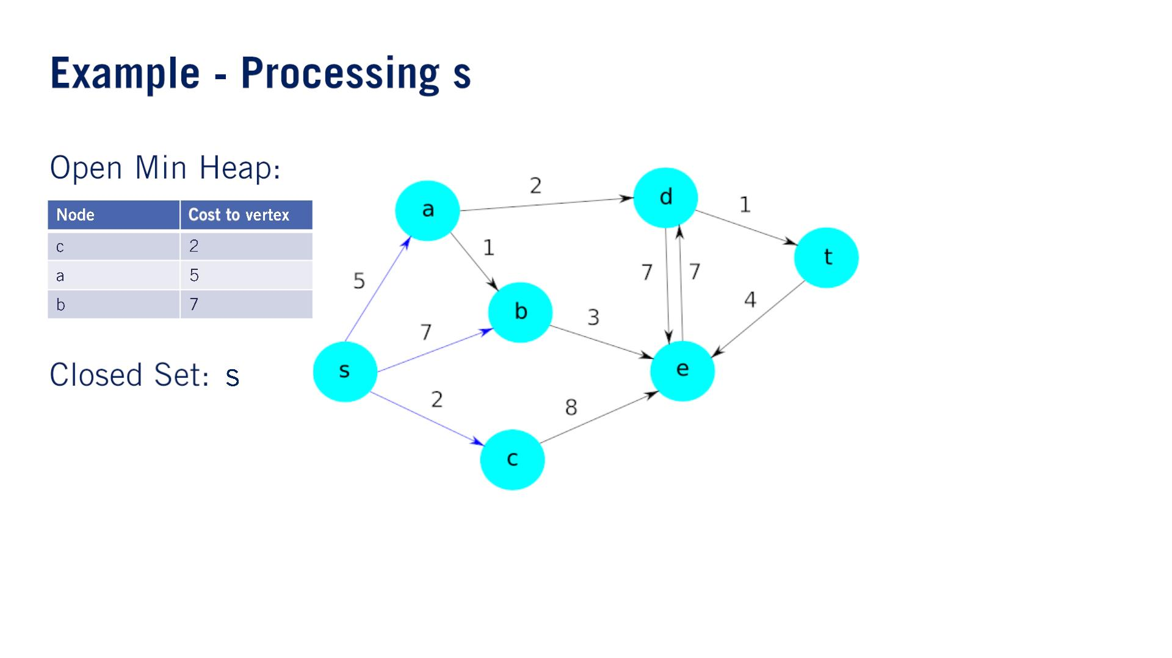

Slide 16


Slide 17


Slide 18
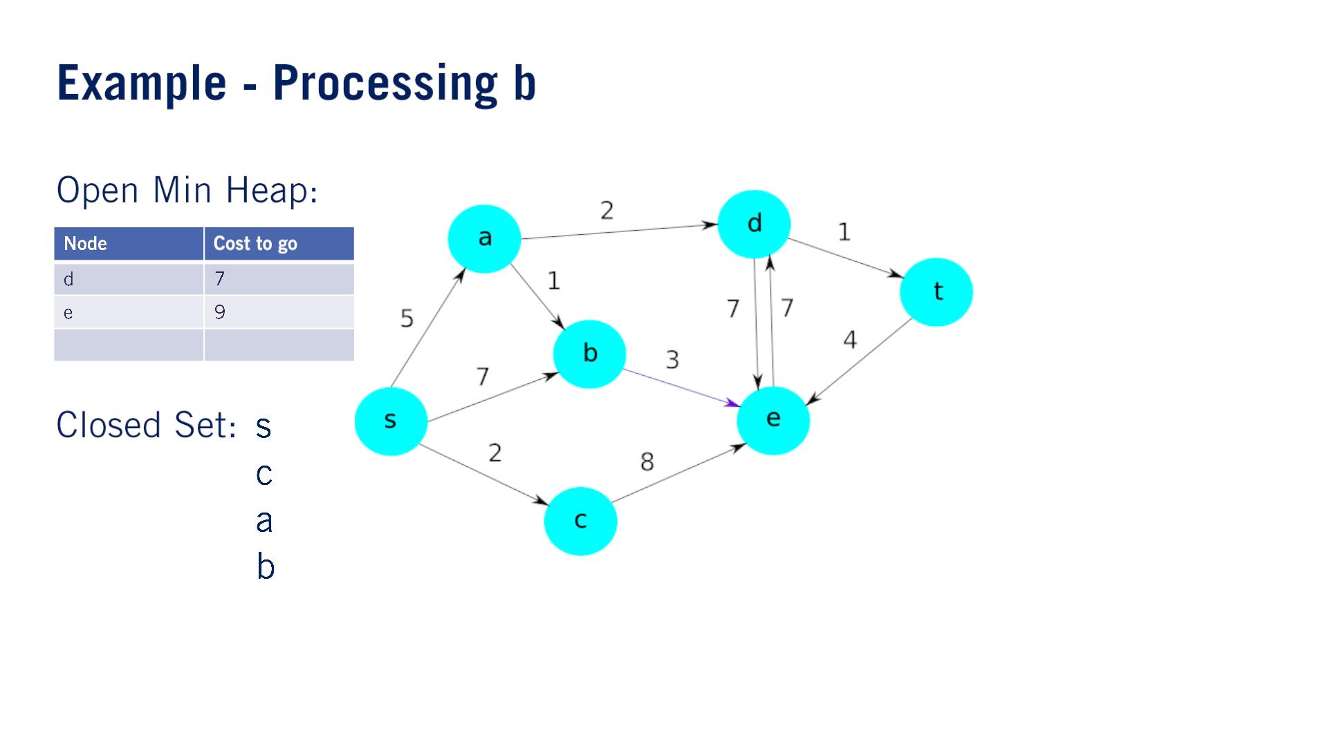

Slide 19


Slide 20
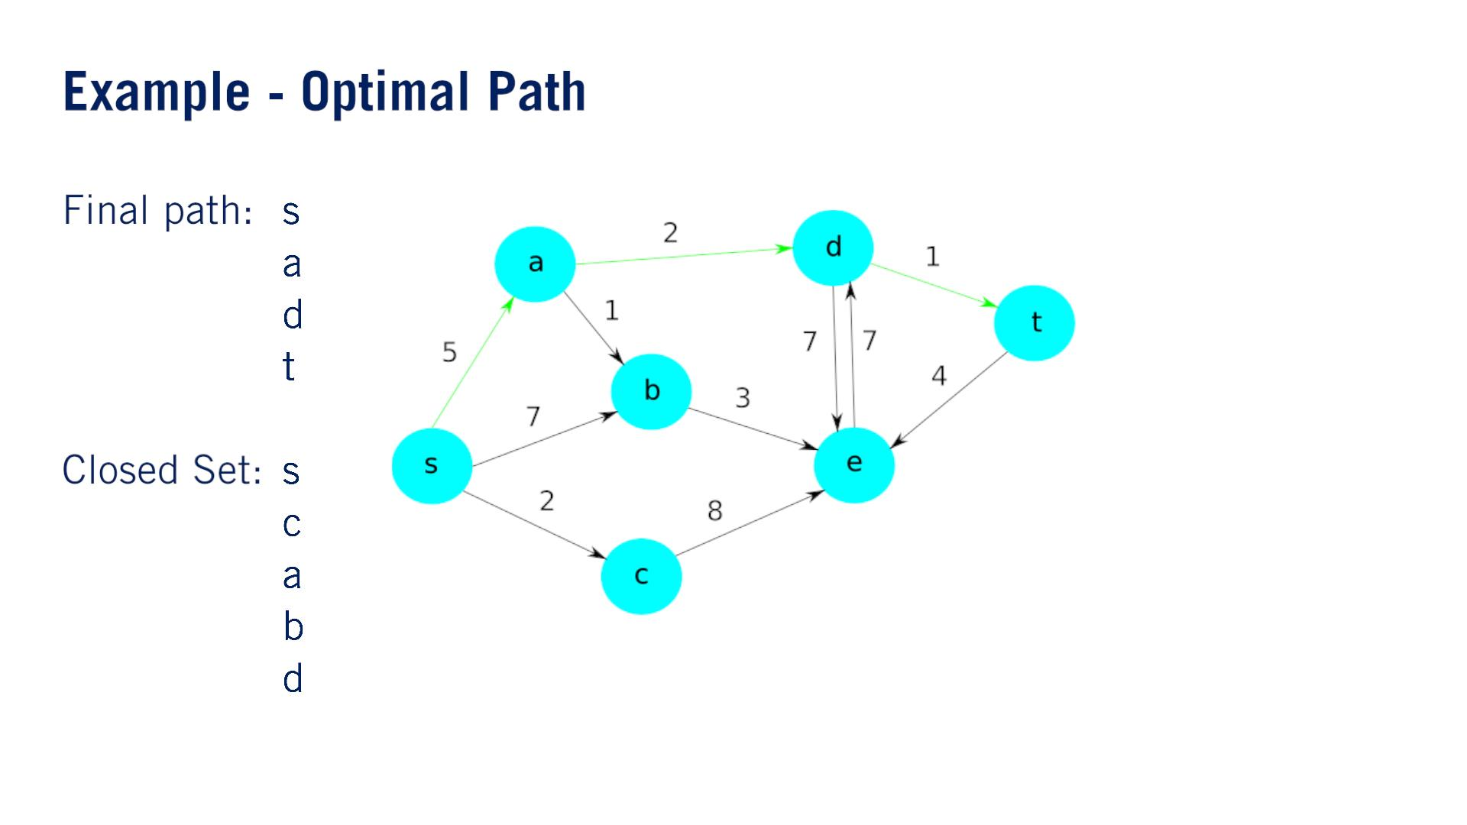

Slide 21
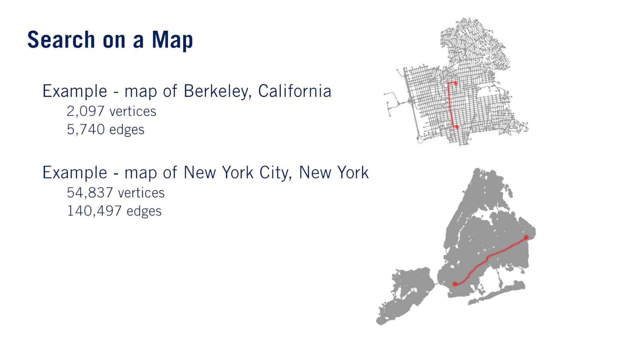
•
•
o
o
o
o
Vertices of the graph correspond to intersections, and the edges correspond to road segments.
Dijkstra’s algorithm is quite efficient, which allows it to scale really well to real-world problems such as these two maps.
While Dijkstra’s is an efficient algorithm, we can leverage certain heuristics to make it even faster in practice.

Slide 22
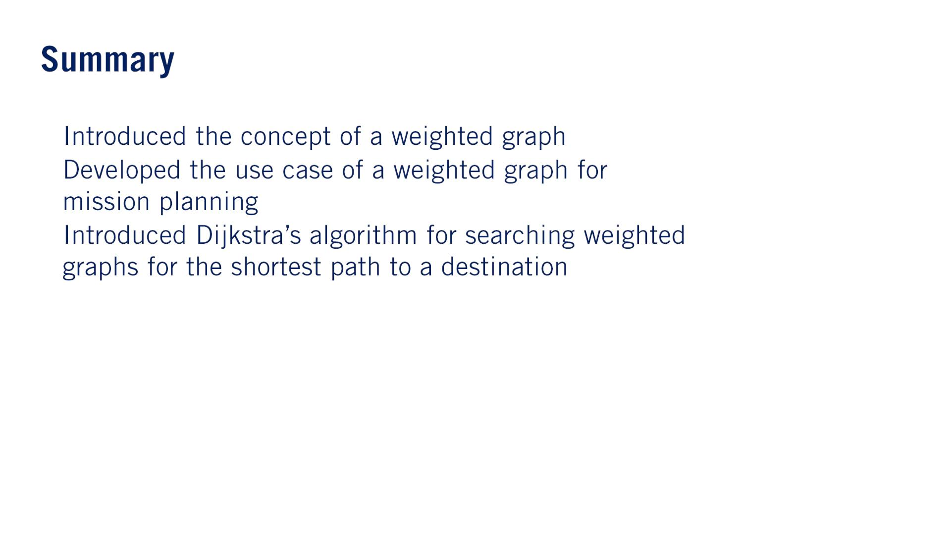
•
•
•

Slide 23


Slide 24
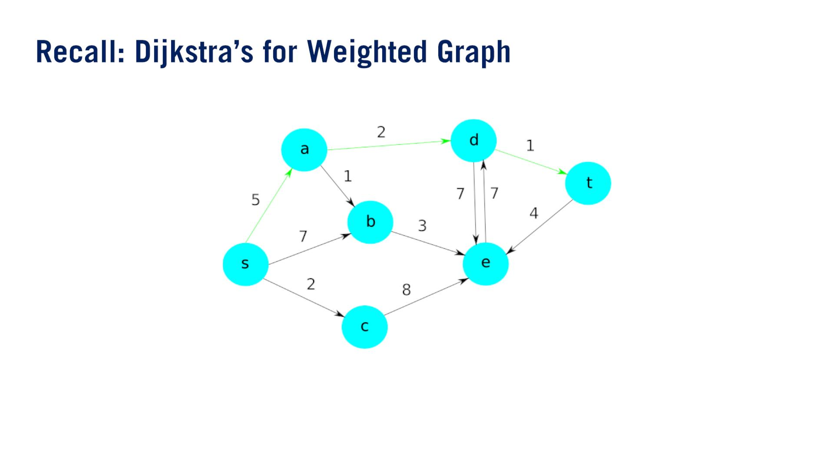
Dijkstra’s algorithm required us to search almost all of the edges present in the graph, even though only a few of them were actually useful for constructing the optimal path.

Slide 25
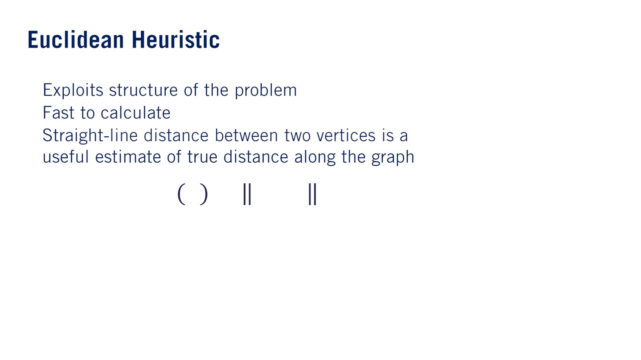

Search Heuristicの意味：In this context, a search heuristic is an estimate of the remaining cost to reach the destination vertex from any given vertex in the graph.
•
•
•
このestimateが可能な理由は、graphは地図だから。
This estimate is always an underestimate of the true distance to reach the goal.（⼤事）
This is an important requirement for A* search, and heuristics that satisfy this requirement are called admissible heuristics（認めて許されるヒューリスティック、容認されるヒューリスティック）.

Slide 26
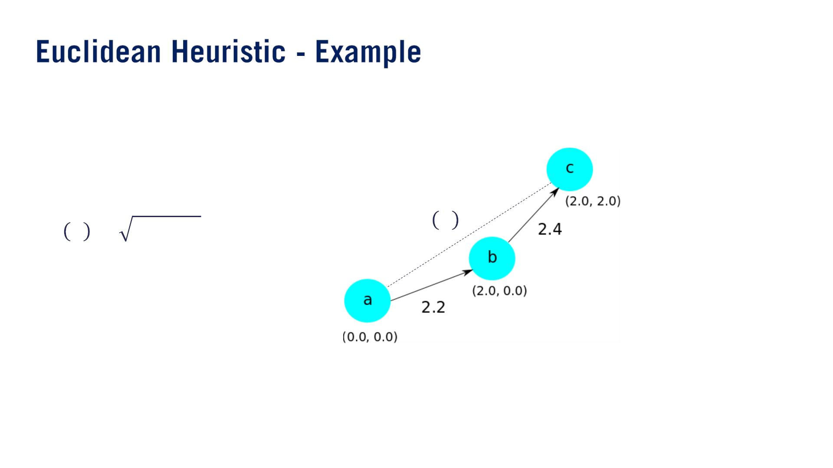
ℎ 푎
2
2
ℎ 푎 = 2 + 2 = 2.828

Slide 27
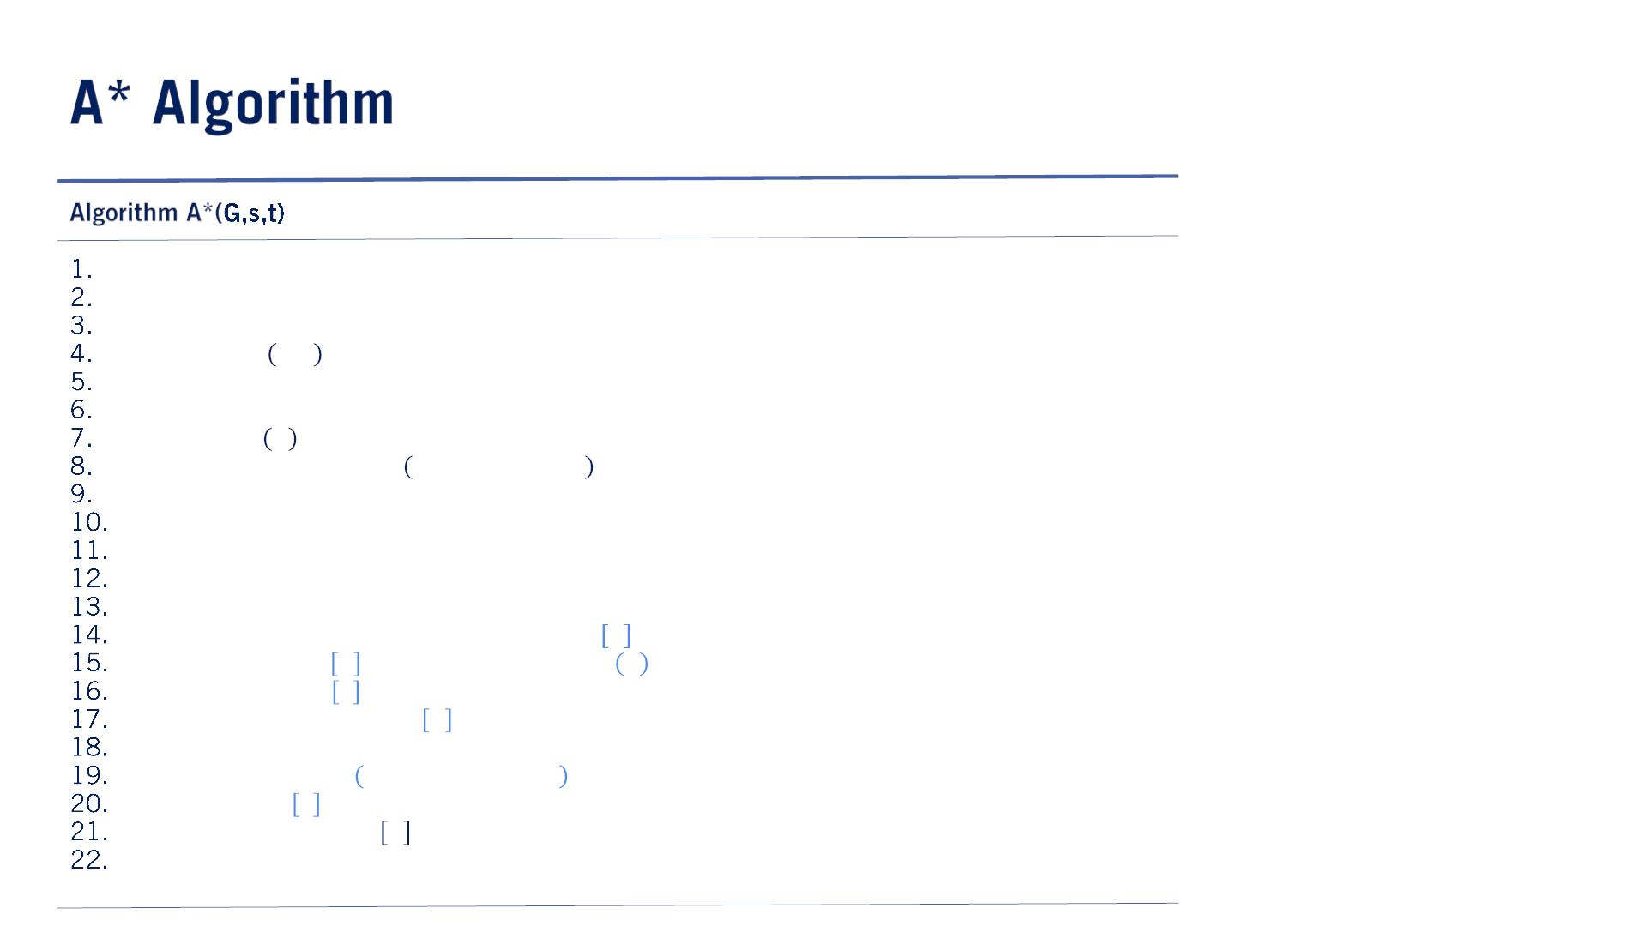

The main difference between Dijkstra’s algorithm and A* is that instead of using the accumulated cost, we use the accumulated cost plus $h(v)$(つまりestimated total cost to the goal), as the value we push onto the MinHeap.
In this sense, A* biases the search towards vertices that are likely to be part of the optimal path according to our search heuristic.
$accumulated cost+h(v)$の意味は、もし始点から$v$まで最短パスにあったら、goalまでの最低コストだよ。
この最低コストが⼩さい⽅が最短パスになりそうだよ、というバイアス。
Since we are storing a heuristic based total cost in the MinHeap, we also need to keep track of the true cost of each vertex as well, which we store in the $cost$ structure.
An interesting thing to note is that if we take our heuristic to be zero for all vertices which is still an admissible heuristic, we then end up with Dijkstra’s algorithm.
スライドのアルゴリズムは間違っている。
6⾏⽬：uCostは$costs[v]$から取るべき！なぜなら$open$には$h$が⼊るので、本当のコストじゃ ない！
そういえば$costs$ dictionaryの初期化も⽋いている。
14⾏⽬：$if uCost+uvCost<costs\left[v\right] then$と同じらしいが。
19⾏⽬：$open.push(v,uCost+uvCost+h\left(v\right))$.
https://en.wikipedia.org/wiki/A*_search_algorithm
http://theory.stanford.edu/~amitp/GameProgramming/ImplementationNotes.html
open ← MinHeap()
closed ← Set()
predecessors ← Dict()
open. push 푠, 0
퐰퐡퐢퐥퐞 ! open. isEmpty() 퐝퐨
푢, 푢Cost ← open. pop()
퐢퐟 isGoal 푢 퐭퐡퐞퐧
return extractPath 푢, predecessors
퐟퐨퐫 퐚퐥퐥 푣 ∈ 푢. successors()
퐢퐟 푣 ∈ closed 퐭퐡퐞퐧
continue
푢푣Cost ← edgeCost(G, 푢, 푣)
퐢퐟 푣 ∈ open 퐭퐡퐞퐧
퐢퐟 푢Cost + 푢푣Cost + h(푣) < open 푣 퐭퐡퐞퐧
open 푣 ← 푢Cost + 푢푣Cost + h(v)
costs v ← 푢Cost + 푢푣Cost
predecessors 푣 ← 푢
else
open. push 푣, 푢Cost + 푢푣Cost
costs v ← 푢Cost + 푢푣Cost
predecessors 푣 ← 푢
closed. add(푢)

Slide 28
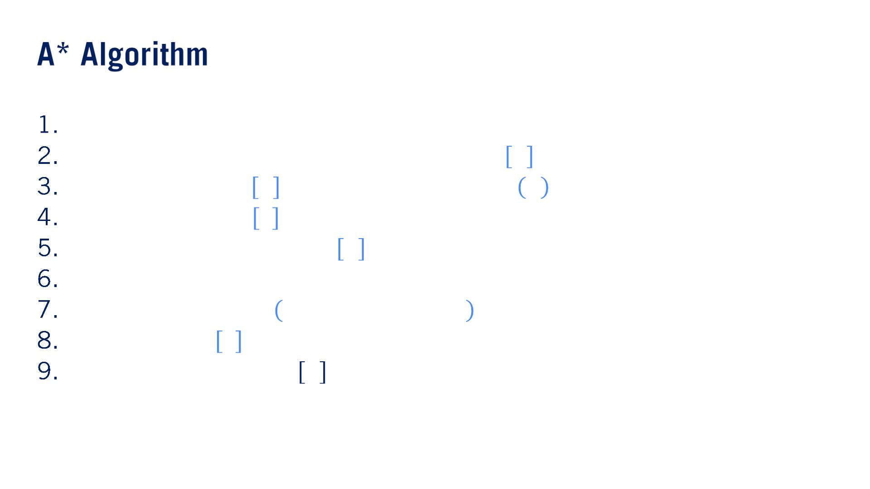
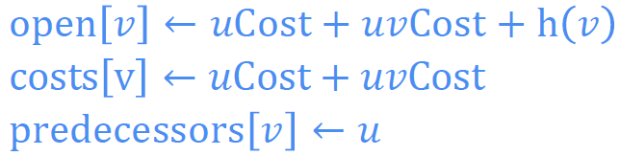
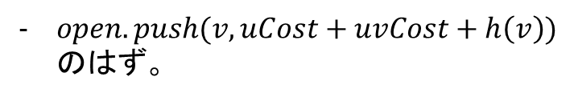
퐢퐟 푣 ∈ open 퐭퐡퐞퐧
퐢퐟 푢Cost + 푢푣Cost + h(푣) < open 푣 퐭퐡퐞퐧
else
open. push 푣, 푢Cost + 푢푣Cost
costs v ← 푢Cost + 푢푣Cost
predecessors 푣 ← 푢
$open.push(v,uCost+uvCost+h\left(v\right))$のはず。

Slide 29
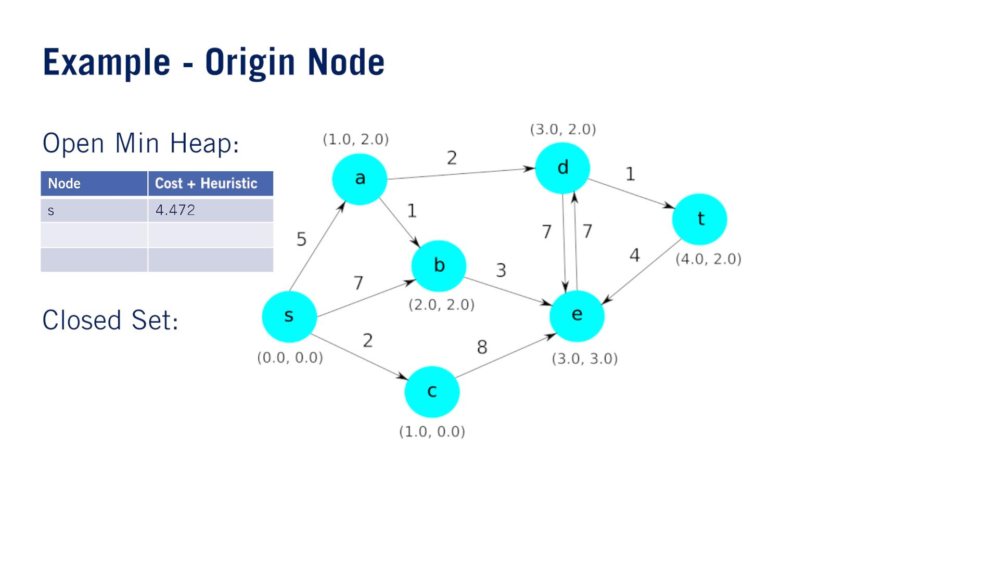

Slide 30
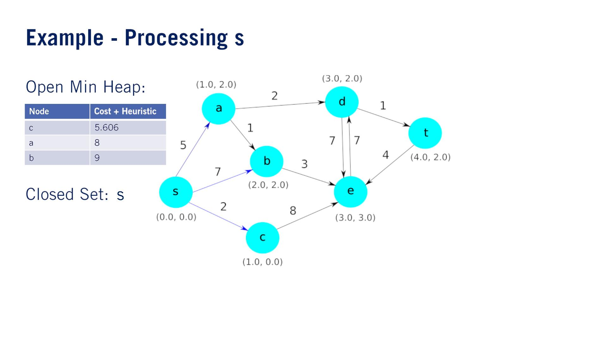
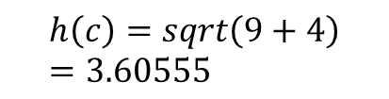
$$h\left(c\right)=sqrt\left(9+4\right)=3.60555$$

Slide 31


Slide 32

8のはず

Slide 33
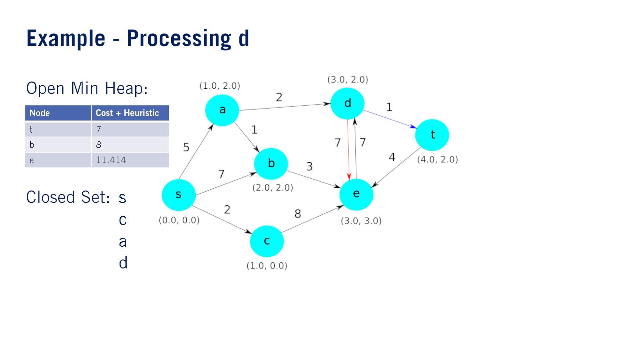

Slide 34
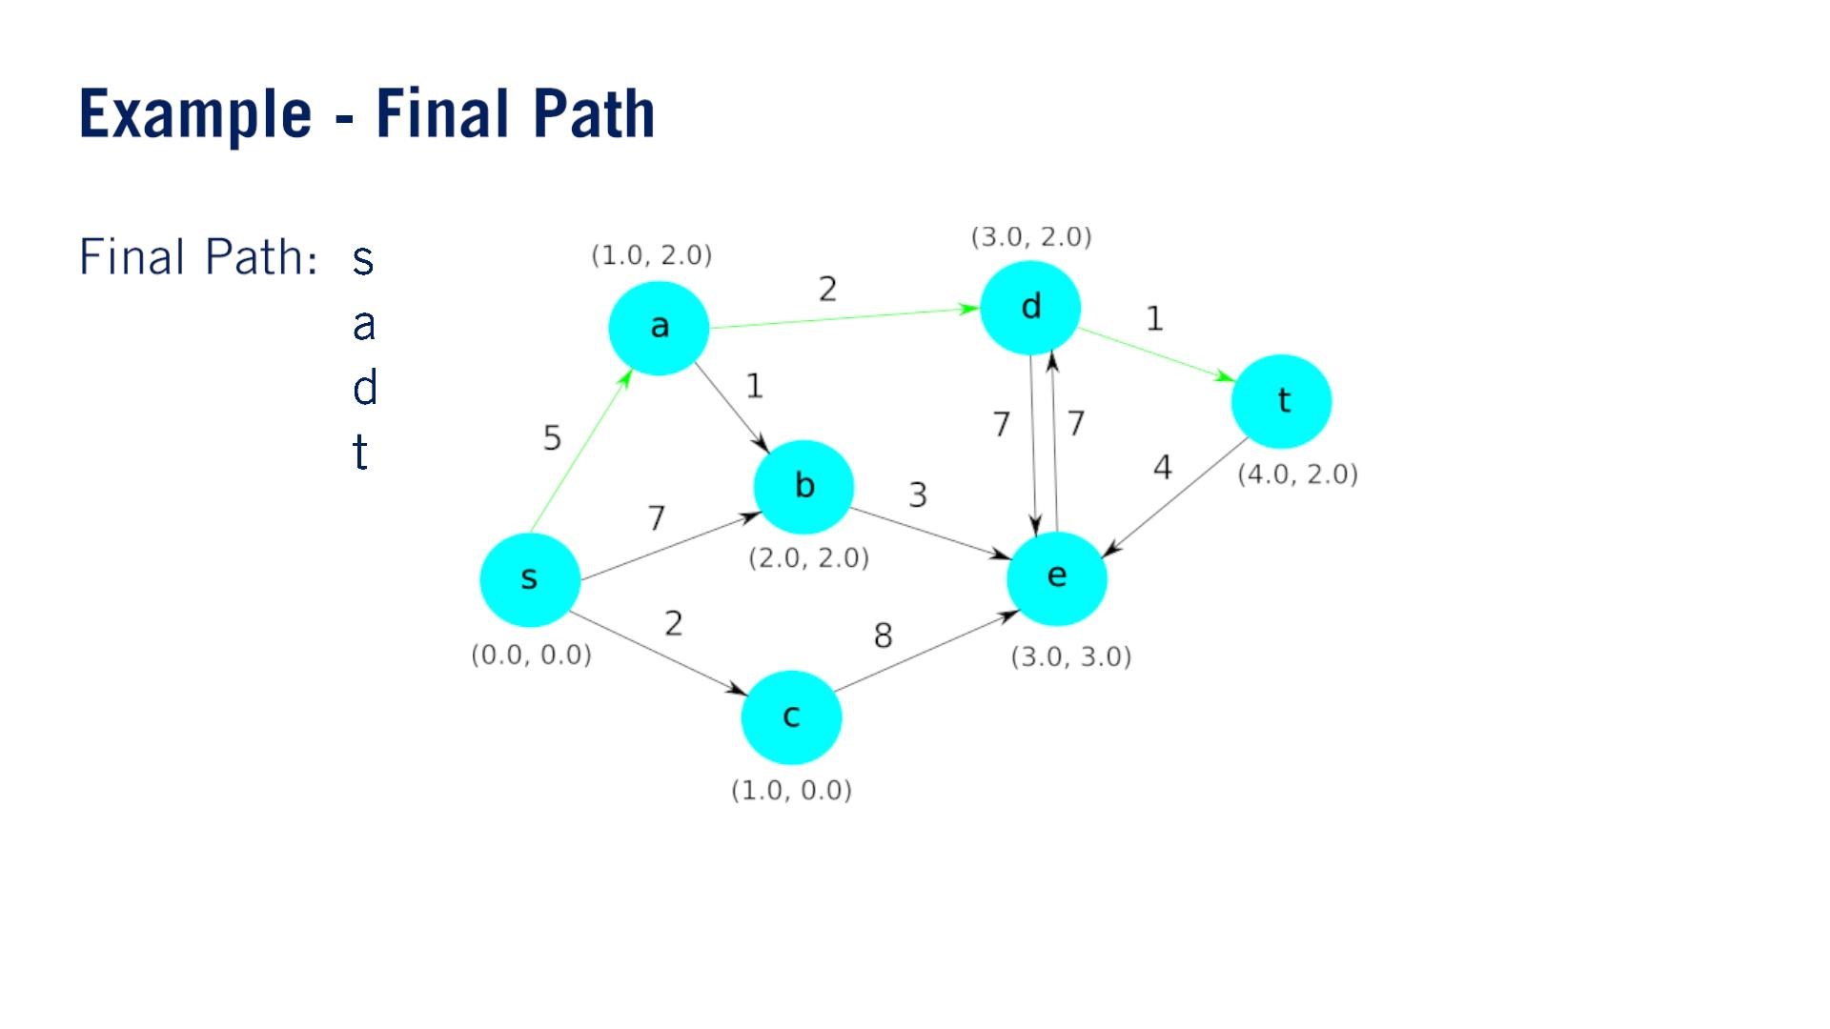

Slide 35
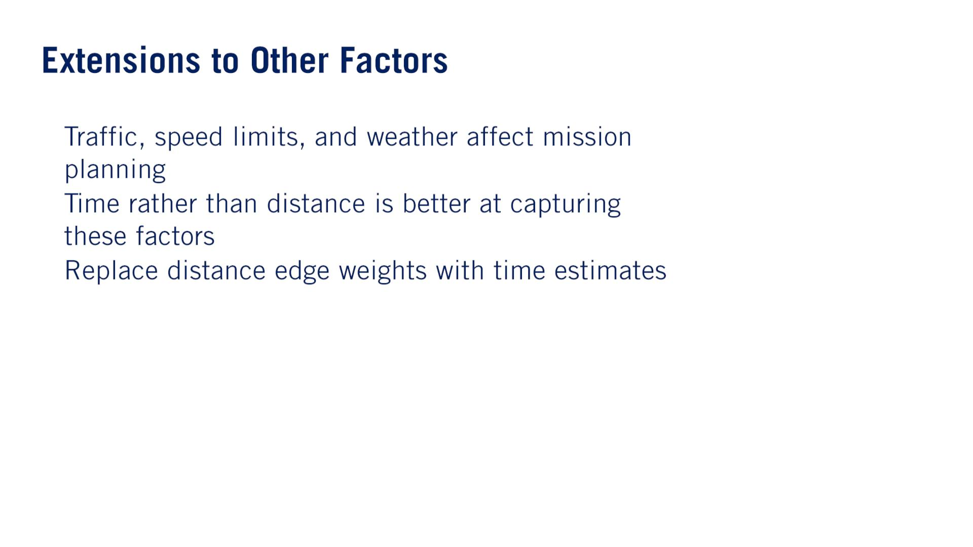

•
•
•
Use $\frac{h\left(v\right)}{v_{max}}$ as the new heuristic.

Slide 36
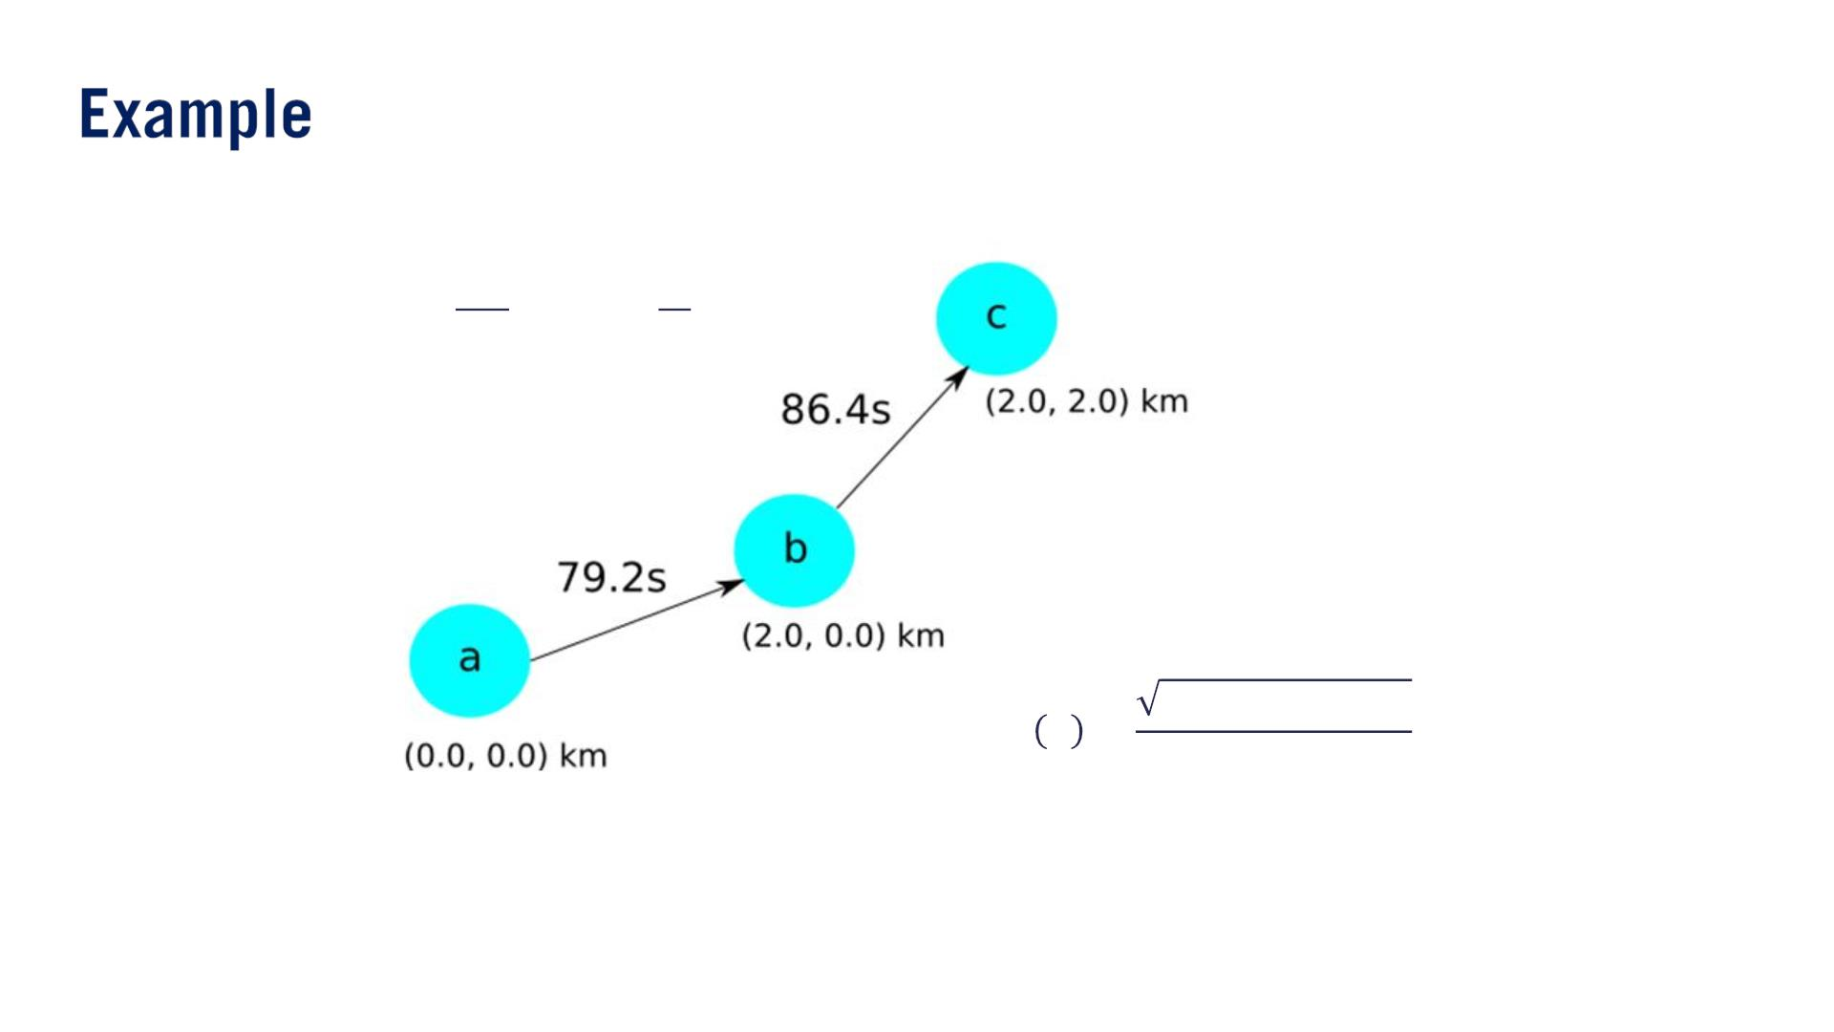
푘푚
푚
푣_{푚푎푥} = 100
= 27.78
ℎ
푠
2000² + 2000²
ℎ 푎 =
= 101.82푠
^{푣}푚푎푥

Slide 37





