Slide 1
Hosting Images

Slide 2
Saving Images
Large images take longer to load. Large meaning file size rather than the dimensions of an image, i.e. the value in KB, MB, GB etc.
There are three things you can do to optimize your images.
Save the right dimensions
Save images for the web
Compress images for the web

Slide 3
Saving Images
Save the right dimensions
Open the image in Photoshop and view it at a 100%. This allows you to view the image at the exact size it will be displayed on a computer monitor when you save the image for web.
For Mac users, Preview can do this.

Slide 4
Saving Images
Save images for the web
It’s possible to reduce the file size without significantly reducing the quality of your images. Open your image in Photoshop and go to File > Export > Save for Web (Legacy)
A window will appear which will allow you to choose your export quality. A quality of 60 works best because it drops the file size down to below a megabyte and there’s no noticeable difference in quality.
For Mac users, Preview can do this. Click on the Markup tool, then the resize button to get the options.

Slide 5
Saving Images
Compress image
Image compression apps are the easiest way to reduce file size of images. These types of tools remove hidden data in the image file like additional color profiles and metadata (like geolocation of where the photograph was taken) that aren’t needed.
These tools provide a quick and easy way to reduce files size without losing any image quality:
TinyJPG | TinyPNG
Compressor.io
ImageOptimizer
Ezgif (reduce size of animated gif)

Slide 6
Hosting Images
Google Drive
Upload images to Google Drive
Make the file a publicly available link and copy that link.
The part after the /d/ is what we are looking for, as it's the unique ID of the image.
https://drive.google.com/file/d/1KPRlrlpHSZKOceSLrmDOUXBClYdEx6cG/view
Copy this unique ID and paste it into the following URL.

Slide 7

Hosting Images
Google Drive Image URL
https://drive.google.com/uc?id={ID}
https://drive.google.com/uc?id=1KPRlrlpHSZKOceSLrmDOUXBClYdEx6cG

Slide 8
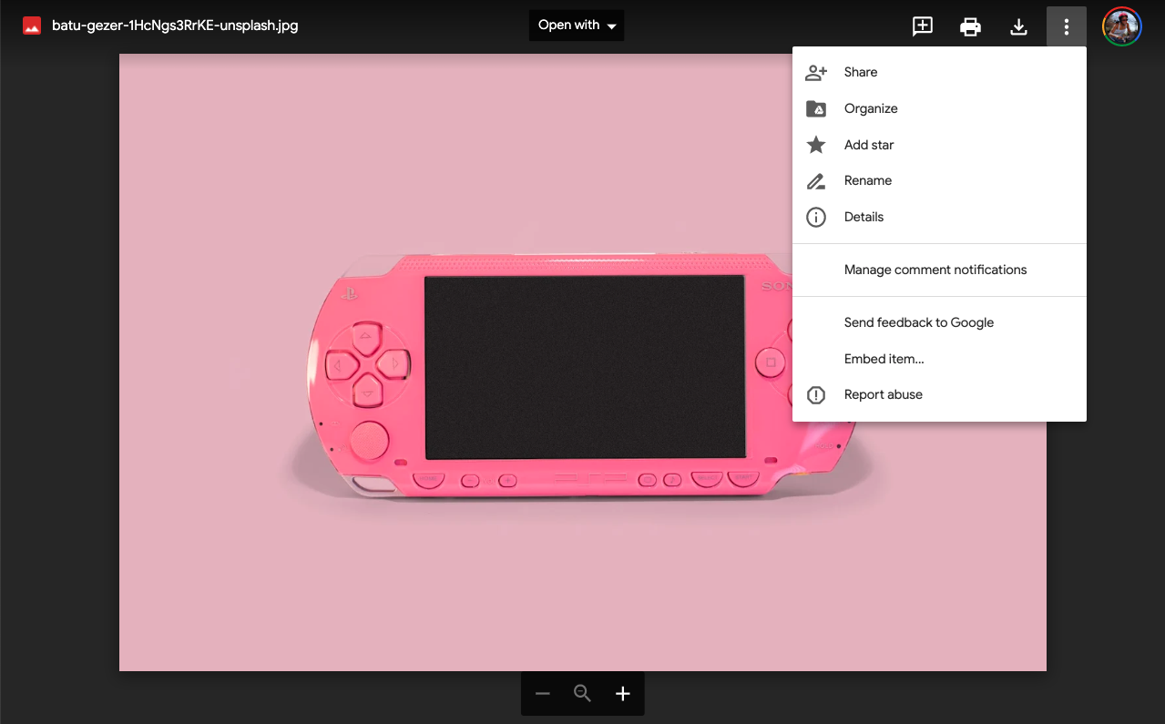
Hosting Images

Slide 9
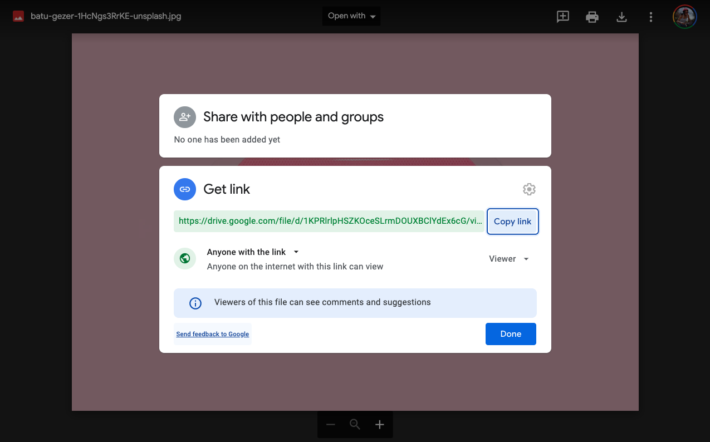
Hosting Images
Unfortunately, I don’t believe that this feature is available in the LionMail version of Google Drive. So, if you have a personal Google Drive, use that one.

Slide 10
Hosting Images
Dropbox Image URL
Upload your image(s) to your Dropbox account (you must already have an account with Dropbox to access this).
Once the image has been uploaded, click on the image itself and click Share.
Click Create a link.
Click Copy link.
Locate the text ?dl=0 within the URL and change it to raw=1
Once this has been completed, you will see the image in the preview window.

Slide 11
Hosting Images
GitHub
Using GitHub Issues
Download the image
Create a new GitHub issue
Drag and drop the image onto the comment field
Copy the URL starting with: http://...

Slide 12
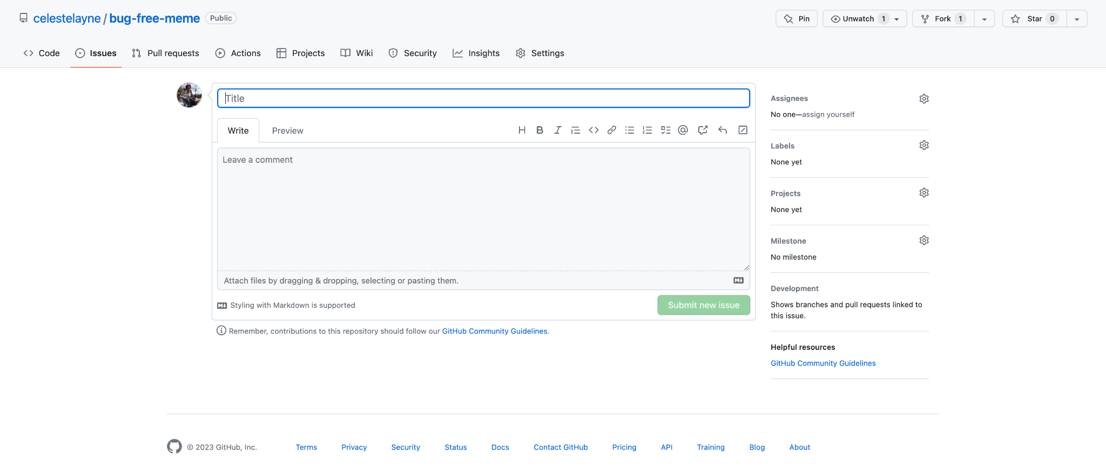
Hosting Images
GitHub
Using GitHub Issues
Drag & Drop
image here

Slide 13
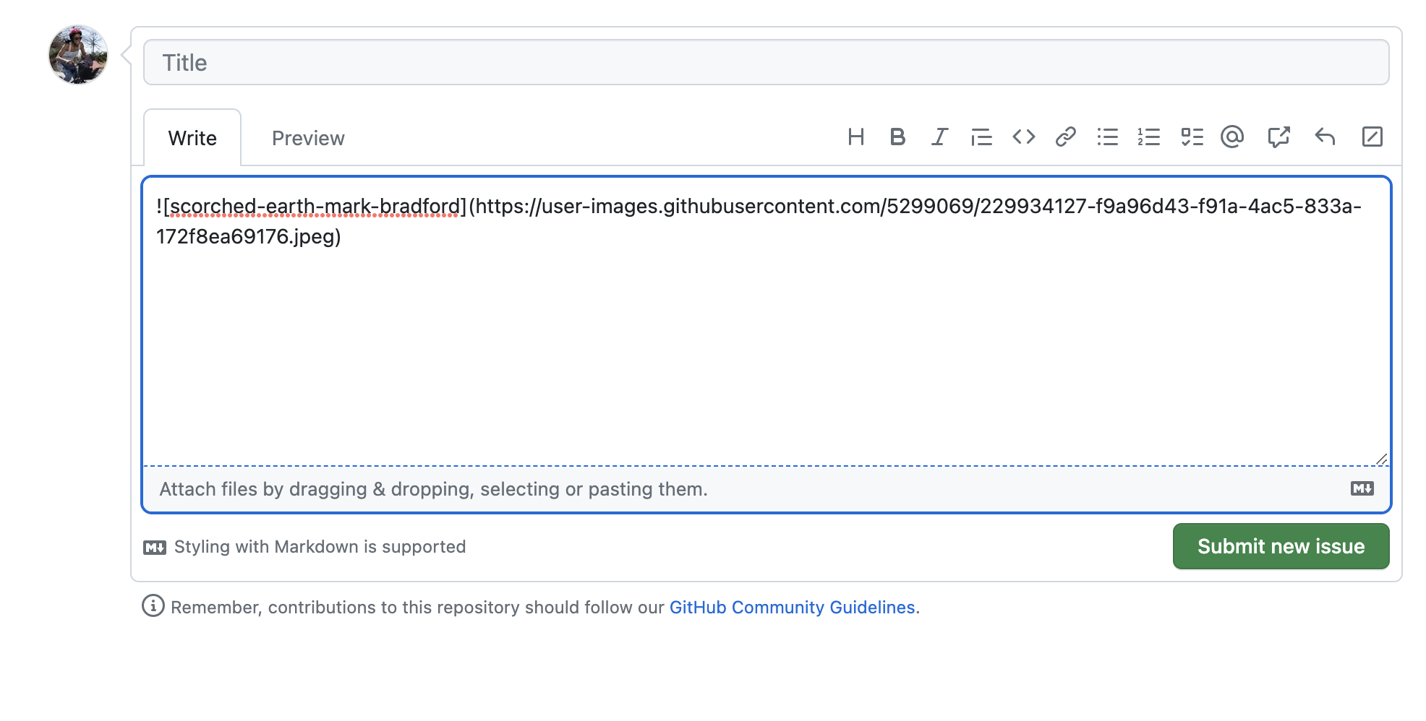
Hosting Images

Slide 14
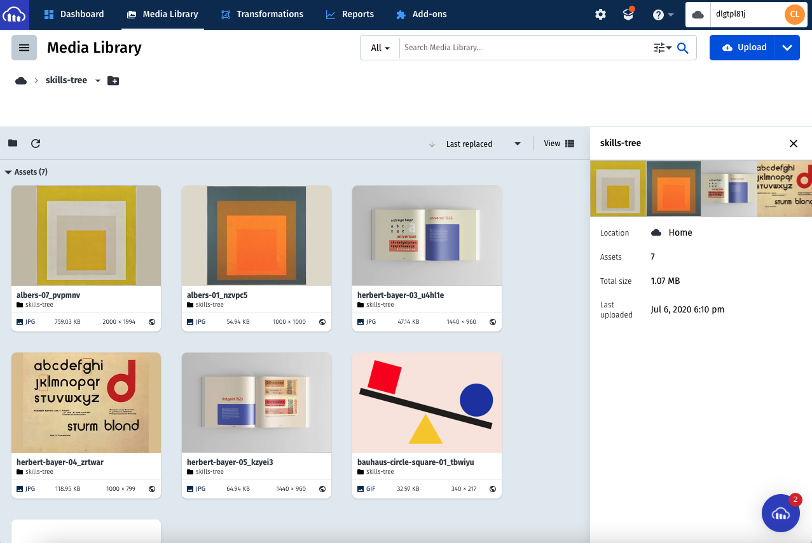
Cloudinary

Slide 15
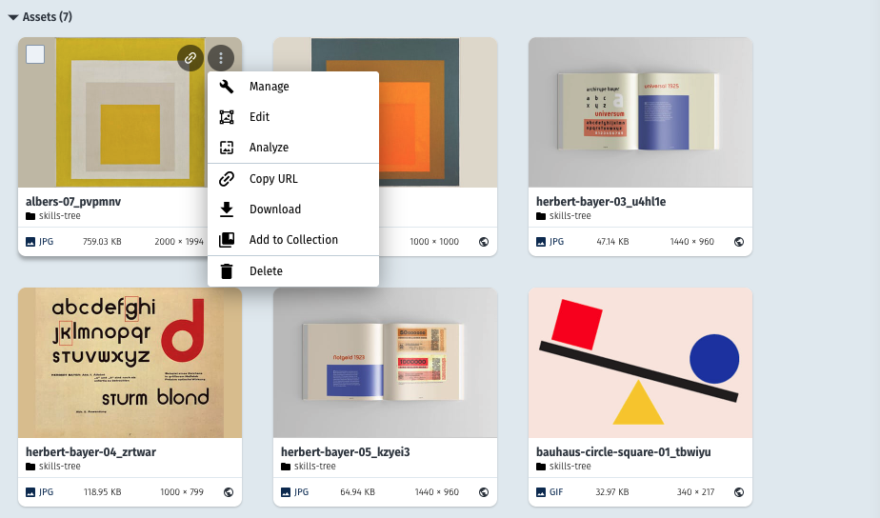
Cloudinary
https://res.cloudinary.com/dlgtpl81j/image/upload/v1594073450/skills-tree/albers-07_pvpmnv.jpg

