Slide 1
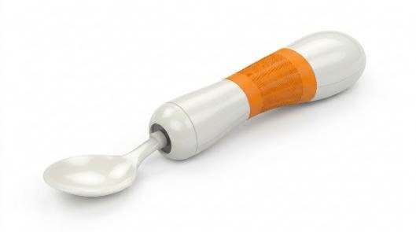
GROUP 18 · MECHENG 736
Aditya Naik · Kevin Mispa Anand · Suhas Panchal · Tom Liu
SensoSpoon
Eating with hand tremor
GROUP 18 · Product design rendering · 1 / 14

Slide 2

Background: When Tremor Disrupts Eating
8.5
A daily task becomes difficult
Hand tremor can interrupt carrying food to the mouth, even when a person can still grip a spoon.
million+
People living with Parkinson disease worldwide in 2019
(Mo & Priefer, 2021; Pathak et al., 2014)
(World Health Organization, 2023)
Design need: steady the utensil while allowing natural movement.
Population context, not an estimate of demand for SensoSpoon.
GROUP 18 · 2 / 14

Slide 3
03
Evidence, User Needs and the Gap
What the literature shows
Active stabilisation improved feeding tasks
(Pathak et al., 2014).
Two-axis control reduced tremor in simulation
(Taşar et al., 2023).
Orthoses combined suppression and voluntary tracking
(Herrnstadt & Menon, 2016).
One end-user interview
Tight gripping was the only coping strategy.
Unrestricted movement was “extremely important.”
Bulk, weight and cost could deter use.
WHAT THIS MEANS FOR SENSOSPOON
DESIGN TARGET
≥90% attitude RMS reduction
+ low voluntary tracking error
Combine muscle cues with motion sensing.
Test tremor rejection and voluntary tracking
under the same conditions.
GROUP 18 · Team interview and design requirements. Target applies to feasible test conditions. · 3 / 14

Slide 4
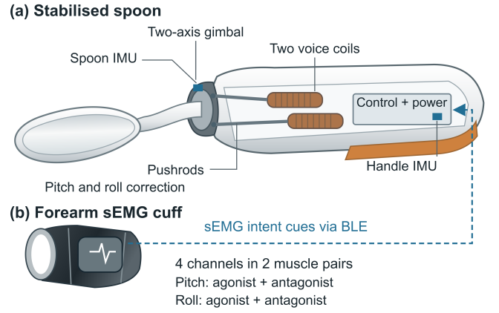
04
Conceptual Design: Spoon + Cuff
INITIAL TEAM CONCEPT · COMPLEMENTARY MUSCLE AND MOTION SENSING
ACTIVE SPOON
IMUs measure motion
Pitch + roll correct rotation
Detachable head for cleaning
FOREARM CUFF
Muscle activation
Cue to user intent
BLE
Wireless features
Correct at the utensil, leaving the arm free.
Voice coils + flexures: low moving mass and no geared backlash.
Wireless cuff: intent cues without a cable; fitting and calibration required.
Two axes keep the mechanism compact; the user controls translation.
GROUP 18 · Team conceptual design · 4 / 14

Slide 5
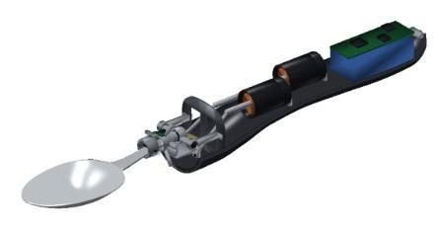
05
Detailed Design: The Mechanism
01 CURRENT BECOMES LINEAR FORCE
2 × Moticont GVCM-016-019-01M
Bidirectional push and pull
1.5 N continuous force per actuator
02 LINKAGE CREATES ROTATION
Offset, spherical-ended pushrods act on the flexure gimbal.
Both rods contribute to pitch and roll.
03 FLEXURE GUIDANCE + LIMITS
C-Flex: 2 × B-10 pitch; 1 × D-10 roll
±15° joints; ±6.35 mm actuator stroke
Restoring torque is included in the model.
GROUP 18 · Component specifications (C-Flex Bearing Co., Inc., n.d.-a, n.d.-b; Moticont, n.d.) · 5 / 14

Slide 6
06
Detailed Design: Sensors and Signals
CUFF: MUSCLE ACTIVATION · SPOON: MOTION FEEDBACK
20–450 Hz
FILTER
RECTIFY
+ ENVELOPE
TIMESTAMPED
BLE FEATURES
CUFF · ADS1294
4-channel sEMG at 4 kHz/channel.
SPOON · 2 × BMI270 IMUs at 800 Hz
Handle and carrier motion feed the controller.
Muscle features adjust intent confidence.
Signal loss falls back to IMU-only control.
PITCH: AGONIST + ANTAGONIST
ROLL: AGONIST + ANTAGONIST
4 bipolar channels
8 measurement contacts + shared reference
GROUP 18 · Sensor specifications (Bosch Sensortec, 2026; Texas Instruments, 2015) · 6 / 14

Slide 7
07
Control and Feasibility Method
Challenge: intent and tremor overlap, while actuator force and travel are limited.
2 IMUs + sEMG cue
Intent / tremor EKF
800 Hz
ATTITUDE PID
FORCE
ALLOCATION
10 kHz CURRENT PI
DRV8874 drivers
Voice coils + gimbal
EVALUATION
Same plant and inputs; six controller variants.
20 synthetic scenarios + sEMG ablation
+ replay of 60 recorded tremor signals.
CURRENT + TRAVEL
AUTHORITY LIMITER
GROUP 18 · Driver: Texas Instruments (2019). Recorded tremor: Beuter et al. (2001). · 7 / 14

Slide 8
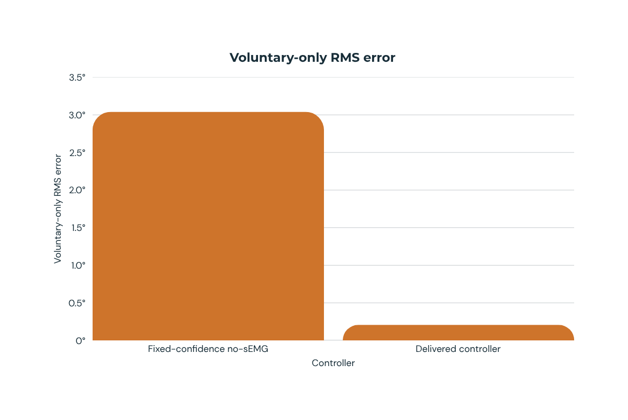
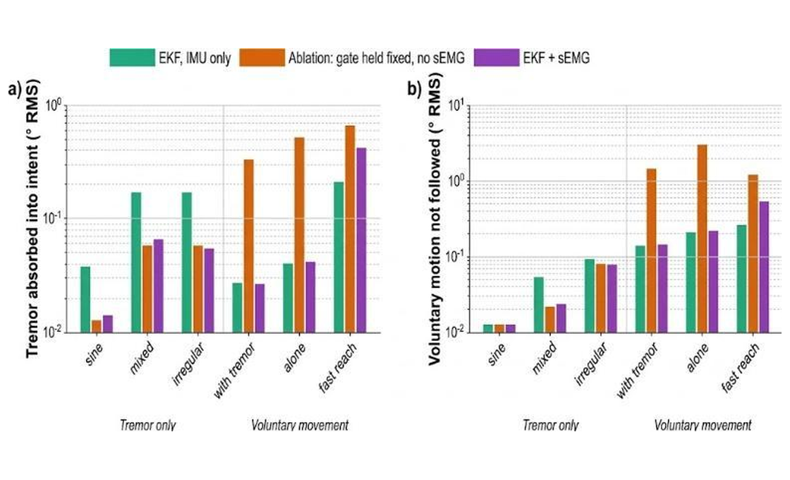
08
Novelty: Preserving the User's Intent
SIMULATED MUSCLE CUE
14.7×
Lower voluntary tracking error
3.0418° → 0.2070° RMS
Motion-based correction already exists (Pathak et al., 2014). Our contribution adds muscle-informed intent estimation to the two-axis mechanism.
Same hardware. Fixed-confidence baseline versus sEMG-gated control. Muscle signals simulated.
GROUP 18 · Team simulation results. Log plots: lower is better. · 8 / 14
Notes:
This slide is about our main contribution, keeping the user's own movement.
If the spoon cancels everything, the person cannot move it. So we use a muscle signal to tell when the movement is on purpose.
We ran the same controller with that signal turned off. The error was about 15 times higher.

Slide 9
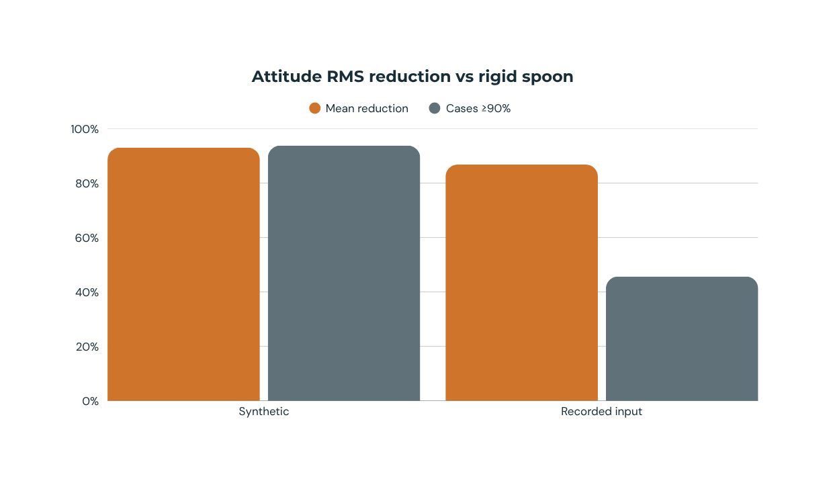
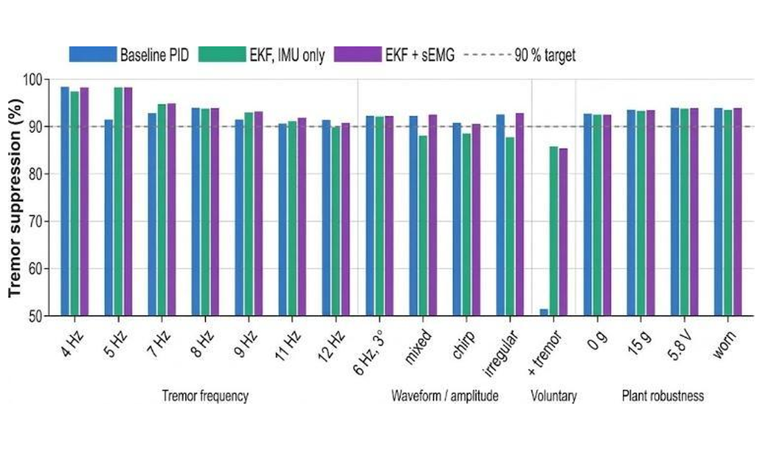
09
Tremor Suppression in Simulation
93.04%
mean · 16 feasible synthetic cases
15 / 16 reached ≥90%
86.81%
mean · 46 eligible recorded-input cases
21 / 46 reached ≥90%
Figure: 16 feasible synthetic scenarios; dashed line = 90% target.
Metric: attitude RMS reduction vs a rigid spoon, not food transfer.
Recorded-input tests use processed tremor and synthetic sEMG.
GROUP 18 · Team simulation using recorded tremor (Beuter et al., 2001) · 9 / 14
Notes:
This slide shows our tremor results in simulation.
On the synthetic tests we averaged 93 percent, and met our target in 15 of 16 cases.
We then played back 60 real recordings from 14 patients. The average dropped to 87 percent, because real tremor is less steady than a sine wave.

Slide 10
10
Feasibility: Strengths and Remaining Limits
WHAT WORKED
15/16 feasible synthetic cases met 90%.
Muscle cues improved intent separation.
17 automated verification groups passed.
WHAT REMAINS
Fast reach: 0.697° vs 0.289° IMU-only.
Recorded sEMG separation was inconsistent.
No physical prototype; cuff and hardware unvalidated.
Two-axis correction does not control translation.
Next: synchronised recordings, bench tests and food-transfer trials.
GROUP 18 · Team evaluation using GRABMyo data (Pradhan et al., 2022) · 10 / 14
Notes:
This slide covers what worked and what did not.
We met the target in 15 of 16 cases, and all 17 automated checks passed.
The weak point is fast movement. When the user reaches quickly, we are more than twice as bad.
Our muscle signal is simulated, so the next step is to record a real person.

Slide 11
11
New Zealand Launch
CUSTOMER
Adults whose tremor disrupts eating
Families may be the buyer
3-YEAR PLANNING ASSUMPTION
65–280 sets
CHANNEL
Occupational therapists
Rehabilitation providers
2% of the assumed serviceable market
A planning scenario, not measured demand
Pilot with rehabilitation partners: food transfer vs standard and weighted spoons
New Zealand first. Australia next.
GROUP 18 · Team market assumptions and proposed pilot · 11 / 14

Slide 12
12
Pricing and Unit Economics
INTRODUCTORY PRICE
TARGET LANDED COST
NZ$699
NZ$294
ex GST · budget NZ$300 at ~1,000 units
incl GST
Regular NZ$799 incl GST
DIRECT GROSS PROFIT
~NZ$308 / 51%
Lease NZ$30–40 / month incl GST · 30 months
Planning targets, not supplier quotes. Cost excludes development, tooling and compliance. Gross margin is before support and marketing.
GROUP 18 · Team pricing, cost and margin estimates · 12 / 14

Slide 13
13
Next Step: A Tested Prototype
Steadier eating with
voluntary control
01
Rehabilitation partners · bench control · sealing · battery · thermal safety
02
66°C worst-case handle estimate requires mitigation before participant use
03
Regulatory pathway · ethics-approved usability pilot · supplier quotes · production testing
WAND notification is not approval
(Medsafe, 2011).
GROUP 18 · Proposed development plan · 13 / 14

Slide 14

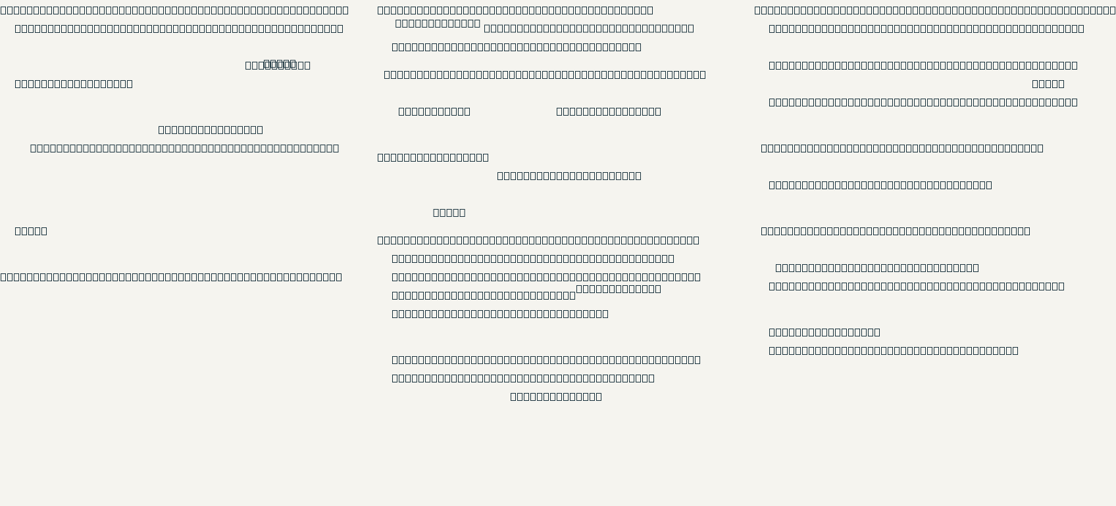
References
External sources cited in the presentation. Team designs, interview and simulation results are original project work.
GROUP 18 · 14 / 14

