Slide 1


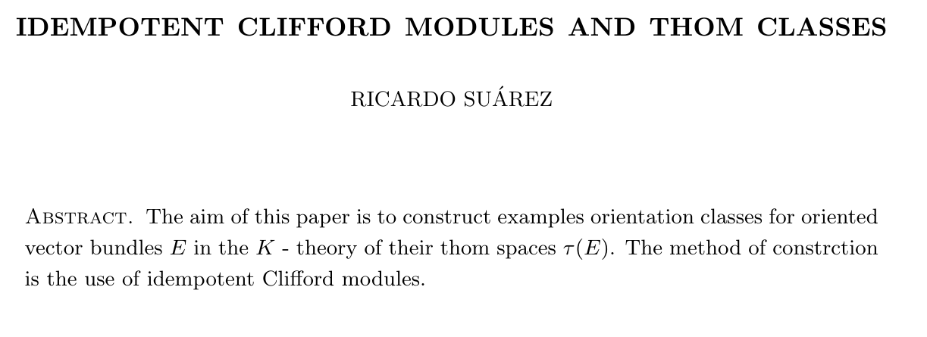
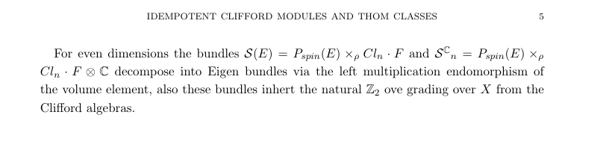
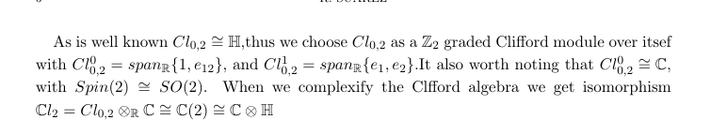
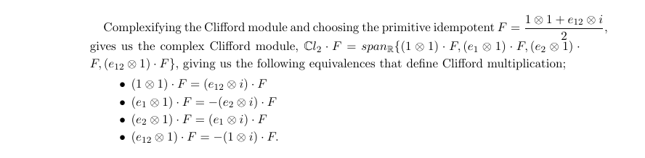
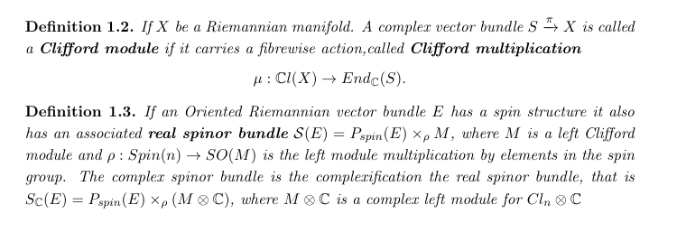


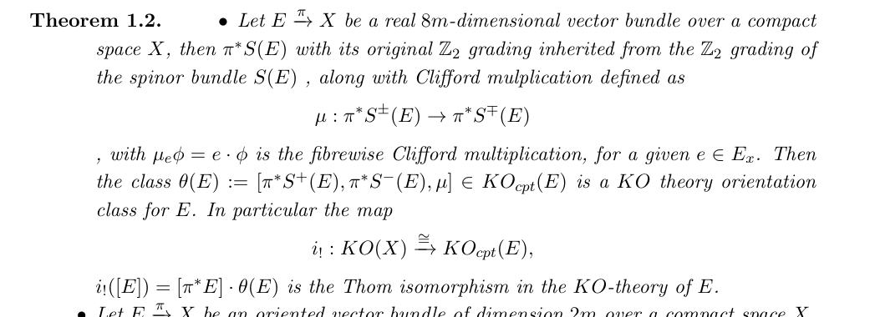

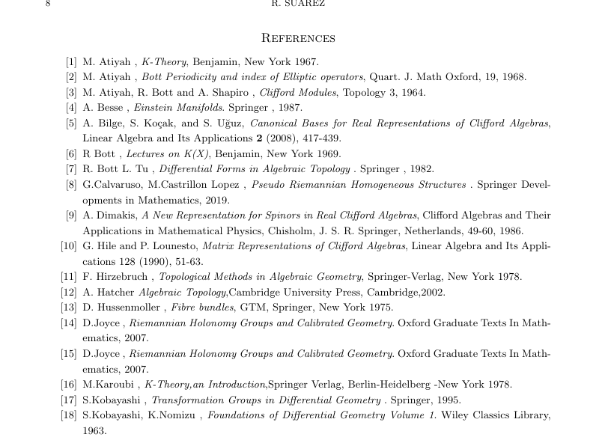
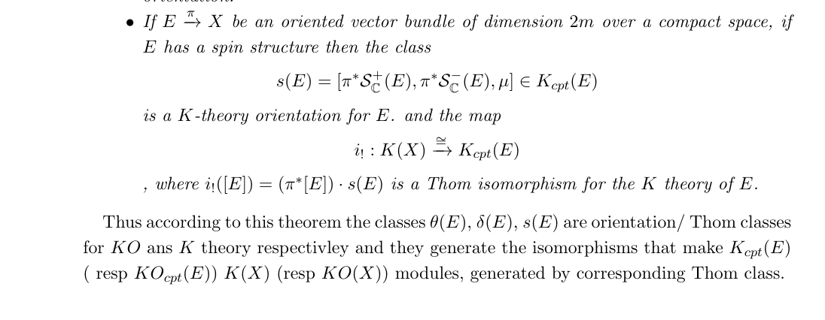
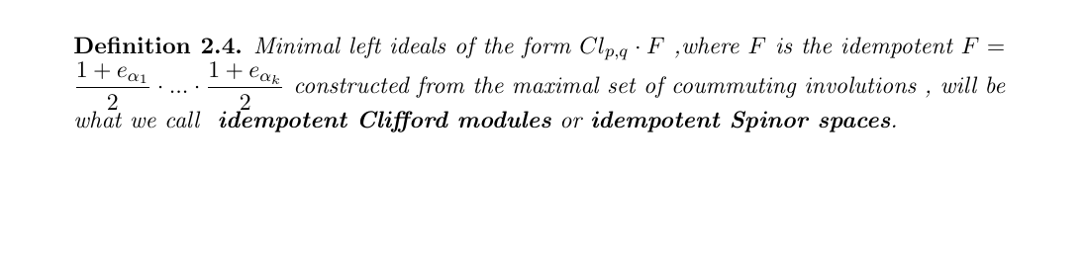
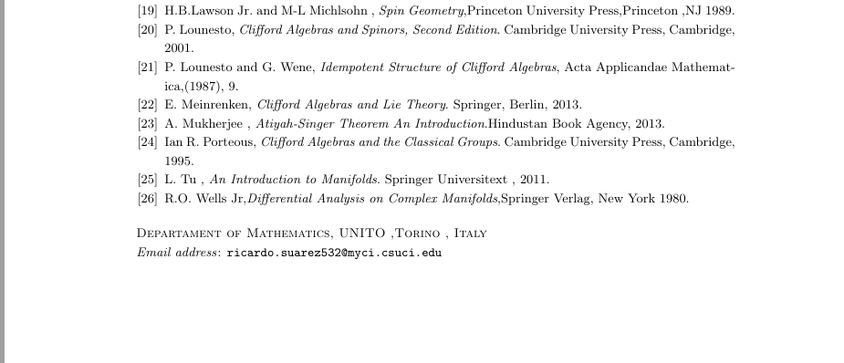

Idempotent Clifford Modules
Ricardo Suarez Advisors : Dr. Ivona Grzegorczyk(CSUCI), Dr.Anna Fino (UNITO)
ABSTRACT+ Elementary Background
Generic construction of the Thom classes
Dimension 2 example
What is it about?
Here we compute our examples in dimension 2. (In dimension 2 we express the representatives in terms of complexified quaternionic bundles.), In the paper we also come up with a dimension 4 example
BIBLIOGRPPHY
Enter cited Literature here…
Acknowledgements
Enter acknowledgements here…

