Slide 1





MIRICOMPANY
CAS
5주차
PHONE
+123-456-7890
WEBSITE
yoursitehere.com
LOCATION
123 Anywhere St., Any City

Slide 2



Agenda
01
공지사항
05
Budget
02
복습 문제풀이
06
Marketing Mix
03
개념 학습
07
Marketing Channels
04
이번주 문제풀이
08
KPI Overview

Slide 3





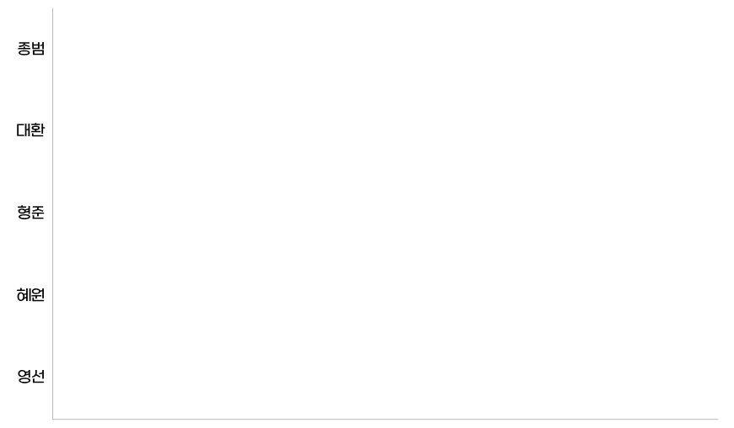

MARKETING PLAN Presentation
MIRICOMPANY
벌금
05
Please add a short description about the topic.
Explain the relevant details that is related to the relevant information.
Item 1
Phasellus porta erat non odio semper dictum
Item 2
Nunc non orci ac leo placerat tincidunt lorem
Item 3
Quisque eu lorem tempus, sollicitudin turpis
Item 4
Maecenas auctor mauris eget suscipit mollis

Slide 4

MARKETING PLAN Presentation
MIRICOMPANY
복습문제
A+B-C 백준 31403

Slide 5

MARKETING PLAN Presentation
MIRICOMPANY
복습문제
단어의 개수

Slide 6
MARKETING PLAN Presentation
MIRICOMPANY
복습문제
ACM 호텔

Slide 7

MARKETING PLAN Presentation
MIRICOMPANY
이번 시간에 배운 내용
DFS,BFS
1) 정의
2) 구현방법
3) 사용 이유
4)예제

Slide 8
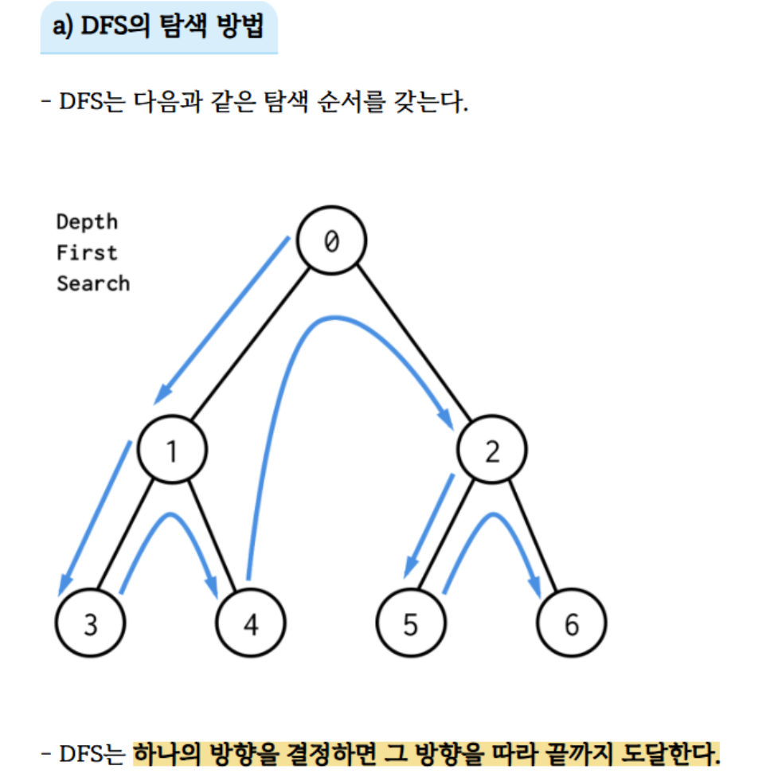
MARKETING PLAN Presentation
MIRICOMPANY
DFS

Slide 9

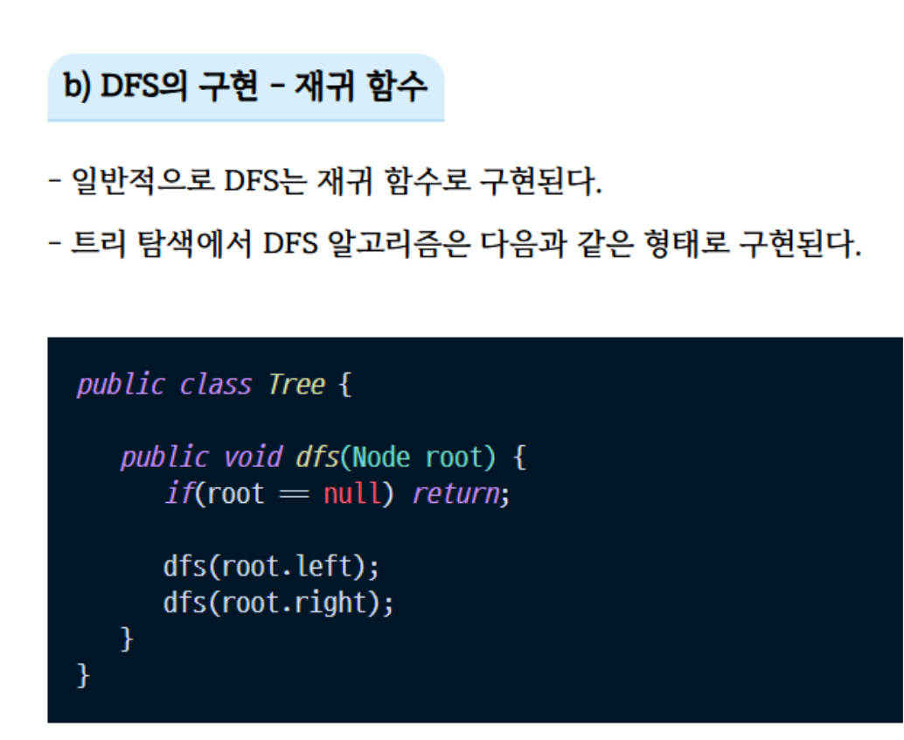
MARKETING PLAN Presentation
MIRICOMPANY
DFS 구현법

Slide 10
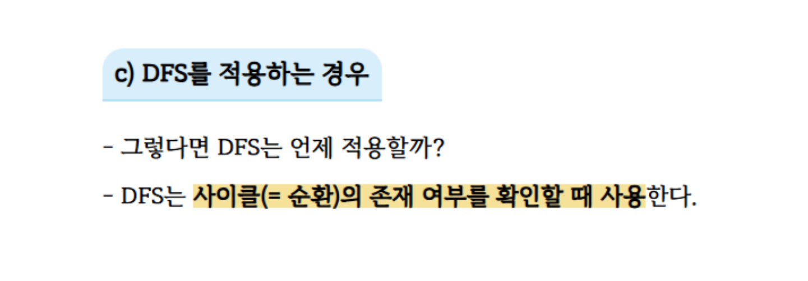
MARKETING PLAN Presentation
MIRICOMPANY
DFS 사용이유

Slide 11
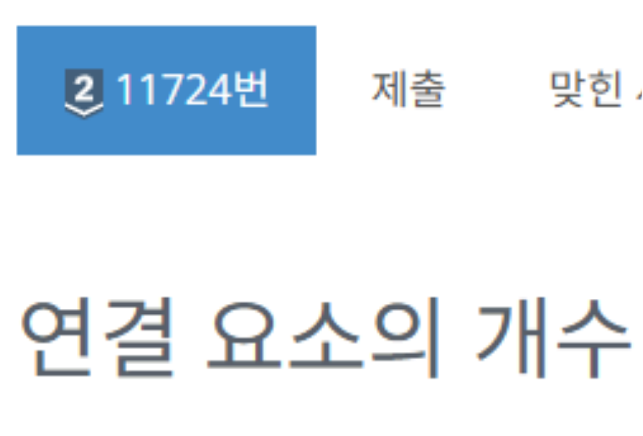
MARKETING PLAN Presentation
MIRICOMPANY
DFS 예제

Slide 12
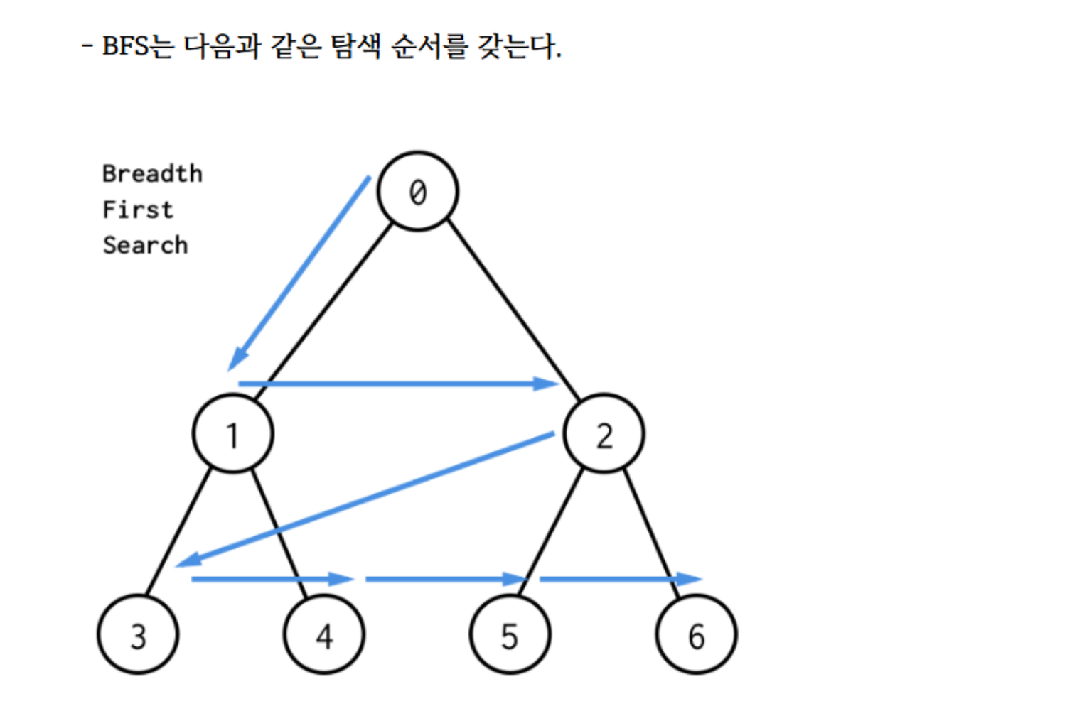
MARKETING PLAN Presentation
MIRICOMPANY
BFS

Slide 13
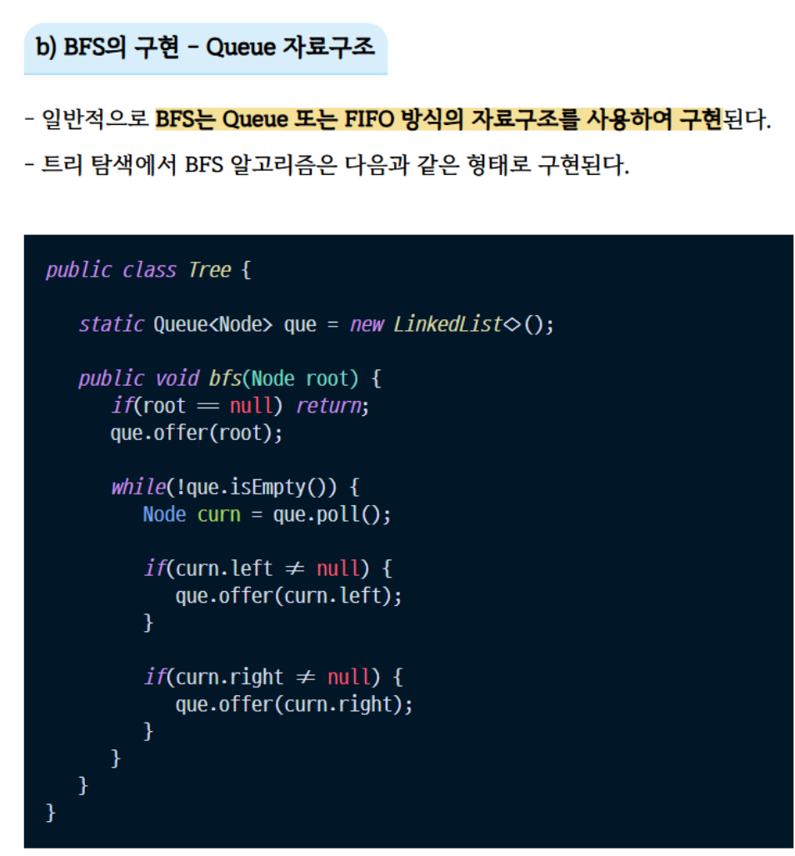
MARKETING PLAN Presentation
MIRICOMPANY
BFS 구현법

Slide 14
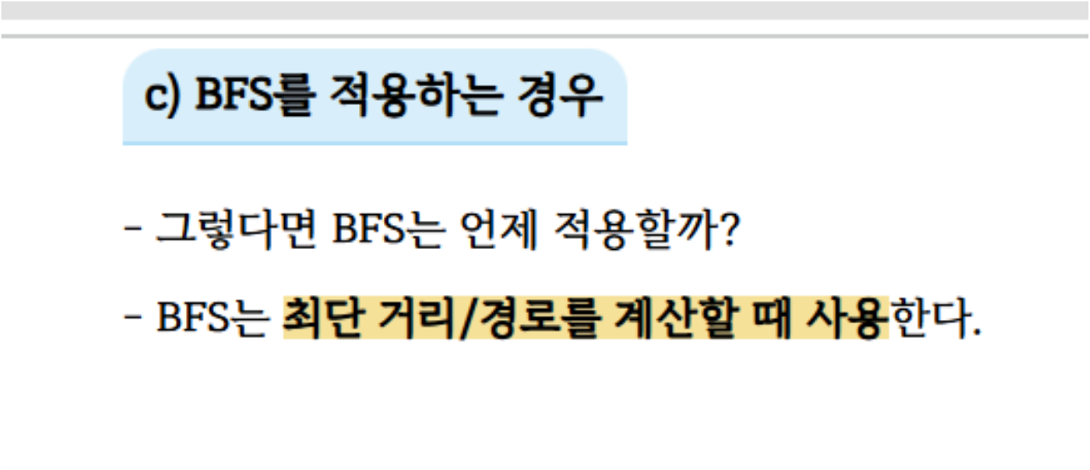
MARKETING PLAN Presentation
MIRICOMPANY
BFS 사용이유

Slide 15
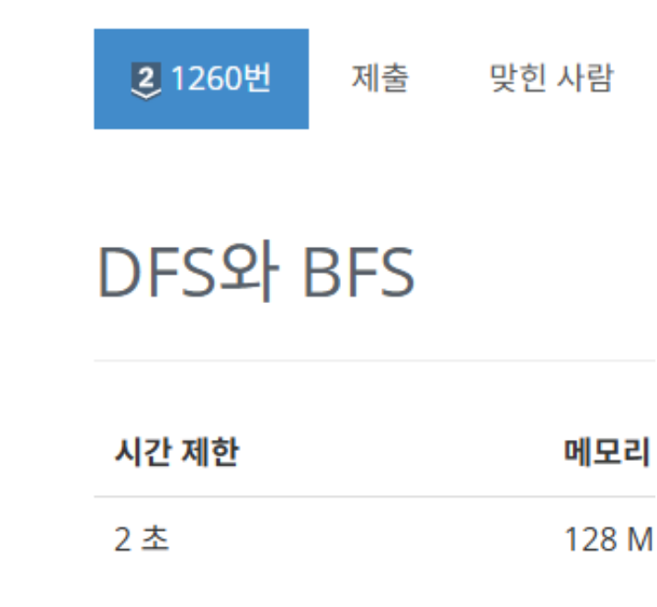
MARKETING PLAN Presentation
MIRICOMPANY
BFS 예제

Slide 16





MIRICOMPANY
THANK
YOU
PHONE
+123-456-7890
LOCATION
123 Anywhere St., Any City
WEBSITE
yoursitehere.com

