Slide 2
CONTENTS
Design Goals
System Decomposition
Hardware-Software Mapping
Persistent Data Management
Access Control and Security
Global Software Control Flow
Boundary Condition

Slide 3


CONTENTS
Design Goals
System Decomposition
Hardware-Software Mapping
I. Design Goals
Persistent Data Management
Access Control and Security
Global Software Control Flow
Boundary Condition

Slide 4








Design Goals
Performance
End User
CRITERIA
Dependability
Maintenance
Cost

Slide 5


Design Goals
Performance Criteria
Response Time
Throughput
Memory

Slide 6
Design Goals
Dependability Criteria
Robustness
Fault Tolerance
Reliability
Security
Availability
Safety

Slide 7
Design Goals
Cost Criteria
Development
Maintenance
Deployment
Administration
Upgrade

Slide 8
Design Goals
Maintenance Criteria
Extensibility
Portability
Modifiability
Readability
Adaptability

Slide 9
Design Goals
End User Criteria
Utility
Usability

Slide 10


Design Goal Trade-Off
Precision Of 3D Data
Processing Speed
Product Priority
Room Priority
VS
Inviting Message
Test Message
Delivery Time
Staffing

Slide 11
CONTENTS
Design Goals
System Decomposition
Hardware-Software Mapping
II. System Decomposition
Persistent Data Management
Access Control and Security
Global Software Control Flow
Boundary Condition

Slide 12
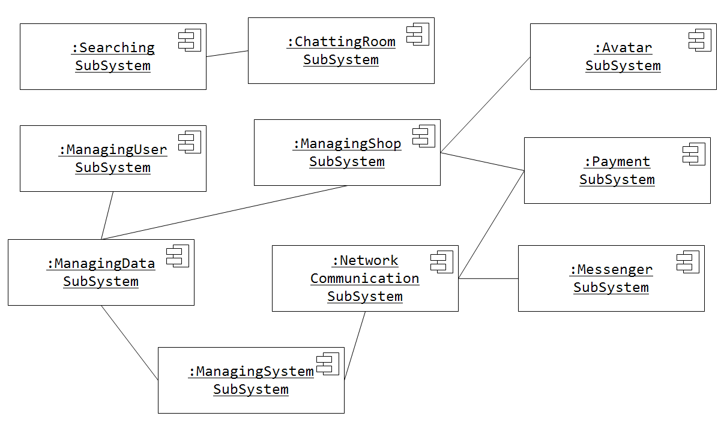
Diagram of Subsystem

Slide 13
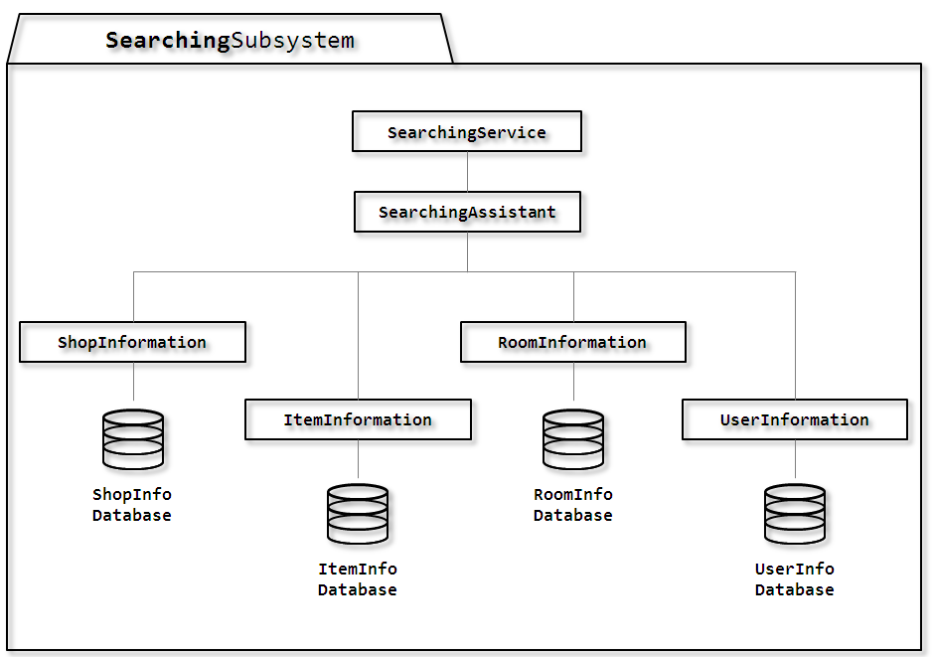
Documents of Subsystem

Slide 14
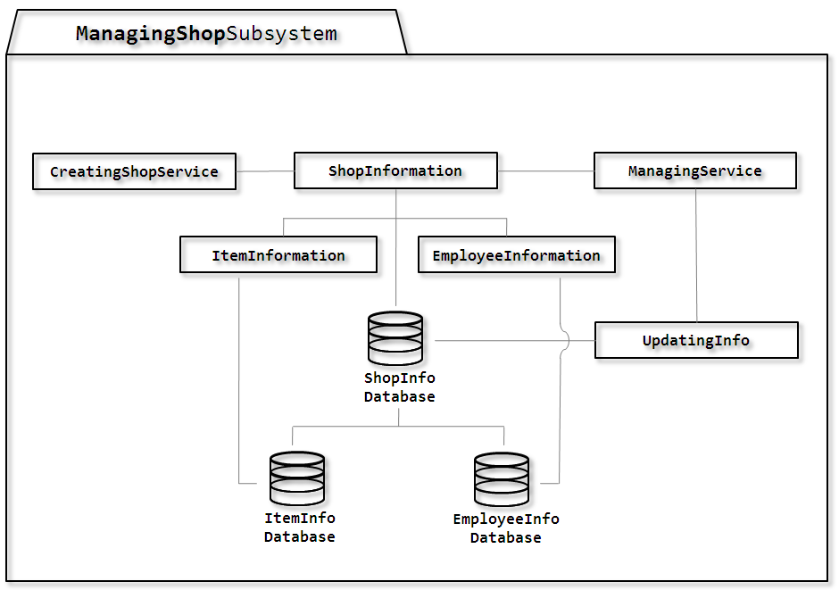
Documents of Subsystem

Slide 15
CONTENTS
Design Goals
System Decomposition
Hardware-Software Mapping
III. Addressing Design Goals
Persistent Data Management
Access Control and Security
Global Software Control Flow
Boundary Condition

Slide 16
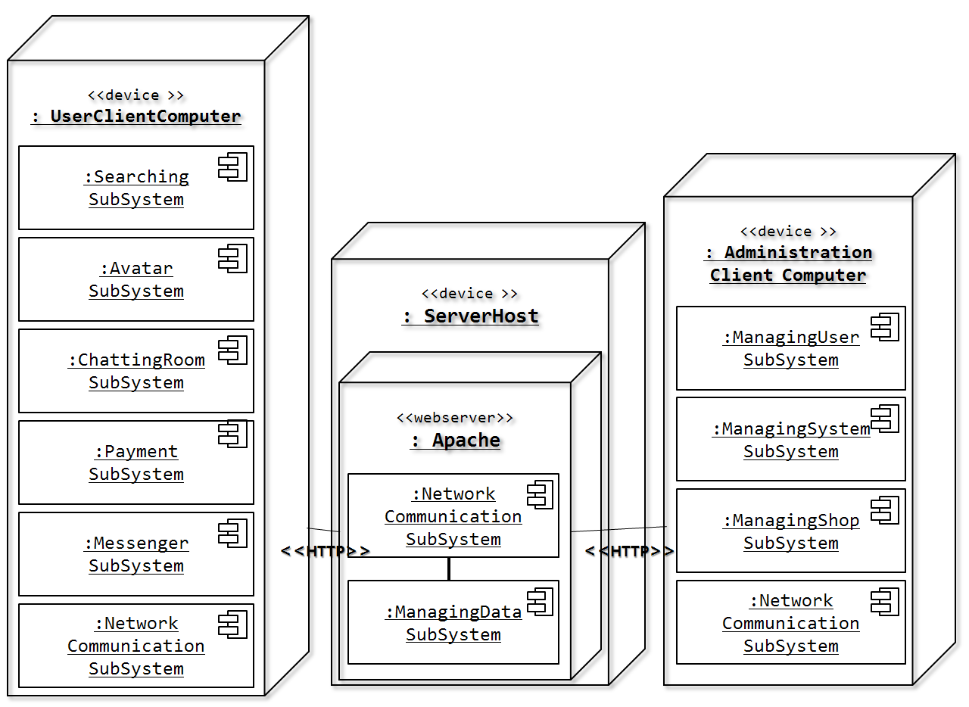
H/S Mapping
관리자용 컴퓨터
실질적인 프로그램 적용 장치
데이터 전달자
Assigning Subsystem To Hardware

Slide 17
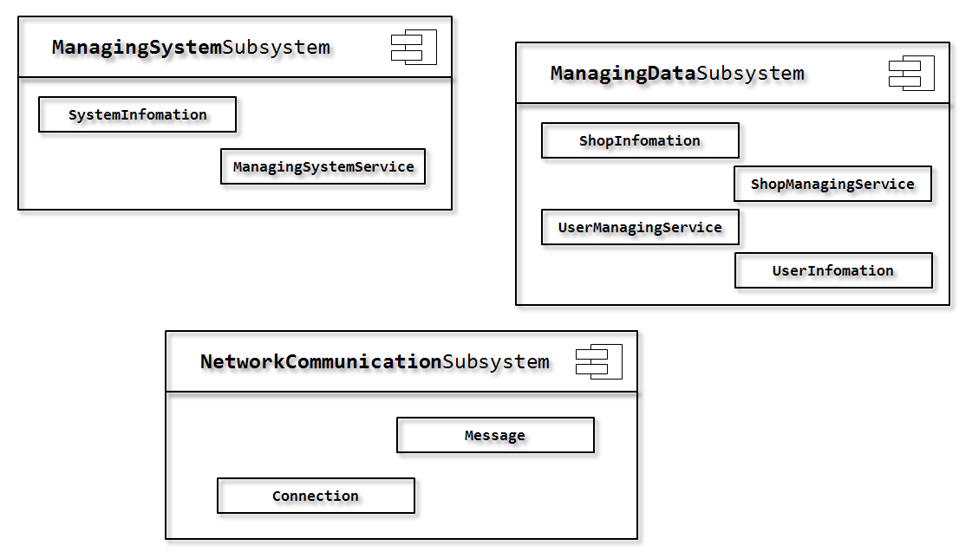
H/S Mapping
Allocating Objects and Subsytems
To Nodes

Slide 18


Persistent Data Management
DATABASE
ItemInfo
Employee
ShopInfo
UserInfo
Friend
FriendList
Chatting
Record
Advertising

Slide 19
Access Control and Security
The User model of the System : Access Matrix
Access Matrix |  | UserInfo | ShopInfo | RoomInfo | ItemInfo | Chatting Record
Owner |  |  | - SetShopInfo() - GetShopInfo() - UpdateShopInfo() |  | - SetItem() - GetItem() - UpdateItem()
Employee |  | - GetUserID() | - SetShopInfo() - GetShopInfo() |  | - GetItemInfomation() | - SetChatting() - GetChatting()
Customer | RoomLeader | - GetUserInfo() - SetUserInfo() - SetPassword() - UpdateUserInfo() | - GetSomeShopInfo() | - SetRoomInfo() - GetRoomInfo() - UpdateRoomInfo() | - GetItemInfomation() | - SetChatting() - GetChatting()
 | Friend |  |  | - GetRoomInfo()
System Administrator |  |  | - GetSomeShopInfo() |  | - GetItemInfomation()

Slide 20
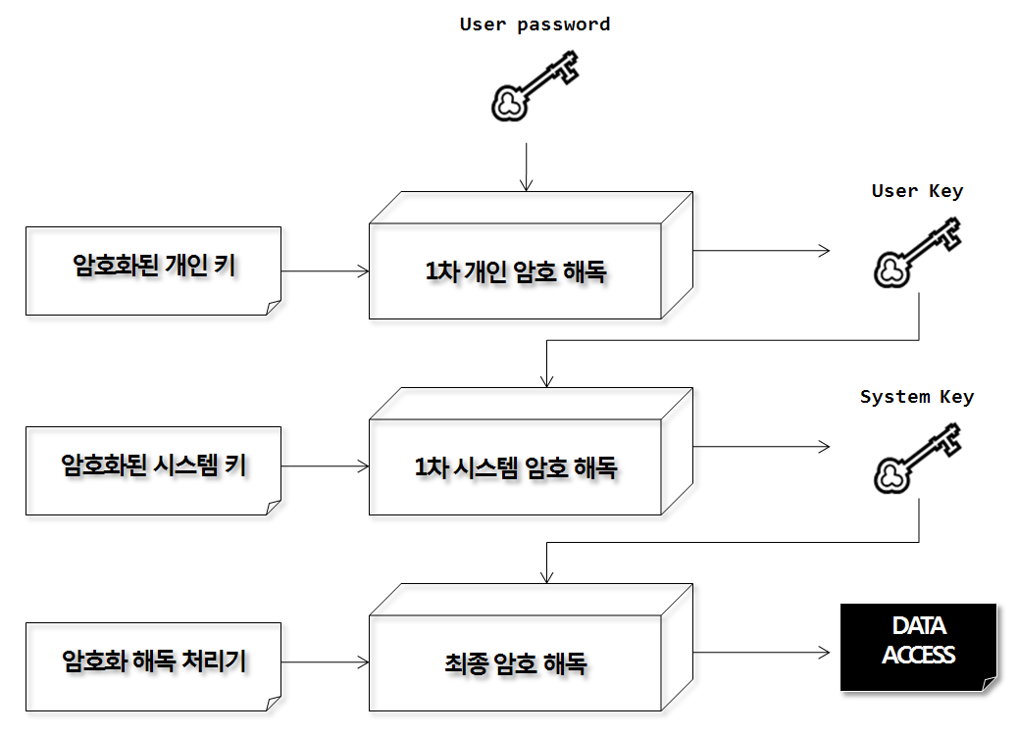
Access Control and Security
Authentication Mechanism

Slide 21


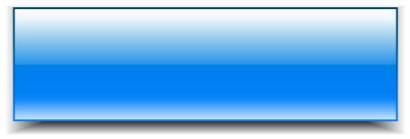
Global Software Control Flow
Event
driven
Procedure
driven
전체적으로는 Event-driven Control 방식 채택
일부 기능은 Procedure-driven Control 방식 채택

Slide 22







Boundary Condition
<Start-up Use Case>
Install
System
프로그램 최초 설치 시 최초사용자의 기본정보를 입력 받아 프로그램 설치, 사용자 데이터와 서버에서 가져온 데이터를 저장하기 위한 공간 할당
<Shutdown Use Case>
Delete
System
프로그램 삭제 시 정보 유출 방지를 위해 사용자 정보를 삭제 및 초기화
<Exception Use Case>
Backup
에러상황으로 인한 데이터 손실을 막기 위해 현재 사용자 정보를 백업하여 보관

