Slide 1

DataMind
Airline Passenger Satisfaction
Di Vita, Montori, Sandrin, Zancan, Zenoni

Slide 2
Timeline
1
2
3
4
Choosing the Dataset
Exploring the Dataset
Modeling
Evaluation
Firstly we briefly analysed the four available dataset to choose which was the best choice for our interest and background
We explored the data in order to see pattern within the data.
We applied ensemble and non-ensemble models to make predictions
We evaluated our models and selected which is the best to put in production

Slide 3
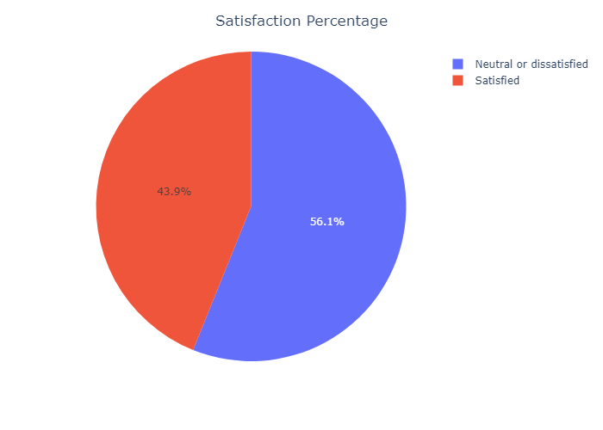
Objective
Predict customer satisfaction based on characteristics of his own (gender-age…) & on his rating of flight experience characteristics (gate location-cleanliness…)
SUPERVISED LEARNING: BINARY CLASSIFICATION
TARGET VARIABLE: SATISFACTION, N. OF FEATURES: 23

Slide 4

Methods
Exploring dataset
EDA
Encoding
Scaling
Grid Search
Models
Predictions
Evaluation

Slide 5
Presentation → Roles
Introduction and EDA
Grid search and first two models
Evaluation
Domenico
Valentina
Alberto
Federica
Valeria
EDA and Encoding/Scaling
Ensemble Models

