Slide 1
Monty Hall Problem
CSC 4370 Web Programming Project 1
Matt AuGSBURGER
SHAMARI SOUTHWELL
VIRAJ SHAH

Slide 2
WHAT IS THE MONTY HALL PROBLEM?
The Monty Hall problem is a brain teaser loosely based on the American television game show Let's Make a Deal and named after its original host, Monty Hall.
Suppose you're on a game show, and you're given the choice of three doors: Behind one door is a car; behind the others, goats.
You pick a door, say No. 1, and the host, who knows what's behind the doors, opens another door, say No. 3, which has a goat. He then says to you, "Do you want to pick door No. 2?" Is it to your advantage to switch your choice?

Slide 3
DESIGN CONSIDERATIONS
This project mandated that we can only use CSS. This requirement introduced some restrictions we had to consider before we started implementing the code. Below are problems we encountered when developing the software for the project.
What CSS properties/selectors can we leverage?
How would we can we change the view for the user?
How do we pass logic between views?

Slide 4
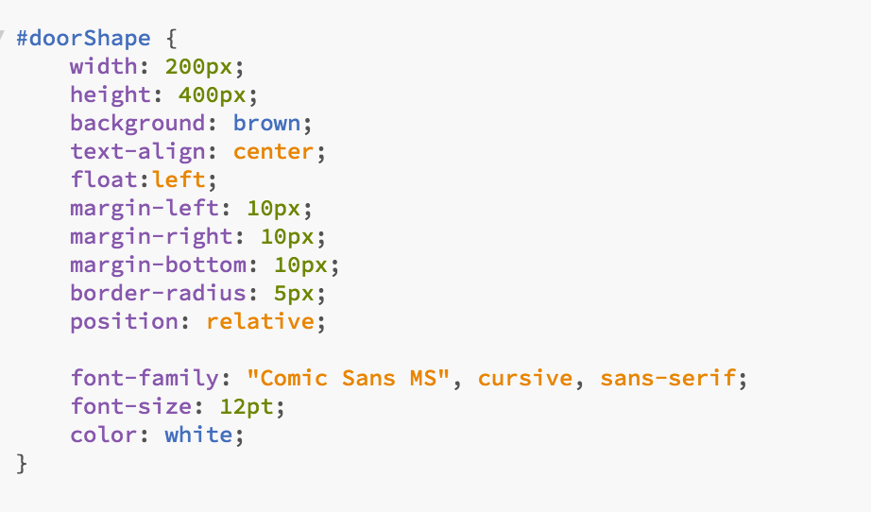
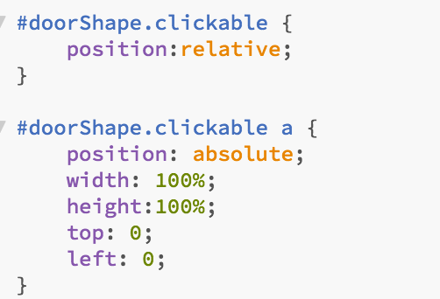
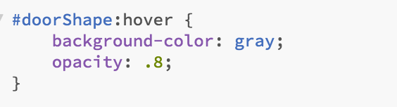
CSS PROPERTIES and Selectors

Slide 5
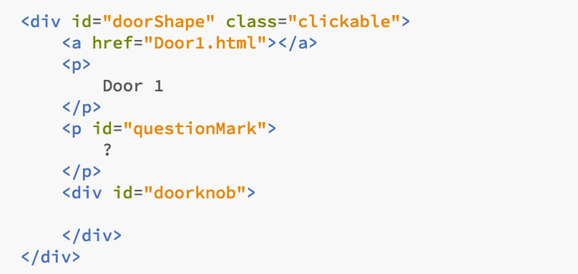
Changing the view for the user

Slide 6
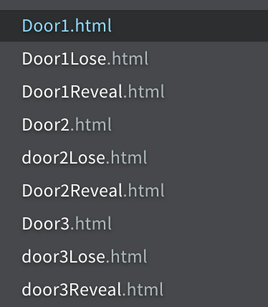
Passing logic between views

Slide 7
